Slide 2
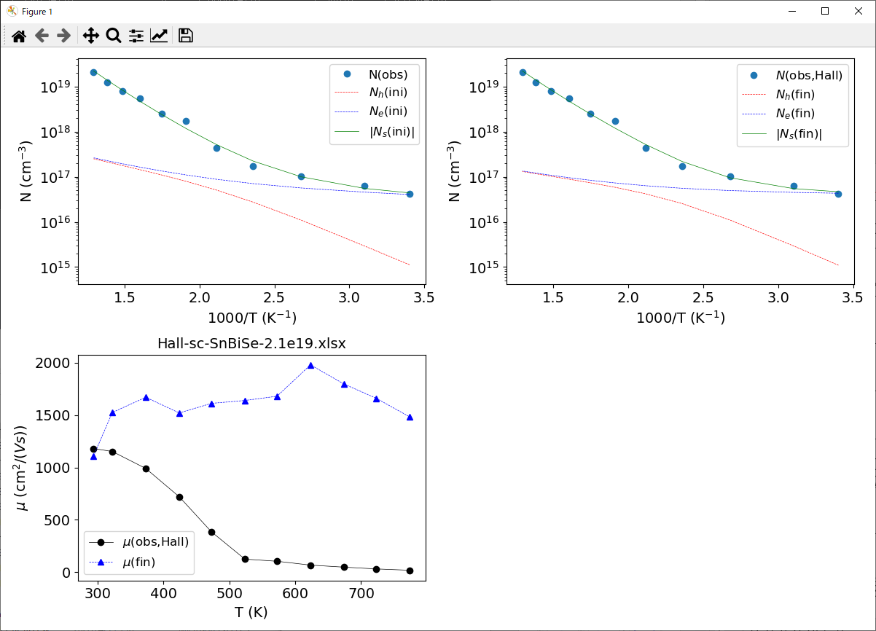
(Sn,Bi)Se 2.1x10¹⁹ cm⁻³
[Parameters]
Eb=-0.01842968717298104:1
Aop=1e-10:0
Eop=0.0001:0
apolyi[0]=-0.5098443960009953:1
ppolyi[0]=0.0:0
apolyi[1]=4.278766466986334e-05:1
ppolyi[1]=-1.5:0
apolyi[2]=3880.30988787542:1
ppolyi[2]=1.5:0
apolyi[3]=0.0:0
ppolyi[3]=-1.0:0
apolyi[4]=0.0:0
ppolyi[4]=1.0:0
meeff=0.0016076006361616065:1
mheff=6.929761670298067:1
EV=0.0:0
EC=0.04990597653329279:1
EA=0.05:0
NA=0.0:0
ED=0.24258198410715487:1
ND=1.2182631648634173e+18:1
[Preferences]
rfac=0.5
l0=1e-08
last_fitmode=fit
print_level=0.0

Slide 3
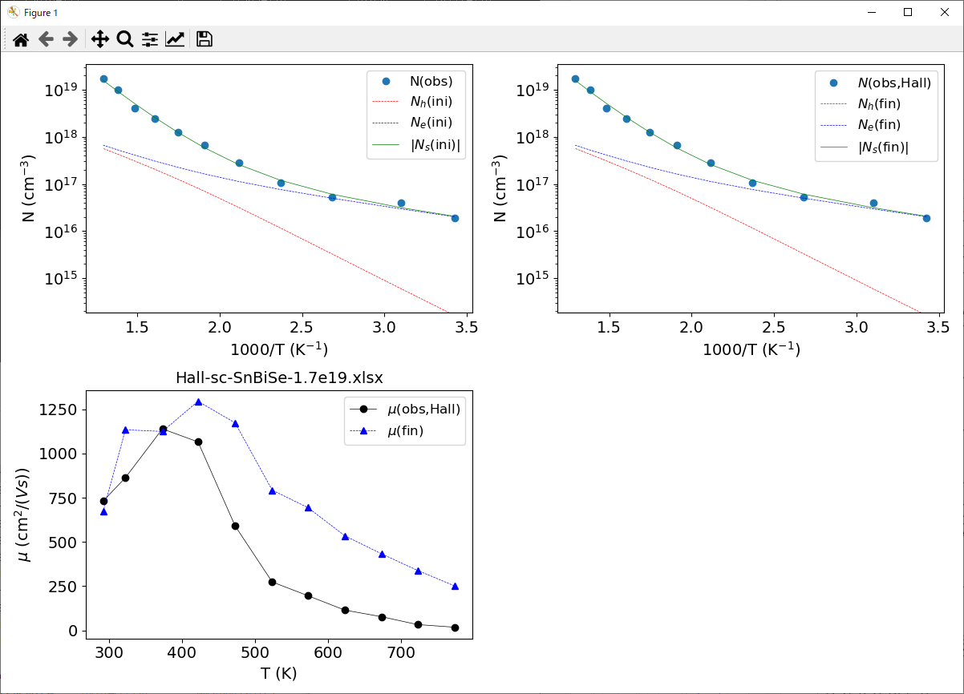
(Sn,Bi)Se 1.7x10¹⁹ cm⁻³
[Parameters]
Eb=-0.01842968717298104:1
Aop=1e-10:0
Eop=0.0001:0
apolyi[0]=-0.5098443960009953:1
ppolyi[0]=0.0:0
apolyi[1]=4.278766466986334e-05:1
ppolyi[1]=-1.5:0
apolyi[2]=3880.30988787542:1
ppolyi[2]=1.5:0
apolyi[3]=0.0:0
ppolyi[3]=-1.0:0
apolyi[4]=0.0:0
ppolyi[4]=1.0:0
meeff=0.023269067776359245:1
mheff=2.941233102421002:1
EV=0.0:0
EC=0.37442979303465995:1
EA=0.05:0
NA=0.0:0
ED=0.20625690912191894:1
ND=4.113875040043347e+18:1
[Preferences]
rfac=0.5
l0=1e-08
last_fitmode=fit
print_level=0.0

Slide 4
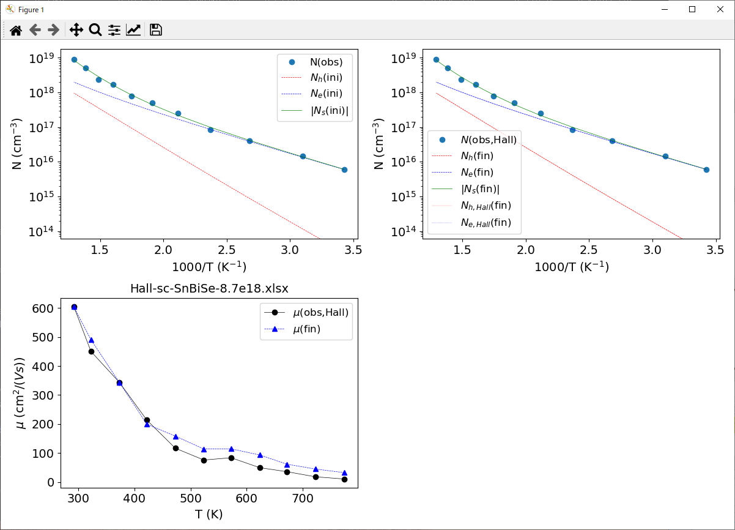
(Sn,Bi)Se 8.7x10¹⁸ cm⁻³
[Parameters]
Eb=-0.01842968717298104:1
Aop=1e-10:0
Eop=0.0001:0
apolyi[0]=-0.5098443960009953:1
ppolyi[0]=0.0:0
apolyi[1]=4.278766466986334e-05:1
ppolyi[1]=-1.5:0
apolyi[2]=3880.30988787542:1
ppolyi[2]=1.5:0
apolyi[3]=0.0:0
ppolyi[3]=-1.0:0
apolyi[4]=0.0:0
ppolyi[4]=1.0:0
meeff=0.5881376029723083:1
mheff=1.274484300204292:1
EV=0.0:0
EC=0.545226149990734:1
EA=0.05:0
NA=0.0:0
ED=0.1582623761122357:1
ND=1.5825039399613536e+19:1
[Preferences]
rfac=0.5
l0=1e-08
last_fitmode=fit_RH
print_level=0.0

Slide 5
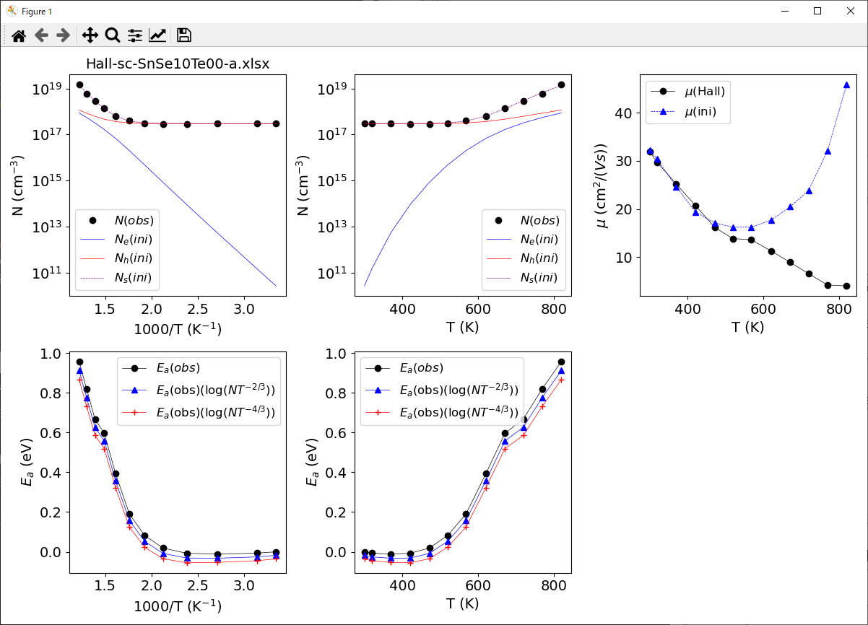
sc-SnSe a
[Parameters]
meeff=0.15427913149098813:1
mheff=5.022646779986915:1
EV=0.0:0
EC=0.6373346430148095:1
EA=-0.3346715188043936:1
NA=2.964797178095861e+17:1
ED=1.05:0
ND=0.0:0

Slide 6
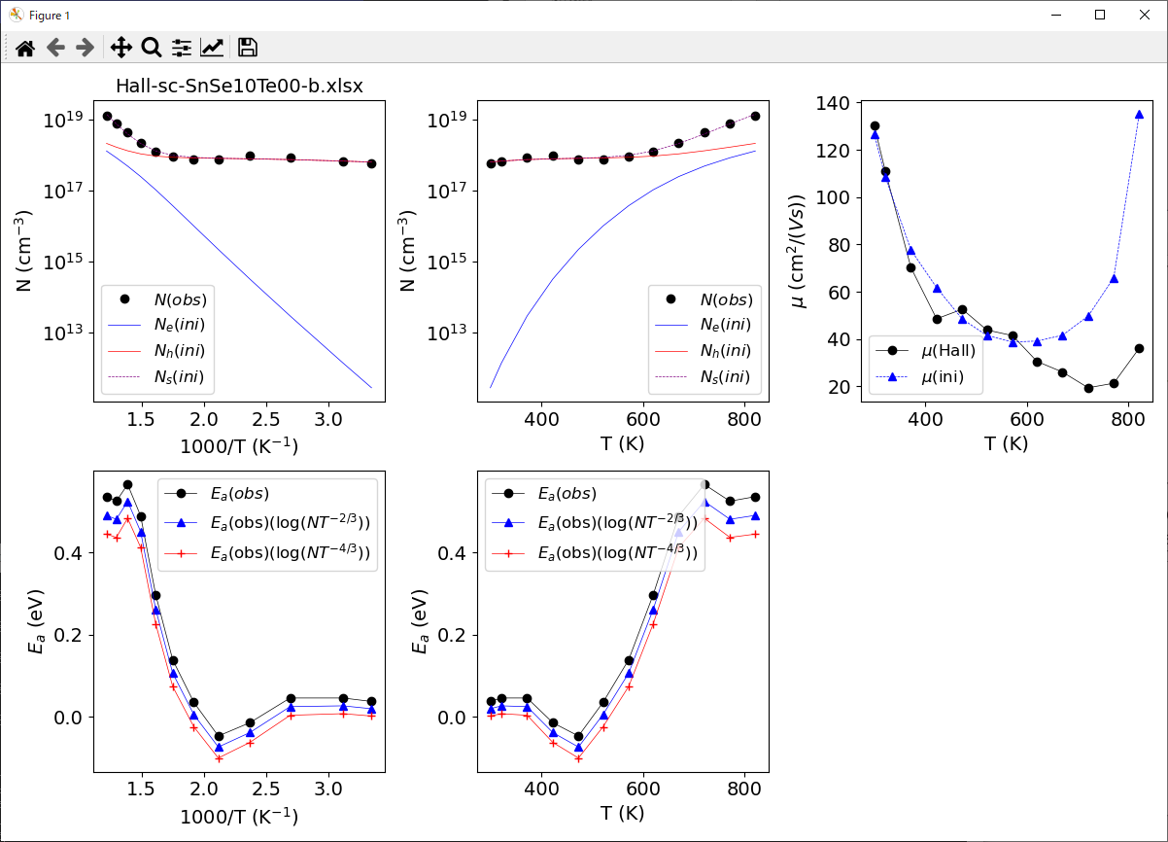
sc-SnSe b
[Parameters]
Eb=-0.01842968717298104:1
meeff=0.33975524474147994:1
mheff=1.8915463935345957:1
EV=0.0:0
EC=0.5491295328966059:1
EA=0.09153259376829213:1
NA=8.450913387049948e+17:1
ED=1.05:0
ND=0.0:0

Slide 7
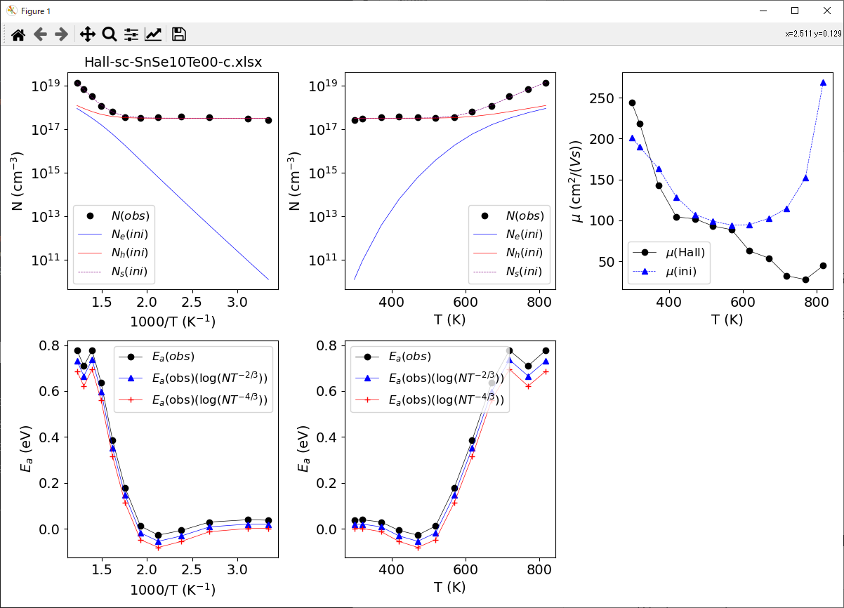
sc-SnSe c
[Parameters]
meeff=0.4577528191147937:1
mheff=2.383023018677985:1
EV=0.0:0
EC=0.6661589768513083:1
EA=-0.14979027212179274:1
NA=3.202564261716755e+17:1
ED=1.05:0
ND=0.0:0

Slide 8
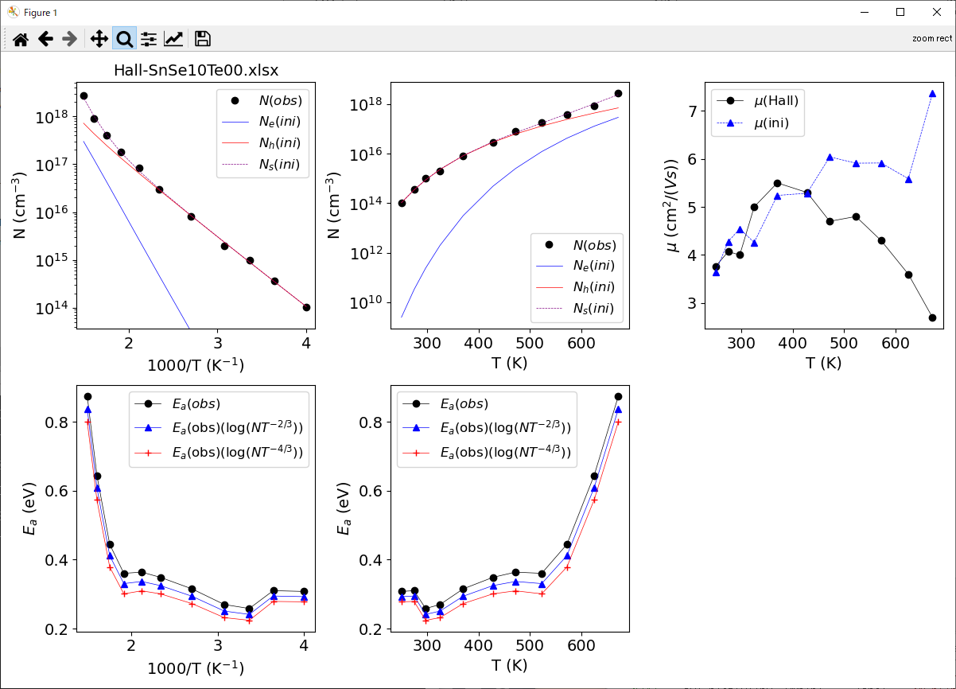
Poly-SnSe

Slide 9
Electronic structure: SnSe vs Sn(Se_{0.6}Te_{0.4})
Indirect
Direct
x=0（SnSe）と、x=0.4（Sn(Se0.6Te0.4)のバンドギャップは、下記のとおりです。
x=0：間接 1.01 eV、直接 1.04eV
x=0.4：間接 0.77eV、直接 0.82eV
Notes:
Then I investigated the electronic structures. This is diffuse reflectance for pure tin selenide and x of 0.4. For both cases, indirect gap is smaller than direct gap, and the bandgap becomes smaller by tellurium doping. We can see clear band structure change in valence band region. Valence band maximum shifts to higher energy by tellurium doping. So, The contribution of tellurium orbital reduces the band gap.

Slide 10
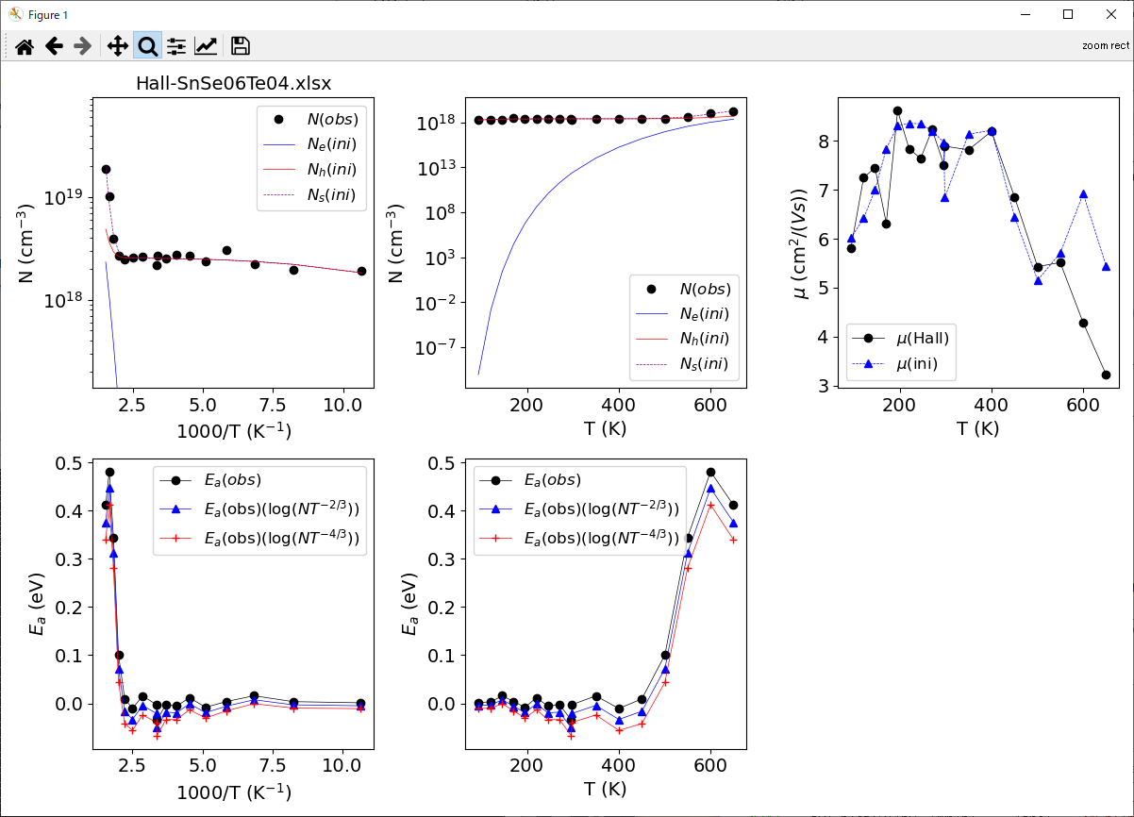

Slide 11
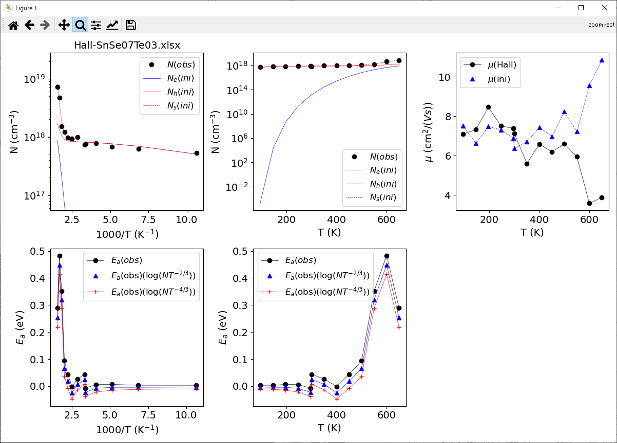

Slide 12
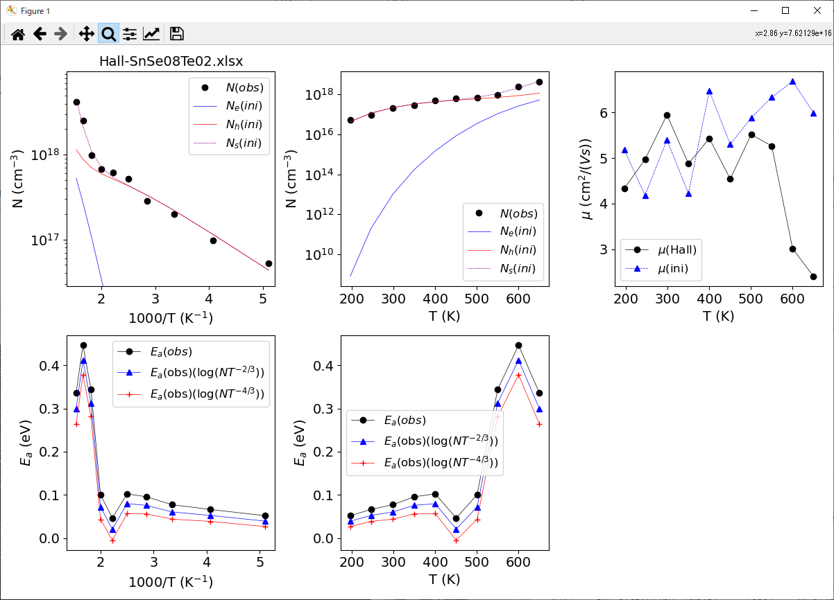

Slide 13
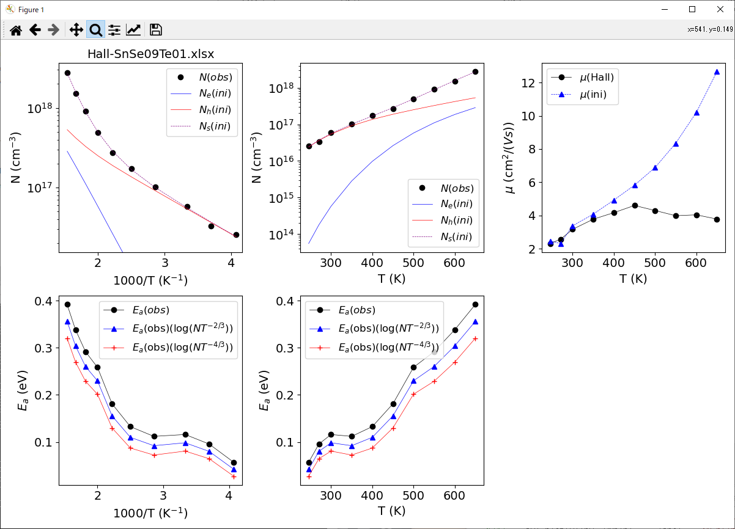

Slide 15
The following results are with r=2.0

Slide 16
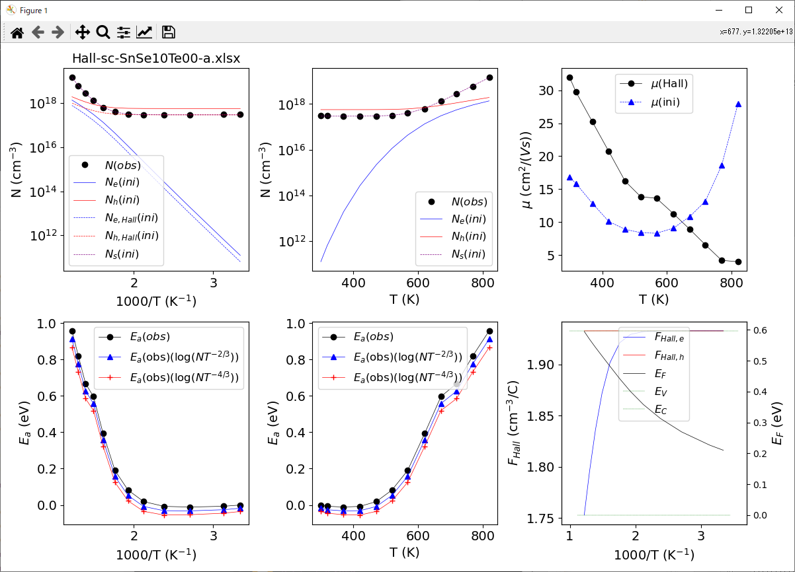
Sc-SnSe a-axis
r=2.0
Sc-SnSe a-axis
r=0.5

