Slide 1
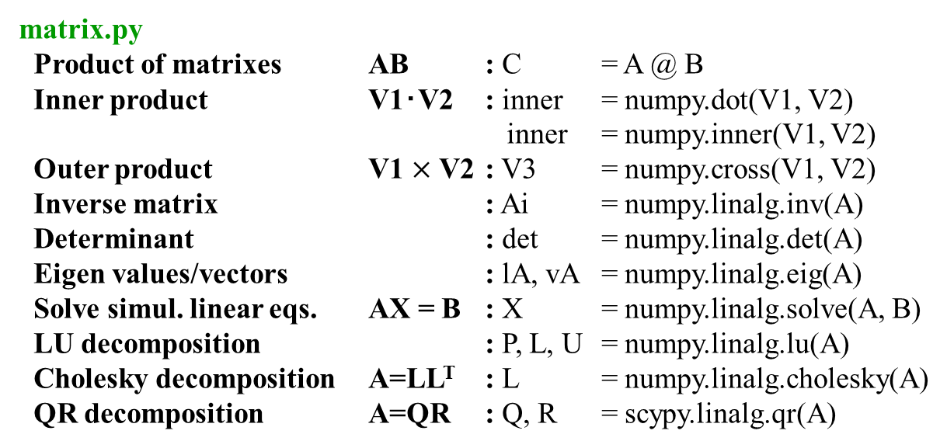
Linear algebra libraries
(線形幾何学・行列計算ライブラリ)
Fortran, C, C++, etc
LAPACK (Linear Algebra PACKage)
ScaLAPACK (Scalable LAPACK)
Intel Math Kernel Library (MKL)
Python: numpy.linalg, scipy.linalg
matrix.py
Product of matrixes AB : C = A @ B
Inner product V1･V2 : inner = numpy.dot(V1, V2)
inner = numpy.inner(V1, V2)
Outer product V1 $×$ V2 : V3 = numpy.cross(V1, V2)
Inverse matrix : Ai = numpy.linalg.inv(A)
Determinant : det = numpy.linalg.det(A)
Eigen values/vectors : lA, vA = numpy.linalg.eig(A)
Solve simul. linear eqs. AX = B : X = numpy.linalg.solve(A, B)
LU decomposition : P, L, U = numpy.linalg.lu(A)
Cholesky decomposition A=LL^{T} : L = numpy.linalg.cholesky(A)
QR decomposition A=QR : Q, R = scypy.linalg.qr(A)

Slide 2
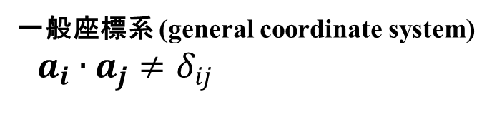
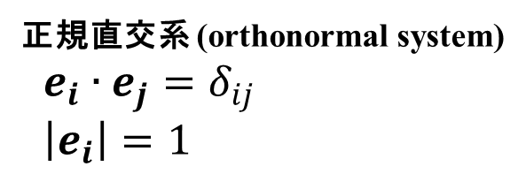

一般座標系 (general coordinate system)
直交座標系 (Orthogonal)
デカルト座標系 (Cartesian)
一般座標/非直交系 (Non-Cartesian)
P
r = x_{c,1}e₁+ x_{c,2}e₂
x_{n,2}
P
r = x_{g,1}a₁+ x_{g,2}a₂
e₂
a₂
e₁
a₁
x_{n,1}
正規直交系 (orthonormal system)
$e_{i}∙e_{j}=δ_{ij}$
$\left|e_{i}\right|=1$
一般座標系 (general coordinate system)
$a_{i}∙a_{j}≠δ_{ij}$
$e_{i}$, $a_{i}$: 基底ベクトル (base vecor)

Slide 3
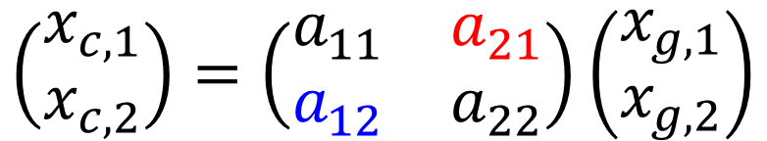
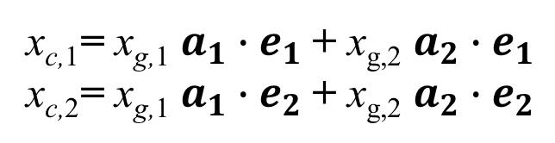
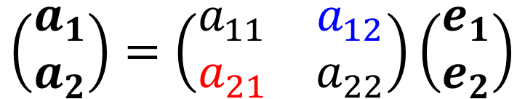
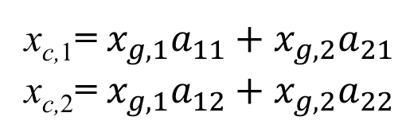
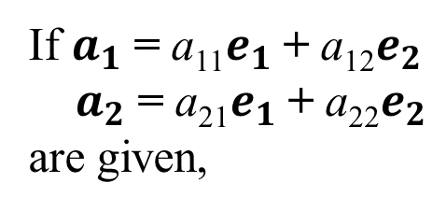
Cartesian – general coord. Conversion
(直交系 － 一般座標系変換)
r = x_{c,1}e₁+ x_{c,2}e₂= x_{g,1}a₁+ x_{g,2}a₂
x_{c,1}= x_{g,1} $a_{1}∙e_{1}$+ x_{g,2} $a_{2}∙e_{1}$
x_{c,2}= x_{g,1} $a_{1}∙e_{2}$+ x_{g,2} $a_{2}∙e_{2}$
If $a_{1}$= a₁₁$e_{1}$+ a₁₂$e_{2}$
$a_{2}$= a₂₁$e_{1}$+ a₂₂$e_{2}$
are given,
$$\left(\begin{matrix}a_{1} \\ a_{2}\end{matrix}\right)=\left(\begin{matrix}a_{11} & a_{12} \\ a_{21} & a_{22}\end{matrix}\right)\left(\begin{matrix}e_{1} \\ e_{2}\end{matrix}\right)$$
x_{c,1}= $x_{g,1}a_{11}+x_{g,2}a_{21}$
x_{c,2}= $x_{g,1}a_{12}+x_{g,2}a_{22}$
$$\left(\begin{matrix}x_{c,1} \\ x_{c,2}\end{matrix}\right)=\left(\begin{matrix}a_{11} & a_{21} \\ a_{12} & a_{22}\end{matrix}\right)\left(\begin{matrix}x_{g,1} \\ x_{g,2}\end{matrix}\right)$$

Slide 4
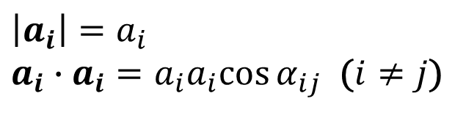
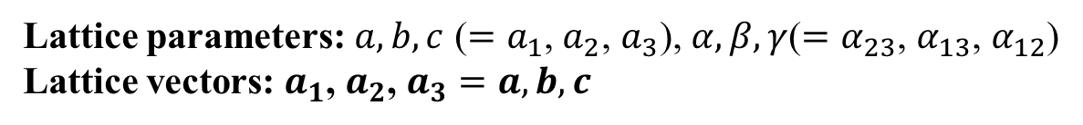
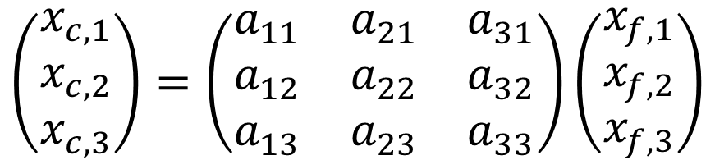
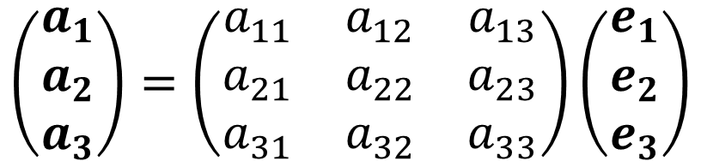
Fractional coordinates in crystal
(結晶の内部座標)
Lattice parameters: $a, b, c$ ($=a_{1}$, $a_{2}$, $a_{3}$), $α,β,γ$($=α_{23}$, $α_{13}$, $α_{12}$)
Lattice vectors: $a_{1}$, $a_{2}$, $a_{3}=a, b, c$
r = x_{f,1}a₁+ x_{f,2}a₂ + x_{f,3}a₃ = x_{c,1}e₁+ x_{c,2}e₂ + x_{c,3}e₃
(x_{f,1}, x_{f,1}, x_{f,3}): Fractional coordinate (部分座標)
Internal coordinate (内部座標)
$$\left|a_{i}\right|=a_{i}$$
$a_{i}∙a_{i}=a_{i}a_{i}cos{α_{ij}}$ ($i≠j$)
$$\left(\begin{matrix}a_{1} \\ a_{2} \\ a_{3}\end{matrix}\right)=\left(\begin{matrix}a_{11} & a_{12} & a_{13} \\ a_{21} & a_{22} & a_{23} \\ a_{31} & a_{32} & a_{33}\end{matrix}\right)\left(\begin{matrix}e_{1} \\ e_{2} \\ e_{3}\end{matrix}\right)$$
Fractional coordinate to Cartesian coordinate
$$\left(\begin{matrix}x_{c,1} \\ x_{c,2} \\ x_{c,3}\end{matrix}\right)=\left(\begin{matrix}a_{11} & a_{21} & a_{31} \\ a_{12} & a_{22} & a_{32} \\ a_{13} & a_{23} & a_{33}\end{matrix}\right)\left(\begin{matrix}x_{f,1} \\ x_{f,2} \\ x_{f,3}\end{matrix}\right)$$

Slide 5
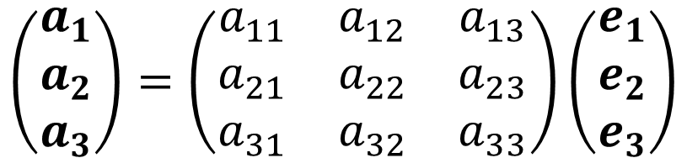
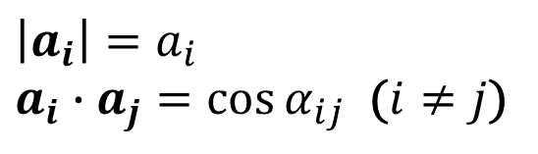
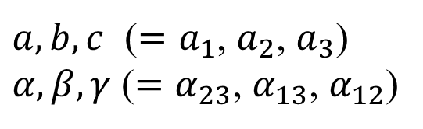
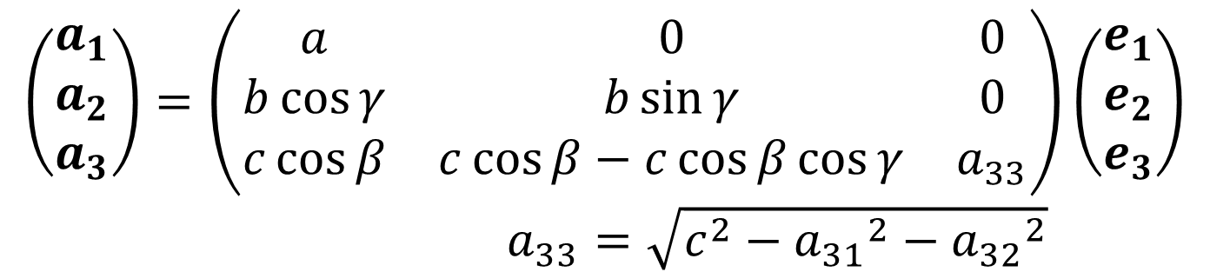
Conversion matrix
$$\left(\begin{matrix}a_{1} \\ a_{2} \\ a_{3}\end{matrix}\right)=\left(\begin{matrix}a_{11} & a_{12} & a_{13} \\ a_{21} & a_{22} & a_{23} \\ a_{31} & a_{32} & a_{33}\end{matrix}\right)\left(\begin{matrix}e_{1} \\ e_{2} \\ e_{3}\end{matrix}\right)$$
$$\left|a_{i}\right|=a_{i}$$
$a_{i}∙a_{j}=\cos{α_{ij}}$ ($i≠j$)
$a, b, c$ ($=a_{1}$, $a_{2}$, $a_{3}$)
$α,β,γ$ ($=α_{23}$, $α_{13}$, $α_{12}$)
tkcrystalbase.cal_lattice_vectors()
$$\left(\begin{matrix}a_{1} \\ a_{2} \\ a_{3}\end{matrix}\right)=\left(\begin{matrix}a & 0 & 0 \\ b\cos{γ} & b\sin{γ} & 0 \\ c\cos{β} & c\cos{β}−c\cos{β}\cos{γ} & a_{33}\end{matrix}\right)\left(\begin{matrix}e_{1} \\ e_{2} \\ e_{3}\end{matrix}\right)$$
$a_{33}=\sqrt{c^{2}−{a_{31}}^{2}−{a_{32}}^{2}}$

Slide 6
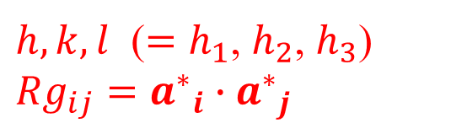
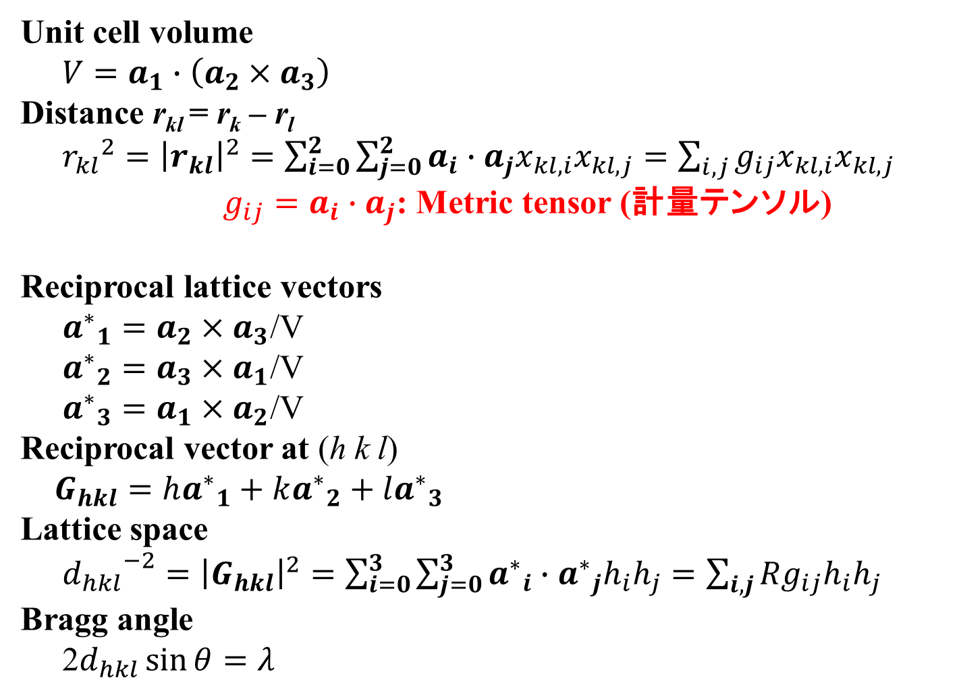
Lattice properties
Unit cell volume
$V=a_{1}∙\left(a_{2}×a_{3}\right)$
Distance r_{kl} = r_{k} – r_{l}
${r_{kl}}^{2}={\left|r_{kl}\right|}^{2}=\sum_{i=0}^{2}{\sum_{j=0}^{2}{a_{i}∙a_{j}x_{kl,i}x_{kl,j}}}=\sum_{i,j}{g_{ij}x_{kl,i}x_{kl,j}}$
$g_{ij}=a_{i}∙a_{j}$: Metric tensor (計量テンソル)
Reciprocal lattice vectors
${a^{∗}}_{1}=a_{2}×a_{3}$/V
${a^{∗}}_{2}=a_{3}×a_{1}$/V
${a^{∗}}_{3}=a_{1}×a_{2}$/V
Reciprocal vector at (h k l)
$G_{hkl}=h{a^{∗}}_{1}+k{a^{∗}}_{2}+l{a^{∗}}_{3}$
Lattice space
${d_{hkl}}^{−2}={\left|G_{hkl}\right|}^{2}=\sum_{i=0}^{3}{\sum_{j=0}^{3}{{a^{∗}}_{i}∙{a^{∗}}_{j}h_{i}h_{j}}}=\sum_{i,j}{{Rg}_{ij}h_{i}h_{j}}$
Bragg angle
2$d_{hkl}\sin{θ}=λ$
tkcrystalbase.cal_volume ()
tkcrystalbase.distance2() / .distance()
tkcrystalbase.cal_metrics()
tkcrystalbase.cal_reciprocal_lattice_vectors()
$h,k,l$ ($=h_{1}$, $h_{2}$, $h_{3}$)
${Rg}_{ij}={a^{∗}}_{i}∙{a^{∗}}_{j}$

Slide 7
どうやって逆格子を描くか
実格子のフーリエ変換
逆格子の長さ: 実格子の逆数
角度: α* = 180º – α
逆格子の基本ベクトルは実格子の基本ベクトルに直交する
ブラベー格子の消滅側を考える
(基本格子の基本ベクトルを考えるのと同じ結果が得られる)
実格子の基本ベクトル
逆格子の基本ベクトル
a*₂
a₂
a₁
a*₁

Slide 8
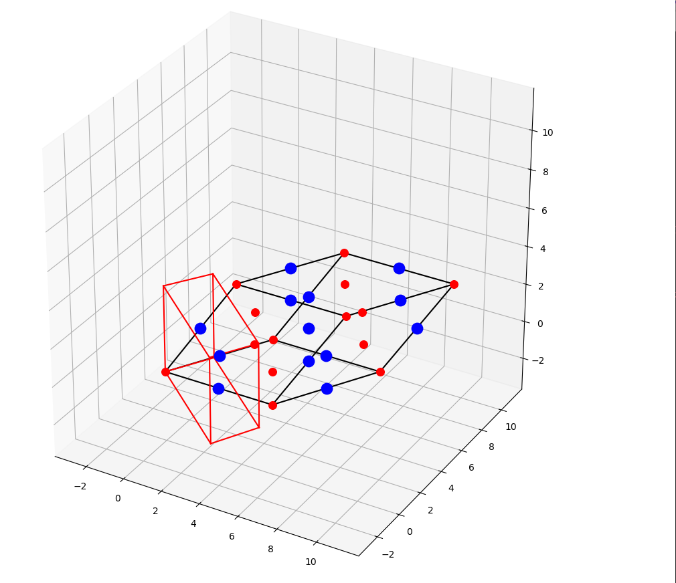
Fractional – Cartesian conversion
python crystal_draw_cell.py
Rhombohedral cell
and reciprocal unit cell

Slide 9
Inter-atomic distances
python crystal_distance.py
NaCl
Source code:
# Lattice parameters (angstrom and degree)
lattice_parameters = [ 5.62, 5.62, 5.62, 90.0, 90.0, 90.0]
# Site information (atom name, site label, atomic number, atomic mass, charge, radius, color, position)
sites = [
# 原子量 電荷 描画条件 内部座標
[‘Na’, ‘Na1’, 11, 22.98997, +1.0, 0.7, ‘red‘, np.array([0.0, 0.0, 0.0])]
,[‘Na’, ‘Na2’, 11, 22.98997, +1.0, 0.7, ‘red‘, np.array([0.0, 0.5, 0.5])]
,[‘Na’, ‘Na3’, 11, 22.98997, +1.0, 0.7, ‘red‘, np.array([0.5, 0.0, 0.5])]
,[‘Na’, ‘Na4’, 11, 22.98997, +1.0, 0.7, ‘red‘, np.array([0.5, 0.5, 0.0])]
,[‘Cl‘, ’Cl1’, 17, 35.4527, -1.0, 1.4, ‘blue‘, np.array([0.5, 0.0, 0.0])]
,[‘Cl‘, ’Cl2’, 17, 35.4527, -1.0, 1.4, ‘blue‘, np.array([0.5, 0.5, 0.5])]
,[‘Cl‘, ’Cl3’, 17, 35.4527, -1.0, 1.4, ‘blue‘, np.array([0.0, 0.0, 0.5])]
,[‘Cl‘, ’Cl4’, 17, 35.4527, -1.0, 1.4, ‘blue‘, np.array([0.0, 0.5, 0.0])]
]
# Distance range
rmin = 0.1 # angstrom. 原子間距離がrmin未満の場合、同一の原子とみなす
rmax = 4.5 # angstrom. rmaxまでの原子間距離を計算

Slide 10
Inter-atomic distances
python crystal_distance.py
NaCl
Lattice parameters: [5.62, 5.62, 5.62, 90.0, 90.0, 90.0]
Lattice vectors:
ax: ( 5.62, 0, 0) A
ay: ( 2.546e-10, 5.62, 0) A
az: ( 2.546e-10, 0, 5.62) A
Metric tensor:
gij: ( 31.58, 1.431e-09, 1.431e-09) A
( 1.431e-09, 31.58, 6.48e-20) A
( 1.431e-09, 6.48e-20, 31.58) A
Volume: 177.5 A^3
Unit cell volume: 177.5 A^3
Reciprocal lattice parameters: [0.17793594306049823, 0.17793594306049823, 0.17793594306049823, 90.00000000257246, 90.00000000516778, 90.00000000516778]
Reciprocal lattice vectors:
Rax: ( 0.1779, -8.06e-12, -8.06e-12) A^-1
Ray: ( 0, 0.1779, 0) A^-1
Raz: ( 0, 0, 0.1779) A^-1
Reciprocal lattice metric tensor:
Rgij: ( 0.03166, -1.422e-12, -1.422e-12) A^-1
(-1.422e-12, 0.03166, 6.382e-23) A^-1
(-1.422e-12, 6.382e-23, 0.03166) A^-1
Reciprocal unit cell volume: 0.005634 A^-3
nmax: 1 1 1
Interatomic distances:
Cl1 ( 0.5, 0, 0) - Na4 ( 0.5, 0.5, 0) + ( 0, -1, 0): dis = 2.81 A
(cut)
Na4 ( 0.5, 0.5, 0) - Na1 ( 0, 0, 0) + ( 0, 1, 0): dis = 3.974 A
Na4 ( 0.5, 0.5, 0) - Na2 ( 0, 0.5, 0.5) + ( 1, 0, -1): dis = 3.974 A
Na4 ( 0.5, 0.5, 0) - Na1 ( 0, 0, 0) + ( 1, 0, 0): dis = 3.974 A

Slide 11
三斜晶の面間隔 d_{hkl}

Slide 12
Bragg angles
NaCl
python crystal_xrd.py
Lattice parameters: [5.62, 5.62, 5.62, 90.0, 90.0, 90.0]
Lattice vectors:
ax: ( 5.62, 0, 0) A
ay: ( 2.546e-10, 5.62, 0) A
az: ( 2.546e-10, 0, 5.62) A
Metric tensor:
gij: ( 31.58, 1.431e-09, 1.431e-09) A
( 1.431e-09, 31.58, 6.48e-20) A
( 1.431e-09, 6.48e-20, 31.58) A
Volume: 177.5 A^3
Unit cell volume: 177.5 A^3
Reciprocal lattice parameters: [0.17793594306049823, 0.17793594306049823, 0.17793594306049823, 90.00000000257246, 90.00000000516778, 90.00000000516778]
Reciprocal lattice vectors:
Rax: ( 0.1779, -8.06e-12, -8.06e-12) A^-1
Ray: ( 0, 0.1779, 0) A^-1
Raz: ( 0, 0, 0.1779) A^-1
Reciprocal lattice metric tensor:
Rgij: ( 0.03166, -1.422e-12, -1.422e-12) A^-1
(-1.422e-12, 0.03166, 6.382e-23) A^-1
(-1.422e-12, 6.382e-23, 0.03166) A^-1
Reciprocal unit cell volume: 0.005634 A^-3
hkl range: 7 7 7
Diffraction angle, d, h, k, l:
2Q= 15.75 d= 5.62 ( -1 0 0)
2Q= 15.75 d= 5.62 ( 0 -1 0)
(cut)
2Q= 22.35 d= 3.97394 ( -1 -1 0)
2Q= 22.35 d= 3.97394 ( -1 0 -1)
2Q= 22.35 d= 3.97394 ( 1 0 1)
\

Slide 13

六方/三方格子 － 底心斜方格子変換
a'_{i} = Σ_{j} (t_{ij} a_{j}) (A' = TA)
$\left(\begin{matrix}a_{1,o} \\ a_{2,o} \\ a_{3,o}\end{matrix}\right)=\left(\begin{matrix}1 & 0 & 0 \\ 1 & 2 & 0 \\ 0 & 0 & 1\end{matrix}\right)\left(\begin{matrix}a_{1,h} \\ a_{2,h} \\ a_{3,h}\end{matrix}\right)$
R = Σ_{i} (x_{i} a_{i} ) = Σ_{i} (x'_{i} a'_{i} ) = Σ_{i,j} (x'_{i} t_{ij} a_{j}) から、
x_{i} = Σ_{,j} (x'_{j} t_{ji}) (X = ^{t}TX’)
$\left(\begin{matrix}x_{1,h} \\ x_{2,h} \\ x_{3,h}\end{matrix}\right)=\left(\begin{matrix}1 & 1 & 0 \\ 0 & 2 & 0 \\ 0 & 0 & 1\end{matrix}\right)\left(\begin{matrix}x_{1,o} \\ x_{2,o} \\ x_{3,o}\end{matrix}\right)$
x'_{i} = Σ_{,j} x'_{j} (t_{ji})⁻¹ (X' = ^{t}T⁻¹X)
$\left(\begin{matrix}x_{1,o} \\ x_{2,o} \\ x_{3,o}\end{matrix}\right)={\left(\begin{matrix}1 & 1 & 0 \\ 0 & 2 & 0 \\ 0 & 0 & 1\end{matrix}\right)}^{−1}\left(\begin{matrix}x_{1,h} \\ x_{2,h} \\ x_{3,h}\end{matrix}\right)$
a_{2,o}
a_{2,h}
P
y_{o}
y_{h}
O
x_{o}
x_{h}
a_{1,h}
a_{1,o}

Slide 14
格子変換
実格子空間のベクトルの変換： (a_{i}) => (a’_{i}) 変換行列: (t_{ij})
a'_{i} = Σ_{j} (t_{ij} a_{j}) ( A' = TA )
R = Σ_{i} (x_{i} a_{i} ) = Σ_{i} (x'_{i} a'_{i} ) = Σ_{i,j} (x'_{i} t_{ij} a_{j}) から、
x_{i} = Σ_{,j} (x'_{j} t_{ji}) ( X = ^{t}TX' )
x'_{i} = Σ_{,j} x'_{j} (t_{ji})⁻¹ ( X' = ^{t}T⁻¹X )
R・G_{hkl} = hx + ky + lz はスカラー: R・G_{hkl} = R'・G'_{h'k'l'}
Σ_{i} (h_{i}x_{i}) = Σ_{i} (h'_{i}x'_{i}) = Σ_{i,j} (h_{i} x'_{j} t_{ji})
h'_{j} = Σ_{i} (h_{i} t_{ji}) ( H' = TH )
G_{hkl} = G'_{h'k'l'} より、
Σ_{i} (h'_{i}a*'_{i}) = Σ_{i} (h_{i}a*_{i}) = Σ_{i,j} (h_{i} t_{ji} a*'_{i})
a*_{i} = Σ_{i,j} (t_{ji} a*'_{j}) ( A* = ^{t}TA*' )
a*'_{i} = Σ_{i,j} ((t_{ji})⁻¹ a*_{j}) ( A*' = ^{t}T⁻¹A* )

Slide 15
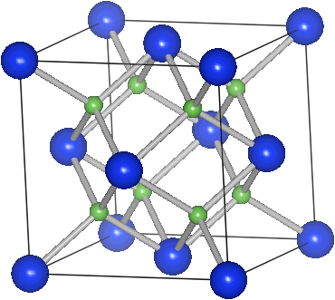
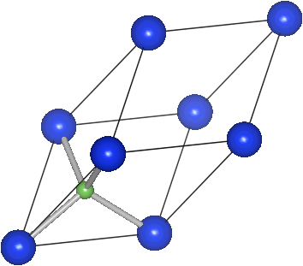






単位格子(ブラベー格子) と 基本格子
Siの構造 (室温)
空間群 Fd3m, No. 227 (立方晶系, ダイヤモンド構造)
ブラベー格子 基本格子
a_{C} = 0.5431 nm a_{R} = 0.3840 nm α=60º
Si
Si,Ga
Si,As
Si (0, 0, 0)

Slide 16
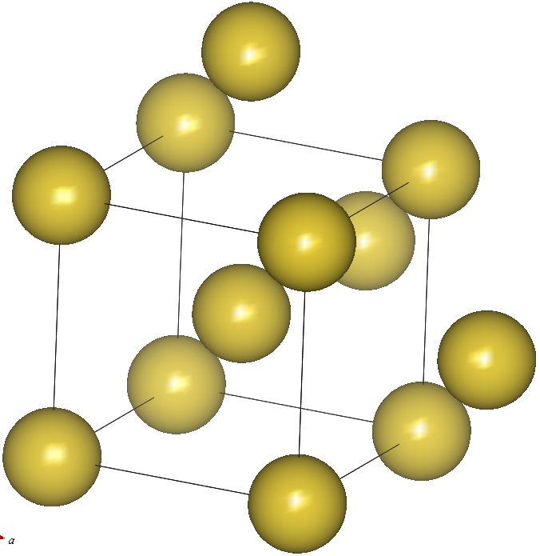
単位格子(ブラベー格子) と 基本格子
体心立方格子

Slide 17
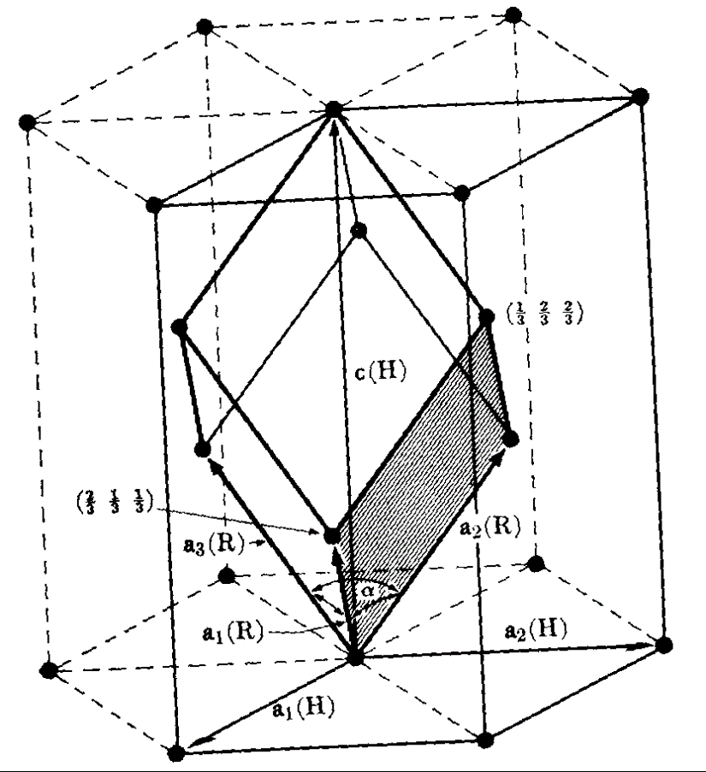
六方格子－三方格子変換
菱面体晶: 六方格子軸と三方格子軸のどちらも取れる。
六方格子軸の基本ベクトル: a₁(H), a₂(H), a₃(H)
三方格子軸の基本ベクトル: a₁(R), a₂(R), a₃(R)
a₁(R) = (2a₁(H) + a₂(H) + a₃(H)) / 3
a₂(R) = (-a₁(H) + a₂(H) + a₃(H)) / 3
a₃(R) = (-a₂(H) - 2a₂(H) + a₃(H)) /3
三方格子軸での逆格子座標 h k l
六方格子軸での逆格子座標 H K L
h = (2H + K + L) / 3
k = (-H + K + L) / 3
l = (-H - 2K + L) /3
H = h - k
K = k - l
L = h + k + l
格子定数の関係
a_{R} = √(3a_{H}² + c²)
sin(α/2) = 3/2 / √(3 + (c/a_{H})²)

Slide 18
格子変換行列
'RhombHex' [ [ 1, -1, 0],
[ 0, 1, -1],
[ 1, 1, 1] ] );
'HexRhomb' [ [ 2/3, 1/3, 1/3],
[-1/3, 1/3, 1/3],
[-1/3,-2/3, 1/3] ]);
'HexOrtho’ [ [ 1, 0, 0],
[ 1, 2, 0],
[ 0, 0, 1] ] );
'FCCPrim' or $PresetRule eq 'PrimFCC’ [ [ 0.5, 0.5, 0],
[ 0, 0.5, 0.5],
[ 0.5, 0, 0.5] ] );
'BCCPrim' or $PresetRule eq 'PrimBCC’ [ [-0.5, 0.5, 0.5],
[ 0.5,-0.5, 0.5],
[ 0.5, 0.5,-0.5] ] );
'ACenterPrim' [ [ 1.0, 0.0, 0.0],
[ 0.0, 0.5, 0.5],
[ 0.0,-0.5, 0.5] ] );
'BCenterPrim' [ [ 0.5, 0.0, 0.5],
[ 0.0, 1.0, 0.0],
[-0.5, 0.0, 0.5] ] );
'CCenterPrim' [ [ 0.5, 0.5, 0.0],
[-0.5, 0.5, 0.0],
[ 0.0, 0.0, 1.0] ] );

Slide 19
六方格子－三方格子変換
菱面体晶: 六方格子軸と三方格子軸のどちらも取れる。
六方格子軸の基本ベクトル: a₁(H), a₂(H), a₃(H)
三方格子軸の基本ベクトル: a₁(R), a₂(R), a₃(R)
a₁(R) = (2a₁(H) + a₂(H) + a₃(H)) / 3
a₂(R) = (-a₁(H) + a₂(H) + a₃(H)) / 3
a₃(R) = (-a₂(H) - 2a₂(H) + a₃(H)) /3
三方格子軸での逆格子座標 h k l
六方格子軸での逆格子座標 H K L
h = (2H + K + L) / 3
k = (-H + K + L) / 3
l = (-H - 2K + L) /3
H = h - k
K = k - l
L = h + k + l
格子定数の関係
a_{R} = √(3a_{H}² + c²)
sin(α/2) = 3/2 / √(3 + (c/a_{H})²)

Slide 20
Madelung potential
Sum of Coulomb potential in 3D is very slowly converging
Potential is proportional to r⁻¹
Polarization potential due to +/- ions is to r ⁻²
Number of ions on the sphere surface at radius r is to r²
=> Contribution of ions from a surface region at r
to Coulomb sum is almost constant, independent of r
Madelung constant

Slide 21
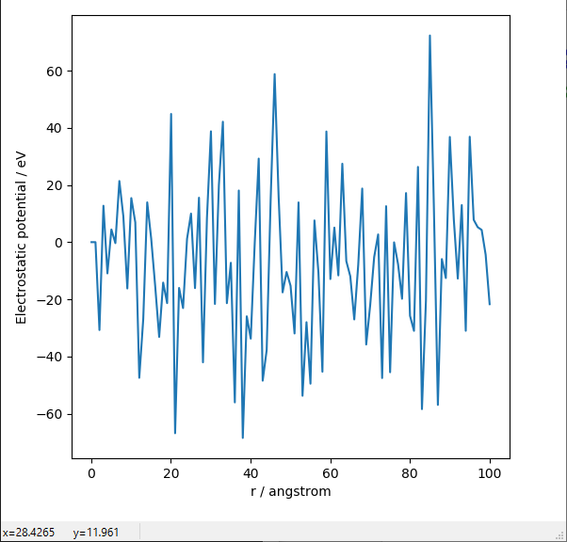
Madelung potential: Simple sum
python crystal_MP_simple.py
Coulomb sum in sphere with the radius r
Exact: -8.9 eV
Rock salt type

Slide 22
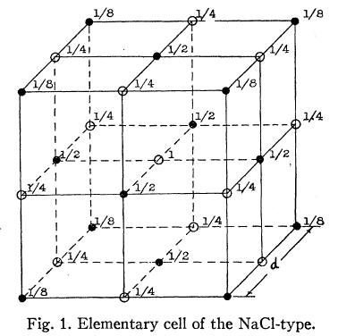
Efficient Coulomb sum: Evjen method
Sum up Coulomb potential in
units with zero net charge
Ion charges: Z_{i}
On boundary plane : 1/2Z_{i}
On boundary edge : 1/4Z_{i}
On boundary corner : 1/8Z_{i}
Madelung constant of Rock salt type structure

Slide 23
Madelung potential: Evjen method
Usage: python crystal_MP_Evjen.py n_{cell}
n_{cell} MP Madelung constant
1 -8.9766 1.7517691
2 -8.95586 1.7477211
3 -8.95521 1.7475955
4 -8.9511 1.7475744
5 -8.95508 1.7475686
6 -8.95507 1.7475665
8 -8.95506 1.7475652
10 -8.95506 1.7475648
Exact (精確値) 1.74756
Rock salt type

Slide 24
3D sum of Coulomb potential: Ewald method
Periodic calculation can be enhanced by FT?
Periodic positions of charge
=> converted to the origin of FT data
But the charges are point charges
=> converted to infinite in FT space
=> Calculate for charges with finite width
(拡がりのある電荷の周期配列として計算する)
+

Slide 25
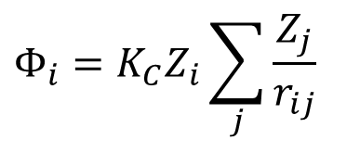
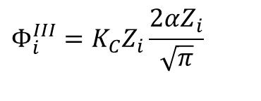
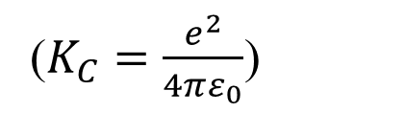

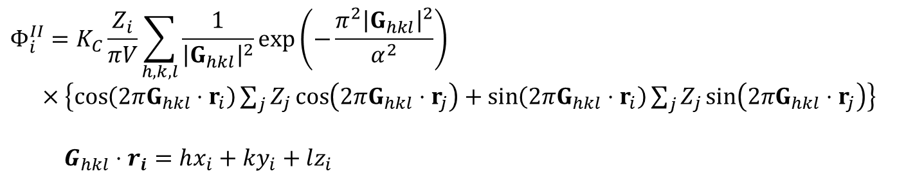
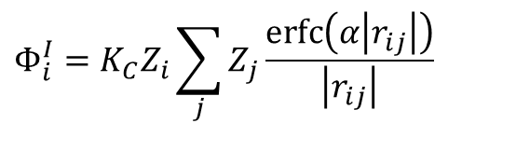
3D sum of Coulomb potential: Ewald method
The finite width charge distributions are converted by FT
=> Take faster calculation parts in the real space and the reciprocal space
拡がった電荷のフーリエ変換を利用し、実空間和と逆空間和の計算の速い部分をとる
$$Φ_{i}=K_{C}Z_{i}\sum_{j}{\frac{Z_{j}}{r_{ij}}}$$
($K_{C}=\frac{e^{2}}{4πε_{0}}$)
$$Φ_{i}^{I}=K_{C}Z_{i}\sum_{j}{Z_{j}\frac{erfc\left(α\left|r_{ij}\right|\right)}{\left|r_{ij}\right|}}$$
$$Φ_{i}^{II}=K_{C}\frac{Z_{i}}{πV}\sum_{h,k,l}{\frac{1}{{\left|G_{hkl}\right|}^{2}}\exp\left(−\frac{π^{2}{\left|G_{hkl}\right|}^{2}}{α^{2}}\right)}$$
$×\left\{\cos\left(2πG_{hkl}⋅r_{i}\right)\sum_{j}{Z_{j}\cos\left(2πG_{hkl}⋅r_{j}\right)}+\sin\left(2πG_{hkl}⋅r_{i}\right)\sum_{j}{Z_{j}\sin\left(2πG_{hkl}⋅r_{j}\right)}\right\}$
$G_{hkl}⋅r_{i}=hx_{i}+ky_{i}+lz_{i}$
$$Φ_{i}^{III}=K_{C}Z_{i}\frac{2αZ_{i}}{\sqrt{π}}$$
$$Φ_{i}=Φ_{i}^{I}+Φ_{i}^{II}−Φ_{i}^{III}$$

Slide 26
Madelung potential: Ewald method
Usage: python crystal_MP_Ewald.py alpha prec
Alpha Precision MP Madelung constant Range Time (s)
0.3 10⁻³ -8.95558 1.7476663 10.1/222 0.063 /222 0.016/0 /0.016
0.3 10⁻⁵ -8.95506 1.7475646 11.9/333 0.105 /222 0.031/0 /0.031
0.3 10⁻⁷ -8.95506 1.7475646 13.6/333 0.147 /333 0.047/0 /0.047
0.2 10⁻³ -8.95506 1.7475646 15.2/333 0.028 /111 0.042/0 /0.042
0.6 10⁻³ -8.95607 1.7477629 5.1/111 0.25 /333 0 /0.016 /0.016
0.8 10⁻³ -8.95584 1.747718 3.8/111 0.45 /444 0 /0.016 /0.016
0.2 10⁻¹⁰ -8.95506 1.7475646 24.3/555 0.093/222 0.16/0 /0.16
0.4 10⁻¹⁰ -8.95506 1.7475646 12.1/333 0.373/444 0.036/0.016/0.052
0.5 10⁻¹⁰ -8.95506 1.7475646 9.7/222 0.58 /555 0.016/0.016/0.031
0.6 10⁻¹⁰ -8.95506 1.7475646 8.1/222 0.84 /666 0.016/0.031/0.047
Exact (精確値) 1.74756
Range: R_{max} [Å]/n_{xmax}n_{ymax}n_{zmax} G_{max} [Å⁻¹]/h_{max}k_{max}l_{max}
Time: Real space sum / Reciprocal space sum / Total [s]
Rock salt type

Slide 27
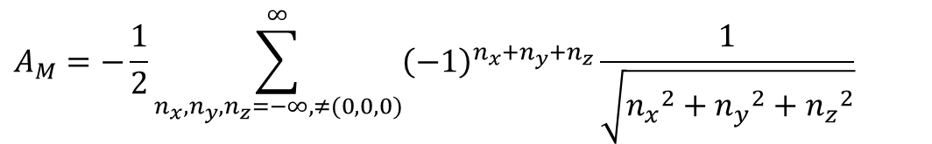
Comparison: Evjen method
$$A_{M}=−\frac{1}{2}\sum_{n_{x},n_{y},n_{z}=−∞,≠(0,0,0)}^{∞}{{\left(−1\right)}^{n_{x}+n_{y}+n_{z}}\frac{1}{\sqrt{{n_{x}}^{2}+{n_{y}}^{2}+{n_{z}}^{2}}}}$$
Rock salt type
Exact value = 1.7476

