Slide 1
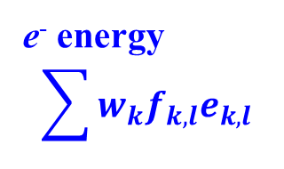
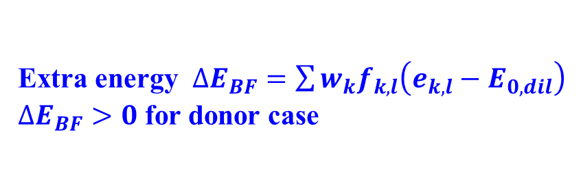
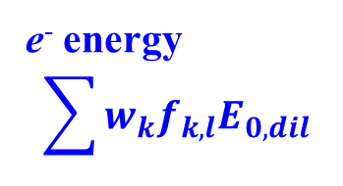
Band filling correction: Correction to dilution limit
Walle and Neugebauer, J. Appl. Phys. 9 (2004) 3851; Oba et al., Sci. Technol. Adv. Mater. 12 (2011) 034302
Small super cell (high defect dens.)
Infinite cell (dilute. limit)
CB
CB
Summation is taken over the electrons having extra energy in CB / defect states
E_{F}
E_{0,dil}
E_{F} ~ E_{0,dil}
e⁻ energy
$$\sum{w_{k}f_{k,l}e_{k,l}}$$
e⁻ energy
$$\sum{w_{k}f_{k,l}E_{0,dil}}$$
VB
VB
Log (DOS)
Log (DOS)
Extra energy $∆E_{BF}=\sum{w_{k}f_{k,l}\left(e_{k,l}−E_{0,dil}\right)}$
$∆E_{BF}>0$ for donor case
Notes:
1

Slide 2

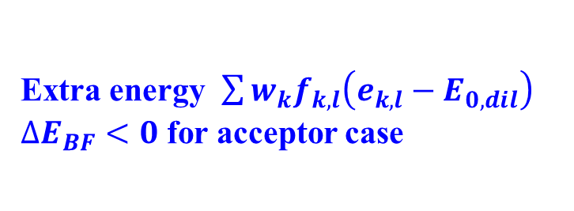

Band filling correction: Hole / acceptor case
Small super cell (high defect dens.)
Infinite cell (dilute limit)
CB
CB
Summation is taken over the electrons having extra energy in VB / defect states
e⁻ energy
$$\sum{w_{k}f_{k,l}e_{k,l}}$$
e⁻ energy
$$\sum{w_{k}f_{k,l}E_{0,dil}}$$
E_{0,dil}
E_{F} ~ E_{0,dil}
E_{F}
VB
VB
Log (DOS)
Log (DOS)
Extra energy $\sum{w_{k}f_{k,l}\left(e_{k,l}−E_{0,dil}\right)}$
$∆E_{BF}<0$ for acceptor case
Notes:
2

Slide 3
Configuration on TSUBAME
Directories:
$DataRoot/bin/Databases DB files required for python/perl scripts
$DataRoot/bin/python
$DataRoot/bin/python/lib python modules, should be in PYTHONPATH
$DataRoot/bin/python/vasp python vasp scripts
$DataRoot/bin/Perl
$DataRoot/bin/Perl/lib perl modules, should be in PERL5PATH
$DataRoot/bin/Perl/VASP perl vasp scripts
Aliases:
alias vasp_input="python $PythonVASPDir/vasp_input.py"
alias vasp_plot_band="python $PythonVASPDir/vasp_plot_band.py"
alias vasp_plot_dos="python $PythonVASPDir/vasp_plot_dos.py"
alias vasp_plot_epsilon="python $PythonVASPDir/vasp_plot_epsilon.py"
alias vasp_output="python $PythonVASPDir/vasp_output.py"
alias vasp_md_history="python $PythonVASPDir/make_md_history.py"
alias vasp_outcar2axsf="python $PythonVASPDir/outcar2axsf.py"
alias vasp_correction_bandfilling="python $PythonVASPDir/vasp_correction_bandfilling.py"
alias vasp_correction_VBM="python $PythonVASPDir/vasp_correction_VBM.py"
alias vasp_correction_charge="python $PythonVASPDir/vasp_correction_charge.py"
alias vasp_defect="python $PythonVASPDir/vasp_defect.py"

Slide 4
Example data directory structure
TSUBAME:
Data root: $DataRoot/Data-kamiya/Defect
Working dir: copy Defect to your home
Windows:
Data root: vasp/Defect
Working dir: vasp
Ideal model: ./Defect/ZnO
VCRelax: Full relaxation with high accuracy
SCF : SCF
DOS : DOS
BandX : Band structure
VO model (neutral): ./Defect/ZnO-VO
VCRelax: Fixed-cell relaxation with high accuracy
SCF : SCF
VO model (+1e charged): ./Defect/ZnO-VOp1
VCRelax: Fixed-cell relaxation with high accuracy
SCF : SCF

Slide 5
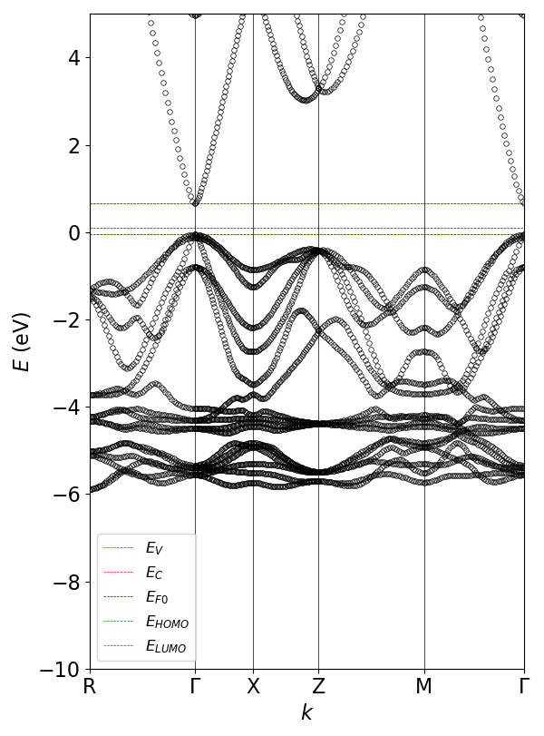
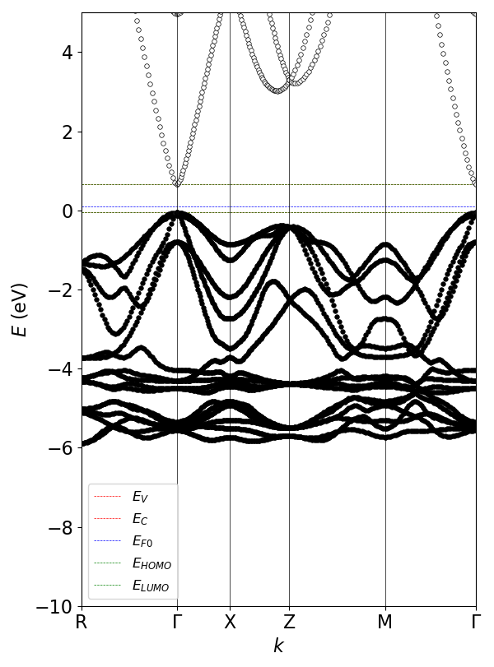
Band structure: Ideal
vasp_plot_band-test.bat
(left) python vasp_plot_band.py band .\Defect\ZnO\BandX
(right) python vasp_plot_band.py bandocc .\Defect\ZnO\BandX
Occupancy is expressed by grey level in the circles

Slide 6
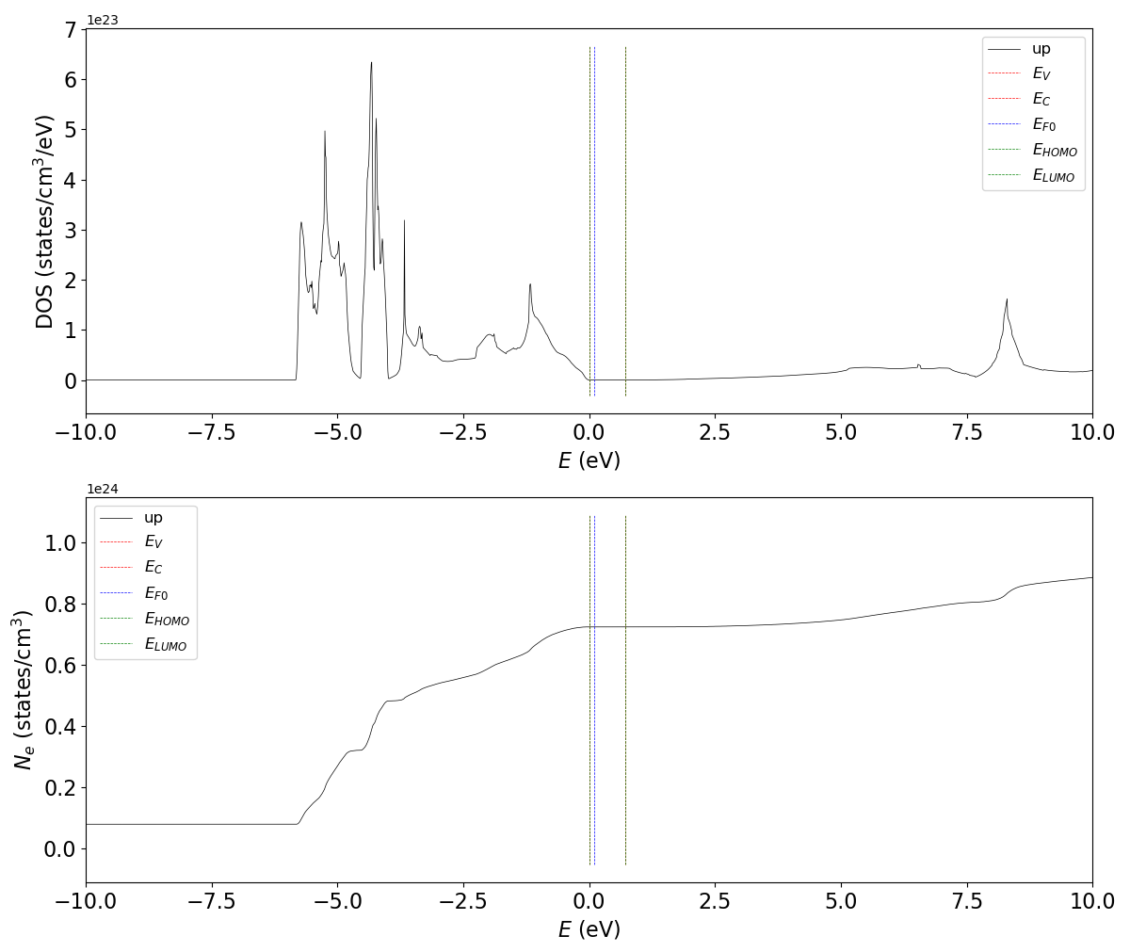
Density of states: Ideal
vasp_plot_dos-test.bat
python vasp_plot_dos.py DOS .\Defect\\ZnO\DOS

Slide 7
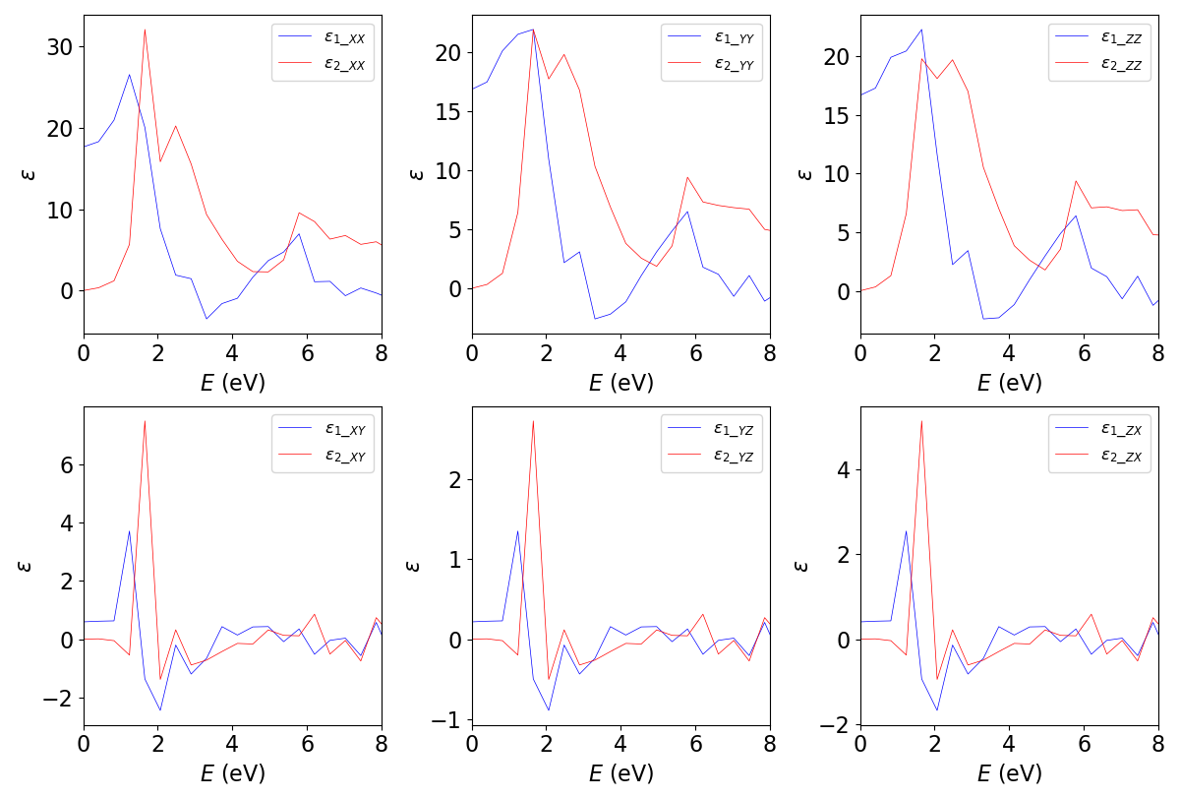
Optical dielectric function: Ideal
vasp_plot_epsilon-test.bat
python vasp_plot_epsilon.py density eps_i6_hse_LOPT

Slide 8
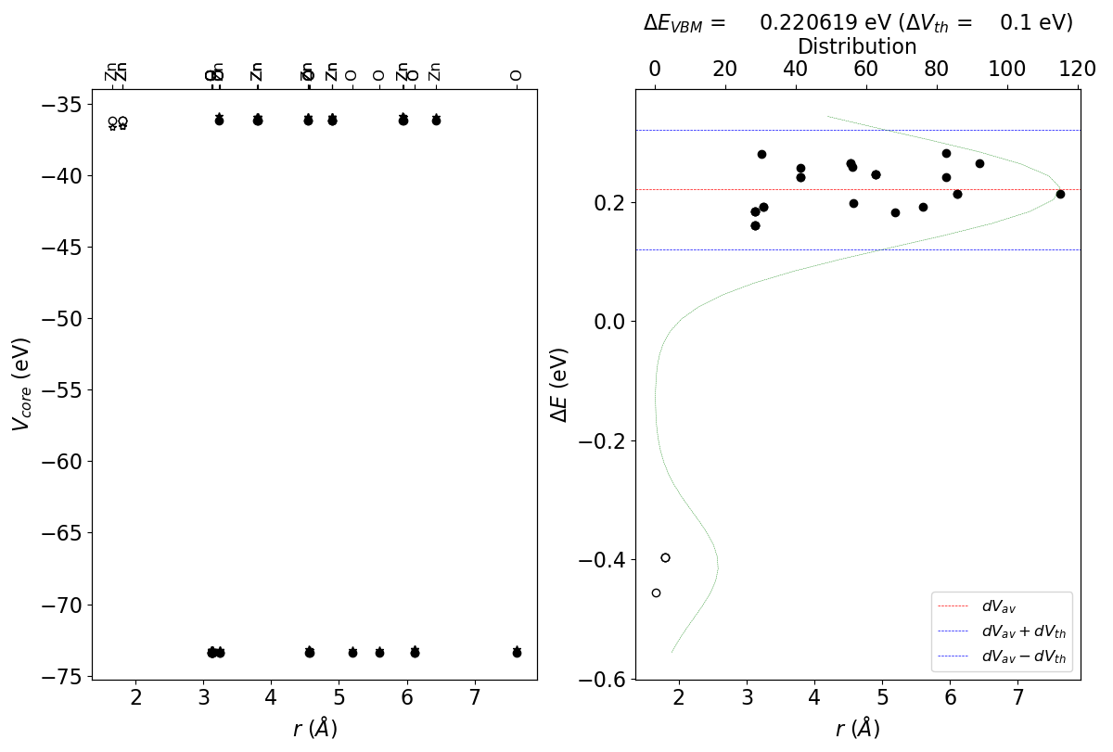
ΔE_{VBM} correction: V_{O}⁰
vasp_correction_VBM-test.bat 0.05
python vasp_correction_VBM.py exclude .\Defect\ZnO\SCF .\Defect\ZnO-VO\SCF
Use mode = Exclude
Output:
Average core potentials:
.\Defect\ZnO\SCF
0000 Zn ( 0.3333, 0.6667, 0.0005) -36.137 eV
0001 Zn ( 0.6667, 0.3333, 0.5005) -36.137 eV
0002 O ( 0.3333, 0.6667, 0.3821) -73.3886 eV
0003 O ( 0.6667, 0.3333, 0.8821) -73.3886 eV
.\Defect\ZnO-VO\SCF
Origin: ( 0.1667, 0.3333, 0.1910)
Zn 0000 (Zn 0000) ( 0.1667, 0.3333, 0.0316) -36.5935 eV - -36.1370 eV = -0.4565 eV (0) 1.656 A
Zn 0001 (Zn 0000) ( 0.1658, 0.8329, 0.0008) -35.8960 eV - -36.1370 eV = 0.2410 eV (1) 3.798 A
Zn 0002 (Zn 0000) ( 0.6671, 0.3342, 0.0008) -35.8960 eV - -36.1370 eV = 0.2410 eV (1) 3.798 A
Zn 0003 (Zn 0000) ( 0.6671, 0.8329, 0.0008) -35.8960 eV - -36.1370 eV = 0.2410 eV (1) 5.95 A
Zn 0004 (Zn 0001) ( 0.3197, 0.1803, 0.2418) -36.5342 eV - -36.1370 eV = -0.3972 eV (0) 1.798 A
Zn 0005 (Zn 0001) ( 0.3197, 0.6394, 0.2418) -36.5344 eV - -36.1370 eV = -0.3974 eV (0) 1.798 A
Zn 0006 (Zn 0001) ( 0.8606, 0.1803, 0.2418) -36.5344 eV - -36.1370 eV = -0.3974 eV (0) 1.798 A
Zn 0007 (Zn 0001) ( 0.8333, 0.6667, 0.2509) -35.8794 eV - -36.1370 eV = 0.2576 eV (1) 3.796 A
Zn 0008 (Zn 0000) ( 0.1667, 0.3333, 0.5011) -35.8566 eV - -36.1370 eV = 0.2804 eV (0) 3.222 A
(cut here)
VBM correction:
dEVBM: 0.220619 eV

Slide 9
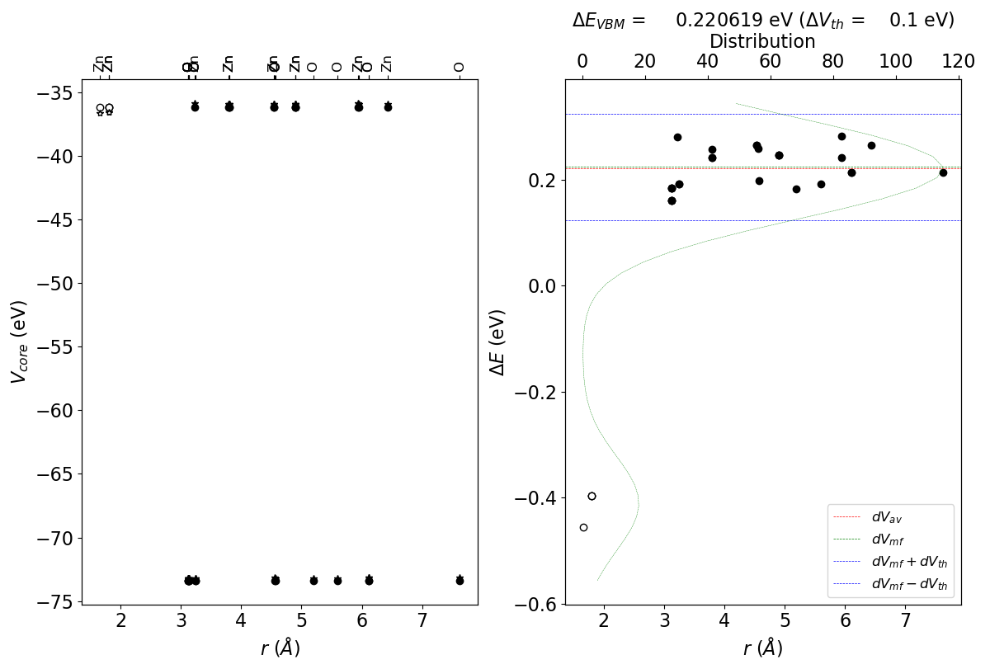
ΔE_{VBM} correction: V_{O}⁰
vasp_correction_VBM-test.bat 0.05
python vasp_correction_VBM.py mode .\Defect\ZnO\SCF .\Defect\ZnO-VO\SCF
Use mode = mode (mode value, most frequent ΔE)
Output:
Defect sites:
V: O 0000 ( 0.1667, 0.3333, 0.1910)
range: 0.6000000000000001 30
Vcore difference threshold (dVth): 0.1000 eV
Most frequent dVcore (dVmf): 0.2235 eV
Averaged dVcore in dVth (dVav): 0.2206 eV
(cut)
Origin: ( 0.1667, 0.3333, 0.1910)
Zn 0000 (Zn 0000) ( 0.1667, 0.3333, 0.0316) -36.5935 eV - -36.1370 eV = -0.4565 eV (0) 1.656 A
Zn 0001 (Zn 0000) ( 0.1658, 0.8329, 0.0008) -35.8960 eV - -36.1370 eV = 0.2410 eV (1) 3.798 A
Zn 0002 (Zn 0000) ( 0.6671, 0.3342, 0.0008) -35.8960 eV - -36.1370 eV = 0.2410 eV (1) 3.798 A
Zn 0003 (Zn 0000) ( 0.6671, 0.8329, 0.0008) -35.8960 eV - -36.1370 eV = 0.2410 eV (1) 5.95 A
Zn 0004 (Zn 0001) ( 0.3197, 0.1803, 0.2418) -36.5342 eV - -36.1370 eV = -0.3972 eV (0) 1.798 A
Zn 0005 (Zn 0001) ( 0.3197, 0.6394, 0.2418) -36.5344 eV - -36.1370 eV = -0.3974 eV (0) 1.798 A
Zn 0006 (Zn 0001) ( 0.8606, 0.1803, 0.2418) -36.5344 eV - -36.1370 eV = -0.3974 eV (0) 1.798 A
Zn 0007 (Zn 0001) ( 0.8333, 0.6667, 0.2509) -35.8794 eV - -36.1370 eV = 0.2576 eV (1) 3.796 A
Zn 0008 (Zn 0000) ( 0.1667, 0.3333, 0.5011) -35.8566 eV - -36.1370 eV = 0.2804 eV (0) 3.222 A
(cut here)
VBM correction:
dEVBM: 0.220619 eV

Slide 10
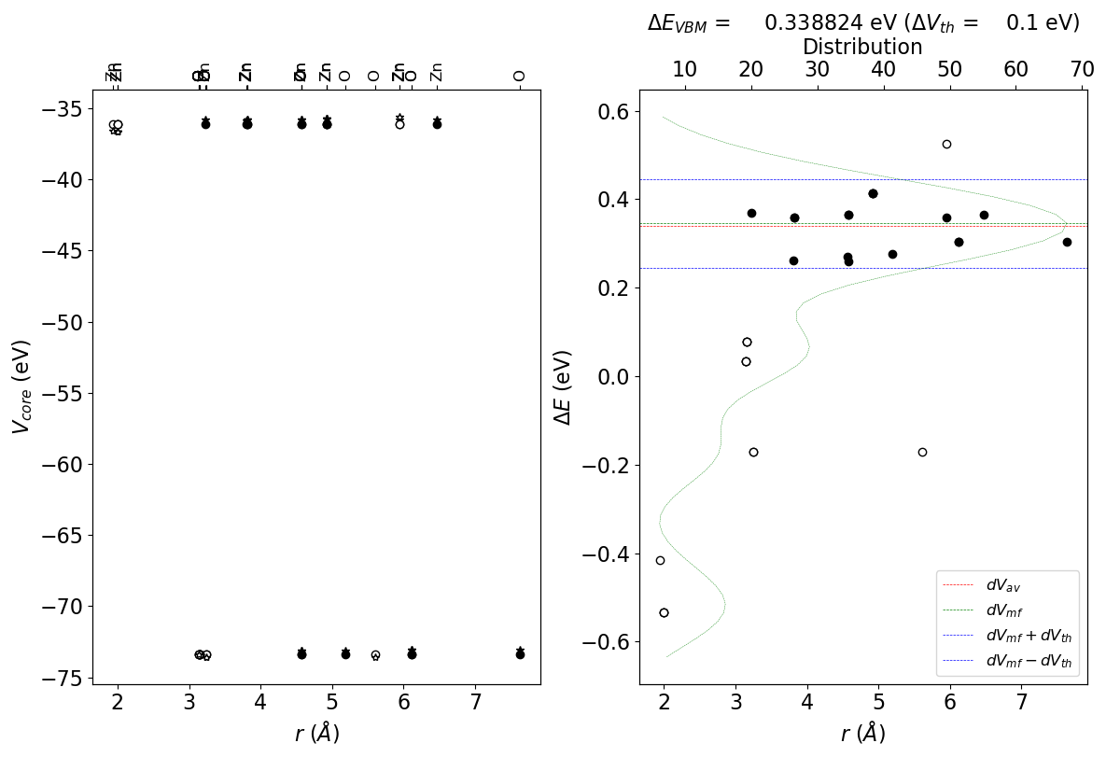
ΔE_{VBM} correction: V_{O}⁺
vasp_correction_VBM-test.bat
python vasp_correction_VBM.py mode .\Defect\ZnO\SCF .\Defect\ZnO-VOp1\SCF
Output:
_{Defect sites:}
V: O 0000 ( 0.1667, 0.3333, 0.1910)
Vcore difference threshold (dVth): 0.1000 eV
Most frequent dVcore (dVmf): 0.3457 eV
Averaged dVcore in dVth (dVav): 0.3388 eV
_{(cut)}
_{VBM correction:}
_{dEVBM: 0.338824 eV}

Slide 11
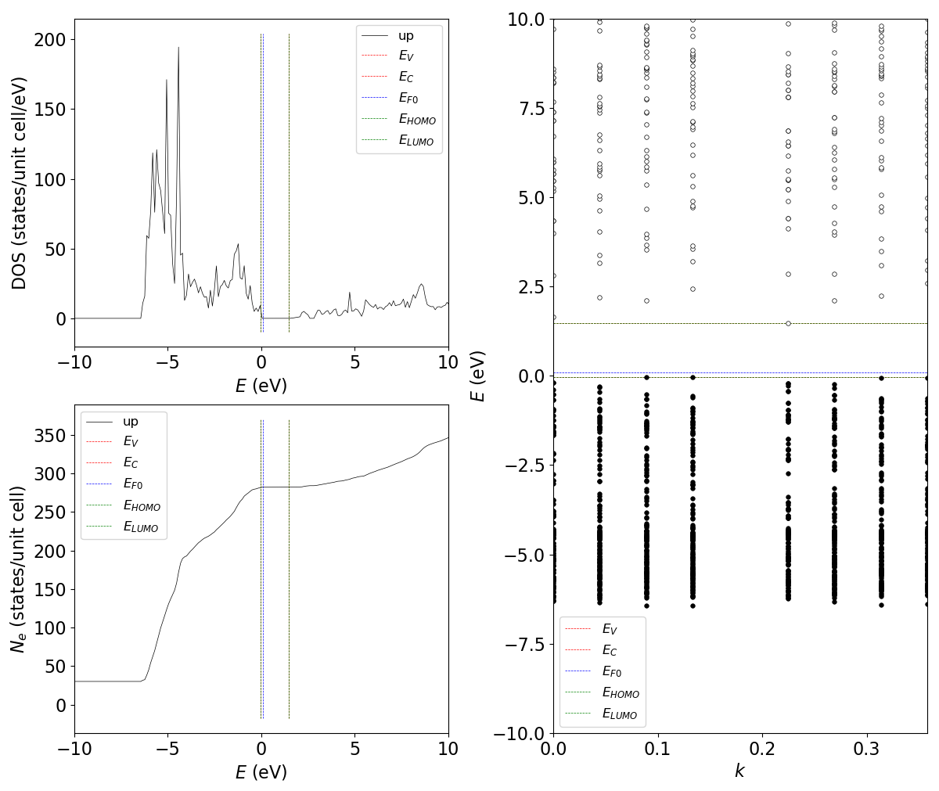
Band filling correction: V_{O}⁰
vasp_correction_bandfilling-test.bat
python vasp_correction_bandfilling.py BF .\Defect\ZnO-VO\SCF
Adjust EF0 so as to find appropriate EV and EC
Default EF0 is 0.1 eV, which seems to be ok
Output:
Total weight: 1.0
Total Ne : 141.0
NELECT : 282.0
Count spin degeneration of 2:
Total Ne : 282.0
dEh = 0 eV
dEe = 0 eV
Count spin degeneration of 2:
dEh = 0 eV
dEe = 0 eV

Slide 12
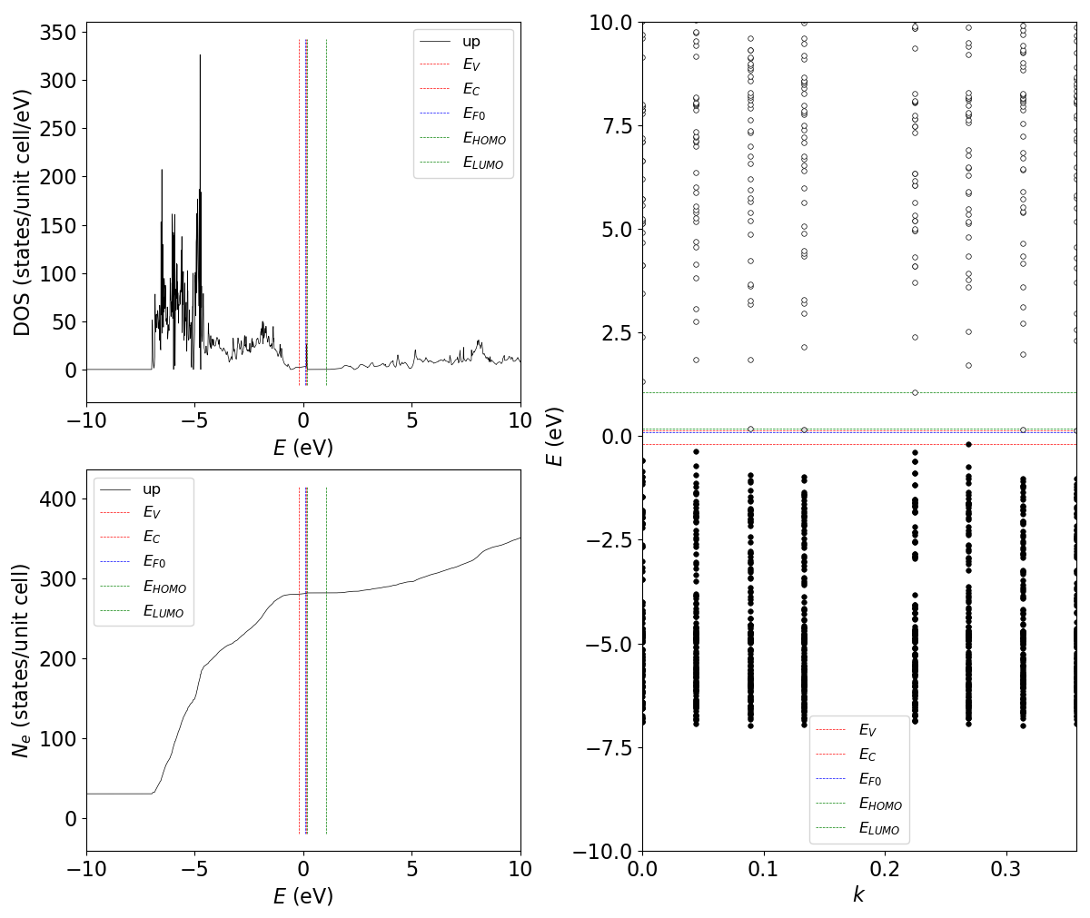
Band filling correction: V_{O}⁺
vasp_correction_bandfilling-test.bat
python vasp_correction_bandfilling.py BF .\Defect\ZnO-VOp1\SCF
Adjust EF0 so as to find appropriate EV and EC
Default EF0 is 0.1 eV, which seems to be ok
Output:
Total weight: 1.0
Total Ne : 140.50000003125
NELECT : 281.0
Count spin degeneration of 2:
Total Ne : 281.0000000625
dEh = 0.00235026 eV
dEe = 0.000292896 eV
dEtot = 0.00264315 eV
Count spin degeneration of 2:
dEh = 0.00470051 eV
dEe = 0.000585792 eV
dEtot = 0.00528631 eV

Slide 13
Band filling correction: Note for V_{O}⁰
Occupancy in VASP is not at 0 K, and some electrons occupy excited states.
In the PBE V_{O}⁰ case trace electrons exists in CB.
EHOMO is defined as the highest level occupied by electrons greater than 0.0.
Output:
Band filling energy correction:
Band edge from EIGENVAL:
EF0 = 0.100000 eV
EF = 1.723700 => 0.0 eV
EV = -0.200448 eV
EC = 0.146521 eV
Eg = 0.346969 eV
EHOMO = 0.181438 eV
ELUMO = 1.066398 eV
k[ 0]: ( 0.0000 0.0000 0.0000) w= 0.03125
k[ 1]: ( 0.2500 0.0000 0.0000) w= 0.1875
dEh: up iE=140 E= -0.354216 eV dNh= -0.08152 dEh= 0.00235026 eV
k[ 2]: ( 0.5000 0.0000 0.0000) w= 0.09375
dEe: up iE=140 E= 0.181438 eV dNe= 0.04228 dEe= 0.000138396 eV
k[ 3]: ( 0.2500 0.2500 0.0000) w= 0.1875
dEe: up iE=140 E= 0.149776 eV dNe= 0.1239 dEe= 0.000213995 eV
k[ 4]: ( 0.0000 0.0000 0.5000) w= 0.03125
k[ 5]: ( 0.2500 0.0000 0.5000) w= 0.1875
dEh: up iE=140 E= -0.200448 eV dNh= 0.04648 dEh= 0.00235026 eV
k[ 6]: ( 0.5000 0.0000 0.5000) w= 0.09375
dEe: up iE=140 E= 0.160428 eV dNe= 0.06052 dEe= 0.000292896 eV
k[ 7]: ( 0.2500 0.2500 0.5000) w= 0.1875
dEe: up iE=140 E= 0.146521 eV dNe= 0.123 dEe= 0.000292896 eV

Slide 14
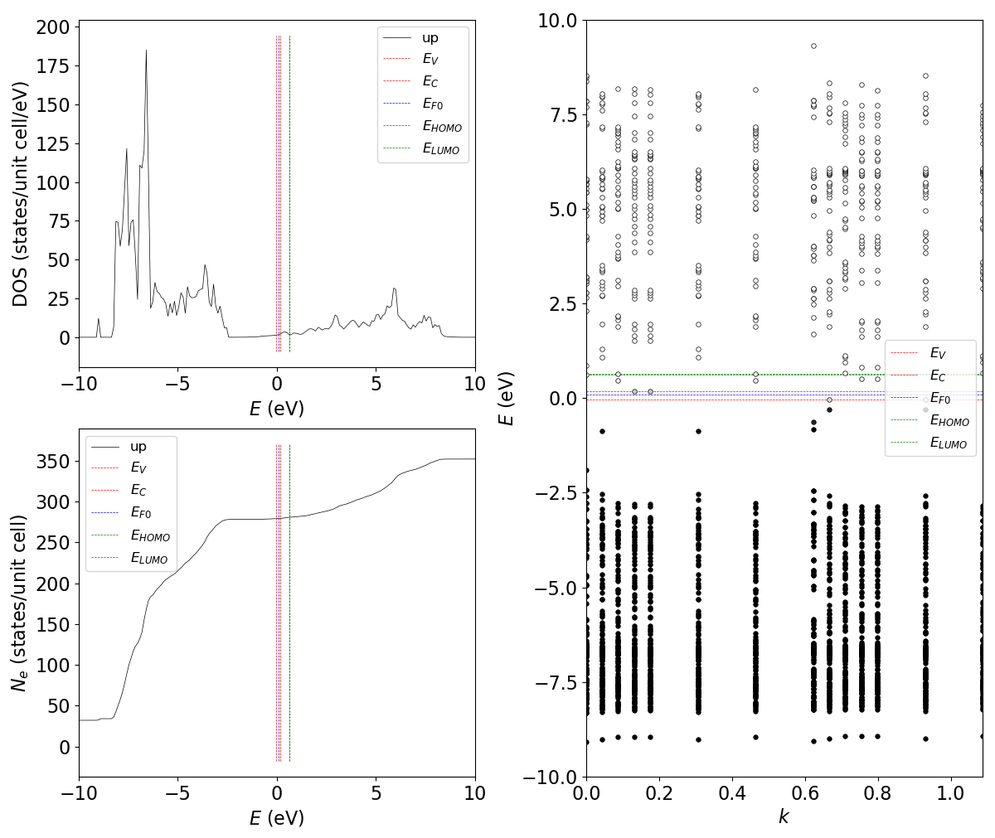
Band filling correction: Ga_{Zn}⁰
vasp_correction_bandfilling-test.bat
python vasp_correction_bandfilling.py BF .\Defect\ZnO-GaZn\SCF
Adjust EF0 so as to find appropriate EV and EC
Default EF0 is 0.1 eV, but the estimated EV seems in CB
CBM
VBM
EF0 should be between CBM and VBM
Try EF0 = -2.2 eV (next page)

Slide 15
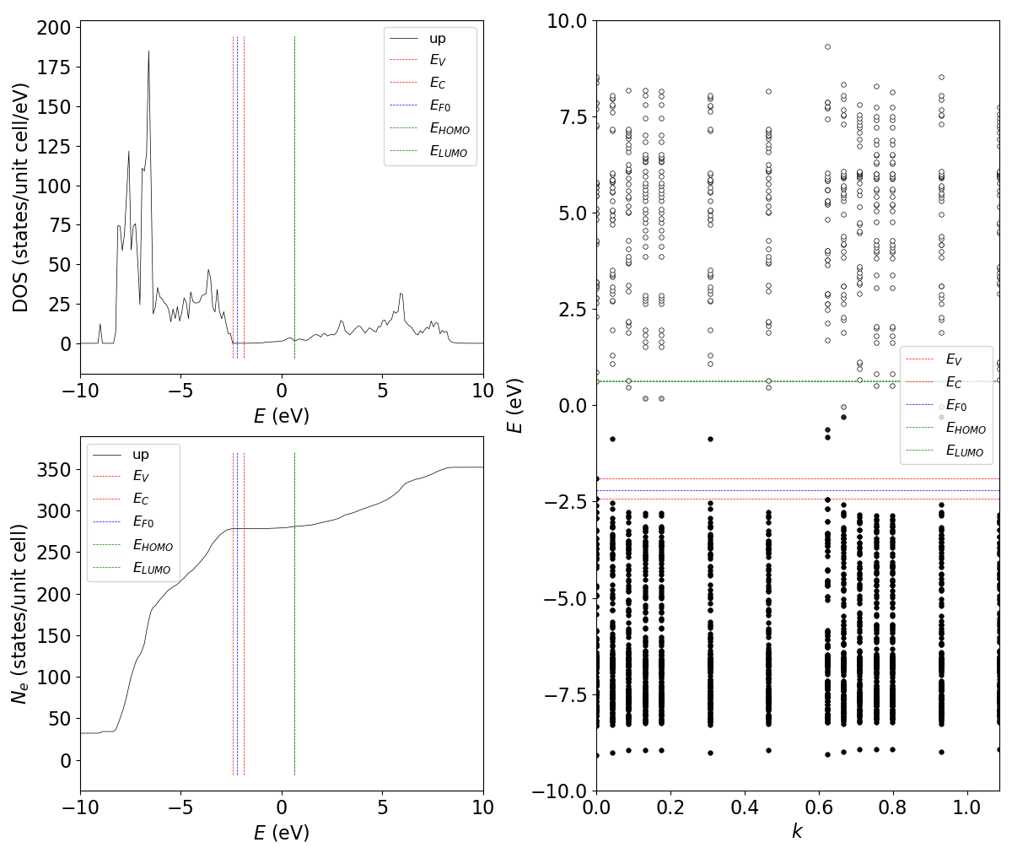
Band filling correction: Ga_{Zn}⁰
vasp_correction_bandfilling-test.bat
python vasp_correction_bandfilling.py BF .\Defect\ZnO-GaZn\SCF
Adjust EF0 so as to find appropriate EV and EC
Default EF0 is 0.1 eV, but the estimated EV seems in CB
Try EF0 = -2.2 eV
vasp_correction_bandfilling-test.bat -2.2
Output:
Total weight: 1.0
Total Ne : 139.49999999999997
NELECT : 279.0
Count spin degeneration of 2:
Total Ne : 278.99999999999994
dEh = 0 eV
dEe = 0.662459 eV
dEtot = 0.662459 eV
Count spin degeneration of 2:
dEh = 0 eV
dEe = 1.32492 eV
dEtot = 1.32492 eV

Slide 16
Charge/dipole correction: Ideal
vasp_correction_charge-test.bat
python vasp_correction_charge.py .\Defect\ZnO\DOS ε
Provide already-known dielectric constant ε
python vasp_correction_charge.py .\Defect\ZnO\DOS 12.2
Output:
*** Read dielectric constant from argument [12.2]
eps(tot): 12.2
*** Read IDIPOL information from [.\Defect\ZnO\DOS\OUTCAR]
dipolemoment: [0.0, -0.0, -6.034717]
Tr[quadrupol] : -5.863427
Ecorr(di+quadrupol): -14.4355 eV
Ecorr(with field) : 0 eV
Ecorr(charge)=q^2 * aM / L : 0 eV
NELECT = 36.0
nVe = 36.0
q = 0.0
eps(tot)= 12.2 e0
L = 3.677614306961553 A
q^2 * aM : 0
(2/3) * q^2 * aM / L / eps(tot,av): 0 eV

Slide 17
Charge/dipole correction: Ideal
vasp_correction_charge-test.bat
python vasp_correction_charge.py CAR_dir(IDIPOL) CAR_dir(Dielectric constant)
Provide CAR_dir for dielectric constant calculation
python vasp_correction_charge.py .\Defect\ZnO\DOS .\Defect\ZnO\Phonon
Output:
*** Read OUTCAR from [.\Defect\ZnO\Phonon\OUTCAR]
Information in OUTCAR:
ISPIN : 1
LEPSILON: T
e(tot): | 7.931 0 0|
| 0 7.931 0|
| -0 0 7.351|
trace average: 7.73768
e(ion): | 6.711 0 -7.6e-05|
| 0 6.711 -0.000116|
| -7.6e-05 -0.000116 7.868|
trace average: 7.09668
*** Read IDIPOL information from [.\Defect\ZnO\DOS\OUTCAR]
(cut here)
q = 0.0
eps(tot)= 7.737676333333333 e0
L = 3.677614306961553 A
q^2 * aM : 0
(2/3) * q^2 * aM / L / eps(tot,av): 0 eV

Slide 18
Charge/dipole correction: V_{O}⁺
vasp_correction_charge-test.bat
python vasp_correction_charge.py mode CAR_dir(IDIPOL) CAR_dir(Dielectric constant)
Provide CAR_dir for dielectric constant calculation
python vasp_correction_charge.py .\Defect\ZnO-VOp1\SCF .\Defect\ZnO\Phonon
Output:
*** Read OUTCAR from [.\Defect\ZnO\Phonon\OUTCAR]
Information in OUTCAR:
ISPIN : 1
LEPSILON: T
e(tot): | 7.931 0 0|
| 0 7.931 0|
| -0 0 7.351|
trace average: 7.73768
(cut)
*** Read IDIPOL information from [.\Defect\ZnO-VOp1\SCF\OUTCAR]
(cut)
Ecorr(charge)=q^2 * aM / L : 2.52695 eV
NELECT = 281.0
nVe = 282.0
q = 1.0
eps(tot)= 7.737676333333333 e0
L = 7.23325925567137 A
aM : 18.2781 eV*A
(2/3) * q^2 * aM / L / eps(tot,av): 0.217718 eV

