Slide 1

Defect calculation by VASP
Xinyi HE
2020.12.04

Slide 2
Today’s contents
How to get defect formation energy
1.How to get total energy of defect models
2.How to get chemical potential

Slide 3
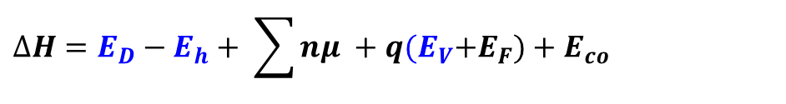

How to get defect formation energy
Defect (D) formation energy:
Energy of perfect cell
Correction Energy
$$∆H=E_{D}−E_{h}+ \sum{nμ }+q{(E}_{V}+E_{F})+E_{co}$$
Valence band maximum
Energy of defects cell
Chemical potential
$$μ ={ μ}^{el}+∆μ$$
μ^{el}: Standard chemical potential
Δμ: Chemical potential depend on growth condition

Slide 4
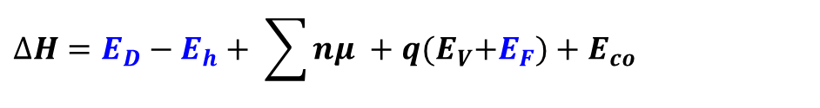
How to get defect formation energy
Defect (D) formation energy:
$$∆H=E_{D}−E_{h}+ \sum{nμ }+q{(E}_{V}+E_{F})+E_{co}$$
Fermi level
Unstable
q=2-
q=2+
q=1-
q=1+
q=0
Transition levels
Stable

Slide 5
How to get defect formation energy
Defect (D) formation energy:
Energy of perfect cell
$$∆H=E_{D}−E_{h}+ \sum{nμ }+q{(E}_{V}+E_{F})+E_{co}$$
Valence band maximum
Energy of defects cell
1. Calculate defect models

Slide 6
How to get defect formation energy
Defect (D) formation energy:
$$∆H=E_{D}−E_{h}+ \sum{nμ }+q{(E}_{V}+E_{F})+E_{co}$$
Chemical potential
2. Calculate chemical potential window

Slide 7
1.How to get total energy of defect models
Build a perfect supercell
Relax atomic positions (fixed cell) by GGA-PBE functional
Relaxed perfect supercell
Build the defect models
Scf-consistent calculation by HSE06 functional
Relax atomic positions (fixed cell) by GGA-PBE functional
Charged defect models
(changing NELECT in INCAR)
Get total energy E_{H}
Relaxed defect models
Scf-consistent calculation by HSE06 functional
Relax atomic positions (fixed cell) by GGA-PBE functional
Get total energy E_{d}
Relaxed Charged defect models
Scf-consistent calculation by HSE06 hybrid functional
Get total energy E_{d}

Slide 8
1.How to get total energy of defect models
Build a perfect supercell
Relax atomic positions (fixed cell) by GGA-PBE functional
Relaxed perfect supercell
Build the defect models
Scf-consistent calculation by HSE06 functional
Relax atomic positions (fixed cell) by GGA-PBE functional
Charged defect models
(changing NELECT in INCAR)
Get total energy E_{H}
Relaxed defect models
Scf-consistent calculation by HSE06 functional
Relax atomic positions (fixed cell) by GGA-PBE functional
Get total energy E_{d}
Relaxed Charged defect models
Scf-consistent calculation by HSE06 hybrid functional
Get total energy E_{d}

Slide 9
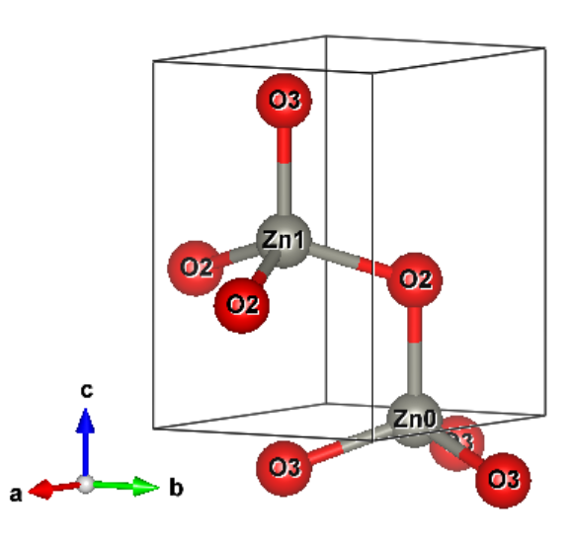
(1) How to build a perfect supercell
ZnO
1. Get the relaxed cell [CONTCAR]
(4 atoms)
2. Build the supercell by vesta or p4vasp
Note: if it occurs errors when open CONTCAR in vesta, please rename CONTCAR to CONTCAR.vasp
How to determine the supercell size
(Test energy VS supercell size)
n×a → 15 Å
Eg:
a=b=3.3 Å
c=5.3 Å
4×4×3 supercell (192 atoms)
Open the relaxed ZnO primitive cell by vesta.

Slide 10
1.How to get total energy of defect models
Build a perfect supercell
Relax atomic positions (fixed cell) by GGA-PBE functional
Relaxed perfect supercell
Build the defect models
Scf-consistent calculation by HSE06 functional
Relax atomic positions (fixed cell) by GGA-PBE functional
Charged defect models
(changing NELECT in INCAR)
Get total energy E_{H}
Relaxed defect models
Scf-consistent calculation by HSE06 functional
Relax atomic positions (fixed cell) by GGA-PBE functional
Get total energy E_{d}
Relaxed Charged defect models
Scf-consistent calculation by HSE06 hybrid functional
Get total energy E_{d}

Slide 11
(2) How to set input files for defect calculation
1. POSCAR
2. POTCAR
3. KPOINTS
K-Points
0
Gamma-centered
1 1 1
0 0 0
4. INCAR
Relaxation calculation by GGA-PBE functional
Scf-consistent calculation by HSE06 functional
5. vasp-info
Get E_{H} , E_{D} , E_{V}

Slide 12
(2) How to set input files for defect calculation
4. INCAR
Relaxation calculation by GGA-PBE functional
Scf-consistent calculation by HSE06 hybrid functional
general:
System = xxx
ISTART = 0 ; ICHARG = 2
ENCUT = 500
ISMEAR = 0; SIGMA = 0.2
ISIF = 2
NSW = 100
IBRION = 2
EDIFF = 1E-4
EDIFFG = -0.03
LREAL= Auto
LCHARG = F
LWAVE = F
general:
System = xxx
ISTART = 0; ICHARG = 2
ENCUT = 400
ISMEAR = 0; SIGMA = 0.2
ISIF = 2
#NSW = 100
IBRION = -1
EDIFF = 1E-3
LREAL= Auto
LCHARG = F
LWAVE = F
ALGO = All
LHFCALC = .TRUE.
HFSCREEN = 0.2
PREC = Normal

Slide 13
(2) How to set input files for defect calculation
5. vasp-info
#!/bin/bash
JOB_NAME=VC-S
NUM_NODE=2
NUM_CPU=14
TIME=23:30:00
#NODE_TYPE=s_core #MAX_CPU 1
#NODE_TYPE=q_core #MAX_CPU 4
#NODE_TYPE=f_node #MAX_CPU 28 MAX_NODE 2
NODE_TYPE=h_node #MAX_CPU 14
#NODE_TYPE=q_node #MAX_CPU 7
#BIN=vasp_ncl
#BIN=vasp_gpu
MAIL_TYPE=abe
MAIL_ADDR=h-xinyi@mces.titech.ac.jp
BIN=vasp_gam #vasp_std
LOG=vasp.log
GROUP=tgd-mts
BIN_DIR=/gs/hs0/tgd-mts/bin/
~
Gamma-only

Slide 14
(2) How to set input files for defect calculation
Get E_{H}, E_{V} from the perfect supercell
Get E_{H}
grep ' without' OUTCAR |tail -n 1 | awk '{print $7}'
Get E_{v}
python gbandedges
Efermi : 0.624
N band : 1036
N kpoint: 1
N spin : 1
Band gap: 2.403
Bottom of conduction band:
Energy : 1.993
K point: 1 ['0.1262379E-14', '0.1262379E-14', '0.1262379E-14']
Band : 865
Spin : 1
Top of valence band:
Energy : -0.410
K point: 1 ['0.1262379E-14', '0.1262379E-14', '0.1262379E-14']
Band : 864
Spin : 1
gbandedges in /gs/hs0/tgd-mts/Data
E_{v}

Slide 15
1.How to get total energy of defect models
Build a perfect supercell
Relax atomic positions (fixed cell) by GGA-PBE functional
Relaxed perfect supercell
Build the defect models
Scf-consistent calculation by HSE06 functional
Relax atomic positions (fixed cell) by GGA-PBE functional
Charged defect models
(changing NELECT in INCAR)
Get total energy E_{H}
Relaxed defect models
Scf-consistent calculation by HSE06 functional
Relax atomic positions (fixed cell) by GGA-PBE functional
Get total energy E_{d}
Relaxed Charged defect models
Scf-consistent calculation by HSE06 hybrid functional
Get total energy E_{d}

Slide 16
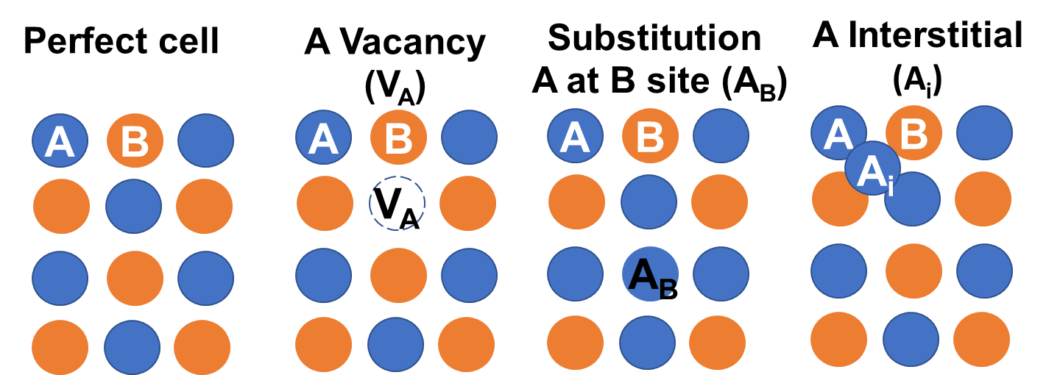
(3) How to build defect models
Intrinsic point defects in ZnO:
Vacancy: V_{Zn}, V_{O}
Substitution: Zn_{O}, O_{Zn}
Interstitial: Zn_{i}, O_{i}
So, we need to build 6 defect models.
Open the relaxed ZnO perfect cell by vesta.

Slide 17
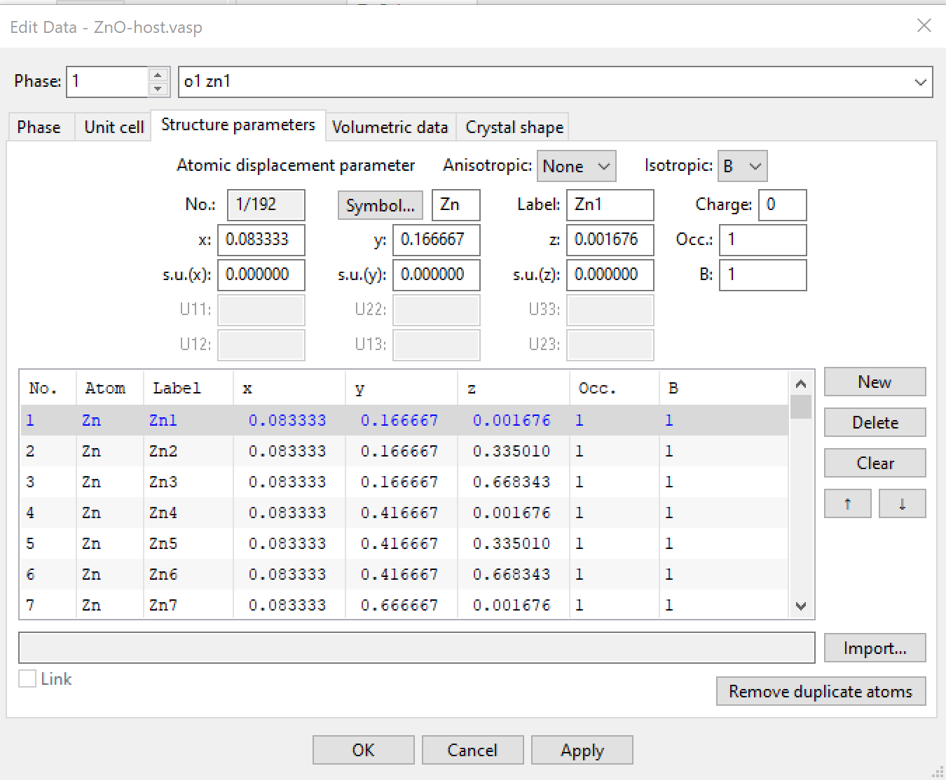
(3) How to build defect models
Intrinsic point defects in ZnO:
Vacancy: V_{Zn}, V_{O}
Substitution: Zn_{O}, O_{Zn}
Interstitial: Zn_{i}, O_{i}
V_{Zn}
1
2
3

Slide 18
(3) How to build defect models
Intrinsic point defects in ZnO:
Vacancy: V_{Zn}, V_{O}
Substitution: Zn_{O}, O_{Zn}
Interstitial: Zn_{i}, O_{i}
2. Change to O
O_{Zn}
1
3

Slide 19
(3) How to build defect models
Intrinsic point defects in ZnO:
Vacancy: V_{Zn}, V_{O}
Substitution: Zn_{O}, O_{Zn}
Interstitial: Zn_{i}, O_{i}
O_{Zn}
1

Slide 20
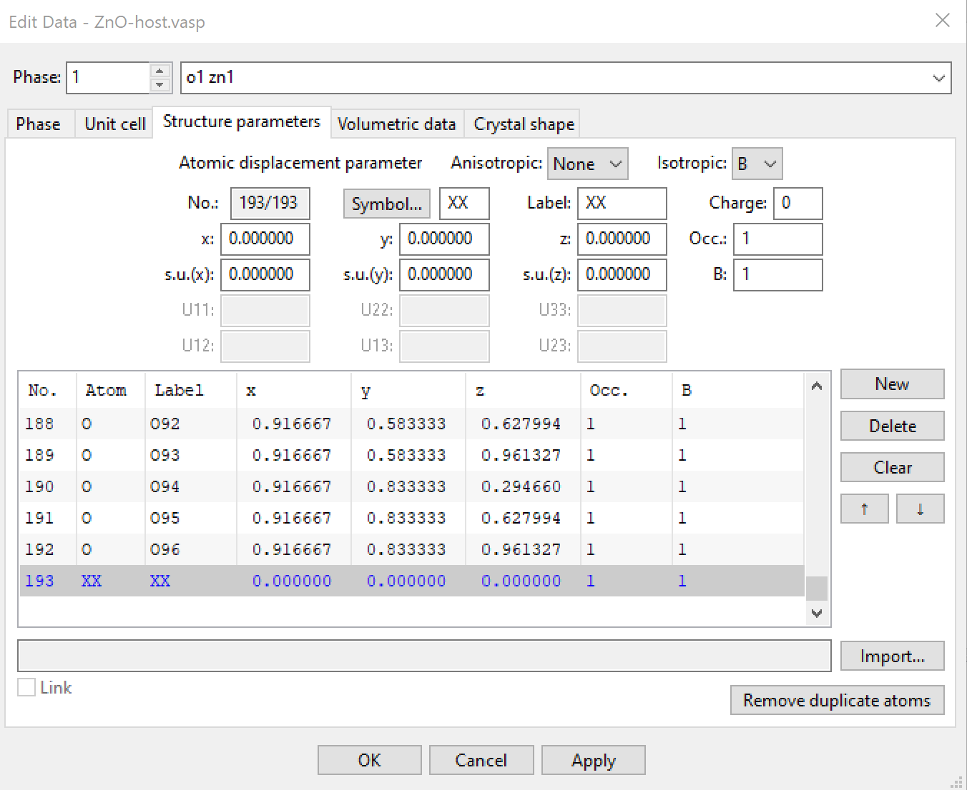
(3) How to build defect models
Intrinsic point defects in ZnO:
Vacancy: V_{Zn}, V_{O}
Substitution: Zn_{O}, O_{Zn}
Interstitial: Zn_{i}, O_{i}
O_{i}
2. Add interstitial O

Slide 21
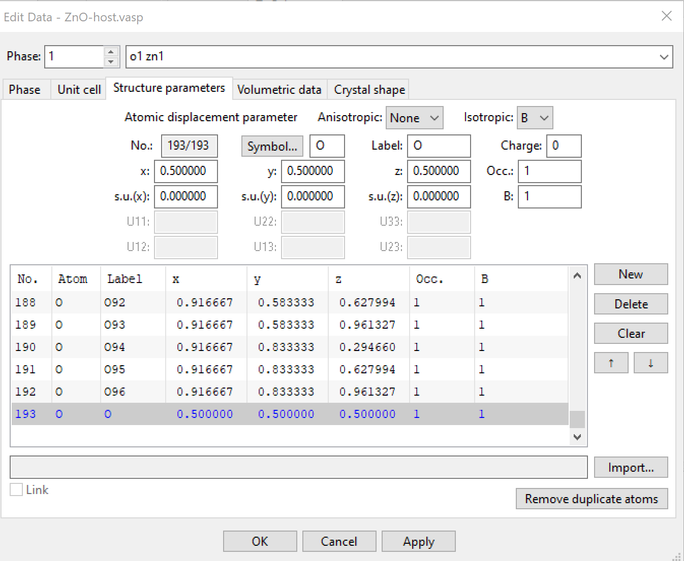
(3) How to build defect models
Intrinsic point defects in ZnO:
Vacancy: V_{Zn}, V_{O}
Substitution: Zn_{O}, O_{Zn}
Interstitial: Zn_{i}, O_{i}
O_{i}
2. Add interstitial O
3

Slide 22
1.How to get total energy of defect models
Build a perfect supercell
Relax atomic positions (fixed cell) by GGA-PBE functional
Relaxed perfect supercell
Build the defect models
Scf-consistent calculation by HSE06 functional
Relax atomic positions (fixed cell) by GGA-PBE functional
Charged defect models
(changing NELECT in INCAR)
Get total energy E_{H}
Relaxed defect models
Scf-consistent calculation by HSE06 functional
Relax atomic positions (fixed cell) by GGA-PBE functional
Get total energy E_{d}
Relaxed Charged defect models
Scf-consistent calculation by HSE06 hybrid functional
Get total energy E_{d}

Slide 23
1.How to get total energy of defect models
Build a perfect supercell
Relax atomic positions (fixed cell) by GGA-PBE functional
Relaxed perfect supercell
Build the defect models
Scf-consistent calculation by HSE06 functional
Relax atomic positions (fixed cell) by GGA-PBE functional
Charged defect models
(changing NELECT in INCAR)
Get total energy E_{H}
Relaxed defect models
Scf-consistent calculation by HSE06 functional
Relax atomic positions (fixed cell) by GGA-PBE functional
Get total energy E_{d}
Relaxed Charged defect models
Scf-consistent calculation by HSE06 hybrid functional
Get total energy E_{d}

Slide 24
(4) How to set input files for charged defect
1. POSCAR
2. POTCAR
Keep
3. KPOINTS
K-Points
0
Gamma-centered
1 1 1
0 0 0
4. INCAR
Change NELECT tag
Relaxation calculation
Scf-consistent calculation
Get E_{D}

Slide 25
(4) How to set input files for charged defect
4. INCAR for charged defect cells
Check NELECT from defect model calculation:
Eg: NELECT = 70; 1+ states: NELECT = 69; 1- states: NELECT = 71.
grep NELECT OUTCAR
Relaxation calculation by GGA-PBE functional
Scf-consistent calculation by HSE06 hybrid functional
general:
System = xxx
NELECT =
ISTART = 0 ; ICHARG = 2
ENCUT = 500
ISMEAR = 0; SIGMA = 0.2
ISIF = 2
NSW = 100
IBRION = 2
EDIFF = 1E-4
EDIFFG = -0.03
LREAL= Auto
LCHARG = F
LWAVE = F
general:
System = xxx
NELECT =
ISTART = 0; ICHARG = 2
ENCUT = 400
ISMEAR = 0; SIGMA = 0.2
ISIF = 2
#NSW = 100
IBRION = -1
EDIFF = 1E-3
LREAL= Auto
LCHARG = F
LWAVE = F
ALGO = All
LHFCALC = .TRUE.
HFSCREEN = 0.2
PREC = Normal

Slide 26
1.How to get total energy of defect models
Build a perfect supercell
Relax atomic positions (fixed cell) by GGA-PBE functional
Relaxed perfect supercell
Build the defect models
Scf-consistent calculation by HSE06 functional
Relax atomic positions (fixed cell) by GGA-PBE functional
Charged defect models
(changing NELECT in INCAR)
Get total energy E_{H} E_{v}
Relaxed defect models
Scf-consistent calculation by HSE06 functional
Relax atomic positions (fixed cell) by GGA-PBE functional
Get total energy E_{d}
Relaxed Charged defect models
Scf-consistent calculation by HSE06 hybrid functional
Get total energy E_{d}

Slide 27
(4) How to set input files for charged defect
Some errors may occur in the VASP calculation process
VERY BAD NEWS! internal error in subroutine INVGRP:
inverse of rotation matrix was not found (increase SYMPREC) 3
Set SYMPREC=1E-3 in INCAR

Slide 28
How to get defect formation energy
Defect (D) formation energy:
$$∆H=E_{D}−E_{h}+ \sum{nμ }+q{(E}_{V}+E_{F})+E_{co}$$
Chemical potential
2. Calculate chemical potential window

Slide 29
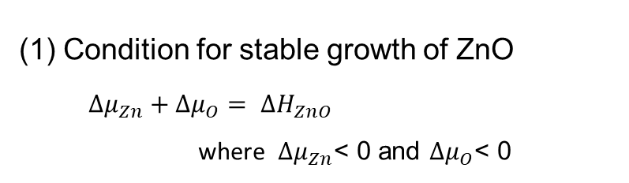

2.How to get chemical potential
Chemical potential
$$μ ={ μ}^{el}+∆μ$$
μ^{el}: Standard chemical potential of elements ← total energy eg: μ^{Zn}=E(Zn)
Δμ: Chemical potential depend on growth condition ←chemical potential window
Chemical potential window
(1) Condition for stable growth of ZnO
$∆μ_{Zn}+∆μ_{O}= ∆H_{ZnO}$
where $∆μ_{Zn}$< 0 and $∆μ_{O}$< 0

Slide 30
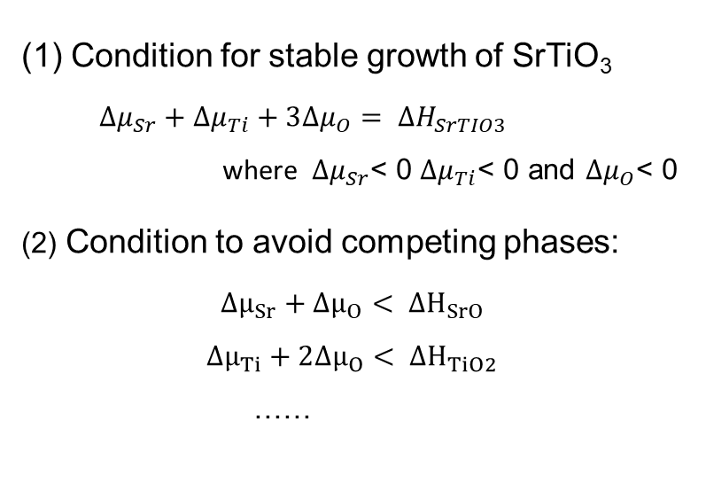
2.How to get chemical potential
Chemical potential
$$μ ={ μ}^{el}+∆μ$$
μ^{el}: Standard chemical potential of elements ← total energy eg: μ^{Zn}=E(Zn)
Δμ: Chemical potential depend on growth condition ←chemical potential window
Chemical potential window
(1) Condition for stable growth of SrTiO₃
$∆μ_{Sr}+∆μ_{Ti}+3∆μ_{O}= ∆H_{SrTIO3}$
where $∆μ_{Sr}$< 0 $∆μ_{Ti}$< 0 and $∆μ_{O}$< 0
(2) Condition to avoid competing phases:
$∆μ_{Sr}+∆μ_{O}< ∆H_{SrO}$
$$∆μ_{Ti}+2∆μ_{O}< ∆H_{TiO2 }$$
……
Calculate the total energy of
elemental phases and competing phases
Check in Materials Projects

Slide 31
2.How to get chemical potential
Calculate the total energy of
elemental phases and competing phases
Get chemical potential window by Chesta
Download Chesta in /gs/hs0/tgd-mts/Data
Open chemicalwindow-2e.xlsx in Chesta3.2.6.9 folder
データファイル作成ウィザード3.xls
Chesta3.exe

Slide 32
How to get defect formation energy
Defect (D) formation energy:
Energy of perfect cell
Correction Energy
$$∆H=E_{D}−E_{h}+ \sum{nμ }+q{(E}_{V}+E_{F})+E_{co}$$
Valence band maximum
Energy of defects cell
Chemical potential
Use defect_anlysis.xlsx in in /gs/hs0/tgd-mts/Data

Slide 33
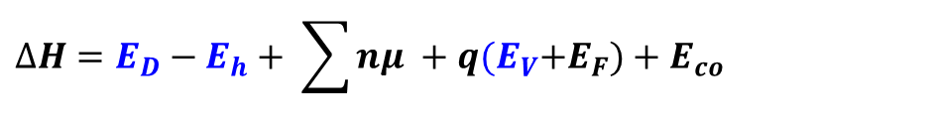
1. H, O, F doping-Interstitial sites
Summary
How to get defect formation energy
1.How to get total energy of defect models
2.How to get chemical potential
Energy of perfect cell
Correction Energy
$$∆H=E_{D}−E_{h}+ \sum{nμ }+q{(E}_{V}+E_{F})+E_{co}$$
Valence band maximum
Energy of defects cell
Chemical potential

Slide 34
DFT calculation by VASP
Xinyi HE
2020.11.27

Slide 35
The linux command
Change folders: cd
Rename folder/file names: mv
Copy files: cp
Copy folders recursively with tree: cp -r
Create folders: mkdir
Remove files: rm
Remove folders: rm -r
Show files in the current folder: ls
Edit a txt file: vi → a (append) → :wq(save the file) / :q!(not save and quit)

Slide 36
The needed softwares
P4vasp:
Edit/show the crystal structures (POSCAR/CONTCAR)
Show DOS or band structures (vasprun.xml)
Use for example [p4v POSCAR; p4v vasprun.xml]
Vesta:
Edit/show the crystal structures (POSCAR/CONTCAR)
Change format .cif → .vasp
Use as [vesta POSCAR]

Slide 37
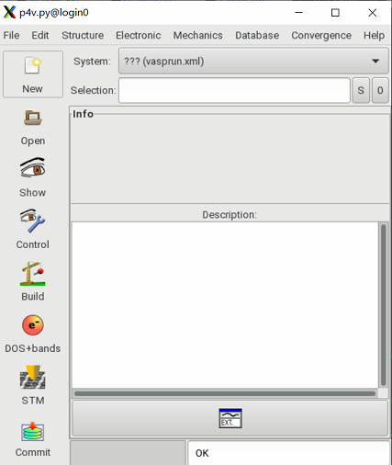
The needed software
P4vasp:
Edit/show the crystal structures (POSCAR/CONTCAR)
Show DOS or band structures (vasprun.xml)
Use as [p4v POSCAR; p4v vasprun.xml]

Slide 38
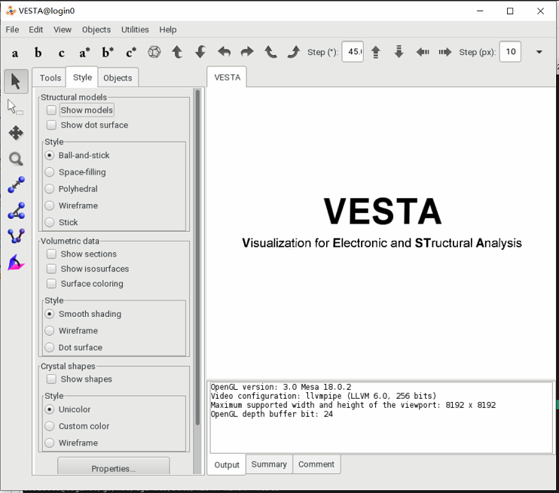


The needed software
Vesta:
In linux system:
Use as [vesta POSCAR]
vi ~/.bashrc
a
export VESTA=/gs/hs0/tgd-mts/VESTA-x86_64
export PATH="$PATH:$VESTA"
alias vesta='/gs/hs0/tgd-mts/VESTA-x86_64/VESTA’
(cat /gs/hs0/tgd-mts/Data/vesta-info)
:wq
chmod 777 -R /gs/hs0/tgd-mts/VESTA-x86_64/
vesta
In Windows system:
Download /gs/hs0/tgd-mts/Data/VESTA-win64
Enter VESTA-win64 and click VESTA.exe

Slide 39
Input/output files
INCAR in
POTCAR in
KPOINTS in
POSCAR in
CHGCAR in/out
WAVECAR in/out
IBZKPT out
CONTCAR out
OUTCAR out
CHG out
EIGENVAL out
DOSCAR out
PROCAR out
OSZICAR out
PCDAT out
XDATCAR out

Slide 40
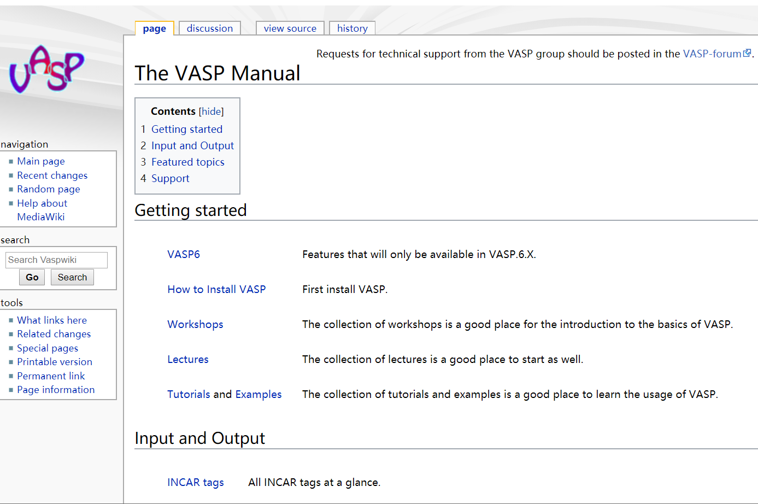
Input/output files
https://www.vasp.at/wiki/index.php/The_VASP_Manual

Slide 41
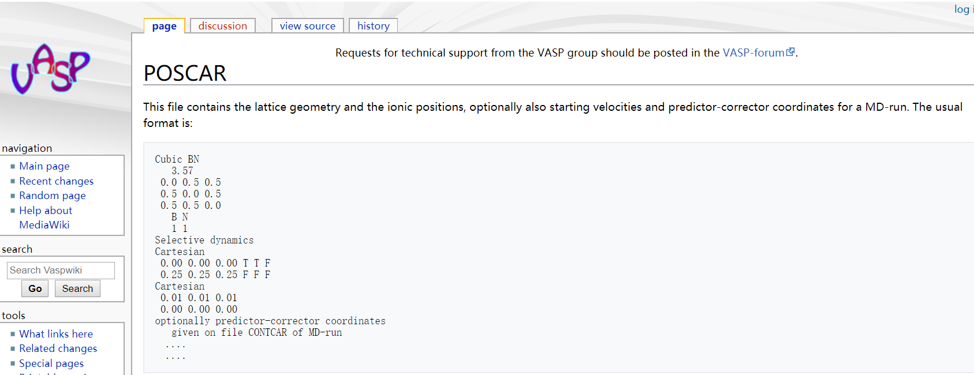
Input/output files
https://www.vasp.at/wiki/index.php/The_VASP_Manual

Slide 42
Input files
1. POSCAR: Crystal structure
2. POTCAR: Pseudopotential
3. KPOINTS: K-points
4. INCAR: Calculation setting
5. vasp-info: Submit script, called from qvasp

Slide 43
Input files
POSCAR
The lattice constant and the atomic positions
POSCAR of ZnO:
Zn2 O2 # system information
1.0 # universal scaling parameters
3.2891025543 0.0000000000 0.0000000000 # lattice vector
-1.6445512772 2.8484463677 0.0000000000
0.0000000000 0.0000000000 5.3068208694
Zn O # elements
2 2 # number of atoms
Direct # positions in Fractional coordinates / if it’s Cartesian, it means Cartesian coordinates
0.333333340 0.666666681 0.000548000 # atomic position #Zn1
0.666666706 0.333333340 0.500548017 #Zn2
0.333333340 0.666666681 0.379761996 #O1
0.666666706 0.333333340 0.879761996 #O2

Slide 44
Input files
POSCAR
The lattice constant and the atomic positions
POSCAR of ZnO:
Zn2 O2 # system information
1.0 # universal scaling parameters
3.2891025543 0.0000000000 0.0000000000 # lattice vector
-1.6445512772 2.8484463677 0.0000000000
0.0000000000 0.0000000000 5.3068208694
Zn O # elements
2 2 # number of atoms
Cartesian # positions in Cartesian coordinates
0.000000000 1.898964286 0.002908138 # atomic position #Zn1
1.644551396 0.949482143 2.656318665 #Zn2
0.000000000 1.898964286 2.015328884 #O1
1.644551396 0.949482143 4.668739319 #O2

Slide 45
Input files
POSCAR
The lattice constant and the atomic positions
How to get POSCAR:
Get the experimental data and edit by self
(need the lattice constant and the atomic positions )
2. From database
(1) Materials Project https://materialsproject.org/
format transfer: cif→vasp (by vesta)
(2) ICSD

Slide 46
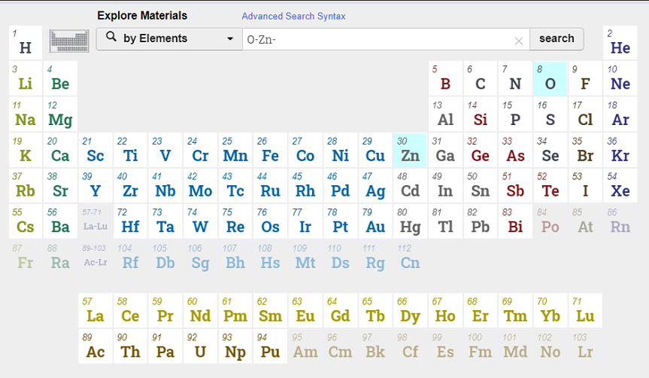
Input files
POSCAR
The lattice constant and the atomic positions
How to get POSCAR:
2. From database
(1) Materials Project https://materialsproject.org/
1
3
2

Slide 47
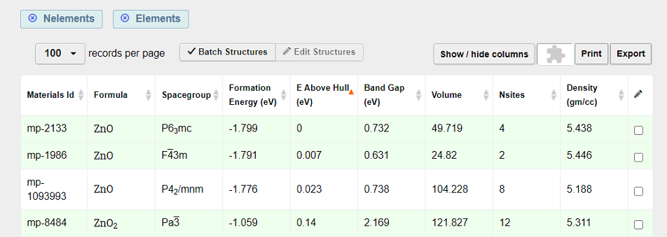
Input files
POSCAR
The lattice constant and the atomic positions
How to get POSCAR:
2. From database
(1) Materials Project https://materialsproject.org/

Slide 48
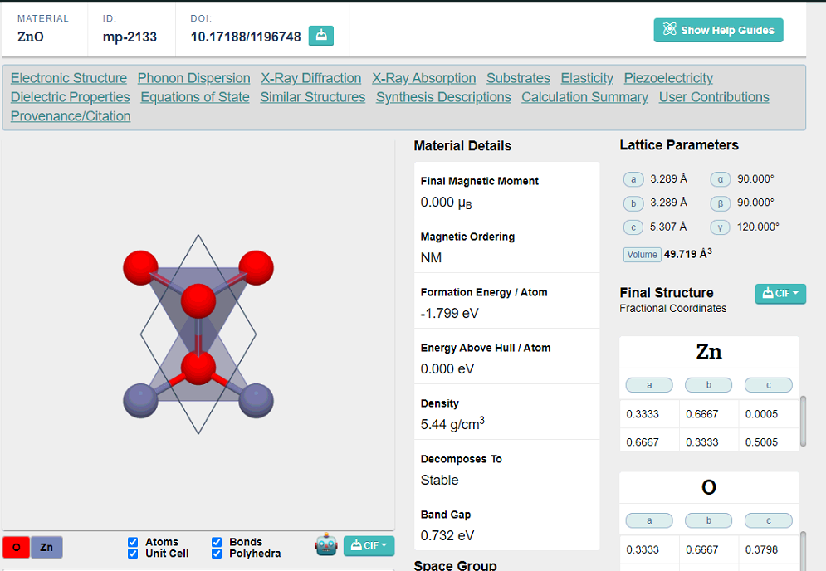
Input files
POSCAR
The lattice constant and the atomic positions
How to get POSCAR:
2. From database
(1) Materials Project https://materialsproject.org/

Slide 49
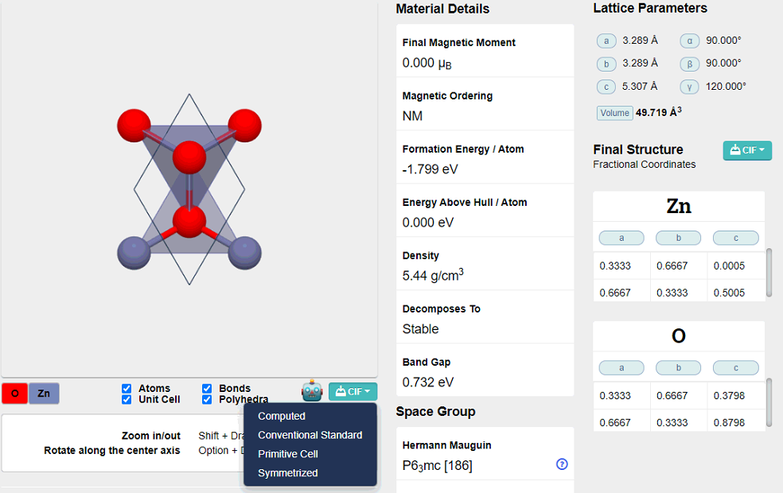
Input files
POSCAR
The lattice constant and the atomic positions
How to get POSCAR:
2. From database
(1) Materials Project https://materialsproject.org/
Get cif file

Slide 50
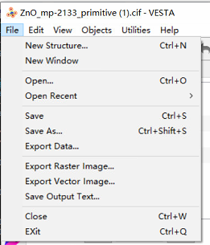
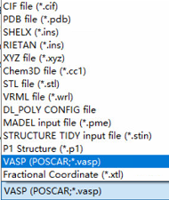
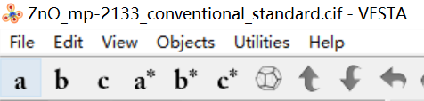
Input files
POSCAR
The lattice constant and the atomic positions
How to get POSCAR:
2. From database
(1) Materials Project https://materialsproject.org/
format transfer: cif→vasp (by vesta)
vesta xx.cif or
File→export→.vasp
1
2
3

Slide 51
Input files
POTCAR
The mass, valence, pseudopotential for each element.
PAW_PBE Fe 06Sep2000
8.00000000000000000
parameters from PSCTR are:
VRHFIN =Fe: d7 s1
LEXCH = PE
EATOM = 594.4687 eV, 43.6922 Ry
TITLE = PAW_PBE Fe 06Sep2000
LULTRA = F use ultrasoft PP
IUNSCR = 1 unscreen: 0-lin 1-nonlin 2-no
RPACOR = 2.000 partial core radius
POMASS = 55.847; ZVAL = 8.000 mass and valenz
RCORE = 2.300 outmost cutoff radius
RWIGS = 2.460; RWIGS = 1.302 wigner-seitz radius (au A)
ENMAX = 267.883; ENMIN = 200.912 eV
RCLOC = 1.701 cutoff for local pot
LCOR = T correct aug charges
LPAW = T paw PP
EAUG = 511.368
…
VRHFIN: valence electron configuration
TITEL: which element
ZVAL: valence electron number
ENMAX: cutoff energy

Slide 52
Input files
POTCAR
The mass, valence, pseudopotential for each element.
How to get POTCAR:
From POT folder: /pwd/= /gs/hs0/tgd-mts/POT/potpaw_PBE54/elements
cat /pwd/Zn/POTCAR /pwd/O/POTCAR > POTCAR
potcar.sh
(mkdir ~/bin; cp /gs/hs0/tgd-mts/Data/potcar.sh ~/bin; chmod u+x ~/bin/potcar.sh)
potcar.sh Zn O
grep TIT POTCAR
[he@csrv7 1-relax]$ grep TIT POTCAR
TITEL = PAW_PBE Zn 06Sep2000
TITEL = PAW_PBE O 08Apr2002

Slide 53
Input files
POTCAR
The mass, valence, pseudopotential for each element.
How to get POTCAR:
For some elements, there are several POTCAR versions
Eg: cd /gs/hs0/tgd-mts/POT/potpaw_PBE54/elements/; ls Ti*
19D28063@login0:/gs/hs0/tgd-mts/Data> cd /gs/hs0/tgd-mts/POT/potpaw_PBE54/elements/
19D28063@login0:/gs/hs0/tgd-mts/POT/potpaw_PBE54/elements> ls Ti*
Ti:
POTCAR PSCTR
Ti_pv:
POTCAR PSCTR
Ti_sv:
POTCAR PSCTR
Ti_sv_GW:
POTCAR PSCTR
_pv and _sv: treat the p and s semi-core states as valence states
(i.e. for Ti_pv the 3p states are treated as valence states,
and for Ti_sv the 3s and 3p states are treated as valence states).
_d: treat the d semi core states as valence states
(i.e. for Ga d the 3d states are treated as valence states)
Recommended POTCAR: /gs/hs0/tgd-mts/Data/POTCAR.pdf

Slide 54
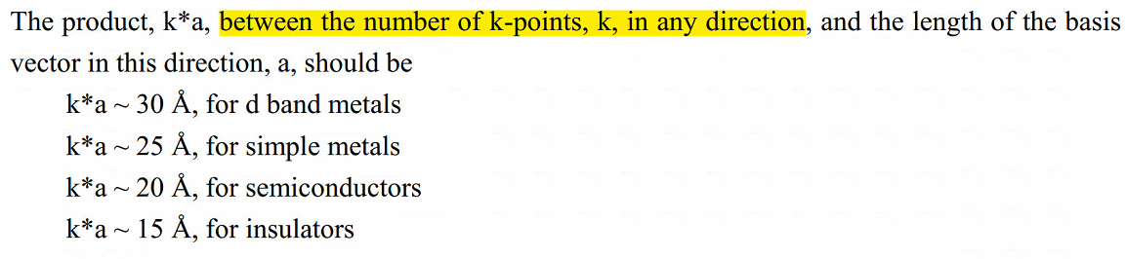
Input files
KPOINTS
The Bloch vectors (k-points) that will be used to sample the Brillouin zone
K-POINTS # Comment
0 # automatic generation of k-points
Gamma # gamma-centered
4 4 4 # grid 4x4x4
0 0 0 # shift (usually 0 0 0)
KPOINTS for the DOS calculation: denser k-points

Slide 55
Input files
KPOINTS
The Bloch vectors (k-points) that will be used to sample the Brillouin zone
K-POINTS # Comment
0 # automatic generation of k-points
Gamma # gamma-centered
4 4 4 # grid 4x4x4
0 0 0 # shift (usually 0 0 0)
kpoints.sh
(cp /gs/hs0/tgd-mts/Data/kpoints.sh ~/bin; chmod u+x ~/bin/kpoints.sh )
kpoints.sh 4 4 4
cat KPOINTS
19D28063@login0:/gs/hs0/tgd-mts/Data> kpoints.sh 4 4 4
19D28063@login0:/gs/hs0/tgd-mts/Data> cat KPOINTS
K-Points
0
Gamma-centered
4 4 4
0 0 0

Slide 56
Input files
KPOINTS
The Bloch vectors (k-points) that will be used to sample the Brillouin zone
KPOINTS for the band structure calculation:
K-Path # comment
20 # 20 intersections, 20 k-points between two high symmetry points
Line-Mode # line mode to generate k-points
Reciprocal # reciprocal coordinates
0.0000000000 0.0000000000 0.0000000000 G # high symmetry point
0.0000000000 0.5000000000 0.0000000000 X # band along G→X
0.0000000000 0.5000000000 0.0000000000 X
0.5000000000 0.5000000000 0.0000000000 M
0.5000000000 0.5000000000 0.0000000000 M
0.0000000000 0.0000000000 0.0000000000 G
0.0000000000 0.0000000000 0.0000000000 G
0.5000000000 0.5000000000 0.5000000000 R

Slide 57
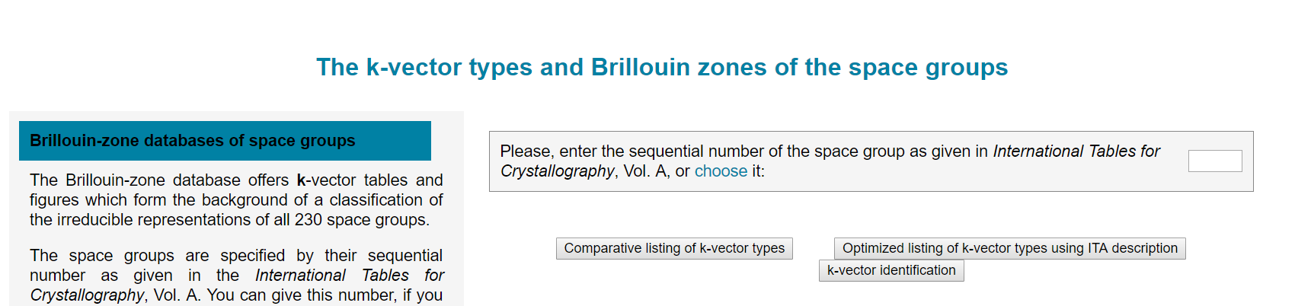
Input files
KPOINTS
The Bloch vectors (k-points) that will be used to sample the Brillouin zone
KPOINTS for the band structure calculation:
https://www.cryst.ehu.es/cgi-bin/cryst/programs/nph-kv-list
1. Input space group
2.Click

Slide 58
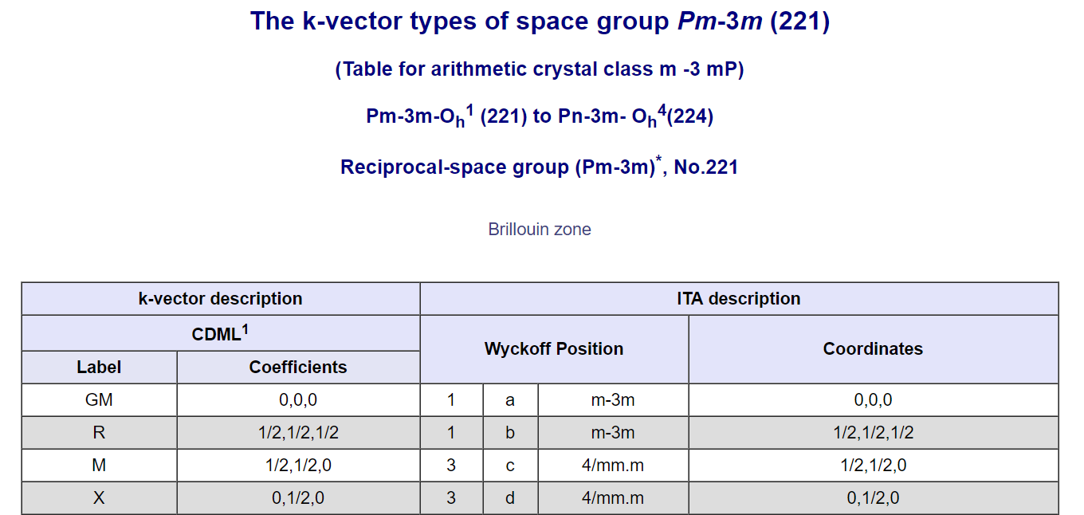
Input files
KPOINTS
The Bloch vectors (k-points) that will be used to sample the Brillouin zone
KPOINTS for the band structure calculation:
https://www.cryst.ehu.es/cgi-bin/cryst/programs/nph-kv-list
Click

Slide 59
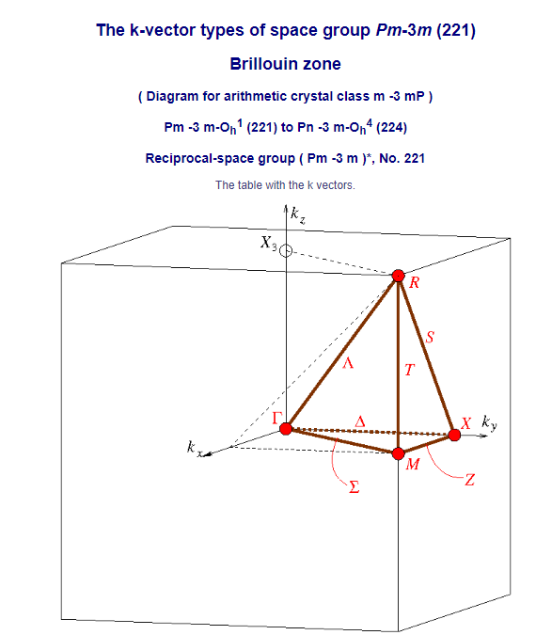
Input files
KPOINTS
The Bloch vectors (k-points) that will be used to sample the Brillouin zone
KPOINTS for the band structure calculation:
https://www.cryst.ehu.es/cgi-bin/cryst/programs/nph-kv-list

Slide 60
Input files
INCAR
Tell VASP what to calculate and how to calculate
general:
System = ZnO
ENCUT = 550
ISMEAR = 0
ISIF = 3
NSW = 100
IBRION = 2
EDIFF = 1E-6
EDIFFG = -0.01
LWAVE = F
LCHARG = F
OK to input “space” before or after “=”
eg: ISMEAR=0 and ISMEAR = 0 ----same
Don’t use “tab”，use “space”.

Slide 61
Input files
INCAR
Tell VASP what to calculate and how to calculate
general:
System = ZnO
ENCUT = 550
ISMEAR = 0
(SIGMA = 0.1)
ISIF = 3
NSW = 100
IBRION = 2
EDIFF = 1E-6
EDIFFG = -0.01
LWAVE = F
LCHARG = F
System: what to calculate, can be random, no effect to the result

Slide 62
Input files
INCAR
Tell VASP what to calculate and how to calculate
general:
System = ZnO
ENCUT = 550
ISMEAR = 0
(SIGMA = 0.1)
ISIF = 3
NSW = 100
IBRION = 2
EDIFF = 1E-6
EDIFFG = -0.01
LWAVE = F
LCHARG = F
ENCUT specifies the cutoff energy for the planewave basis set in eV. Default: ENCUT = largest ENMAX on the POTCAR file
(grep ENMAX POTCAR)
If ISIF=3 (relax the cell), ENCUT > 1.3* ENMAX
[he@csrv7 1-relax]$ grep ENMAX POTCAR
ENMAX = 276.723; ENMIN = 207.542 eV
ENMAX = 400.000; ENMIN = 300.000 eV

Slide 63
Input files
INCAR
Tell VASP what to calculate and how to calculate
general:
System = ZnO
ENCUT = 550
ISMEAR = 0
(SIGMA = 0.1)
ISIF = 3
NSW = 100
IBRION = 2
EDIFF = 1E-6
EDIFFG = -0.01
LWAVE = F
LCHARG = F
ISMEAR: determines how the partial occupancies for each orbital.
For semiconductors or insulators with large kpoints: ISMEAR=-5 (tetrahedron method, more accurate for simple band structures
For large supercells and Gamma-point only calc: ISMEAR=0 (Gaussian smearing)
For metals: ISMEAR=0 (Gaussian smearing) or 1
For DOS cal.: ISMEAR= -5 or 0
if k-points < 3, must use ISMEAR= 0

Slide 64
Input files
INCAR
Tell VASP what to calculate and how to calculate
general:
System = ZnO
ENCUT = 550
ISMEAR = 0
ISIF = 3
NSW = 100
IBRION = 2
EDIFF = 1E-6
EDIFFG = -0.01
LWAVE = F
LCHARG = F
ISIF: determines whether the stress tensor is calculated.
=3: relax the lattice constant and atomic positions
=2: only relax the atomic positions

Slide 65
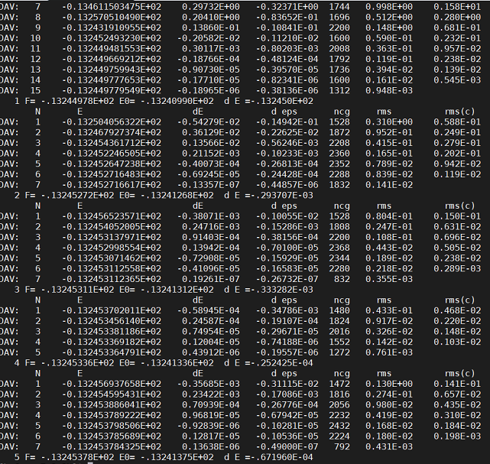
Input files
INCAR
Tell VASP what to calculate and how to calculate
general:
System = ZnO
ENCUT = 550
ISMEAR = 0
ISIF = 3
NSW = 100
IBRION = 2
EDIFF = 1E-6
EDIFFG = -0.01
LWAVE = F
LCHARG = F
NSW: the maximum number of ionic steps.
ionic steps

Slide 66
Input files
INCAR
Tell VASP what to calculate and how to calculate
general:
System = ZnO
ENCUT = 550
ISMEAR = 0
ISIF = 3
NSW = 100
IBRION = 2
EDIFF = 1E-6
EDIFFG = -0.01
LWAVE = F
LCHARG = F
IBRION: how the ions are updated and moved.
IBRION=2

Slide 67
Input files
INCAR
Tell VASP what to calculate and how to calculate
general:
System = ZnO
ENCUT = 550
ISMEAR = 0
ISIF = 3
NSW = 100
IBRION = 2
EDIFF = 1E-6
EDIFFG = -0.01
LWAVE = F
LCHARG = F
EDIFF: the global break condition for the electronic SC-loop.
Default: EDIFF = 1E-4
EDIFF = 1E-6
EDIFFG: the break condition for the ionic relaxation loop.
Default: EDIFFG = EDIFF×10
EDIFFG = -0.01 # this case the relaxation will stop if all forces are smaller than |EDIFFG| . This is usually a more convenient setting.

Slide 68
Input files
INCAR
Tell VASP what to calculate and how to calculate
general:
System = ZnO
ENCUT = 550
ISMEAR = 0
ISIF = 3
NSW = 100
IBRION = 2
EDIFF = 1E-6
EDIFFG = -0.01
LWAVE = F
LCHARG = F
LWAVE: whether the wavefunctions are written to the WAVECAR file
LCHARG: whether the charge densities (CHGCAR and CHG) are written
Default: LWAVE=T; LCHARG=T
In order to save memory space, not write WAVECAR, CHGCAR and CHG

Slide 69
Input files
vasp-info
#!/bin/bash
JOB_NAME=VC-S
NUM_NODE=4
NUM_CPU=7
TIME=01:00:00
#NODE_TYPE=s_core #MAX_CPU 1
#NODE_TYPE=q_core #MAX_CPU 4
#NODE_TYPE=f_node #MAX_CPU 28 #NODE_TYPE=h_node #MAX_CPU 14
NODE_TYPE=q_node #MAX_CPU 7
#BIN=vasp_ncl
#BIN=vasp_gpu
MAIL_TYPE=abe
MAIL_ADDR=xx@mces.titech.ac.jp
BIN=vasp_std
LOG=vasp.log
GROUP=tgd-mts
BIN_DIR=/gs/hs0/tgd-mts/bin/
cp /gs/hs0/tgd-mts/Data/vasp-info .
Use vasp by qvasp
qstate: check the task state
qdel: delete the task

Slide 70
Output files
1. CONTCAR: relaxed crystal structure
2. OUTCAR: detailed output of a VASP run

Slide 71
Output files
CONTCAR
The lattice constant and the atomic positions
eg:
Zn2 O2 # system information
1.0 # universal scaling parameters
3.2891025543 0.0000000000 0.0000000000 # lattice vector
-1.6445512772 2.8484463677 0.0000000000
0.0000000000 0.0000000000 5.3068208694
Zn O # elements
2 2 # number of atoms
Direct # positions in Fractional coordinates / if it’s Cartesian, it means cartesian coordinates
0.333333340 0.666666681 0.000548000 # atomic position #Zn1
0.666666706 0.333333340 0.500548017 #Zn2
0.333333340 0.666666681 0.379761996 #O1
0.666666706 0.333333340 0.879761996 #O2

Slide 72
Output files
OUTCAR
Detailed output of a VASP run:
A summary of the used input parameters.
The electronic steps, KS-eigenvalues.
Stress tensors.
Forces on the atoms.
Local charges and magnetic moments.
Dielectric properties
…
Energy:
FREE ENERGIE OF THE ION-ELECTRON SYSTEM (eV)
---------------------------------------------------
free energy TOTEN = -39.74588443 eV
energy without entropy= -39.74588443 energy(sigma->0) = -39.74588443
Time:
Total CPU time used (sec): 4.879
User time (sec): 4.823

Slide 73
Output files
OUTCAR
Energy:
FREE ENERGIE OF THE ION-ELECTRON SYSTEM (eV)
---------------------------------------------------
free energy TOTEN = -39.74588443 eV
energy without entropy= -39.74588443 energy(sigma->0) = -39.74588443
grep ' without' OUTCAR |tail -n 1 | awk '{print $7}'
[he@csrv7 scf]$ grep ' without' OUTCAR |tail -n 1 | awk '{print $7}'
-39.74588443
Time:
Total CPU time used (sec): 4.879
User time (sec): 4.823
grep "Total CPU time used (sec): " OUTCAR
[he@csrv7 scf]$ ti
Total CPU time used (sec): 4.879

Slide 74
Input files for band structures/DOS
1. POSCAR: Crystal structure
2. POTCAR: Pseudopotential
3. KPOINTS: K-points
4. INCAR: Calculation setting
5. vasp-info: Submit script
6. WAVECAR
7. CHGCAR

Slide 75
Input files for scf calculation
INCAR
Tell VASP what to calculate and how to calculate
general:
System = ZnO
ENCUT = 400
ISMEAR = 0
#ISIF = 3
#NSW = 100
IBRION = 2
EDIFF = 1E-6
EDIFFG = -0.01
LWAVE = T
LCHARG = T
ENCUT can be ENMAX, smaller than the relaxation process
Not change in the crystal structure
The wavefunctions are written to the WAVECAR file
The charge densities are written to CHGCAR and CHG file

Slide 76
Input files for band structures
INCAR
Tell VASP what to calculate and how to calculate
general:
System = ZnO
ENCUT = 400
ISMEAR = 0
#ISIF = 3
#NSW = 100
IBRION = 2
EDIFF = 1E-6
EDIFFG = -0.01
LWAVE = T
LCHARG = T
ISTART = 1
ICHARG = 11
LORBIT = 11
ISTART = 1 : read WAVECAR
ICHARG = 11: read CHGCAR
LORBIT = 11: write projected wave function character of each orbital

Slide 77
Input files for DOS
INCAR
Tell VASP what to calculate and how to calculate
general:
System = ZnO
ENCUT = 400
ISMEAR = -5
#ISIF = 3
#NSW = 100
IBRION = 2
EDIFF = 1E-6
EDIFFG = -0.01
LWAVE = T
LCHARG = T
ISTART = 1
ICHARG = 11
LORBIT = 11
NEDOS = 801
ISTART = 1 : read WAVECAR
ICHARG = 11: read CHGCAR
LORBIT = 11: write projected wave function character of each orbital
ISMEAR = -5: more accurate for DOS calculation
NEDOS: number of gridpoints
Default: NEDOS = 301

Slide 78
Exercise
Use ZnO as an example
cp –r /gs/hs0/tgd-mts/Data/ZnO .
19D28063@login0:/gs/hs0/tgd-mts/Data/ZnO> ls
1-relax 2-scf 3-band 4-dos exercise ZnO_mp-2133_primitive.cif ZnO_mp-2133_primitive.vasp
cd exercise; ls
19D28063@login0:/gs/hs0/tgd-mts/Data/ZnO> cd exercise
19D28063@login0:/gs/hs0/tgd-mts/Data/ZnO/exercise> ls
ZnO_mp-2133_primitive.cif ZnO_mp-2133_primitive.vasp
mkdir 1-relax 2-scf 3-band 4-dos
cd 1-relax; cp ../ZnO_mp-2133_primitive.vasp POSCAR; cat POSCAR
vi INCAR; cat INCAR
vi KPOINTS; (kpoints.sh 9 9 5) cat KPOINTS

Slide 79
Exercise
Use ZnO as an example
POTCAR:
cat /pwd/Zn/POTCAR /pwd/O/POTCAR > POTCAR
/pwd/= /gs/hs0/tgd-mts/POT/potpaw_PBE54/elements
potcar.sh Zn O
grep TIT POTCAR
cp /gs/hs0/tgd-mts/Data/vasp-info .
vi vasp-info . → :wq
qvasp
Check the results
grep ' without' OUTCAR |tail -n 1 | awk '{print $7}'
grep "Total CPU time used (sec): " OUTCAR
p4v CONTCAR

Slide 80
1. H, O, F doping-Interstitial sites
Summary
Know how to set input files:
INCAR POTCAR KPOINTS POSCAR
How to check the results/output files:
CONTCAR OUTCAR
How to submit the task:
qvasp; qstate; qdel
How to use p4v, vesta

