Slide 1
Case of large effective mass material:
Zn₃N₂
Better to use very high dens .transdos

Slide 2
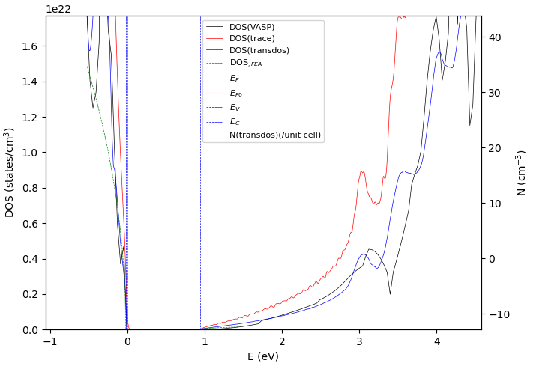
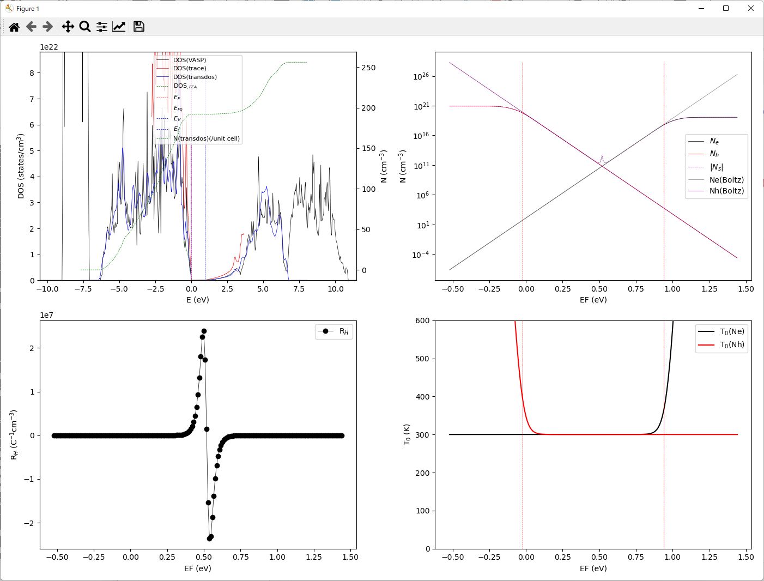
Zn₃N₂-HSE: N_{C}, N_{V}, m_{e}*(DOS), m_{h}*(DOS) from DFT DOS
Data dir: [data-COE]\BoltzTraP-bt2-T\Zn3N2-HSE
python ..\bt2-T.py NC interpolation 300 21
Read BoltzTraP2 output files interpolation.transdos, smoothing DOS by 21 points polynomial method, calculate at 300 K

Slide 3
Zn₃N₂-HSE : N_{C}, N_{V}, m_{e}*(DOS), m_{h}*(DOS) from DFT DOS
Data dir: [data-COE] \BoltzTraP-bt2-T\Zn3N2-HSE
python ..\bt2-T.py NC case 300 21
Read BoltzTraP2 output files case.transdos, smoothing DOS by 21 points polynomial method, calculate at 300 K
Console output:
Band edges from EIGENVAL:
EF = 0.000000 => 0.0 eV
EV = -0.021147 eV
EC = 0.940470 eV
Eg = 0.961617 eV
Effective density of states at the mid gap 0.45966149999999995 eV (i=100, E= 0.4597) by [transdos]:
Source: transdos .trancedosのD(E)を使い、ミッドギャップのNe/Nh-EFの傾きから計算
NC = 7.68821e+17 cm^-3 (T0 = 300 K)
NV = 7.73227e+19 cm^-3 (T0 = 300 K)
DC0 = 2.08708e+20 cm^-3/eV^1.5 (T0 = 300 K)
DV0 = 2.09904e+22 cm^-3/eV^1.5 (T0 = 300 K)
me* = 0.09791 me
mh* = 2.117 me
--cut—
Effective density of states by integration: 積分式から計算。原理的には上の値と一致
NC = 8.98846e+17 cm^-3
NV = 7.85301e+19 cm^-3
DC0 = 2.44005e+20 cm^-3/eV^1.5
DV0 = 2.13182e+22 cm^-3/eV^1.5
me* = 0.1087 me
mh* = 2.139 me
Effective density of states by integrating VASP DOS (do not trust):
NC = 2.14321e+16 cm^-3 DOSCARから積分式で計算
NV = 8.21898e+19 cm^-3
--cut—
Effective density of states by integrating trace DOS (do not trust):
NC = 1.79302e+18 cm^-3 .traceから積分式で計算しているので、2つ目の結果と同じ
NV = 1.51853e+20 cm^-3

