Slide 1
Plot band structure and DOS by pymatgen

Slide 2
Use “vasprun.xml” from band / DOS calculation output
Here is the first part of the script
import matplotlib.pyplot as pyplt
from pymatgen.io.vasp.outputs import Vasprun
from pymatgen.electronic_structure.plotter import BSDOSPlotter,\
BSPlotter,BSPlotterProjected,DosPlotter
bs_vasprun=Vasprun("./bs/vasprun.xml",parse_projected_eigen=True) #pathway for band calculation
bs_data=bs_vasprun.get_band_structure(line_mode=1)
dos_vasprun=Vasprun("./dos/vasprun.xml") #pathway for dos calculation
dos_data=dos_vasprun.complete_dos
#Vasprun(filename, parse_dos=True, parse_eigen=True, parse_projected_eigen=False, parse_potcar_file=True, separate_spins=False)
#get_band_structure(kpoints_filename: str | None = None, efermi: float | Literal['smart'] | None = None, line_mode: bool = False)

Slide 3
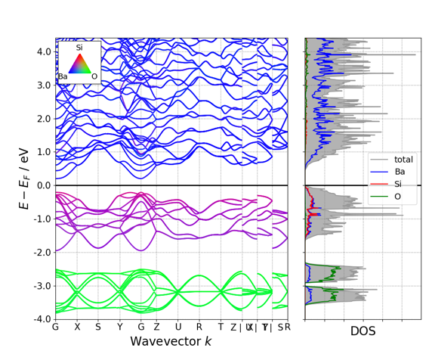
(1) Plot fat band and DOS projected by each element
plt1=BSDOSPlotter(dos_projection='elements', bs_projection='elements’)
plt1.get_plot(bs=bs_data,dos=dos_data)
pyplt.savefig(‘plt1.png')
BSDOSPlotter(bs_projection = 'elements’ or None,\
dos_projection= 'elements’ or ‘orbitals’ ,\
vb_energy_range = 4,\
cb_energy_range = 4, \
fixed_cb_energy = False, \
egrid_interval = 1,\
font = 'Times New Roman', \
axis_fontsize = 20, \
tick_fontsize = 15, \
legend_fontsize = 14,\
bs_legend = 'best',\
dos_legend = 'best',\
rgb_legend = True, \
fig_size = (11, 8.5) )

Slide 4
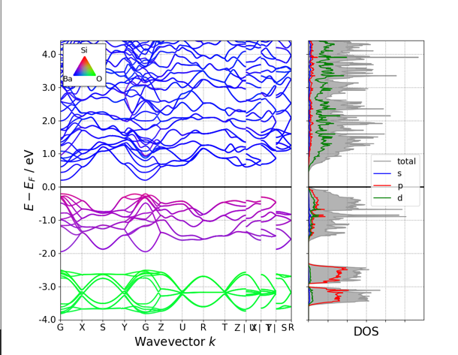
(2) Plot fat band projected by each element and DOS by orbitals
plt2=BSDOSPlotter(dos_projection=‘orbitals’, bs_projection=‘elements’)
plt2.get_plot(bs=bs_data,dos=dos_data)
pyplt.savefig(‘plt2.png')
BSDOSPlotter(bs_projection = 'elements’ or None,\
dos_projection= 'elements’ or ‘orbitals’ ,\
vb_energy_range = 4,\
cb_energy_range = 4, \
fixed_cb_energy = False, \
egrid_interval = 1,\
font = 'Times New Roman', \
axis_fontsize = 20, \
tick_fontsize = 15, \
legend_fontsize = 14,\
bs_legend = 'best',\
dos_legend = 'best',\
rgb_legend = True, \
fig_size = (11, 8.5) )

Slide 5
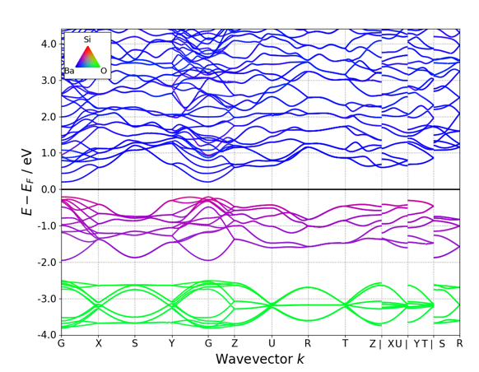
(3) Plot fat band projected by each element
plt3=BSDOSPlotter(dos_projection=None, bs_projection=‘elements’)
plt3.get_plot(bs=bs_data,dos=dos_data)
pyplt.savefig(‘plt3.png')
BSDOSPlotter(bs_projection = 'elements’ or None,\
dos_projection= 'elements’ or ‘orbitals’ ,\
vb_energy_range = 4,\
cb_energy_range = 4, \
fixed_cb_energy = False, \
egrid_interval = 1,\
font = 'Times New Roman', \
axis_fontsize = 20, \
tick_fontsize = 15, \
legend_fontsize = 14,\
bs_legend = 'best',\
dos_legend = 'best',\
rgb_legend = True, \
fig_size = (11, 8.5) )

Slide 6
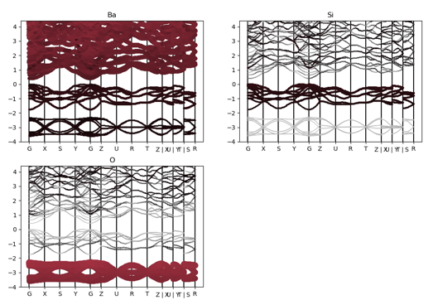
(4) Plot fat band for each element
plt_4=BSPlotterProjected(bs=bs_data)
fig_4=plt_3.get_elt_projected_plots(zero_to_efermi=True, ylim=None, \
vbm_cbm_marker=False)
pyplt.savefig('band_4.png')

Slide 7
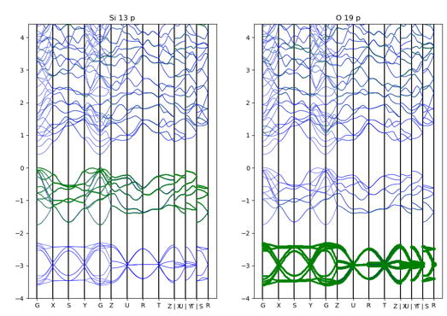
(5) Plot fat band for sum of selected atoms with orbitals
eg: Si (at site 13 in POSCAR index) p and O (at site 19) p orbitals
plt_5=BSPlotterProjected(bs=bs_data)
plt_5.get_projected_plots_dots_patom_pmorb(dictio={'Si':['px','py','pz'],'O':['px','py','pz']},dictpa={'Si':[13],'O':[19]},\
sum_morbs={'Si':['px','py','pz'],'O':['px','py','pz']})
pyplt.savefig('band_5.png')
plt_5.get_projected_plots_dots_patom_pmorb()
diction: selected elements and orbitals
eg:{'Si':['px','py','pz'],'O':['px','py','pz']}
dictpa: atom sites (site numbers)
eg: {'Si':[15,16],'O':[19,20]}
Si site 15,16 in POSCAR
sum_atoms: None or Sum projection of atoms
eg: {‘Si’:[15,16],'O':[19,20]}
sum_morbs: None, or Sum projections of orbitals
eg: {'Si': ['px','py','pz'], 'O': ['px', 'py']}
zero_to_efermi=True, \
ylim=None, \
vbm_cbm_marker=False,\
selected_branches=None, \
w_h_size=(12, 8))

Slide 8
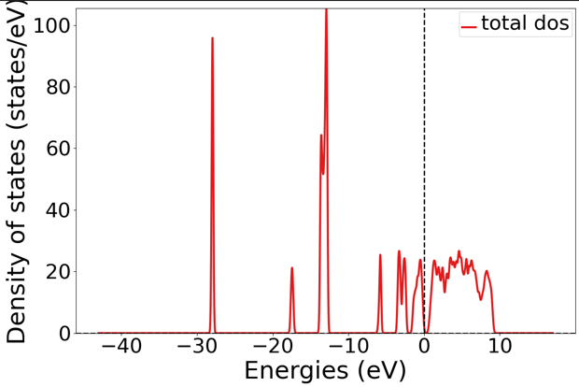
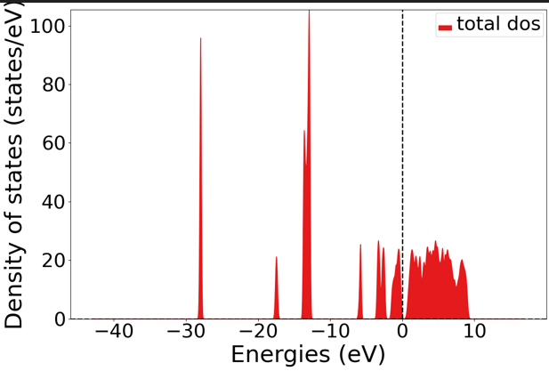
(6) Plot total DOS
plt6=DosPlotter(stack=False,sigma=0.1)
plt6.add_dos('total dos',dos=dos_data)
plt6.save_plot(‘plt6.png', img_format=u'png')
stack=False
stack=True

Slide 9
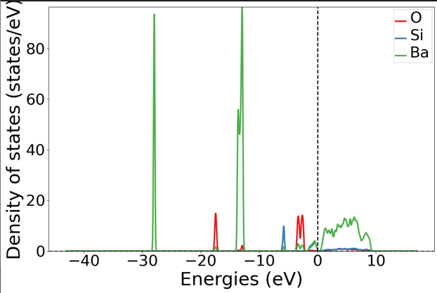
(7) Plot total DOS for each element
plt7=DosPlotter(stack=False,sigma=0.1)
#plt7.add_dos('total dos',dos=dos_data)
plt7.add_dos_dict(dos_data.get_element_dos())
plt7.save_plot(‘plt7.png', img_format=u'png')

Slide 10
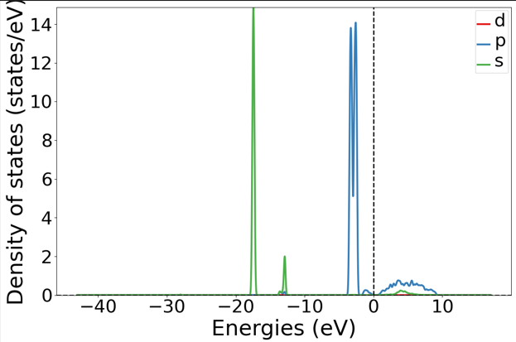
(8) Plot total DOS for element and orbital
plt8=DosPlotter(stack=False,sigma=0.1)
plt8.add_dos_dict(dos_data.get_element_spd_dos(‘O’))
plt8.save_plot(‘plt8.png', img_format=u'png')
For oxygen O

