Slide 1
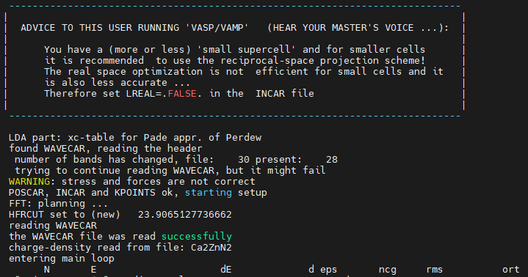
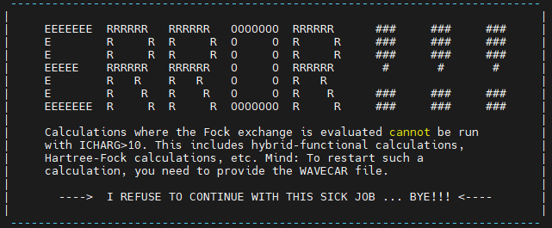
Force stop from VASP .6.3.2
(Beginning) After HSE-SCF calculation, tried to get Band structure using ICHARG=11.
This is the same as Nose-kun’s and Ikeda-san’s method.
At VASP 5.4.4
There is no trouble using ICHARG=11 in HSE06 hybrid-function
At VASP 6.4.1
We are forbidden using ICHARG=11, and Error message appear in the same INCAR.
Force stop.

Slide 2
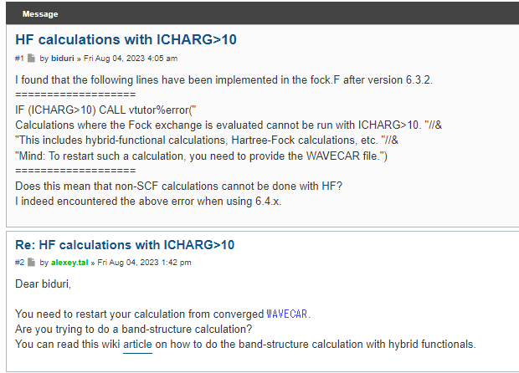
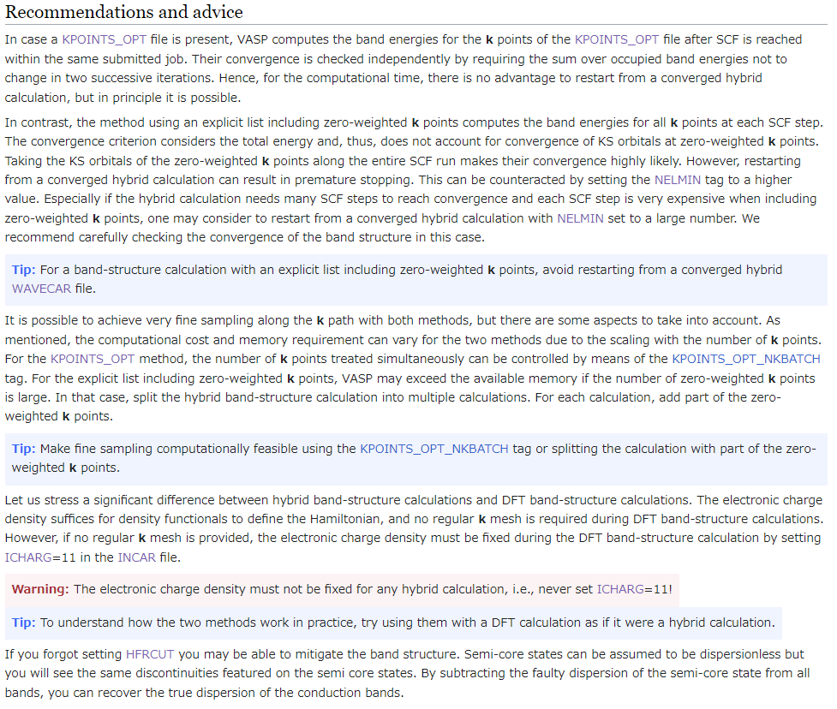
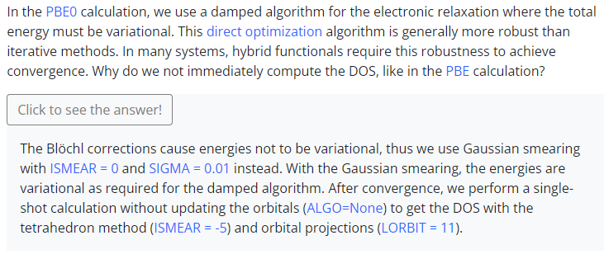
Revise the calculation condition
Conclusion
In calculation using hybrid function such as HSE06 and PBE0
We can’t use ICHARG=11 (Charge density consistent)
Only ISTART=1 (continue WAVECAR) is allowed.
Discussion in VASP forum
Band-structure calculation using hybrid functionals
From VASP tutorial

Slide 3
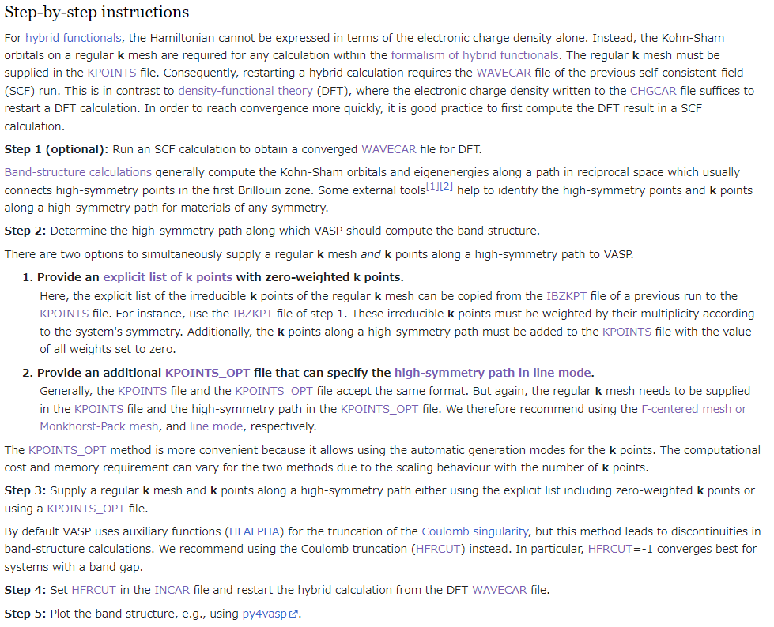
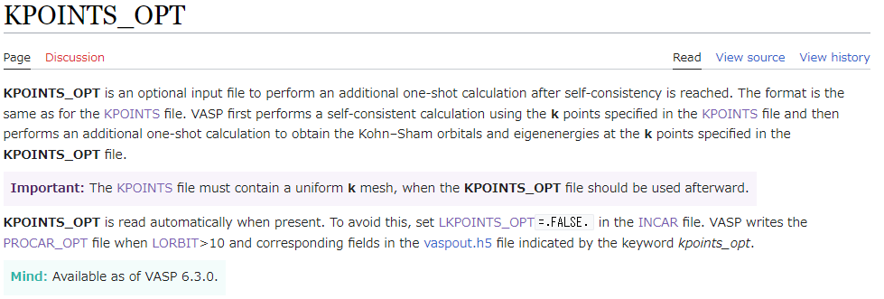
About succeeding hybrid SCF results
Use KPOINTS_OPT for HSE-band
In conventional method
Using 0-weighted K-PATH list in Explicit-KPOINTS,
we got eigenvalues of K-PATH with K-mesh eigenvalues.
New methods from VASP.6.3.0
Single shot calculation implemented in VASP.6.3.0
is useful for Band calculation in hybrid-function calculation.
Please use KPOINTS_OPT.

Slide 4
Calculation scheme
Get relaxed CONTCAR using relatively light function such as GGA-PBE.
(Optional)SCF in GGA-PBE→ get self-consistent WAVECAR
KPOINTS, NBANDS should use in the following hybrid calculation.
Run Hybrid-SCF.
Hybrid-Band is calculated in the same time using LKPOINTS_OPT=.True.
Run Hybrid-DOS in ALGO=None and ISMEAR=-5
(Optional) If you don’t calculate band in step3, Run hybrid-band calculation.
Extract the eigen values of KPOINTS_OPT from vasprun.xml
If you want use Tetrahedron method in DOS, step4 is not required.
For hybrid-Band calculation, there is no advantage to restart from a converged hybrid calculation with respect to computational time, but in principle it is possible.

Slide 5
INCAR
HSE06-SCF(succeeding GGA-PBE)
System = xxx
ENCUT = 500 ; PREC = Normal
ISTART = 1 ; ICHARG = 0
ISMEAR = 0 ; SIGMA = 0.03~0.2 ; EFERMI = MIDGAP
IBRION = -1 ; NSW = 0
EDIFF = 1E-4
LWAVE = .True. ; LCHARG = .True. ; LAECHG = .True.
ALGO = All
LREAL = Auto (or .False.)
LHFCALC = .True. ; HFSCREEN = 0.2 ; HFRCUT = -1
LORBIT = 11 ; LKPOINTS_OPT = .True. ( .False. if you recalculate bands.)
NWRITE = 3 ; NEDOS= 8001
#NBANDS = “grep NBANDS scf_PBE/OUTCAR”
#KPAR=
ISTART=0, ICHARG=2 if you don’t succeed GGA-PBE (start from GGA Davidson)
NBANDS has to be consistent from GGA-PBE to HSE06
LAECHG= .True. for bader radius.

Slide 6
INCAR
HSE06-Band
System = xxx
ENCUT = 500 ; PREC = Normal
ISTART = 1 ; ICHARG = 0
ISMEAR = 0 ; SIGMA = 0.03~0.2 ; EFERMI = MIDGAP
IBRION = -1 ; NSW = 0
EDIFF = 1E-4
LWAVE = .False. ; LCHARG = .False.
ALGO = All
LREAL = Auto (もしくは .False.)
LHFCALC = .True. ; HFSCREEN = 0.2 ; HFRCUT = -1
LKPOINTS_OPT = .True.
NWRITE = 3 ; NEDOS= 8001
#LORBIT = 0
#RWIGS = “POTCARに対応する順番で”
#NBANDS = “grep NBANDS scf_PBE/OUTCAR”
#KPAR=

Slide 7
INCAR
HSE06-DOS
System = xxx
ENCUT = 500 ; PREC = Normal
ISTART = 1 ; ICHARG = 0
ISMEAR = -5 ; EFERMI = MIDGAP
IBRION = -1 ; NSW = 0
EDIFF = 1E-4
LWAVE = .False. ; LCHARG = .False.
ALGO = None
LREAL = Auto (or .False.)
LHFCALC = .True. ; HFSCREEN = 0.2 ; HFRCUT = -1
LORBIT = 0 ; LKPOINTS_OPT = .True.
NWRITE = 3 ; NEDOS= 8001
RWIGS = “POTCARに対応する順番で”
#NBANDS = “grep NBANDS scf_PBE/OUTCAR”
#KPAR=

