Slide 1
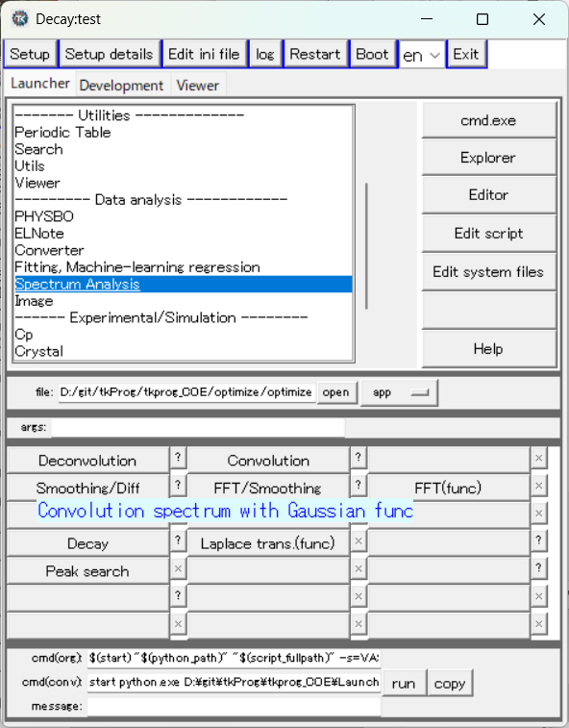
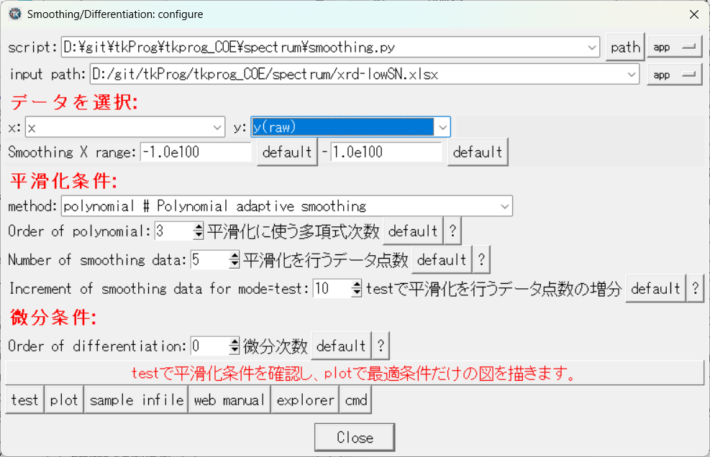
Launcher

Slide 2
設定

Slide 3
平滑化と微分
Excelの入力データに対し、x,yで選んだ関数に対して多項式適合平滑化、微分を行う。
Test: 異なる条件で平滑化を行い、最適条件を確認する
データの変数 “x:” と関数値 “y:” と選択する。
“xmin:”, “xmax:” で計算する範囲を選ぶ。
平滑化条件の “model:” は、単純移動平均 (simple moving average) が多項式適合平滑化より良いことは （まず）ないので、polynomialを選ぶ
“Order of polynomial:” で多項式の次数を選ぶ。この次数、+1、+2次の平滑化をtestする。
“Number of smoothing data:” で、平滑化に使うデータ点数を選ぶ。奇数のみ。
“Increment of smoothing data for mode=test:” に、testモードでの平滑化点数の増分を入力。5.の点数に、この数と２倍の数を加えた平滑化点数をtestする。
“test”ボタンを押して実行
Plot: 最適条件で平滑化したグラフのみを表示する。
“Order of polynomial:”, “Number of smoothing data:” に最適値を入力する
“plot”ボタンで描画
微分
“Order of differentiation” で微分次数を選択。0は微分しない。 多項式の次数よりも高い微分は無意味。

Slide 4
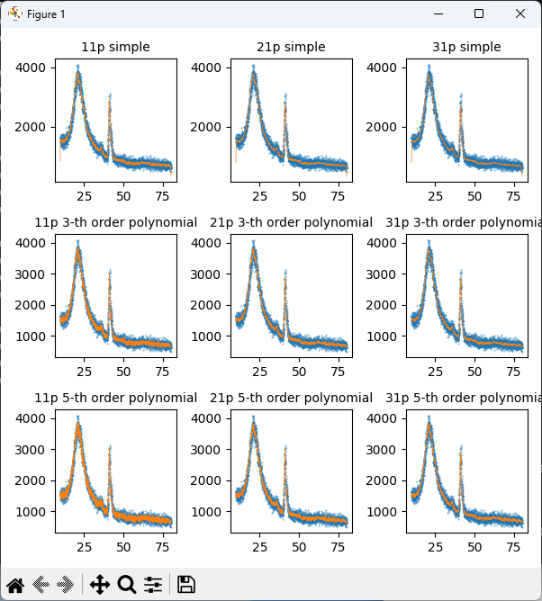
test
単純移動平均
平滑化点数を11,21,31点
2次多項式平滑化
平滑化点数を11,21,31点
5次多項式平滑化
平滑化点数を11,21,31点

Slide 5
平滑化
着目している点 N点 のある平均を取る
・ 単純移動平均 重みを均一に １/N とする
$y_{i,smoothed}=\frac{1}{2m+1}\sum_{j=i−m}^{i+m}{y_{j}}$
・ 加重移動平均 重み: 線形、三角形、指数関数、Gauss関数 など
$y_{i,smoothed}=\sum_{j=i−m}^{i+m}{y_{j}}w_{i}/\sum_{j=i−m}^{i+m}{w_{i}}$
・ 多項式適合法 (Savizky-Golay法)
着目している点を中心に (2m+1)点をとり、 多項式最小二乗法で中心点の値を求める
=> 実際には最小二乗法を実行する必要はない

Slide 6
多項式適合法 (Savizky-Golay法) の重み
南茂夫, 科学計測のための波形データ処理, CQ出版社 (1986)
2次および3次多項式適合法の重み
1次: 単純移動平均
2次と3次は同じ重みになる
(2m+1)点を用いた2,3次多項式適合の重み
$w_{23}(j)=3m(m+1)−1−5j^{2}$ j = -m, ･･･, -1, 0, 1, ･･･, m
$W_{23}=(4m^{2}−1)(2m+3)/3$

Slide 7
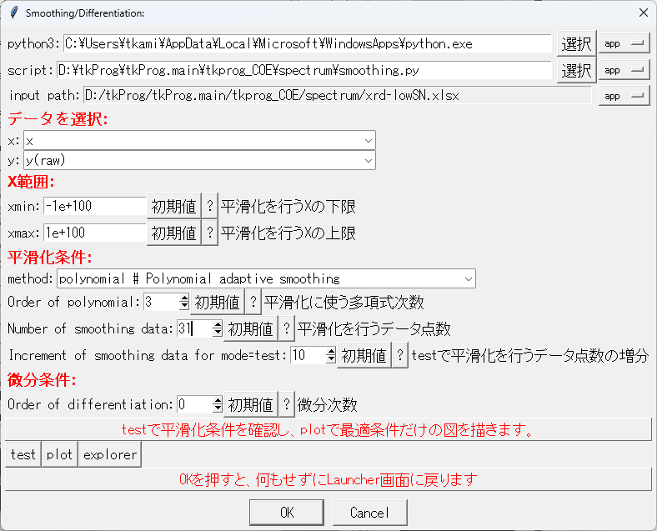
最適条件として、3次、31点を選んだ

Slide 8
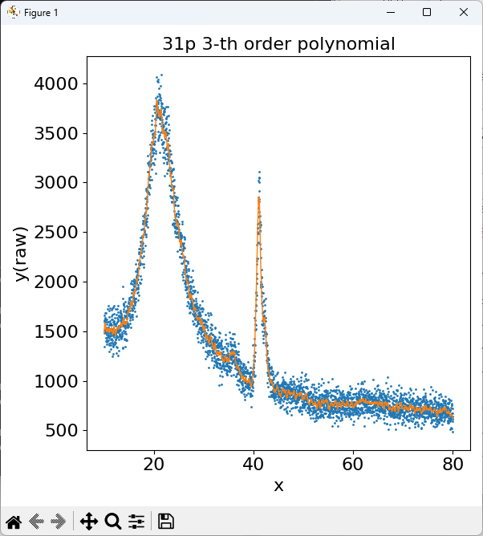
plot

Slide 9
微分

Slide 10
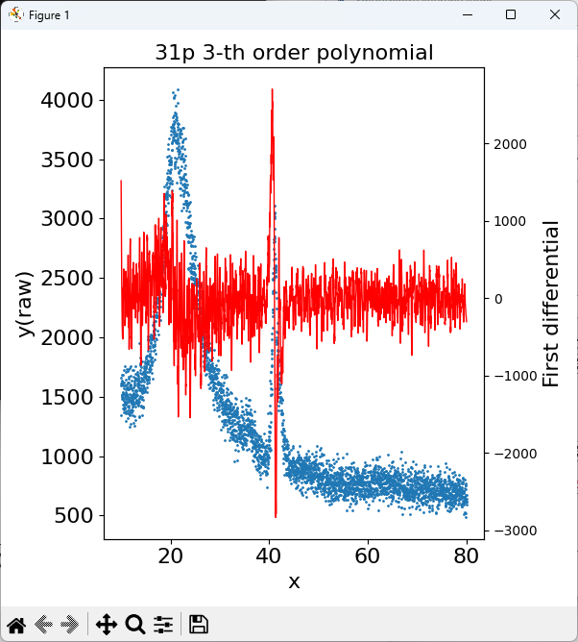
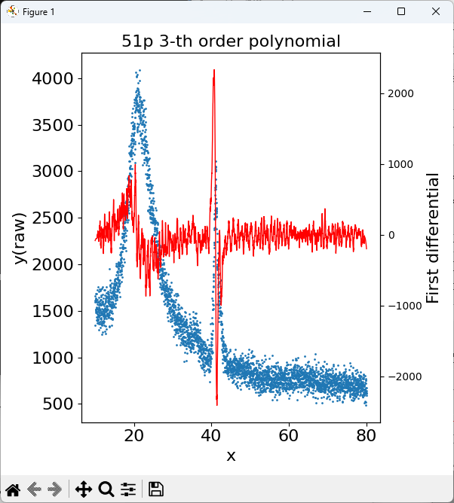
31点、51点で1次微分

Slide 11
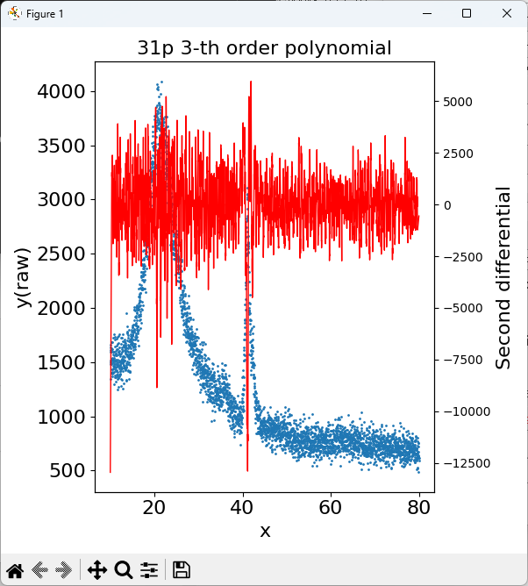
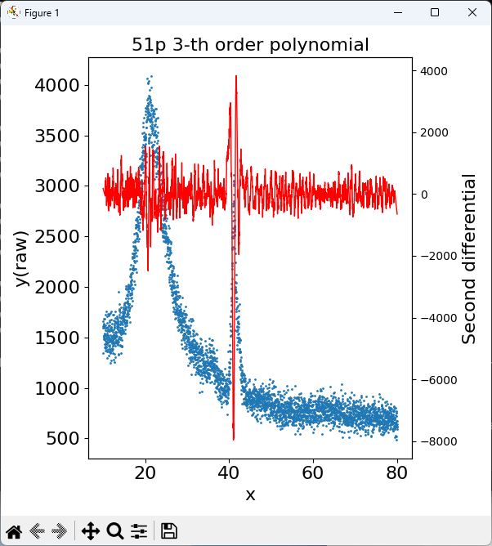
31点、51点で2次微分

Slide 12
補足資料

Slide 13
Smoothing (平滑化)
Take some average for sample points ・ Moving average (移動平均)
・ Simple moving average (単純移動平均): Average of sequential data with the uniform weight ・Weighted moving average (加重移動平均): Average of sequential data with weight Weight： Linear, Triangular, Exponetnial, Gauss, etc…
Approximate sample points by some function ・ Polynomial smoothing (多項式による平滑化) ・ Smoothing spline (スプライン平滑化)
・ Least-squares method (最小二乗法)
Other
・ Fourier transformation (フーリエ変換)

Slide 14
Calculation
Simple moving average (2m+1 points)
$y_{i,smoothed}=\frac{1}{2m+1}\sum_{j=i−m}^{i+m}{y_{j}}$
Weighted moving average (2m+1 points)
$y_{i,smoothed}=\sum_{j=i−m}^{i+m}{{w_{j}y}_{j}}/\sum_{j=i−m}^{i+m}{w_{i}}$

Slide 15
Smoothing (平滑化)
・ Moving average (移動平均法) Smoother with more sample points for average, but would alter the function shape if the function is not monotonic. => Affect peak height, valley depth, peak width etc…
The range of averaged sample points larger than the peak width => split peaks might become difficult to be separated.
Poor S/N ratio XRD pattern
Simple moving average: 5,11,31点
・ sample points
Red: 5-points simple moving average

Slide 16
Smoothing: Polynomial fit method (多項式適合法)
Adopt n_{order} order polynomial to n_{s} sample points among the given n sample points, determined by LSQ
データに n_{order}次多項式を最小自乗法で求め、標本点の値を内挿する
Polynomial fit: 11, 31 points
Simple moving average: 5, 11, 31 points

Slide 17
Weights of polynomial fit (Savizky-Golay method) 多項式適合法 (Savizky-Golay法) の重み
南茂夫, 科学計測のための波形データ処理, CQ出版社 (1986)
Table 5.1 Weights for order 2 and 3 polynomial fit
Order 1: Simple moving average
Orders 2 and 3 have the same weights
Weights for order 2 and 3 using (2m+1) points ((2m+1)点を用いた2,3次多項式適合の重み)
$w_{23}(j)=3m(m+1)−1−5j^{2}$ j = -m, ･･･, -1, 0, 1, ･･･, m
$W_{23}=(4m^{2}−1)(2m+3)/3$

Slide 18
Calculation
Simple moving average (2m+1 points)
$y_{i,smoothed}=\frac{1}{2m+1}\sum_{j=i−m}^{i+m}{y_{j}}$
Weighted moving average (2m+1 points)
$y_{i,smoothed}=\sum_{j=i−m}^{i+m}{{w_{i}y}_{j}}/\sum_{j=i−m}^{i+m}{w_{i}}$
Order 2 and 3 polynomial fit using (2m+1) points
$w_{23}(j)=3m(m+1)−1−5j^{2}$ j = -m, ･･･, -1, 0, 1, ･･･, m
$W_{23}=(4m^{2}−1)(2m+3)/3$
$y_{i,smoothed}=\frac{1}{W_{23}}\sum_{j=i−m}^{i+m}{w_{23}(j)y_{j}}$

Slide 19
Smoothing
Simple moving average (2m+1 points)
$y_{i,smoothed}=\frac{1}{2m+1}\sum_{j=i−m}^{i+m}{y_{j}}$
Weight

Slide 20
Smoothing
Weighted moving average (2m+1 points)
$y_{i,smoothed}=\sum_{j=i−m}^{i+m}{{w_{i}y}_{j}}/\sum_{j=i−m}^{i+m}{w_{i}}$
w_{i}

Slide 21
Smoothing
Order 2 and 3 polynomial fit using (2m+1) points
$w_{23}(j)=3m(m+1)−1−5j^{2}$ j = -m, ･･･, -1, 0, 1, ･･･, m
$W_{23}=(4m^{2}−1)(2m+3)/3$
$y_{i,smoothed}=\frac{1}{W_{23}}\sum_{j=i−m}^{i+m}{w_{23}(j)y_{j}}$
w₂₃(j)

Slide 22
Filter and convolution
First differential ${\left.\frac{dy}{dx}\right|}_{2}=\frac{1}{2h}\left(\begin{matrix}−1 & 0 & 1\end{matrix}\right)\left(\begin{matrix}y_{1} \\ y_{2} \\ y_{3}\end{matrix}\right)$
Second differential ${\left.\frac{d^{2}y}{{dx}^{2}}\right|}_{2}=\frac{1}{2h^{2}}\left(\begin{matrix}1 & −2 & 1\end{matrix}\right)\left(\begin{matrix}y_{1} \\ y_{2} \\ y_{3}\end{matrix}\right)$
Simple moving average (3 points) $y_{2,s}=\frac{1}{3}\left(\begin{matrix}1 & 1 & 1\end{matrix}\right)\left(\begin{matrix}y_{1} \\ y_{2} \\ y_{3}\end{matrix}\right)$
Weighted moving average (3p one-side triangle) $y_{2,s}=\frac{1}{3}\left(\begin{matrix}0 & 2 & 1\end{matrix}\right)\left(\begin{matrix}y_{1} \\ y_{2} \\ y_{3}\end{matrix}\right)$
Weighted moving average (3p double-side triangle) $y_{2,s}=\frac{1}{4}\left(\begin{matrix}1 & 2 & 1\end{matrix}\right)\left(\begin{matrix}y_{1} \\ y_{2} \\ y_{3}\end{matrix}\right)$
Polynomial fit smoothing (2m+1 points) $y_{3,s}=\frac{1}{35}\left(\begin{matrix}−3 & 12 & 17 & 12 & −3\end{matrix}\right)\left(\begin{matrix}\begin{matrix}y_{1} \\ y_{2} \\ y_{3}\end{matrix} \\ y_{4} \\ y_{5}\end{matrix}\right)$
Differentiation, smoothing, convolution may be performed with the same convolution program by adopting appropriate filters. 微分、平滑化、コンボリューションは、 フィルターを変えるだけで 同じコンボリューションプログラムを流用できる
$${\left.\frac{dy}{dx}\right|}_{0}\sim \frac{y_{1}−y_{−1}}{2h}$$
$${\left.\frac{d^{2}y}{{dx}^{2}}\right|}_{0}\sim \frac{y_{1}−2y_{0}+y_{−1}}{h^{2}}$$
$$y_{2,s}\sim \frac{y_{1}+y_{2}+y_{3}}{3}$$
Convolution: Matrix product of data vector and filter
Filter

Slide 23
Weights for various smoothing
Weighted moving average (2m+1 points) $y_{i,smoothed}=\frac{1}{\sum_{j=i−m}^{i+m}{w_{i}}}\sum_{j=i−m}^{i+m}{{w_{i}y}_{j}}$
e.g., one-side triangle : $\left(w_{−1},w_{0},w_{1}\right)=\frac{1}{3}(1,2,0)$
triangle : $\left(w_{−1},w_{0},w_{1}\right)=\frac{1}{4}(1,2,1)$
Gaussian : $w_{i}=\frac{1}{\sum{e^{{\left(ai\right)}^{2}}}}e^{{\left(ai\right)}^{2}}$
Equivalent to convolution using these functions

Slide 24
Weights
Order 2 and 3 polynomial fit using (2m+1) points
Equivalent to convolution using these functions

Slide 25
Smoothing by python library
$$Smoothing.py$$
Simple moving average
# make a constant filter with weight of 1/N
w = np.ones(nsmooth) / nsmooth
# convolution
ys = np.convolve(y, w, mode = ‘same‘)
Polynomial smoothing: Savizky-Golay filter
ys = scipy.signal.savgol_filter(y, nsmooth, norder, deriv = 0) nsmooth: number of smoothing points
norder : order of polynomial
deriv : order of differentiation
注意: savgol_filter() takes differentiation to specify deriv = 1, but its absolute values are different from the first differentials
because savgol_filter() does not know x-axis values. Divide the results by h^{deriv} after smoothing if you need absolute values Note: check the final results by yourself

Slide 26
Multi-dimensional filter, convolution, image processing
e.g., the convolution of y₂₂ is given by
a sum of each product of data $\left(\begin{matrix}\begin{matrix}y_{11} & y_{12} & y_{13}\end{matrix} \\ \begin{matrix}y_{21} & y_{22} & y_{23}\end{matrix} \\ \begin{matrix}y_{31} & y_{32} & y_{33}\end{matrix}\end{matrix}\right)$ and filter $\left(\begin{matrix}\begin{matrix}a_{11} & a_{12} & a_{13}\end{matrix} \\ \begin{matrix}a_{21} & a_{22} & a_{23}\end{matrix} \\ \begin{matrix}a_{31} & a_{32} & a_{33}\end{matrix}\end{matrix}\right)$
NOTE: different from convolution in mathematics
filter: $\left(\begin{matrix}\begin{matrix}a_{11} & a_{12} & a_{13}\end{matrix} \\ \begin{matrix}a_{21} & a_{22} & a_{23}\end{matrix} \\ \begin{matrix}a_{31} & a_{32} & a_{33}\end{matrix}\end{matrix}\right)$ ${y′}_{22}=\sum_{i,j=1,2,3}{a_{ij}y_{ij}}$
X differential filter (edge detection) $\frac{1}{2h}\left(\begin{matrix}\begin{matrix}0 & 0 & 0\end{matrix} \\ \begin{matrix}−1 & 0 & 1\end{matrix} \\ \begin{matrix}0 & 0 & 0\end{matrix}\end{matrix}\right)$
Y differential filter (edge detection) $\frac{1}{2h}\left(\begin{matrix}\begin{matrix}0 & −1 & 0\end{matrix} \\ \begin{matrix}0 & 0 & 0\end{matrix} \\ \begin{matrix}0 & 1 & 0\end{matrix}\end{matrix}\right)$
Diagonal differential filter (edge detection) $\frac{1}{2h}\left(\begin{matrix}\begin{matrix}0 & 1 & 0\end{matrix} \\ \begin{matrix}−1 & 0 & 1\end{matrix} \\ \begin{matrix}0 & −1 & 0\end{matrix}\end{matrix}\right)$
Smoothing filter (smearing/blur) ⬄ sharpening can be done by deconvolution
$\frac{1}{9}\left(\begin{matrix}\begin{matrix}1 & 1 & 1\end{matrix} \\ \begin{matrix}1 & 1 & 1\end{matrix} \\ \begin{matrix}1 & 1 & 1\end{matrix}\end{matrix}\right)$
Convoluted Neural Network (畳み込みニューラルネットワーク)
Insert a convolution layer in multilayer neural network to learn the elements of the filter
We may know how the filter works by analyzing the values of the filter elements

