Slide 1
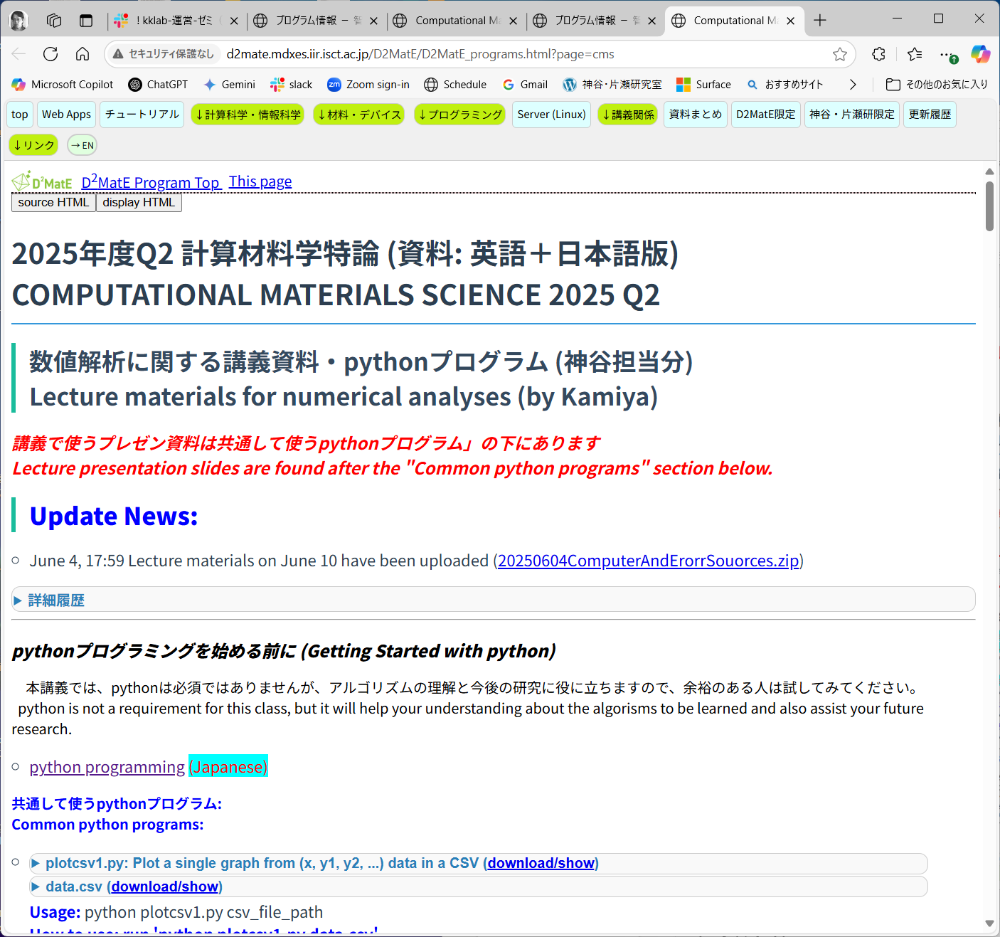
Computational Materials Science (計算材料学特論)
Lecture materials:
http://d2mate.mdxes.iir.isct.ac.jp/D2MatE/D2MatE_programs.html?page=cms
We would wait for five minuities.
In meantime, please be sure to download the latest lecture materials

Slide 2
Computational Materials Science (計算材料学特論)
http://d2mate.mdxes.iir.isct.ac.jp/D2MatE/D2MatE_programs.html?page=cms
Note: Getting Started with python
python is not a requirement for this class, but it will help your understanding about the algorisms to be learned and also assist your future research.
注： pythonプログラミングを始める前に
本講義では、pythonは必須ではありませんが、アルゴリズムの理解と今後の研究に役に立ちますので、 余裕のある人は試してみてください。

Slide 3
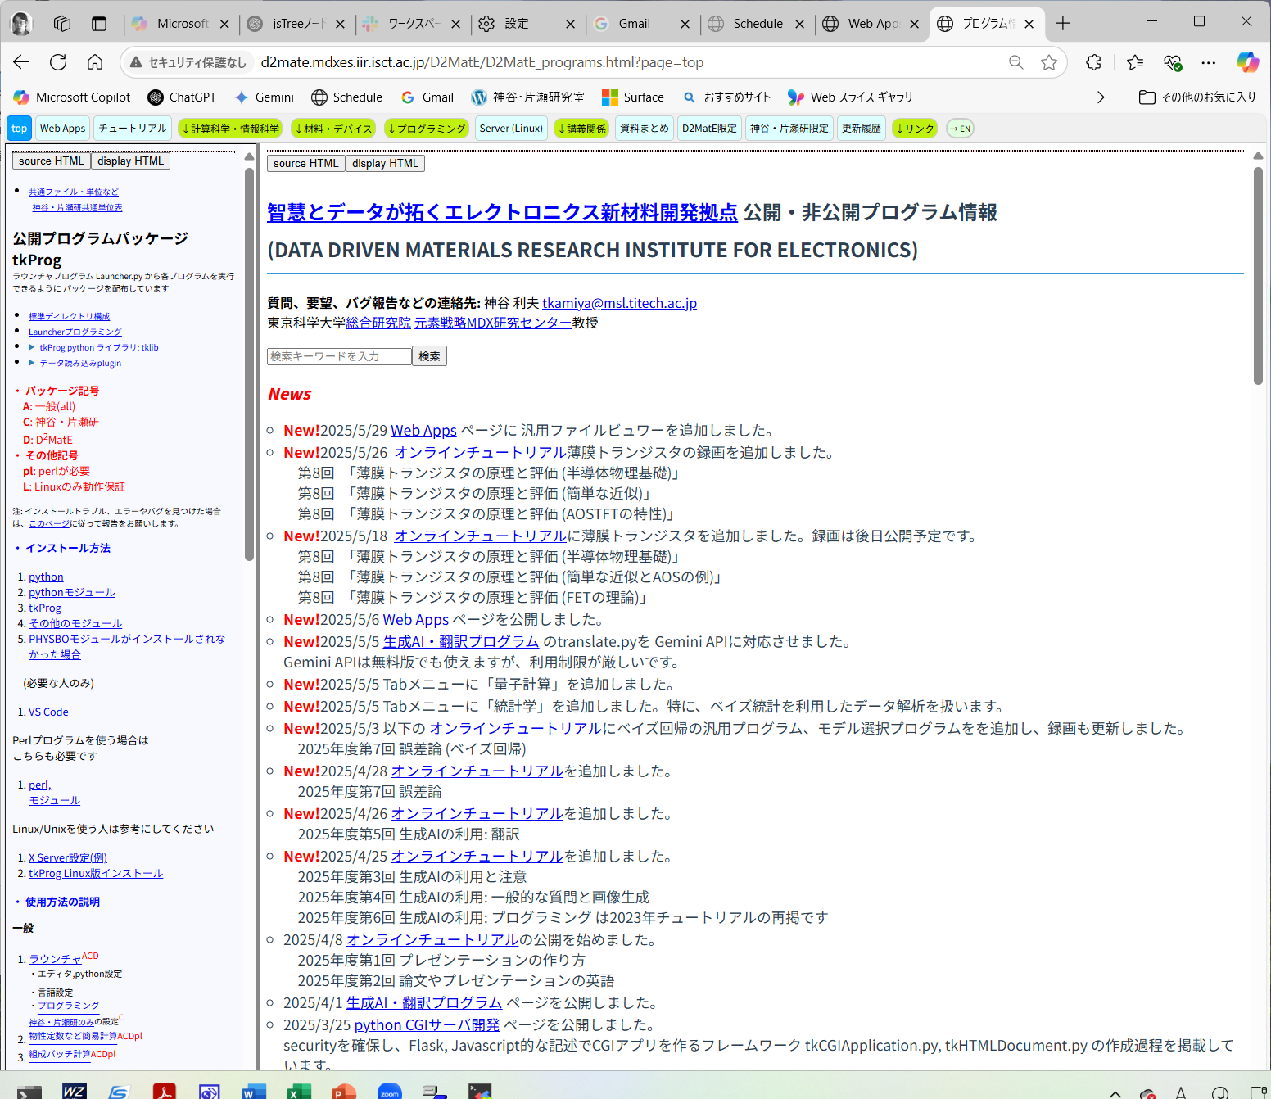
Other open programs [Japanese]
http://d2mate.mdxes.iir.isct.ac.jp/D2MatE/D2MatE_programs.html?page=top

Slide 4

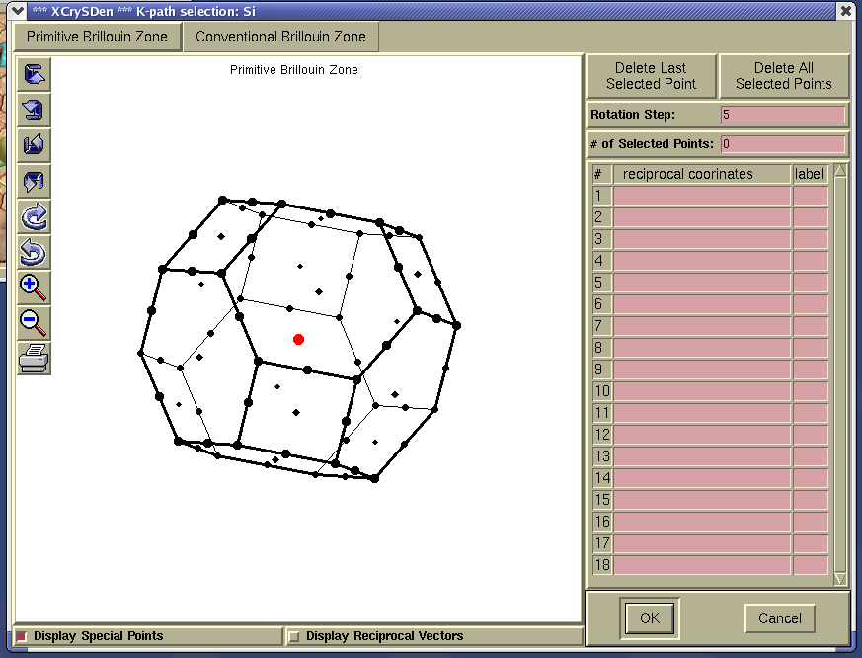
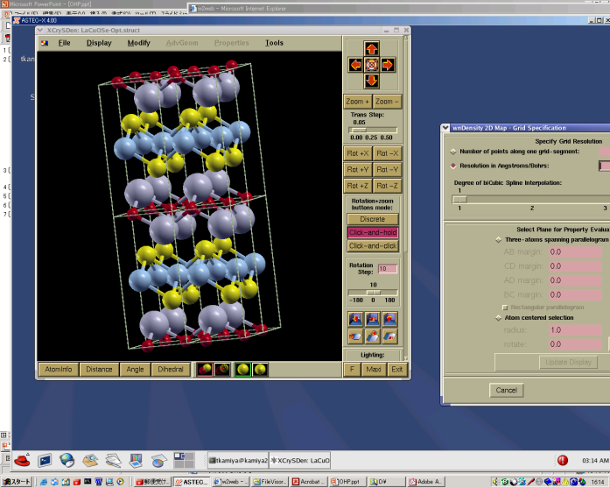
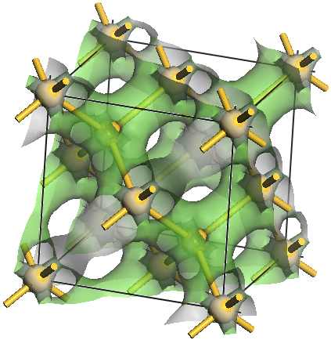
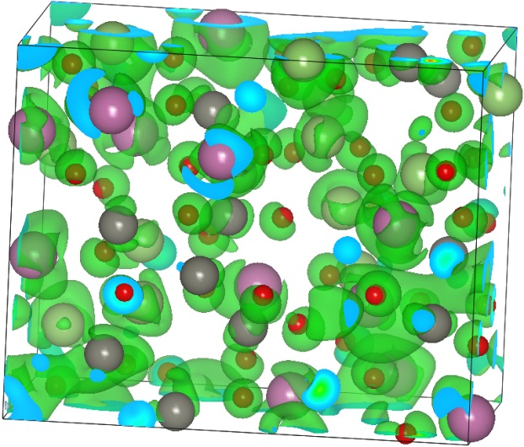
Computational Materials Science
計算材料学特論
Toshio Kamiya
神谷利夫

Slide 5
Class Schedule
Lecture materials (Kamiya’s part): http://d2mate.mdxes.iir.isct.ac.jp/D2MatE/D2MatE_programs.html?page=cms
#01 June 10 (Tue) Kamiya (Fundamentals of computer, Sources of errors (コンピュータの基礎、誤差))
#02 June 13 (Fri) Kamiya (Numerical differentiation/integration (数値微分/積分),
Differential equation (微分方程式))
#03 June 17 (Tue) Kamiya (Differential equation (微分方程式), Molecular dynamics (分子動力学法),
Interpolation (補間), Smoothing (平滑化))
#04 June 20 (Fri) Kamiya (Linear least-squares method (線形最小二乗法), Optimization (最適化),
Numerical solutions of equations (方程式の数値解法), Nonlinear optimization (非線形最適化))
#05 June 24 (Tue) Kamiya (Nonlinear optimization (非線形最適化),
Fourier transformation (フーリエ変換)
#06 June 27 (Fri) Kamiya, Matrix (行列)
#07 July 1 (Tue) Kamiya, Review (復習)
#08 July 4 (Fri) Sasagawa (Review of quantum theory 1: 量子論おさらい1)
#09 July 8 (Tue) Sasagawa (Review of quantum theory 2: 量子論おさらい2)
#10 July 11 (Fri) Sasagawa (First principles calculations: basics 1 第一原理計算：基礎1)
#11 July 15 (Tue) Sasagawa (First principles calculations: basics 2 第一原理計算：基礎2)
#12 July 18 (Fri) Sasagawa (First principles calc.: applications 1 第一原理計算：応用1)
#13 July 22 (Tue) Sasagawa (First principles calc.: applications 2 第一原理計算：応用2)
#14 July 25 (Fri) Sasagawa (Classical and Quantum Computers 古典および量子コンピュータ)

Slide 6
English textbooks
Search by ‘numerical analysis’, ‘numerical simulation’, ‘数値解析’ etc.
Introduction to Applied Numerical Analysis
Richard W. Hamming
Dover publications, inc., New York (1989)
~340 pages
A First Course in Numerical Analysis
Anthony Ralston and Philip Rabinowitz
Dover publications, inc., New York (1978)
~600 pages
For practical programming: Numerical Recipes series
Numerical Recipes in C
Numerical Recipes Example Book (FORTRAN)
Numerical Recipes Source Code
Second Edition: C, Fortran77, Fortran 90
Third Edition: C++

Slide 7
Policy
Evaluation:
Assignment is given in each class
Term-end assignment
You can use AI like ChatGPT,
but your answers must include your own thought and improvements.
Absence of class
If you can’t join a class, let me know prior to the class.
Zoom record
Classes will be recorded, used only for students who request watching it.

Slide 8
Python: A Light Weight Language (LWL)
Install: http://conf.msl.titech.ac.jp/Lecture/InstallPython/InstallPython.html
Interpreter language (インタプリタ言語 – 逐次解釈)
⬄ Compiled language (コンパイル言語 – 機械語翻訳)
Slower execution, but faster development
Only interpreter and editor are required
Free or public domain versions available
Grammar similar to C, C++, perl, php, …
Native Object-Oriented (オブジェクト指向) language
Efficient functions and libraries
Text processing: Regular expression (正規表現),
csv, html, xml, json etc
Science: numpy, scipy, scikit-learn etc
Network: …
Graph plotting: matplotlib etc
GUI: tkinter, pygtk etc

Slide 9
Text editor vs Word processor
 | Text editor | Word processor
Startup time (起動時間) | Shorter | Longer
Processing speed (実行速度) | Faster | Slower
Memory | Light | Heavy
Text style / format | Usually none | Required
File format | Basically text-based | Application specific
Others | Specialized for specific program languages. Macro (small program languages) | Print (WYSIWYG): What You See is What You Get
Examples | Linux : vi, emax Windows: TeraPad, Sakura Edtior Multi : Visual Studio Code, Sublime text, Atom | MS-Word
Recommendation:
Microsoft Visual Studio Code: https://code.visualstudio.com/
Multiplatform (Windows, MacOS, Linux)
Multilanguage
Integrated Development Editor (IDE)

Slide 10
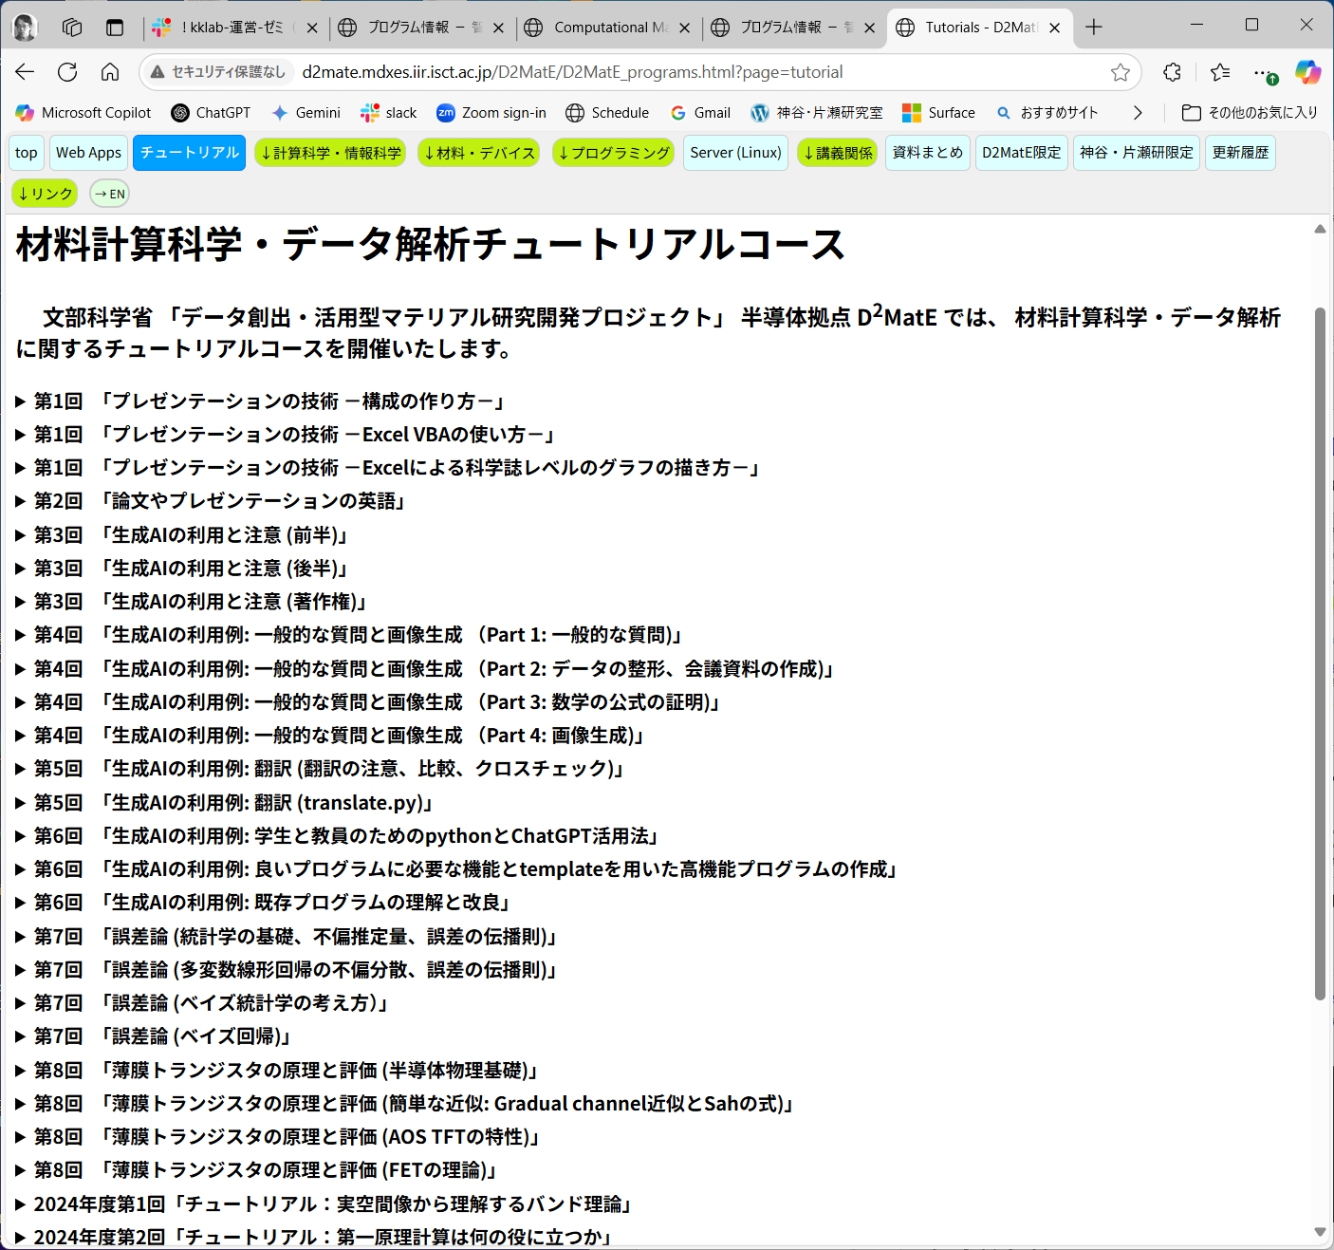
If interested in python and AI-based programming
http://d2mate.mdxes.iir.isct.ac.jp/D2MatE/D2MatE_programs.html?page=tutorial

Slide 11
PROBLEM, June 10
Submit electronic file(s) via LMS until the midnight of June 11
(If LMS doesn’t work, send the files to kamiya.t.aa@m.titech.ac.jp.
In this case, file name must include your STUDENT ID and FULL NAME)
Choose one of the following PROBLEM 1 or PROBLEM 2
PROBLEM 1:
Convert 101001₂ to base 10
Convert 4251₁₀ to base 16
PROBLEM 2:
Choose one of the python programs given today (sum_error.py, sum.py, base.py).
・ Explain what each block of the source code does,
or
・ list up the source code parts that you cannot understand what they do or why they are needed.
今日配布したプログラム (sum_error-plt.py, sum.py, base.py) から１つを選び、
以下のいずれかを答えよ
・ ソースコードのそれぞれの部分が何をしているかを説明する
・ ソースコードの中で理解できない部分、あるいは なぜそれが必要かわからない部分を述べよ

Slide 12
Fundamentals of computer
コンピュータの基礎

Slide 13
Numeric representation
(数の表現)
Base 10
(decimal)
(10進数)
1975 = 1×1000 + 9×100 + 7×10 + 5×1
= 1×10³ + 9×10² + 7×10¹ + 5×10⁰
the 1000’s place
(1000の位)
All data in computer are represented by 0 or 1 (binary) : bit (b)
Base 2
(binary)
(2進数)
(11011)₂ = 1×2⁴ + 1×2³ + 0×2² + 1×2¹ + 1×2⁰
= 1×(16)₁₀ + 1×(8)₁₀ + 0×(4)₁₀ + 1×(2)₁₀ + 1×(1)₁₀
= (27)₁₀
Base r
(r進数)
N = a_{n}r ^{n} + a_{n-1}r ^{n-1} + ･････ + a₃r ³ + a₂r ² + a₁r ¹ + a₀r ⁰
= (a_{n}a_{n-1}･････ a₃a₂a₁a₀)_{r}

Slide 14
Numeric representation
(数の表現)
Base 8 (octal) (8進数)
(01234567)
2 digits: 0 ~ 8² – 1 = 63
00: 0×8¹ + 0×8⁰ = 0
53: 5×8¹ + 3×8⁰ = 43
77: 7×8¹ + 7×8⁰ = 63
Base 16 (hexadecimal) (16進数)
(0123456789ABCDEF) = (0 ~ 15)
2 digits: 0 ~ 16² – 1 = 255
00: 0×16¹ + 0×16⁰ = 0
9F: 9×16¹ + 15×16⁰ = 159
FF: 15×16¹ + 15×16⁰ = 255
(ABCDEFGHIJKLMNOPQRSTUVWXYZ
abcdefghijklmnopqrstuvwxyz
0123456789+/) = (0 ~ 63)

Slide 15
Correspondence relations (対応関係)
Base 10 | Base 2 | Base 8 | Base 16
0 | 0000 | 00 | 0
1 | 0001 | 01 | 1
2 | 0010 | 02 | 2
3 | 0011 | 03 | 3
4 | 0100 | 04 | 4
5 | 0101 | 05 | 5
6 | 0110 | 06 | 6
7 | 0111 | 07 | 7
8 | 1000 | 10 | 8
9 | 1001 | 11 | 9
10 | 1010 | 12 | A
11 | 1011 | 13 | B
12 | 1100 | 14 | C
13 | 1101 | 15 | D
14 | 1110 | 16 | E
15 | 1111 | 17 | F
16 | 10000 | 20 | 10

Slide 16
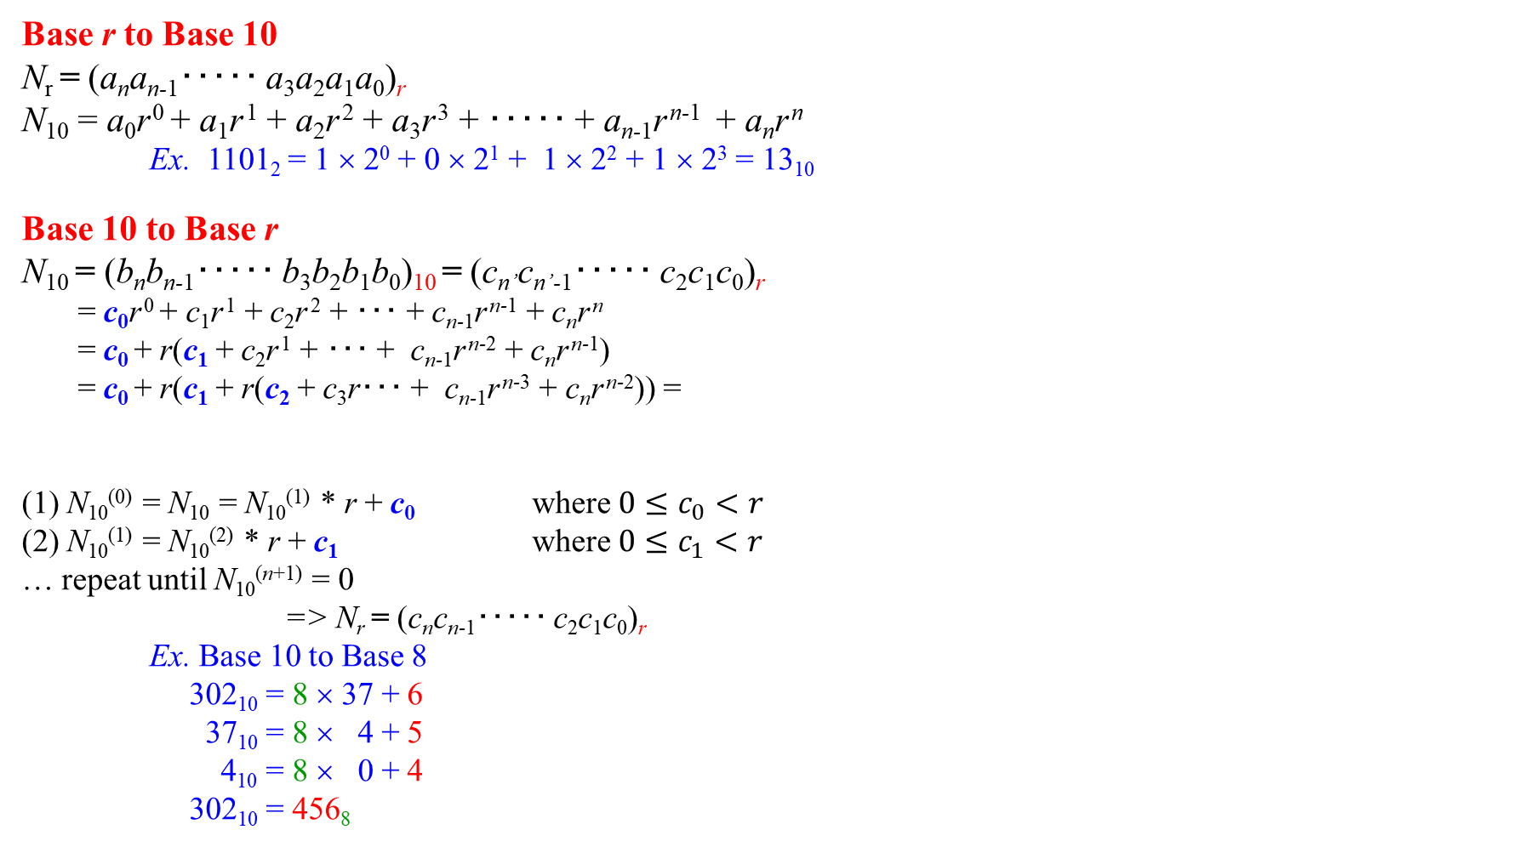
Convert Base (基数の変換)
Base r to Base 10
N_{r} = (a_{n}a_{n-1}･････ a₃a₂a₁a₀)_{r}
N₁₀ = a₀r ⁰ + a₁r ¹ + a₂r ² + a₃r ³ + ･････ + a_{n-1}r ^{n-1} + a_{n}r ^{n}
Ex. 1101₂ = 1 × 2⁰ + 0 × 2¹ + 1 × 2² + 1 × 2³ = 13₁₀
Base 10 to Base r
N₁₀ = (b_{n}b_{n-1}･････ b₃b₂b₁b₀)₁₀ = (c_{n’}c_{n’-1}･････ c₂c₁c₀)_{r}
= c₀r ⁰ + c₁r ¹ + c₂r ² + ･･･ + c_{n-1}r ^{n-1} + c_{n}r ^{n}
= c₀ + r(c₁ + c₂r ¹ + ･･･ + c_{n-1}r ^{n-2} + c_{n}r ^{n-1})
= c₀ + r(c₁ + r(c₂ + c₃r･･･ + c_{n-1}r ^{n-3} + c_{n}r ^{n-2})) =
(1) N₁₀⁽⁰⁾ = N₁₀ = N₁₀⁽¹⁾ * r + c₀ where $0≤c_{0}<r$
(2) N₁₀⁽¹⁾ = N₁₀⁽²⁾ * r + c₁ where $0≤c_{1}<r$
… repeat until N₁₀^{(n+1)} = 0
=> N_{r} = (c_{n}c_{n-1}･････ c₂c₁c₀)_{r}
Ex. Base 10 to Base 8
302₁₀ = 8 × 37 + 6
37₁₀ = 8 × 4 + 5
4₁₀ = 8 × 0 + 4
302₁₀ = 456₈
N₁₀⁽¹⁾
N₁₀⁽²⁾
Divide 3292₁₀ by base (16) and put its remainder from left (top digit),
and repeat it with its quotient (3292₁₀を順次基底16で割り、余りを左から(上の桁から)並べる)

Slide 17
Python program: base.py
Program: base.py
Usage: python base.py value base_source base_target
Ex.
COMMAND:
python base.py FA 16 8
Convert FA in base 16 to base 8
OUTPUT:
Convert FA in base 16 to base 10
1st digit = 10: + 10 * 16⁰ => + 10₁₀ => 10₁₀
2nd digit = 15: + 15 * 16¹ => + 240₁₀ => 250₁₀
Convert 250 in base 10 to base 8
250₁₀ = 31 * 8 + 2: base_8 => 2
31₁₀ = 3 * 8 + 7: base_8 => 72
3₁₀ = 0 * 8 + 3: base_8 => 372₈ result

Slide 18
Units of data processed in computers
(コンピュータ内のデータ単位)
bit (b): binary: 0 or 1
In computer: 8 bits data is treated as a fundamental unit
byte (B): 0 ~ 2⁸ – 1 = 255
Prefixes in computing
1 kB = 2¹⁰ B = 1,024 B = 1 kiB (kibibyte)
1 MB = 1024 kB = 1,048,576 B = 1 MiB (mebibyte)
1 TB = 1024 GB = 1024² MB = 1024³ kB = 1024⁴ B = 1 GiB (gibibyte)
SI unit prefixes
1 kB = 10³ B = 1,000 B

Slide 19
Numeric representation: Integer (整数型)
Integer type： Based on the CPU bit (CPUのbit数が基本)
16bits for 16bit CPU
unsigned int (符号無し整数型) 0 ~ 2¹⁶ – 1 = 65,535
signed int (符号付き整数型) –32,768 – +32,767
32bits for 32bit CPU
unsigned int (符号無し整数型) 0 ~ 4,294,967,295
signed int (符号付き整数型) –2,147,483,648 ~ + 2,147,483,647
For all CPUs:
int : depends on CPU bits
short int : 16 bits
long int : 32 bits
long long int: 64 bits

Slide 20
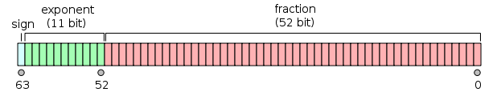

Numeric representation: Floating point, Real
(浮動小数点型, 実数)
Floating point type: Minimum 32bit (except half precision)
The range of available value depends on computer architectures,
programming language etc.
C language (C言語)
float : 32 bits 3.4E-38 – 3.4E+38
double : 64 bits 1.7E-308 – 1.7E+308
long double: 64 bits
Fortran
Single precision (単精度) FP (REAL) : 32 bits
Double precision (倍精度) FP (DOUBLE) : 64 bits, 16 digits (桁) in decimal
Quadruple precision (4倍精度) FP (REAL*16) : 128 bits
Definition of IEEE 754 (binary32, binary64):
Sign : 1 bit
Exponent: 8 bits (REAL, –128 ~ +127) 11 bits (DOUBLE, –1024 ~ +1023)
Fraction : 23 bits (REAL) 52 bits (DOUBLE)
8,388,608: 7 digits 4,503,599,627,370,495: 16 digits
$${−1.011101}_{2}×2^{{−0101}_{2}}$$
Sign
(符号)
Exponent
(指数部)
Fraction
(仮数部)
Sign
(1bit)
Exponent
(11bit)
Fraction
(52bit)

Slide 21
Required variable sizes: Integer types
unsigned int (16 bits): 65,536
16bit CPU can handle only 64 kB of memory
(アドレスバスが16bitだと、64 kBのメモリーしか扱えない)
unsigned int (32 bits): 4,294,967,295
32bit CPU can handle 4 GB memory
(アドレスバスが32bitだと、4 GBのメモリーを扱える)
GDP of Japan: ~5 trillion US$ = 500,000,000,000,000 JYen
(requires 16 digits)
cf. unsigned long long int (64 bit): ~1.8E+19 (18 digits)
The ratio of the circumference of a circle (円周率):
Significant figure: 50 trillion digits (as of Jan, 2020)
Need to use multi-fold calculation (多倍長計算)
Implemented based on software

Slide 22
Required sizes: FP types for quantum calculations
1s orbital energy level:
H atom : 13.6 eV
heavy atoms: >> keV
Energies related to physical properties
Thermal energy at room temperature: 26 meV
Magnetism: several meV
Quantum simulations of physical properties require
the precision for the meV – MeV range (over 9 digits precision)
Definition of standard FP: IEEE 754
Fraction: 23 bit (single) 8,388,608 7 digits
Fraction: 52bit (double) 4,503,599,627,370,495 16 digits

Slide 23
Required sizes: FP types for semiconductor simulation
Boltzmann factor: exp(–E_{g} / k_{B}T)
E_{g} = 1.1 eV
k_{B}T = 0.026 eV (T = 300 K) => exp(-42) ~ 10^{–19}
E_{g} = 4.0 eV
k_{B}T = 0.026 eV (T = 300 K) => exp(-154) ~ 10^{–67}
k_{B}T = 0.00026 eV (T = 3 K) => exp(-15400) ~ 10^{–5141}
Double precision (64bit): Fraction: 16 digits
Exponent: –1024 ~ +1023 (2^{–1024} ~ 10^{–308})
Quad precision : 128 bit
Octuple precision (8倍精度): 256 bit

Slide 24
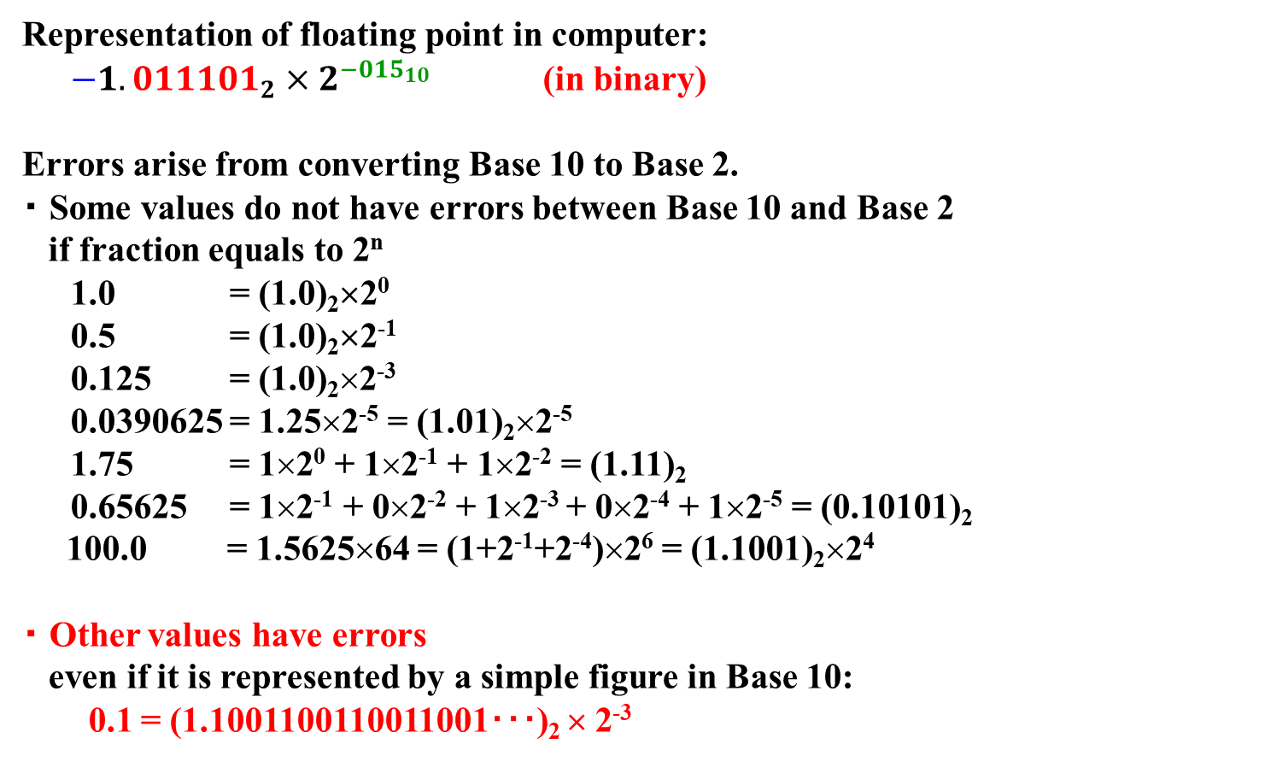
Error of floating-point variables (浮動小数点型の誤差)
Representation of floating point in computer:
${−1.011101}_{2}×2^{{−015}_{10}}$ (in binary)
Errors arise from converting Base 10 to Base 2.
・ Some values do not have errors between Base 10 and Base 2
if fraction equals to 2^{n}
1.0 = (1.0)₂×2⁰
0.5 = (1.0)₂×2⁻¹
0.125 = (1.0)₂×2⁻³
0.0390625 = 1.25×2⁻⁵ = (1.01)₂×2⁻⁵
1.75 = 1×2⁰ + 1×2⁻¹ + 1×2⁻² = (1.11)₂
0.65625 = 1×2⁻¹ + 0×2⁻² + 1×2⁻³ + 0×2⁻⁴ + 1×2⁻⁵ = (0.10101)₂
100.0 = 1.5625×64 = (1+2⁻¹+2⁻⁴)×2⁶ = (1.1001)₂×2⁴
・ Other values have errors
even if it is represented by a simple figure in Base 10:
0.1 = (1.1001100110011001･･･)₂ × 2⁻³

Slide 25
Program (roundoff error): sum_error.py
Usage: python sum_error.py h n iPrintStep
Summing up h for n times with different precision interger types. Output every iPrintStep steps.
python sum_error.py 0.1 100 20
exact: sum16 (error) sum32 (error) sum64 (error)
0.1000: 0.099975585937500000 (+2.44e-05) 0.100000001490116119 (-1.49e-09) 0.100000000000000006 (+0.00e+00)
2.1000: 2.095703125000000000 (+4.30e-03) 2.100000143051147461 (-1.43e-07) 2.100000000000000533 (-4.44e-16)
4.1000: 4.089843750000000000 (+1.02e-02) 4.099998474121093750 (+1.53e-06) 4.100000000000001421 (-8.88e-16)
6.1000: 6.121093750000000000 (-2.11e-02) 6.099996566772460938 (+3.43e-06) 6.099999999999994316 (+6.22e-15)
8.1000: 8.148437500000000000 (-4.84e-02) 8.099994659423828125 (+5.34e-06) 8.099999999999987210 (+1.24e-14)
python sum_error.py 0.125 100 20
exact: sum16 (error) sum32 (error) sum64 (error)
0.1250: 0.125000000000000000 (+0.00e+00) 0.125000000000000000 (+0.00e+00) 0.125000000000000000 (+0.00e+00)
2.6250: 2.625000000000000000 (+0.00e+00) 2.625000000000000000 (+0.00e+00) 2.625000000000000000 (+0.00e+00)
5.1250: 5.125000000000000000 (+0.00e+00) 5.125000000000000000 (+0.00e+00) 5.125000000000000000 (+0.00e+00)
7.6250: 7.625000000000000000 (+0.00e+00) 7.625000000000000000 (+0.00e+00) 7.625000000000000000 (+0.00e+00)
10.125: 10.12500000000000000 (+0.00e+00) 10.12500000000000000 (+0.00e+00) 10.12500000000000000 (+0.00e+00)
python sum_error.py 0.0390625 100 20
exact: sum16 (error) sum32 (error) sum64 (error)
0.0391: 0.039062500000000000 (+0.00e+00) 0.039062500000000000 (+0.00e+00) 0.039062500000000000 (+0.00e+00)
0.8203: 0.820312500000000000 (+0.00e+00) 0.820312500000000000 (+0.00e+00) 0.820312500000000000 (+0.00e+00)
1.6016: 1.601562500000000000 (+0.00e+00) 1.601562500000000000 (+0.00e+00) 1.601562500000000000 (+0.00e+00)
2.3828: 2.382812500000000000 (+0.00e+00) 2.382812500000000000 (+0.00e+00) 2.382812500000000000 (+0.00e+00)
3.1641: 3.164062500000000000 (+0.00e+00) 3.164062500000000000 (+0.00e+00) 3.164062500000000000 (+0.00e+00)
Ex. python sum_error.py 0.65625 100 20
exact: sum16 (error) sum32 (error) sum64 (error)
0.6562: 0.656250000000000000 (+0.00e+00) 0.656250000000000000 (+0.00e+00) 0.656250000000000000 (+0.00e+00)
13.7812: 13.78125000000000000 (+0.00e+00) 13.78125000000000000 (+0.00e+00) 13.78125000000000000 (+0.00e+00)
26.9062: 26.90625000000000000 (+0.00e+00) 26.90625000000000000 (+0.00e+00) 26.90625000000000000 (+0.00e+00)
40.0312: 40.03125000000000000 (+0.00e+00) 40.03125000000000000 (+0.00e+00) 40.03125000000000000 (+0.00e+00)
53.1562: 53.15625000000000000 (+0.00e+00) 53.15625000000000000 (+0.00e+00) 53.15625000000000000 (+0.00e+00)
Ex. python sum_error.py 0.15 100 20
exact: sum16 (error) sum32 (error) sum64 (error)
0.1500: 0.150024414062500000 (-2.44e-05) 0.150000005960464478 (-5.96e-09) 0.149999999999999994 (+0.00e+00)
3.1500: 3.154296875000000000 (-4.30e-03) 3.150000572204589844 (-5.72e-07) 3.149999999999999023 (+8.88e-16)
6.1500: 6.132812500000000000 (+1.72e-02) 6.150002479553222656 (-2.48e-06) 6.150000000000003908 (-4.44e-15)
9.1500: 9.101562500000000000 (+4.84e-02) 9.150000572204589844 (-5.72e-07) 9.150000000000011013 (-1.07e-14)
12.1500: 12.070312500000000000 (+7.97e-02) 12.149992942810058594 (+7.06e-06) 12.150000000000018119 (-1.78e-14)

Slide 26
Round-off error (桁落ち誤差)
h = 0.1
Summing small value h for many times N
Calc by summation
Calc by multiplication
x = 0.0;
for i in range(N)
x = x + h
x0 = 0.0;
for i in range (N)
x = x0 + i * h
Error is accumulated by each summation
Typically multiplication is slower than summation, but the total error originates from
only one multiplication operation
Result of sum_error.py (compare different precision FP types): h = 0.01, N = 101
Program: sum_error.py
float16: half precision, 16 bit float32: single precision, 32 bit float64: half precision, 64 bit
Exact: float16 (error) float32 (error) float64 (error)
0.0100: 0.010002136230468750 (-2.14e-06) 0.009999999776482582 (+2.24e-10) 0.010000000000000000 (+0.00e+00)
0.1100: 0.110046386718750000 (-4.64e-05) 0.109999984502792358 (+1.55e-08) 0.109999999999999987 (+1.39e-17)
0.2100: 0.210083007812500000 (-8.30e-05) 0.210000023245811462 (-2.32e-08) 0.210000000000000048 (-5.55e-17)
0.3100: 0.310058593750000000 (-5.86e-05) 0.309999972581863403 (+2.74e-08) 0.310000000000000109 (-1.11e-16)
0.4100: 0.410156250000000000 (-1.56e-04) 0.409999877214431763 (+1.23e-07) 0.410000000000000198 (-1.67e-16)
0.5100: 0.509765625000000000 (+2.34e-04) 0.509999811649322510 (+1.88e-07) 0.510000000000000231 (-2.22e-16)
…
0.8100: 0.802734375000000000 (+7.27e-03) 0.809999525547027588 (+4.74e-07) 0.810000000000000497 (-4.44e-16)
0.9100: 0.900390625000000000 (+9.61e-03) 0.909999430179595947 (+5.70e-07) 0.910000000000000586 (-5.55e-16)
1.0100: 0.998046875000000000 (+1.20e-02) 1.009999394416809082 (+6.06e-07) 1.010000000000000675 (-6.66e-16)

Slide 27
Python program: sum.py
Program: sum.py
Usage: python sum.py h N
Summing small value h for many times N
Example command: python sum.py 0.1 10
OUTPUT:
0: 0.0 + 0.1 => 0.1
1: 0.1 + 0.1 => 0.2
2: 0.2 + 0.1 => 0.30000000000000004
3: 0.30000000000000004 + 0.1 => 0.4
4: 0.4 + 0.1 => 0.5
…
7: 0.7 + 0.1 => 0.7999999999999999
…
9: 0.8999999999999999 + 0.1 => 0.9999999999999999

Slide 28
Caution for conditional branch (条件分岐における注意)
Calculation of integers does not produce errors.
=> Conditional judgement only using integers works properly
整数変数のみでの条件判断は誤差が出ないので問題ない
if i * 10 == 30:
print(“i == 30”) # executed if i == 30
Calculation of floating points can produce roundoff error.
=> Strict conditional judgement often does not work properly: Must not be used!!
実数計算では丸め誤差が発生するので、厳格な条件判断は使ってはいけない
if x * 10.0 == 30.0:
print(“x == 3.0”) # expected to execute if x == 3.0, but may be not
[Important!!] Consider possible errors:
【重要】起こりうる誤差 (epsilon: eps) を考慮した条件判断をする
eps = 1.0e-30 # epsilon: small, but a bit larger value than possible error
if abs(x * 10.0 - 30.0) < eps:
print(“x == 3.0”) # executed if x is practically equal to 3.0

Slide 29
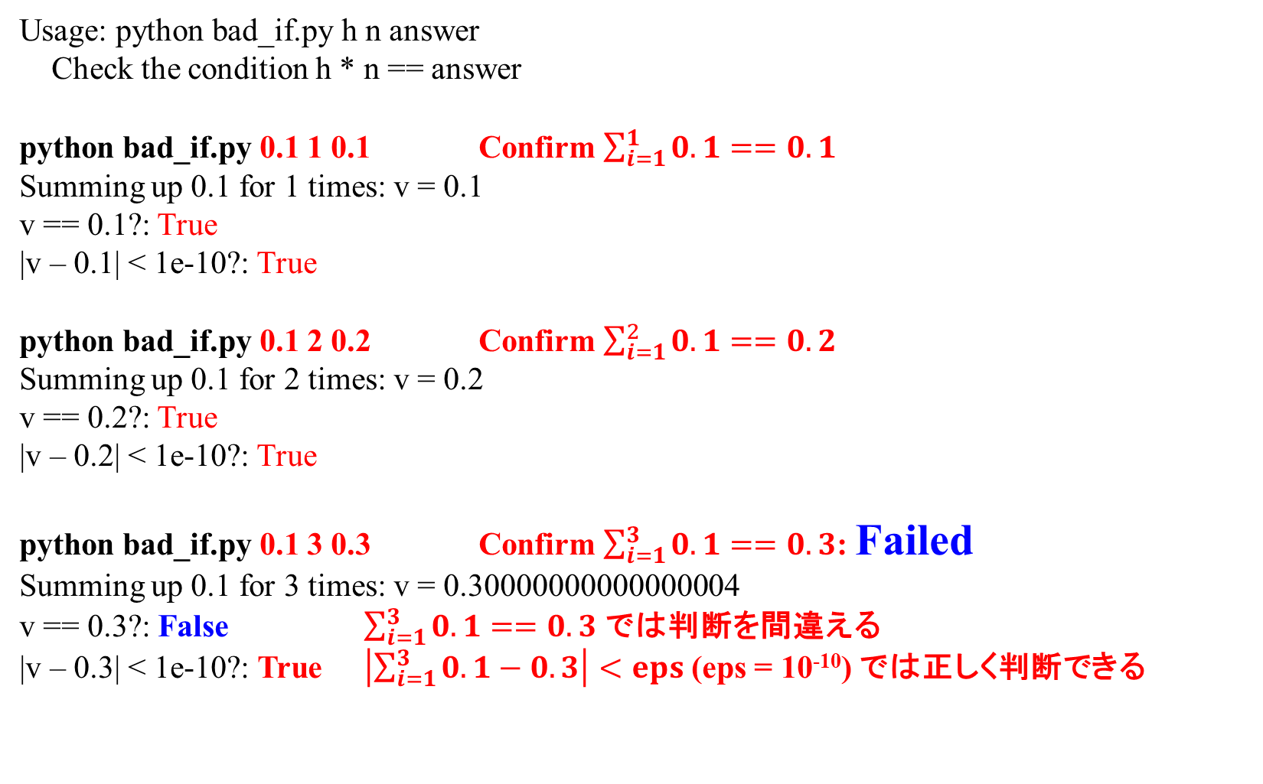
Program: bad_if.py
Usage: python bad_if.py h n answer
Check the condition h * n == answer
python bad_if.py 0.1 1 0.1 Confirm $\sum_{i=1}^{1}{0.1}==0.1$
Summing up 0.1 for 1 times: v = 0.1
v == 0.1?: True
|v – 0.1| < 1e-10?: True
python bad_if.py 0.1 2 0.2 Confirm $\sum_{i=1}^{2}{0.1}==0.2$
Summing up 0.1 for 2 times: v = 0.2
v == 0.2?: True
|v – 0.2| < 1e-10?: True
python bad_if.py 0.1 3 0.3 Confirm $\sum_{i=1}^{3}{0.1}==0.3$: Failed
Summing up 0.1 for 3 times: v = 0.30000000000000004
v == 0.3?: False $\sum_{i=1}^{3}{0.1}==0.3$ では判断を間違える
|v – 0.3| < 1e-10?: True $\left|\sum_{i=1}^{3}{0.1}−0.3\right|<eps$ (eps = 10⁻¹⁰) では正しく判断できる

Slide 30
How to use conditional branch, if
(条件分岐の判断)
Bad (悪い例):
if x * 10.0 == 30.0:
DO NOT use the strict comparison ‘==‘ for floating values
(浮動小数点の比較には、厳密な比較 == は使わない)
Good (良い例):
eps = 1.0e-30 # epsilon:
A value satisfactory smaller than minimum expected value
(想定される誤差よりも十分大きいが、
なるべく小さい値を設定する)
if abs(x * 10.0 - 30.0) < eps

Slide 31
Program: bad_int.py
Usage: python bad_int.py h n
Check interger conversion of the summation of h for n times
python bad_int.py 0.1 100
Summing up 0.1 for 100 times: v = 9.99999999999998
int(9.99999999999998) = 9 10でなければいけない
int(9.99999999999998 + 1e-10) = 10 eps (10⁻¹⁰) を加えてから int() を取ることで正しい解
python bad_int.py 0.4 20
Summing up 0.4 for 20 times: v = 8.000000000000002
int(8.000000000000002) = 8 正しい解だが、v には誤差があることに注意
int(8.000000000000002 + 1e-10) = 8 eps (10⁻¹⁰) を加えてから int() を取っても正しい解
python bad_int.py 1.2 20
Summing up 1.2 for 20 times: v = 23.999999999999993
int(23.999999999999993) = 23 24でなければいけない
int(23.999999999999993 + 1e-10) = 24 eps (10⁻¹⁰) を加えてから int() を取ることで正しい解
Case for floating point to integer conversion (浮動小数点 => 整数変換):
Bad (悪い例):
n = int(v)
Good (良い例):
eps = 1.0e-6
n = int(v + eps)

Slide 32
Typical cases for FP calculations with care
Evaluate possible errors every time for FP floating point calculations
・ Error originates from the limited length of FP type: underflow, overflow
Representation range of 64bit FP (IEEE 754 standard)
Exponent: 11 bit -1024 ~ +1023
Fraction : 23 bit 4,503,599,627,370,495: 16 digits
・ FP type in computer cannot represent accurate values for most of integers
100.0₁₀ = 1.5625×64 = (1+2⁻¹+2⁻⁴) × 2⁶ = (1.1001)₂×2⁴
・ Most of FP values in computer include errors
1.0/3.0 ＝ 0.3333…333 (16 digits) Error ~ 10⁻¹⁶ should be included
Conditional branch:
Bad: if x * 10.0 == 30.0: No guarantee to get the correct judge ‘true’ even if x = 3.0
Good: eps = 1.0e-30 # epsilon: A value satisfactory smaller than expected values
if abs(x * 10.0 - 30.0) < eps: Gives the correct judge within the error of eps
FP => integer conversion:
How to calculate the number of division in the range xmin – xmax at xstep step
Bad: n = int( (xmax – xmin) / xstep): The value in int() can include error.
Even if the correct value is n = 3.0,
you will get n = 2 if int() becomes 2.99999… due to error,.
Good:
eps = 1.0e-6
n = int( (xmax – xmin) / xstep + eps)
Even if (xmax – xmin) / xstep becomes smaller than the expected integer due to erro,
you can receive the correct value as long as the error is smaller than eps.

Slide 33
数値演算プログラムの一般的な注意
浮動小数点型の演算では、常に誤差を意識すること
・ 変数長の制限による誤差: underflow, overflow
IEEE 754の標準で、64bit浮動小数点の範囲は
指数部: 11 bit -1024 ~ +1023
仮数部: 23 bit 4,503,599,627,370,495: 16桁
・ 浮動小数点では、整数を “正確に” 表現できない
100.0₁₀ = 1.5625×64 = (1+2⁻¹+2⁻⁴) × 2⁶ = (1.1001)₂×2⁴
・ 有限の桁数の浮動小数点の表現は、ほぼすべての場合に誤差を含む
1.0/3.0 ＝ 0.3333…333 (小数点以下16桁) 10⁻¹⁶ 程度の誤差が発生する
条件分岐の判断:
悪い例: if x * 10.0 == 30.0: x = 3.0 であっても、true と判断される保証はない
良い例: eps = 1.0e-30 # epsilon: 想定される誤差よりも十分大きいが、なるべく小さい値を設定する。
if abs(x * 10.0 - 30.0) < eps: 誤差 eps 以内で必ず実行される
浮動小数点 => 整数変換: xmin ~ xmax の範囲を xstep 毎の幅で分割したときの分点の数
悪い例:
n = int( (xmax – xmin) / xstep):
(xmax – xmin) / xstepが誤差により 2.99999… となった場合、
本来はint() = 3 となって欲しいのに、2 となってしまう
良い例:
eps = 1.0e-6
n = int( (xmax – xmin) / xstep + eps):
(xmax – xmin) / xstepが誤差により期待する整数値より小さくなっても、
誤差がepsより小さければ、本来期待している整数値が得られる

Slide 34
Precision and errors in computer
Data bit width (データ長): Determine the upper limit of precision
=> Roundoff (rounding) error (丸め誤差)
Other error sources
・ Overflow (積み残し誤差, 桁あふれ):
e.g. by summation between large integers (有効桁数を超える整数の和・積)
⬄ underflow
(overflow and underflow can be detected by CPU / software
but may deteriorate calculation speed)
・ Roundoff error (桁落ち誤差)： By subtracting very similar values
ex: for 4 digits calculation:
5√41 – 32 ~ 5*6.403 – 32.00 = 32.015 – 32.00 = 32.02 – 32.00 = 0.02
The given values have 4 significant digits
but the result has only 1 significant digits
Avoid subtraction between similar large values
・ Loss of trailing digits (情報落ち)：
by summing / subtracting between largely-different values
ex: 1000 + 1.456 = 1001 (The initial significant value of .456 is lost)

Slide 35
Errors in calculation process
・ Overflow (summing large values)
・ Underflow (huge numbers of summing up small values)
・ Rounding off error
・ Information buried (情報埋没)
・ Truncation error (打切り誤差)
To sum up values slowly approaching to zero:
・ Tailor expansion (テーラー展開)
・ Summation of Coulomb energy (Coulombエネルギーの和)
Need to terminate the summation if calculation time has
limitation or the result reaches the required precision
(計算時間と必要な精度に応じて、どこかで計算を打ち切る)
・ Convergence error (収束誤差)
The required precision (often expressed EPS) is given to judge
the termination of iterative convergence calculations
・ Errors originating from physical model (物理モデルの誤差)

Slide 36
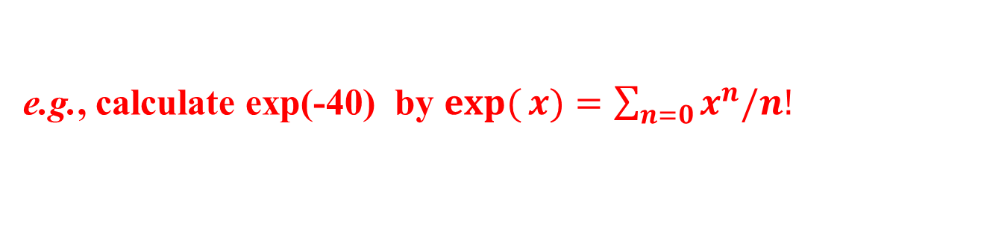
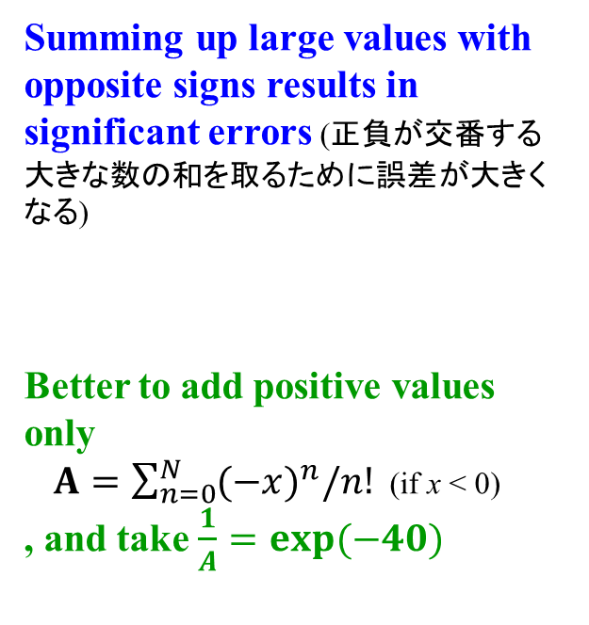
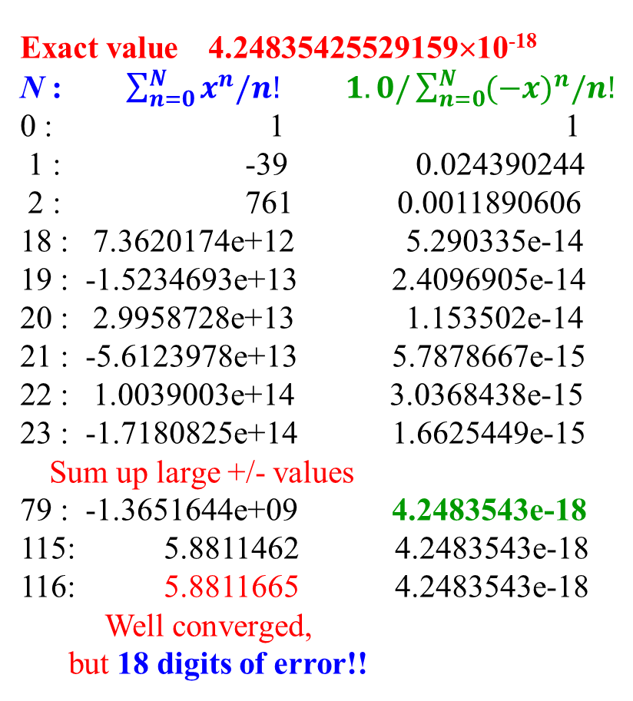
Information buried (情報埋没)
exact: exp(-40.0) = 4.248354255291589e-18
n : sum(x^n/n!) 1 / sum((-x)^n/n!)
0 : 1 1
1 : -39 0.024390244
2 : 761 0.0011890606
3 : -9905.6667 8.6898589e-05
4 : 96761 8.4620744e-06
5 : -756572.33 1.029328e-06
6 : 4932316.6 1.5014121e-07
7 : -27575620 2.5530829e-08
8 : 1.3496406e+08 4.9576612e-09
9 : -5.8743453e+08 1.0821262e-09
10 : 2.3021598e+09 2.6221248e-10
11 : -8.205456e+09 6.9825981e-11
12 : 2.681993e+10 2.0264778e-11
13 : -8.0950489e+10 6.3646787e-12
14 : 2.2696499e+11 2.1503869e-12
15 : -5.9414296e+11 7.7751999e-13
16 : 1.4586269e+12 2.994989e-13
17 : -3.3714199e+12 1.2241465e-13
18 : 7.3620174e+12 5.290335e-14
19 : -1.5234693e+13 2.4096905e-14
20 : 2.9958728e+13 1.153502e-14
21 : -5.6123978e+13 5.7878667e-15
22 : 1.0039003e+14 3.0368438e-15
23 : -1.7180825e+14 1.6625449e-15
24 : 2.8185555e+14 9.4773137e-16
25 : -4.4400652e+14 5.6147809e-16
26 : 6.7270436e+14 3.450984e-16
27 : -9.8168213e+14 2.1967831e-16
28 : 1.3817271e+15 1.4460229e-16
29 : -1.8781477e+15 9.8276284e-17
30 : 2.4683521e+15 6.8861538e-17
31 : -3.1400348e+15 4.9676404e-17
32 : 3.8704488e+15 3.6844945e-17
33 : -4.627107e+15 2.8059683e-17
34 : 5.3700175e+15 2.1912791e-17
35 : -6.0552677e+15 1.7525187e-17
36 : 6.6394936e+15 1.4335789e-17
37 : -7.0845726e+15 1.1978981e-17
38 : 7.3618129e+15 1.0211798e-17
39 : -7.4549928e+15 8.86975e-18
40 : 7.3618129e+15 7.8394755e-18
41 : -7.0936073e+15 7.0415109e-18
42 : 6.6734595e+15 6.4192251e-18
43 : -6.1331142e+15 5.9315986e-18
44 : 5.5092256e+15 5.5484364e-18
45 : -4.8395209e+15 5.2471485e-18
46 : 4.1593891e+15 5.0105569e-18
47 : -3.4992577e+15 4.8253871e-18
48 : 2.8829479e+15 4.6812214e-18
49 : -2.3270159e+15 4.5697693e-18
50 : 1.8409552e+15 4.4843572e-18
51 : -1.4280417e+15 4.4195692e-18
52 : 1.0865713e+15 4.3709922e-18
53 : -8.1124987e+14 4.3350315e-18
54 : 5.9454356e+14 4.3087732e-18
55 : -4.2785166e+14 4.2898751e-18
56 : 3.0243064e+14 4.2764777e-18
57 : -2.1004817e+14 4.2671258e-18
58 : 1.433855e+14 4.2607001e-18
59 : -9.6230546e+13 4.2563546e-18
60 : 6.3513482e+13 4.2534626e-18
61 : -4.12367e+13 4.2515683e-18
62 : 2.6344063e+13 4.2503471e-18
63 : -1.6564358e+13 4.249572e-18
64 : 1.0253405e+13 4.2490878e-18
65 : -6.2498339e+12 4.2487899e-18
66 : 3.752129e+12 4.2486093e-18
67 : -2.2191922e+12 4.2485015e-18
68 : 1.2933497e+12 4.2484381e-18
69 : -7.4290646e+11 4.2484014e-18
70 : 4.2066848e+11 4.2483804e-18
71 : -2.348667e+11 4.2483685e-18
72 : 1.2931951e+11 4.248362e-18
73 : -7.0234575e+10 4.2483584e-18
74 : 3.7632498e+10 4.2483564e-18
75 : -1.9896608e+10 4.2483554e-18
76 : 1.0381869e+10 4.2483548e-18
77 : -5.3472097e+09 4.2483545e-18
78 : 2.7189846e+09 4.2483544e-18
79 : -1.3651644e+09 4.2483543e-18
80 : 6.7691006e+08 4.2483543e-18
81 : -3.3152179e+08 4.2483543e-18
82 : 1.6039619e+08 4.2483543e-18
83 : -76672718 4.2483543e-18
84 : 36217237 4.2483543e-18
85 : -16907447 4.2483543e-18
86 : 7801708.4 4.2483543e-18
87 : -3558823 4.2483543e-18
88 : 1605054.9 4.2483543e-18
89 : -715789.09 4.2483543e-18
90 : 315697.13 4.2483543e-18
91 : -137703.4 4.2483543e-18
92 : 59427.263 4.2483543e-18
93 : -25360.121 4.2483543e-18
94 : 10719.617 4.2483543e-18
95 : -4471.8519 4.2483543e-18
96 : 1857.9266 4.2483543e-18
97 : -752.29133 4.2483543e-18
98 : 313.10376 4.2483543e-18
99 : -117.35891 4.2483543e-18
100: 54.82616 4.2483543e-18
101: -13.365945 4.2483543e-18
102: 13.376057 4.2483543e-18
103: 2.9908133 4.2483543e-18
104: 6.9851377 4.2483543e-18
105: 5.4634903 4.2483543e-18
106: 6.0376969 4.2483543e-18
107: 5.8230402 4.2483543e-18
108: 5.9025427 4.2483543e-18
109: 5.8733674 4.2483543e-18
110: 5.8839766 4.2483543e-18
111: 5.8801535 4.2483543e-18
112: 5.8815189 4.2483543e-18
113: 5.8810356 4.2483543e-18
114: 5.8812052 4.2483543e-18
115: 5.8811462 4.2483543e-18
116: 5.8811665 4.2483543e-18
117: 5.8811596 4.2483543e-18
118: 5.8811619 4.2483543e-18
119: 5.8811611 4.2483543e-18
0: nn=1: v = 1: 1
1: nn=1: v = -40: -39
2: nn=2: v = 800: 761
3: nn=6: v = -10666.6666666667: -9905.66666666667
4: nn=24: v = 106666.666666667: 96761
5: nn=120: v = -853333.333333333: -756572.333333333
6: nn=720: v = 5688888.88888889: 4932316.55555556
7: nn=5040: v = -32507936.5079365: -27575619.952381
8: nn=40320: v = 162539682.539683: 134964062.587302
9: nn=362880: v = -722398589.065256: -587434526.477954
10: nn=3628800: v = 2889594356.26102: 2302159829.78307
11: nn=39916800: v = -10507615840.9492: -8205456011.16611
12: nn=479001600: v = 35025386136.4972: 26819930125.3311
13: nn=6227020800: v = -107770418881.53: -80950488756.1989
14: nn=87178291200: v = 307915482518.657: 226964993762.458
15: nn=1307674368000: v = -821107953383.086: -594142959620.627
16: nn=20922789888000: v = 2052769883457.71: 1458626923837.09
17: nn=355687428096000: v = -4830046784606.39: -3371419860769.3
18: nn=6.402373705728e+015: v = 10733437299125.3: 7362017438356
19: nn=1.21645100408832e+017: v = -22596710103421.7: -15234692665065.7
20: nn=2.43290200817664e+018: v = 45193420206843.4: 29958727541777.7
21: nn=5.10909421717094e+019: v = -86082705155892.2: -56123977614114.5
22: nn=1.12400072777761e+021: v = 156514009374349: 100390031760235
23: nn=2.5852016738885e+022: v = -272198277172782: -171808245412547
24: nn=6.20448401733239e+023: v = 453663795287969: 281855549875423
25: nn=1.5511210043331e+025: v = -725862072460751: -444006522585328
26: nn=4.03291461126606e+026: v = 1.11671088070885e+015: 672704358123519
27: nn=1.08888694504184e+028: v = -1.65438648993903e+015: -981682131815514
28: nn=3.04888344611714e+029: v = 2.36340927134148e+015: 1.38172713952596e+015
29: nn=8.8417619937397e+030: v = -3.25987485702273e+015: -1.87814771749676e+015
30: nn=2.65252859812191e+032: v = 4.34649980936363e+015: 2.46835209186687e+015
31: nn=8.22283865417792e+033: v = -5.60838685079179e+015: -3.14003475892492e+015
32: nn=2.63130836933694e+035: v = 7.01048356348973e+015: 3.87044880456482e+015
33: nn=8.68331761881189e+036: v = -8.49755583453301e+015: -4.62710702996819e+015
34: nn=2.95232799039604e+038: v = 9.9971245112153e+015: 5.37001748124711e+015
35: nn=1.03331479663861e+040: v = -1.14252851556746e+016: -6.05526767442752e+015
36: nn=3.71993326789901e+041: v = 1.26947612840829e+016: 6.63949360965541e+015
37: nn=1.37637530912263e+043: v = -1.37240662530626e+016: -7.08457264340722e+015
38: nn=5.23022617466601e+044: v = 1.44463855295396e+016: 7.36181288613239e+015
39: nn=2.03978820811974e+046: v = -1.48168056713227e+016: -7.45499278519028e+015
40: nn=8.15915283247898e+047: v = 1.48168056713227e+016: 7.36181288613239e+015
41: nn=3.34525266131638e+049: v = -1.44554201671441e+016: -7.09360728101168e+015
42: nn=1.40500611775288e+051: v = 1.37670668258515e+016: 6.67345954483981e+015
43: nn=6.04152630633738e+052: v = -1.28065737914898e+016: -6.13311424664995e+015
44: nn=2.65827157478845e+054: v = 1.16423398104452e+016: 5.50922556379529e+015
45: nn=1.1962222086548e+056: v = -1.03487464981735e+016: -4.83952093437826e+015
46: nn=5.50262215981209e+057: v = 8.99890999841178e+015: 4.15938906403352e+015
47: nn=2.58623241511168e+059: v = -7.65864680715896e+015: -3.49925774312544e+015
48: nn=1.24139155925361e+061: v = 6.38220567263247e+015: 2.88294792950703e+015
49: nn=6.08281864034268e+062: v = -5.20996381439385e+015: -2.32701588488682e+015
50: nn=3.04140932017134e+064: v = 4.16797105151508e+015: 1.84095516662826e+015
51: nn=1.55111875328738e+066: v = -3.26899690314908e+015: -1.42804173652082e+015
52: nn=8.06581751709439e+067: v = 2.51461300242237e+015: 1.08657126590155e+015
53: nn=4.27488328406003e+069: v = -1.89782113390368e+015: -811249868002128
54: nn=2.30843697339241e+071: v = 1.40579343252124e+015: 594543564519114
55: nn=1.26964033536583e+073: v = -1.02239522365181e+015: -427851659132698
56: nn=7.10998587804863e+074: v = 730282302608437: 302430643475739
57: nn=4.05269195048772e+076: v = -512478808848026: -210048165372287
58: nn=2.35056133128288e+078: v = 353433661274501: 143385495902214
59: nn=1.3868311854569e+080: v = -239616041542034: -96230545639820.8
60: nn=8.32098711274139e+081: v = 159744027694690: 63513482054868.7
61: nn=5.07580213877225e+083: v = -104750182094878: -41236700040009.7
62: nn=3.14699732603879e+085: v = 67580762641857: 26344062601847.4
63: nn=1.98260831540444e+087: v = -42908420724988.6: -16564358123141.2
64: nn=1.26886932185884e+089: v = 26817762953117.9: 10253404829976.6
65: nn=8.24765059208247e+090: v = -16503238740380.2: -6249833910403.6
66: nn=5.44344939077443e+092: v = 10001962872957.7: 3752128962554.12
67: nn=3.64711109181887e+094: v = -5971321118183.71: -2219192155629.59
68: nn=2.48003554243683e+096: v = 3512541834225.71: 1293349678596.12
69: nn=1.71122452428141e+098: v = -2036256135783.02: -742906457186.903
70: nn=1.19785716699699e+100: v = 1163574934733.16: 420668477546.252
71: nn=8.50478588567862e+101: v = -655535174497.552: -234866696951.3
72: nn=6.12344583768861e+103: v = 364186208054.196: 129319511102.896
73: nn=4.47011546151268e+105: v = -199554086605.039: -70234575502.1432
74: nn=3.30788544151939e+107: v = 107867073840.562: 37632498338.4183
75: nn=2.48091408113954e+109: v = -57529106048.2995: -19896607709.8812
76: nn=1.88549470166605e+111: v = 30278476867.526: 10381869157.6449
77: nn=1.45183092028286e+113: v = -15729078892.2213: -5347209734.57646
78: nn=1.13242811782063e+115: v = 8066194303.70324: 2718984569.12678
79: nn=8.94618213078297e+116: v = -4084149014.53329: -1365164445.4065
80: nn=7.15694570462638e+118: v = 2042074507.26664: 676910061.86014
81: nn=5.79712602074737e+120: v = -1008431855.44032: -331521793.580178
82: nn=4.75364333701284e+122: v = 491917978.26357: 160396184.683392
83: nn=3.94552396972066e+124: v = -237068905.187262: -76672720.5038709
84: nn=3.31424013456535e+126: v = 112889954.851077: 36217234.3472065
85: nn=2.81710411438055e+128: v = -53124684.6358011: -16907450.2885946
86: nn=2.42270953836727e+130: v = 24709155.6445587: 7801705.35596401
87: nn=2.10775729837953e+132: v = -11360531.3308316: -3558825.97486756
88: nn=1.85482642257398e+134: v = 5163877.87765071: 1605051.90278316
89: nn=1.65079551609085e+136: v = -2320843.98995538: -715792.087172221
90: nn=1.48571596448176e+138: v = 1031486.21775795: 315694.130585724
91: nn=1.3520015276784e+140: v = -453400.535278218: -137706.404692493
92: nn=1.24384140546413e+142: v = 197130.667512269: 59424.2628197751
93: nn=1.15677250708164e+144: v = -84787.3838762445: -25363.1210564694
94: nn=1.08736615665674e+146: v = 36079.7378196785: 10716.6167632091
95: nn=1.03299784882391e+148: v = -15191.4685556541: -4474.85179244501
96: nn=9.91677934870949e+149: v = 6329.77856485588: 1854.92677241087
97: nn=9.61927596824821e+151: v = -2610.21796488902: -755.29119247815
98: nn=9.42689044888324e+153: v = 1065.39508770981: 310.103895231656
99: nn=9.33262154439441e+155: v = -430.462661700932: -120.358766469276
100: nn=9.33262154439441e+157: v = 172.185064680373: 51.8262982110969
101: nn=9.42594775983835e+159: v = -68.1921048239099: -16.3658066128131
102: nn=9.61446671503512e+161: v = 26.7420018917294: 10.3761952789163
103: nn=9.90290071648618e+163: v = -10.3852434530988: -0.00904817418249237
104: nn=1.02990167451456e+166: v = 3.994324405038: 3.9852762308555
105: nn=1.08139675824029e+168: v = -1.52164739239543: 2.46362883846008
106: nn=1.14628056373471e+170: v = 0.574206563168086: 3.03783540162816
107: nn=1.22652020319614e+172: v = -0.214656659128256: 2.82317874249991
108: nn=1.32464181945183e+174: v = 0.0795024663437987: 2.90268120884371
109: nn=1.44385958320249e+176: v = -0.0291752170068986: 2.87350599183681
110: nn=1.58824554152274e+178: v = 0.0106091698206904: 2.8841151616575
111: nn=1.76295255109024e+180: v = -0.00382312425970825: 2.88029203739779
112: nn=1.97450685722107e+182: v = 0.00136540152132438: 2.88165743891911
113: nn=2.23119274865981e+184: v = -0.000483327972150221: 2.88117411094696
114: nn=2.54355973347219e+186: v = 0.000169588762157972: 2.88134369970912
115: nn=2.92509369349301e+188: v = -5.89873955332078e-005: 2.88128471231359
116: nn=3.3931086844519e+190: v = 2.03404812183475e-005: 2.88130505279481
117: nn=3.96993716080872e+192: v = -6.95401067293932e-006: 2.88129809878413
118: nn=4.68452584975429e+194: v = 2.35729175353875e-006: 2.88130045607589
119: nn=5.5745857612076e+196: v = -7.92366975979413e-007: 2.88129966370891
120: nn=6.68950291344912e+198: v = 2.64122325326471e-007: 2.88129992783124
121: nn=8.09429852527344e+200: v = -8.73131653971805e-008: 2.88129984051807
122: nn=9.8750442008336e+202: v = 2.86272673433379e-008: 2.88129986914534
123: nn=1.21463043670253e+205: v = -9.30968043685784e-009: 2.88129985983566
124: nn=1.50614174151114e+207: v = 3.00312272156704e-009: 2.88129986283878
125: nn=1.88267717688893e+209: v = -9.60999270901454e-010: 2.88129986187778
126: nn=2.37217324288005e+211: v = 3.05079133619509e-010: 2.88129986218286
127: nn=3.01266001845766e+213: v = -9.60879161006329e-011: 2.88129986208677
128: nn=3.8562048236258e+215: v = 3.00274737814478e-011: 2.8812998621168
129: nn=4.97450422247729e+217: v = -9.31084458339466e-012: 2.88129986210749
130: nn=6.46685548922047e+219: v = 2.86487525642912e-012: 2.88129986211035
131: nn=8.47158069087882e+221: v = -8.74771070665382e-013: 2.88129986210948
132: nn=1.118248651196e+224: v = 2.65082142625873e-013: 2.88129986210974
133: nn=1.48727070609069e+226: v = -7.97239526694356e-014: 2.88129986210966
134: nn=1.99294274616152e+228: v = 2.37981948266972e-014: 2.88129986210969
135: nn=2.69047270731805e+230: v = -7.05131698568805e-015: 2.88129986210968
136: nn=3.65904288195255e+232: v = 2.07391676049649e-015: 2.88129986210968
137: nn=5.01288874827499e+234: v = -6.05523141750799e-016: 2.88129986210968
138: nn=6.91778647261949e+236: v = 1.75513954130666e-016: 2.88129986210968
139: nn=9.61572319694109e+238: v = -5.05076126994723e-017: 2.88129986210968
140: nn=1.34620124757175e+241: v = 1.44307464855635e-017: 2.88129986210968
141: nn=1.89814375907617e+243: v = -4.09382879023079e-018: 2.88129986210968
142: nn=2.69536413788816e+245: v = 1.15319120851571e-018: 2.88129986210968
143: nn=3.85437071718007e+247: v = -3.22570967416983e-019: 2.88129986210968
144: nn=5.5502938327393e+249: v = 8.96030465047176e-020: 2.88129986210968
145: nn=8.04792605747199e+251: v = -2.47180817944048e-020: 2.88129986210968
146: nn=1.17499720439091e+254: v = 6.77207720394653e-021: 2.88129986210968
147: nn=1.72724589045464e+256: v = -1.84274209631198e-021: 2.88129986210968
148: nn=2.55632391787286e+258: v = 4.98038404408644e-022: 2.88129986210968
149: nn=3.80892263763057e+260: v = -1.33701585076146e-022: 2.88129986210968
150: nn=5.71338395644585e+262: v = 3.56537560203056e-023: 2.88129986210968
Program: python information_buried.py
e.g., calculate exp(-40) by $\exp{(}x)=\sum_{n=0}{x^{n}/n!}$
Exact value 4.24835425529159×10⁻¹⁸
N : $\sum_{n=0}^{N}{x^{n}/n!}$ $1.0/\sum_{n=0}^{N}{{(−x)}^{n}/n!}$
0 : 1 1
1 : -39 0.024390244
2 : 761 0.0011890606
18 : 7.3620174e+12 5.290335e-14
19 : -1.5234693e+13 2.4096905e-14
20 : 2.9958728e+13 1.153502e-14
21 : -5.6123978e+13 5.7878667e-15
22 : 1.0039003e+14 3.0368438e-15
23 : -1.7180825e+14 1.6625449e-15
Sum up large +/- values
79 : -1.3651644e+09 4.2483543e-18
115: 5.8811462 4.2483543e-18
116: 5.8811665 4.2483543e-18
Well converged,
but 18 digits of error!!
Summing up large values with opposite signs results in significant errors (正負が交番する大きな数の和を取るために誤差が大きくなる)
Better to add positive values only
$A=\sum_{n=0}^{N}{{(−x)}^{n}/n!}$ (if x < 0)
, and take $\frac{1}{A}=exp(−40)$

Slide 37
Supplementary materials

Slide 38
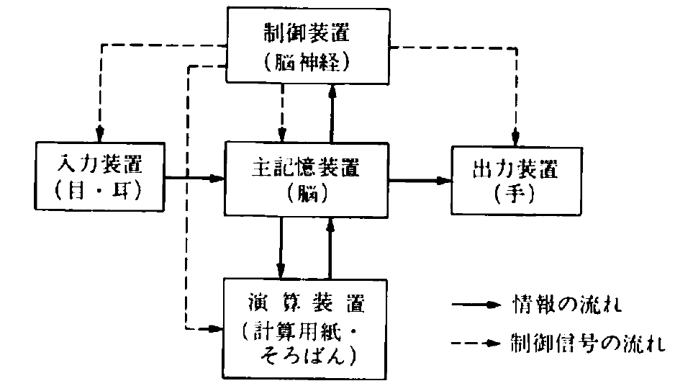
Structure of typical computer
(基本的な計算機の構成)
大河内他、基礎 電子計算機、実教出版
Control unit
CPU/APU
Display
Printer
Speaker
Memory
DRAM/SRAM
Input unit
Output unit
Keyboard
Mouse
Camera
Microphone
Flow of information
Process unit
Flow of control signals

Slide 39
Computer architectures
4bit CPU: Intel 4004 (1971) data 4bit, address 12bit
8bit CPU: 8008 (1972) data 8bit, address 14bit
16bit CPU: 8086 (1978) data 16bit, address 20bit
32bit CPU: 80386SX (1985) External data/address 32bit
Internal data 16bit, address 24bit
80486 (1989) data 32bit, address 32bit
Pentium,,,
64bit CPU: Pentium Pro(?), Itanium, Core i,, …
Pentium Pro:
Processor 32bit: Operation (命令)・Process (データ処理) in CPU
External data bus (外部データバス)
64bit: Data transfer with memory / external units
Floating point operation (浮動小数点演算)
80bit

Slide 40
Logical operations (bitwise operations)
(論理演算, ビット演算)
Logical NOT (Bitwise inversion) (論理否定, ビット反転)
NOT 0 = 1; NOT 1 = 0
Logical AND (論理積)
0 AND 0 = 0; 1 AND 0 = 0
0 AND 1 = 0; 1 AND 1 = 1
Logical OR (論理和)
0 OR 0 = 0; 1 OR 0 = 1
0 OR 1 = 1; 1 OR 1 = 1
Logical Exclusive OR (排他的論理和)
0 XOR 0 = 0; 1 XOR 0 = 1
0 XOR 1 = 1; 1 XOR 1 = 0

Slide 41
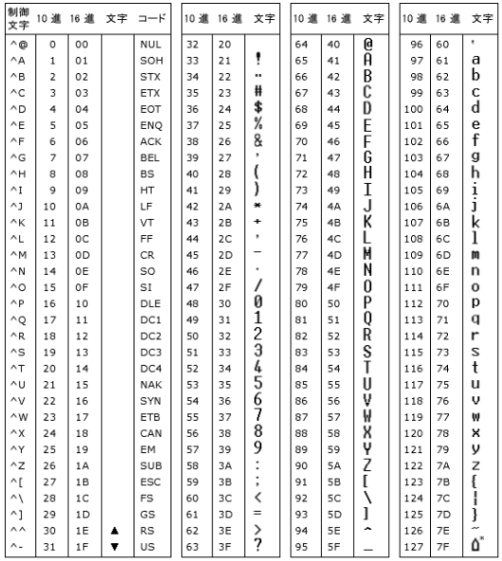
Required data size: Character type
Alphanumeric (英数字文字):
0~9, A~Z, a~z,
Control chars (制御文字) etc
ASCII code: 7 bit (0 ~ 127)
Extended ASCII code
Add non-English chars,
symbols etc: 8 bit
Japanese
ASCII+half-width Kana (半角カナ): 8bit
Kanji・Kana (Full-width Kana, 全角文字): 16 bit
Shift-JIS (SJIS), JIS, EUC-JP
Universal character codes
(全世界共通文字コード)
Unicode: Started from 2 Bytes (Ver1.0.0)
Extended to 1 – 4 Bytes (UCS, Unicode / UTF-7/8/16 etc)

