Slide 1
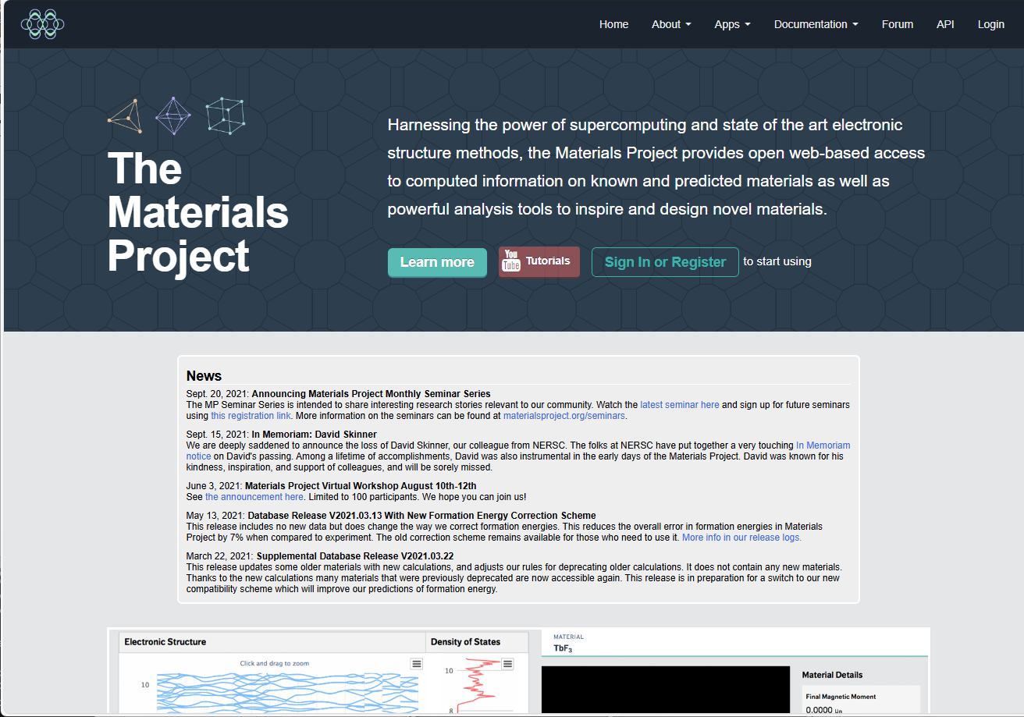
Search Materials Project: First step
Access: https://legacy.materialsproject.org/?trk=public_post_comment-text
Create your account by “Register”, then goto “API”
Notes:
1

Slide 2
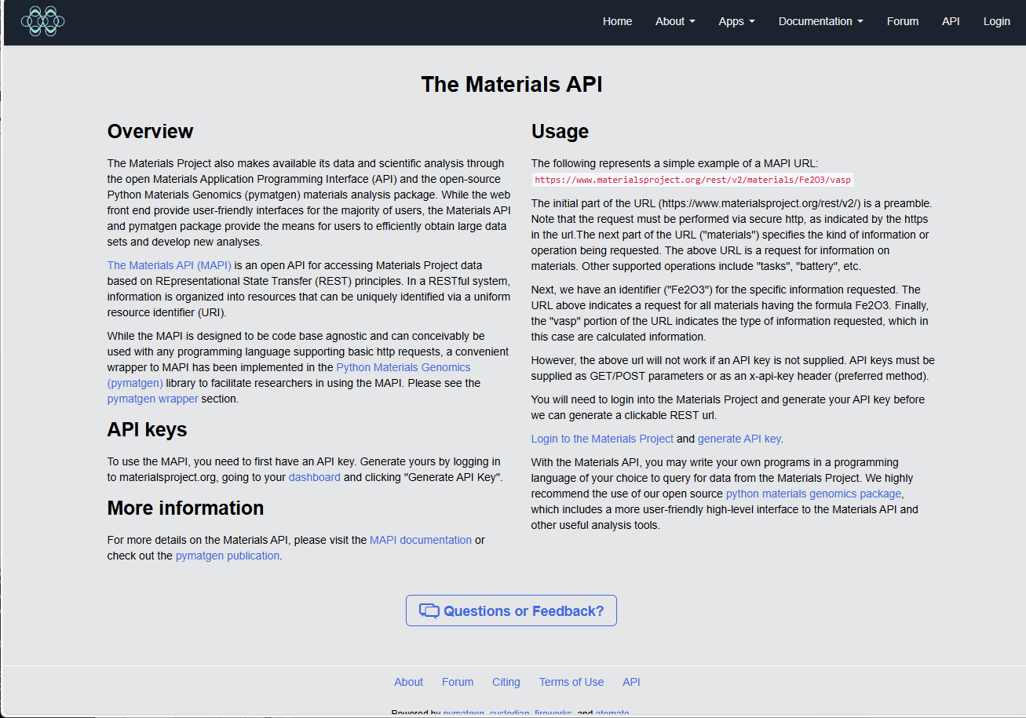
First step: Getting Materials Project API Key
API page
Log in and get your API Key
Add your API Key to
the environment variable
MP_API_KEY
Notes:
2

Slide 3
What we can get?: Output files
Meta information:
TEXT
including band gap, CBM, VBM, energy, dielectric/piezoelectric constant,
magnetic moments
Structure:
CIF/POSCAR
JSON
Electronic/phonon band/dos
JSON
CSV
PNG
Phase diagram:
CSV
HTML: Figure file made by Plotly
Notes:
3

Slide 4
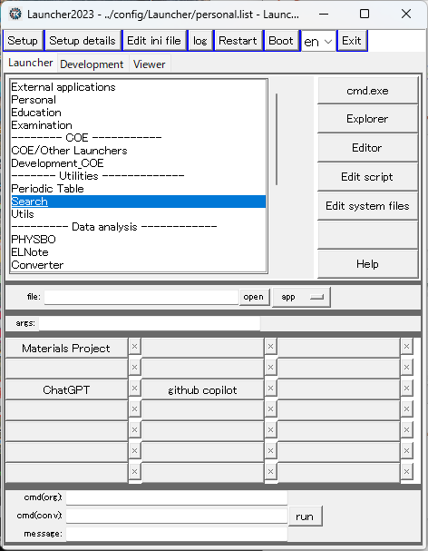
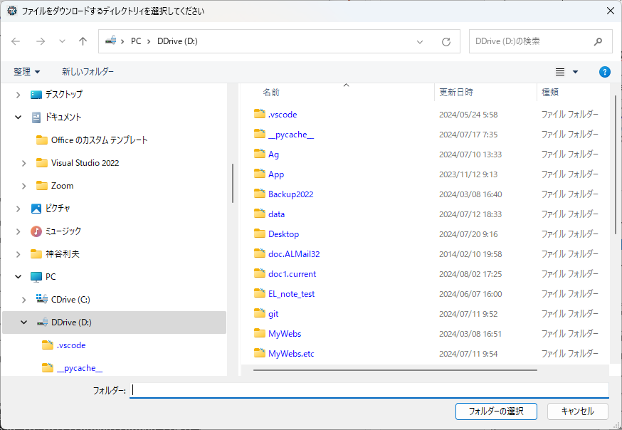
How to launch: Search Materials Project
プログラム: [tkprog_X_path]/MaterialsProject/{search_mp.py, get_phase_diagram.py}
Choose directory to save downloaded files
Notes:
4

Slide 5
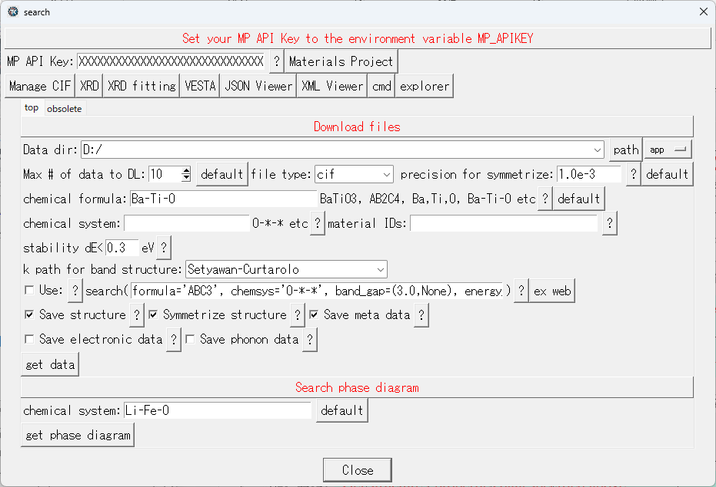
Search Materials Project: Search by formula
Check your API Key is obtained correctly
Specify material by chemical formula or elements
BaTiO3: chemical formula
Ba,Ti,O: materials that doesn’t include other elements
Ba-Ti-O: materials constituted of only these elements
Get structure / properties data specified above
Get phase diagram specified by the “chemical formula”
Notes:
5

Slide 6
Search Materials Project: Search by formula
Increase if needed
Energy unstability: 0.0 if you wants know ground-state phases only.
0.3 eV roughly corresponds to 10k_{B}T (T = 300 K) and 3500 K,
which would safely cover expected synthesis / metastable conditions.
Get structure / properties data specified above
Get phase diagram specified by the “chemical formula”
Notes:
6

Slide 7
Search Materials Project: Search by formula
Pre-defined k-path for electronic band
Get structure / properties data specified above
Get phase diagram specified by the “chemical formula”
Notes:
7

Slide 8
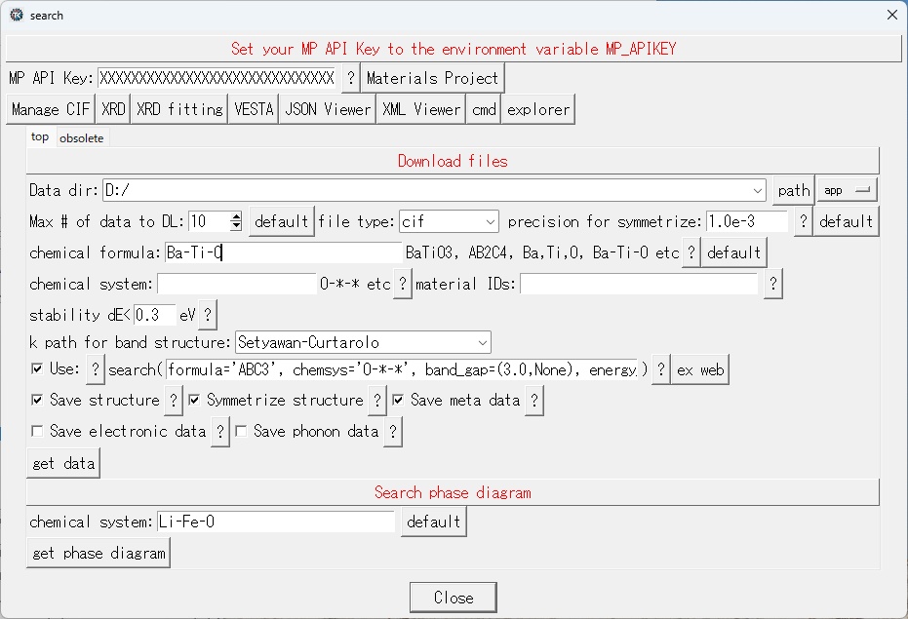
Search Materials Project: Low-level search
If this option is selected, the above conditions about chemical formula/system, material IDs are ignored. Search will be performed only by the “search( XXX )” entry box.
NOTE: Strings must be quoted by ‘’ (not “”)
See e.g. https://docs.materialsproject.org/downloading-data/using-the-api/examples
Notes:
8

Slide 9
Tips for search
See https://docs.materialsproject.org/downloading-data/using-the-api/examples
https://docs.materialsproject.org/downloading-data/using-the-api/querying-data
Specify with chemical formula:
e.g., BaTiO3 in “chemical formula”
Specify with chemical formula without specifying elements:
e.g., ABC3 in “chemical formula”
A, B, C can be any elements
Specify constituent elements that must be included:
e.g., Ba-Ti-O in “chemical formula” or “chemical system”
‘*’ can be used in “chemical system”: e.g., “O-*-*”
Specify constituent elements where at least one element must be included:
e.g., Ba,Ti,O in “chemical formula”
Choose only stable compounds at absolute zero:
Set “dE<“ to 0
Choose some metastable compounds:
Set “dE<“ to some value. Consider typical entropy is at the order of k_{B},
then 10k_{B}T (0.26 eV at 300 K, 0.8 eV at 1000 K) may covers high-T stable phases
More complicated conditions:
Use ‘Use: search ()”
For possible keys, see “available fields:” in console output.
To specify Eg range: bandgap=(1.0,2.0), bandgap=(3.0,None) etc
‘None’ indicates no limitation.
Notes:
9

Slide 10
Search Materials Project: Phase diagram
Get phase diagram specified by the “chemical formula”
Notes:
10

