Slide 1
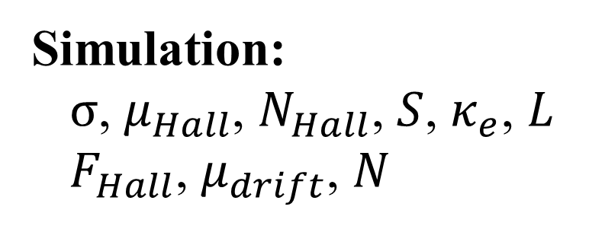
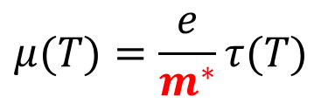
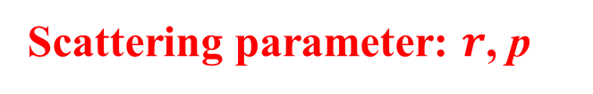
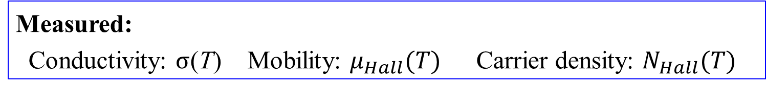


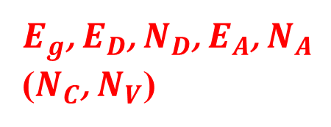
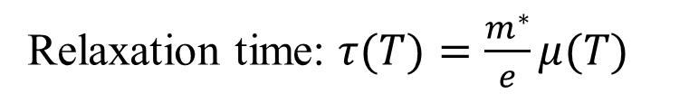
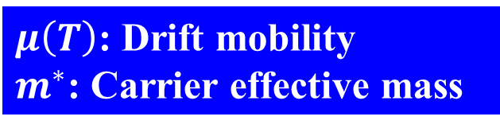
What we can know from Hall measurement?
Measured:
Conductivity: $σ$(T) Mobility: $μ_{Hall}(T)$ Carrier density: $N_{Hall}(T)$
$$μ(T)=\frac{e}{m^{∗}}τ(T)$$
Band structure
Density of states
Free carrier absorption
Relaxation time: $τ(T)=\frac{m^{∗}}{e}μ(T)$
$μ\left(T\right)$: Drift mobility
$m^{∗}$: Carrier effective mass
$$m^{∗}$$
$τ\left(E,T\right)=τ_{0}T^{p}E^{r−1/2}$
$E_{g}$, $E_{D}$, $N_{D}$, $E_{A}$, $N_{A}$
($N_{C}$, $N_{V}$)
Scattering parameter: $r$, p
$${m_{de}}^{∗}$$
Simulation:
$σ$, $μ_{Hall}$, $N_{Hall}$, $S$, $κ_{e}$, $L$
$F_{Hall}$, $μ_{drift}$, $N$

Slide 2
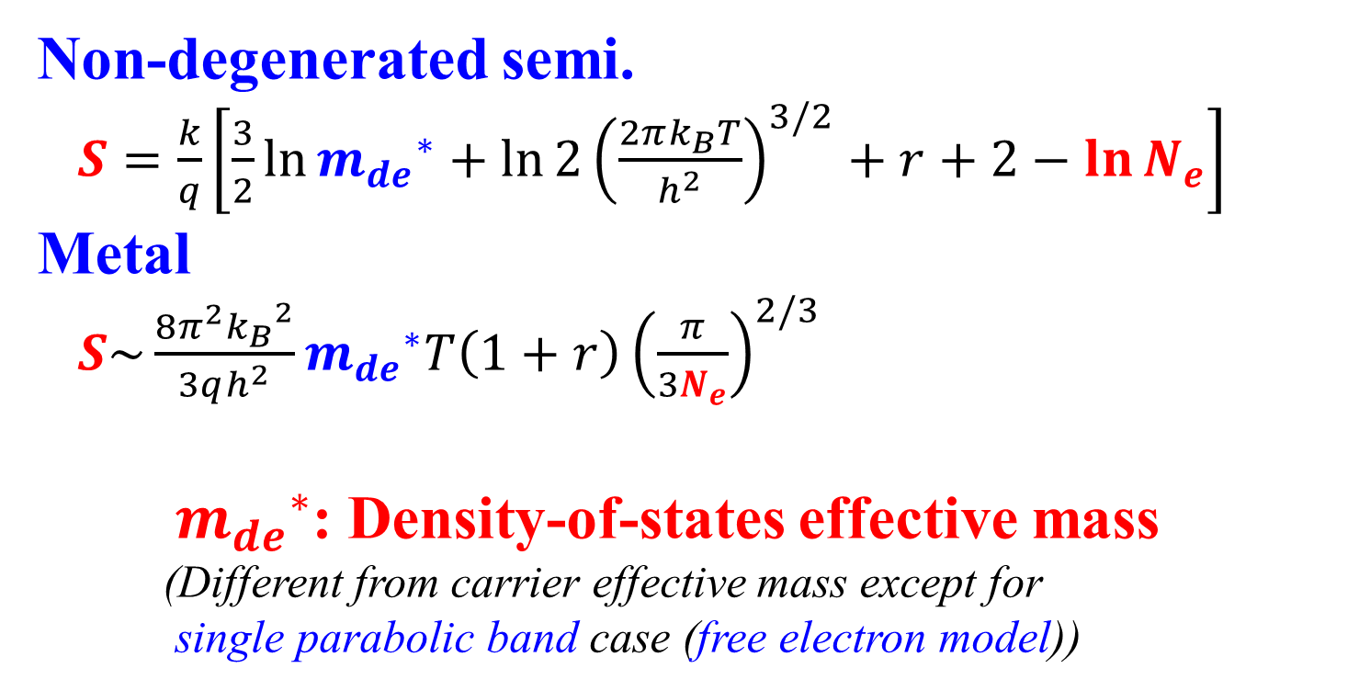
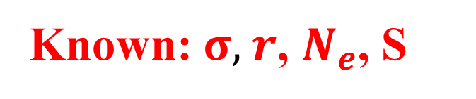
What we can know from Seebeck measurement?
Known: $σ$, $r$, $N_{e}$, S
  Non-degenerated semi.
  $S=\frac{k}{q}\left[\frac{3}{2}\ln{{m_{de}}^{∗}}+ln{2{\left(\frac{2πk_{B}T}{h^{2}}\right)}^{3/2}}+r+2−\ln{N_{e}}\right]$
  Metal
  $S\sim \frac{8π^{2}{k_{B}}^{2}}{3qh^{2}}{m_{de}}^{∗}T\left(1+r\right){\left(\frac{π}{3N_{e}}\right)}^{2/3}$
  ${m_{de}}^{∗}$: Density-of-states effective mass
  (Different from carrier effective mass except for
  single parabolic band case (free electron model))
General case: Need simulation and fitting

Slide 3
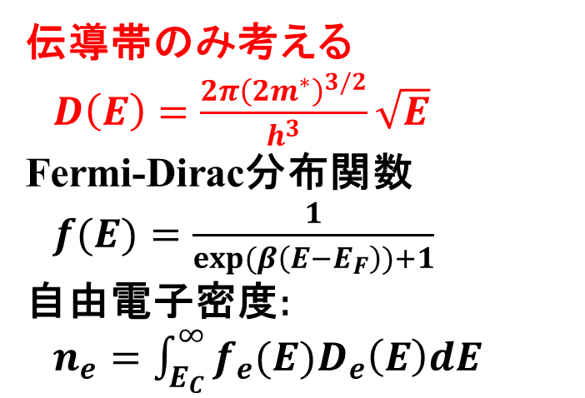
半導体: 1キャリアモデル
エネルギー E
  伝導帯のみ考える
  $D\left(E\right)=\frac{2{π\left(2m^{∗}\right)}^{3/2}}{h^{3}}\sqrt{E}$
Fermi-Dirac分布関数
  $f(E)=\frac{1}{exp(β\left(E−E_{F}\right))+1}$
  自由電子密度:
  $n_{e}=\int_{E_{C}}^{∞}{f_{e}(E)D_{e}\left(E\right)dE}$
真空準位 E_{vac}
伝導帯
伝導帯下端 E_{C}
E_{C}
バンドギャップ
E_{g}
フェルミ準位 E_{F}
E_{F}
E_{V}
価電子帯上端 E_{V}
  価電子帯はE_{F}より十分深いとして無視
価電子帯
状態密度 D(E)

Slide 4
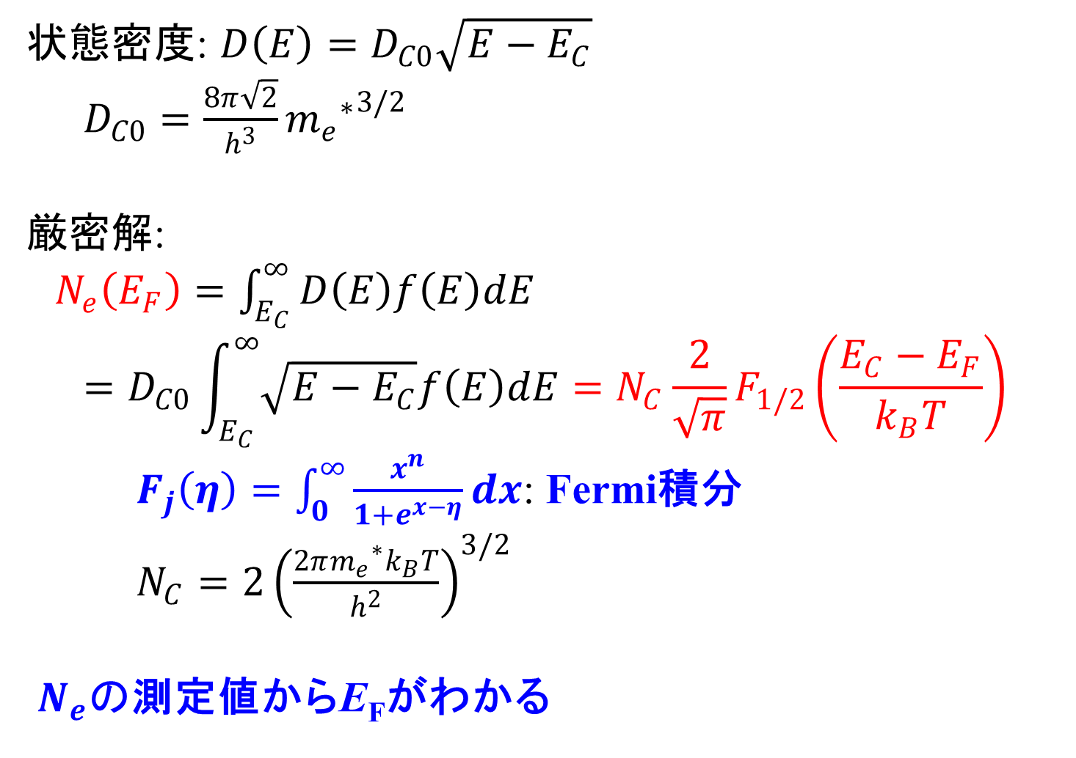
公式: キャリア密度 (自由電子近似)
  状態密度: $D\left(E\right)=D_{C0}\sqrt{E−E_{C}}$
  $D_{C0}=\frac{8π\sqrt{2}}{h^{3}}{{m_{e}}^{∗}}^{3/2}$
  厳密解:
  $N_{e}\left(E_{F}\right)=\int_{E_{C}}^{∞}{D\left(E\right)f\left(E\right)dE}$
  $$=D_{C0}\int_{E_{C}}^{∞}{\sqrt{E−E_{C}}f\left(E\right)dE}=N_{C}\frac{2}{\sqrt{π}}F_{1/2}\left(\frac{E_{C}−E_{F}}{k_{B}T}\right)$$
  $F_{j}\left(η\right)=\int_{0}^{∞}{\frac{x^{n}}{1+e^{x−η}}}dx$: Fermi積分
  $N_{C}=2{\left(\frac{{2πm_{e}}^{∗}k_{B}T}{h^{2}}\right)}^{3/2}$
  $N_{e}の$測定値からE_{F}がわかる

Slide 5
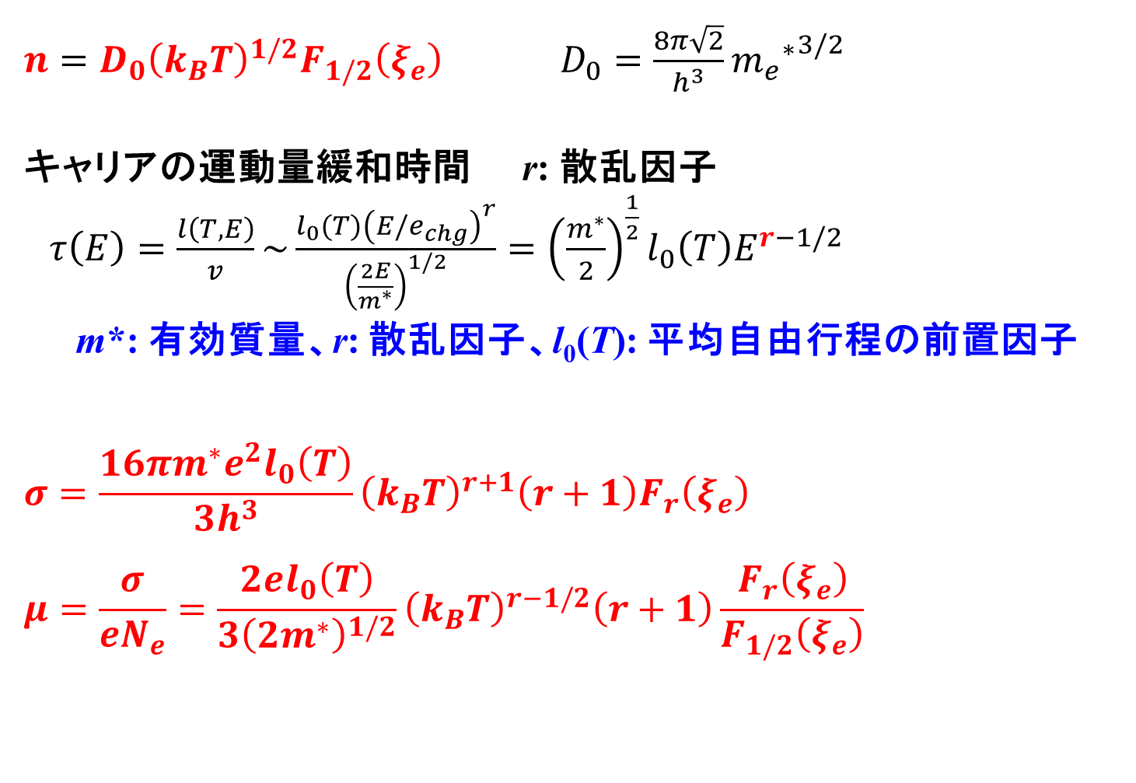
公式: 電気伝導度、移動度
$n=D_{0}{\left(k_{B}T\right)}^{1/2}F_{1/2}\left(ξ_{e}\right)$ $D_{0}=\frac{8π\sqrt{2}}{h^{3}}{{m_{e}}^{∗}}^{3/2}$
  キャリアの運動量緩和時間 r: 散乱因子
  $τ\left(E\right)=\frac{l\left(T,E\right)}{v}\sim \frac{l_{0}(T){\left(E/e_{chg}\right)}^{r}}{{\left(\frac{2E}{m^{∗}}\right)}^{1/2}}={\left(\frac{m^{∗}}{2}\right)}^{\frac{1}{2}}l_{0}\left(T\right)E^{r−1/2}$
m*: 有効質量、r: 散乱因子、l₀(T): 平均自由行程の前置因子
$$σ=\frac{16πm^{∗}e^{2}l_{0}\left(T\right)}{3h^{3}}{\left(k_{B}T\right)}^{r+1}\left(r+1\right)F_{r}\left(ξ_{e}\right)$$
$$μ=\frac{σ}{eN_{e}}=\frac{2el_{0}\left(T\right)}{3{\left(2m^{∗}\right)}^{1/2}}{\left(k_{B}T\right)}^{r−1/2}\left(r+1\right)\frac{F_{r}\left(ξ_{e}\right)}{F_{1/2}\left(ξ_{e}\right)}$$

Slide 6
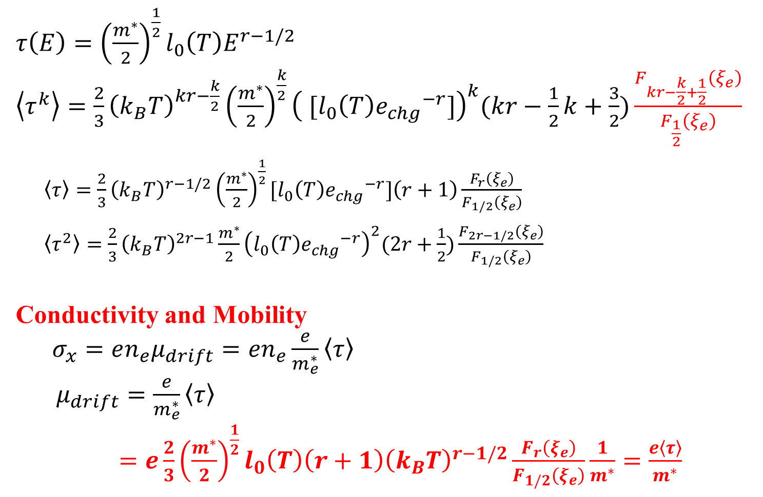
平均緩和時間 $\left\langle τ^{k}\right\rangle$
$τ\left(E\right)={\left(\frac{m^{∗}}{2}\right)}^{\frac{1}{2}}l_{0}\left(T\right)E^{r−1/2}$
$\left\langle τ^{k}\right\rangle =\frac{2}{3}{\left(k_{B}T\right)}^{kr−\frac{k}{2}}{\left(\frac{m^{∗}}{2}\right)}^{\frac{k}{2}}{\left( [l_{0}\left(T\right){e_{chg}}^{−r}]\right)}^{k}(kr−\frac{1}{2}k+\frac{3}{2})\frac{F_{kr−\frac{k}{2}+\frac{1}{2}}\left(ξ_{e}\right)}{F_{\frac{1}{2}}\left(ξ_{e}\right)}$
$\left\langle τ\right\rangle =\frac{2}{3}{\left(k_{B}T\right)}^{r−1/2}{\left(\frac{m^{∗}}{2}\right)}^{\frac{1}{2}}[l_{0}\left(T\right){e_{chg}}^{−r}]\left(r+1\right)\frac{F_{r}\left(ξ_{e}\right)}{F_{1/2}\left(ξ_{e}\right)}$
$\left\langle τ^{2}\right\rangle =\frac{2}{3}{\left(k_{B}T\right)}^{2r−1}\frac{m^{∗}}{2}{\left(l_{0}\left(T\right){e_{chg}}^{−r}\right)}^{2}(2r+\frac{1}{2})\frac{F_{2r−1/2}\left(ξ_{e}\right)}{F_{1/2}\left(ξ_{e}\right)}$
Conductivity and Mobility
$σ_{x}=en_{e}μ_{drift}=en_{e}\frac{e}{m_{e}^{∗}}\left\langle τ\right\rangle$
$μ_{drift}=\frac{e}{m_{e}^{∗}}\left\langle τ\right\rangle$
$=e\frac{2}{3}{\left(\frac{m^{∗}}{2}\right)}^{\frac{1}{2}}l_{0}\left(T\right)\left(r+1\right){\left(k_{B}T\right)}^{r−1/2}\frac{F_{r}\left(ξ_{e}\right)}{F_{1/2}\left(ξ_{e}\right)}\frac{1}{m^{∗}}=\frac{e\left\langle τ\right\rangle }{m^{∗}}$

Slide 7
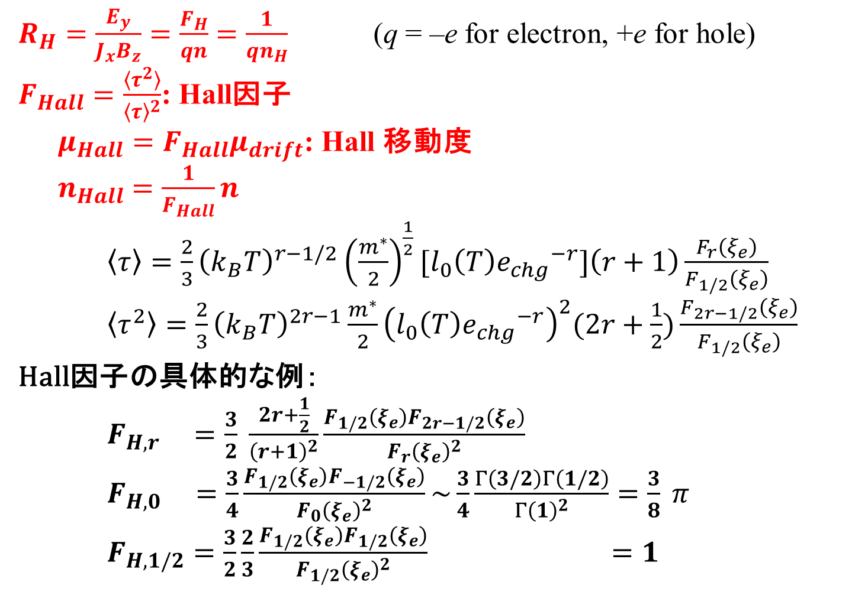
Hall効果とHall因子
太田英二、坂田亮著、半導体の電子物性光学、培風館 (2005)
$R_{H}=\frac{E_{y}}{J_{x}B_{z}}=\frac{F_{H}}{qn}$ $=\frac{1}{qn_{H}}$ (q = –e for electron, +e for hole)
$F_{Hall}=\frac{〈τ^{2}〉}{{〈τ〉}^{2}}$: Hall因子
$μ_{Hall}=F_{Hall}μ_{drift}$: Hall 移動度
$n_{Hall}$ $=\frac{1}{F_{Hall}}n$
$\left\langle τ\right\rangle =\frac{2}{3}{\left(k_{B}T\right)}^{r−1/2}{\left(\frac{m^{∗}}{2}\right)}^{\frac{1}{2}}[l_{0}\left(T\right){e_{chg}}^{−r}]\left(r+1\right)\frac{F_{r}\left(ξ_{e}\right)}{F_{1/2}\left(ξ_{e}\right)}$
$\left\langle τ^{2}\right\rangle =\frac{2}{3}{\left(k_{B}T\right)}^{2r−1}\frac{m^{∗}}{2}{\left(l_{0}\left(T\right){e_{chg}}^{−r}\right)}^{2}(2r+\frac{1}{2})\frac{F_{2r−1/2}\left(ξ_{e}\right)}{F_{1/2}\left(ξ_{e}\right)}$
Hall因子の具体的な例：
$F_{H,r} =\frac{3}{2} \frac{2r+\frac{1}{2}}{{\left(r+1\right)}^{2}}\frac{F_{1/2}\left(ξ_{e}\right)F_{2r−1/2}\left(ξ_{e}\right)}{{F_{r}\left(ξ_{e}\right)}^{2}}$
$F_{H,0} =\frac{3}{4}\frac{F_{1/2}\left(ξ_{e}\right)F_{−1/2}\left(ξ_{e}\right)}{{F_{0}\left(ξ_{e}\right)}^{2}}\sim \frac{3}{4}\frac{Γ\left(3/2\right)Γ\left(1/2\right)}{{Γ\left(1\right)}^{2}}=\frac{3}{8} π$
$F_{H,1/2}=\frac{3}{2}\frac{2}{3}\frac{F_{1/2}\left(ξ_{e}\right)F_{1/2}\left(ξ_{e}\right)}{{F_{1/2}\left(ξ_{e}\right)}^{2}} =1$

Slide 8
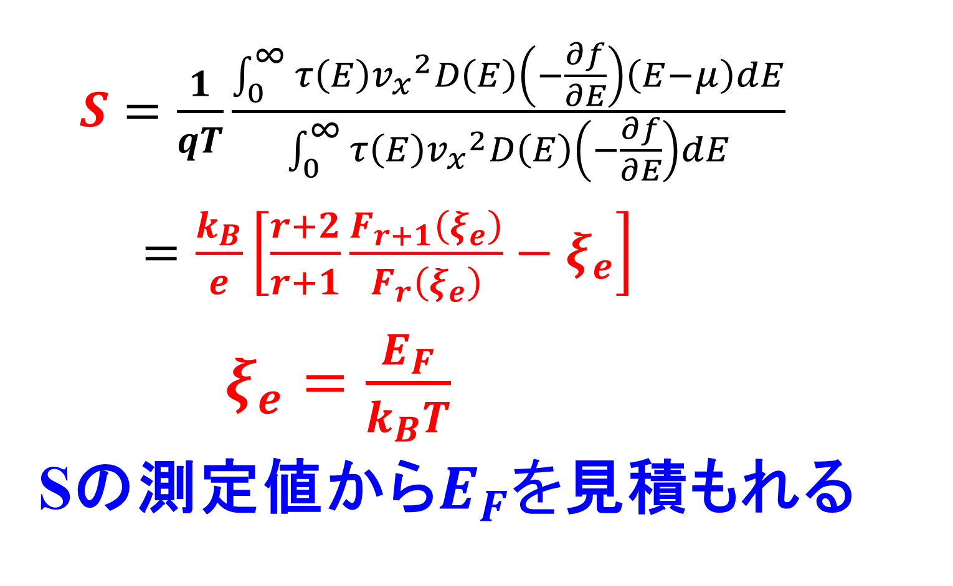
Seebeck係数
$S=\frac{1}{qT}\frac{\int_{0}^{∞}{τ\left(E\right){v_{x}}^{2}D\left(E\right)\left(−\frac{∂f}{∂E}\right)\left(E−μ\right)dE}}{\int_{0}^{∞}{τ\left(E\right){v_{x}}^{2}D\left(E\right)\left(−\frac{∂f}{∂E}\right)dE}}$
$=\frac{k_{B}}{e}\left[\frac{r+2}{r+1}\frac{F_{r+1}\left(ξ_{e}\right)}{F_{r}\left(ξ_{e}\right)}−ξ_{e}\right]$
$ξ_{e}=\frac{E_{F}}{k_{B}T}$
Sの測定値から$E_{F}を$見積もれる

Slide 9
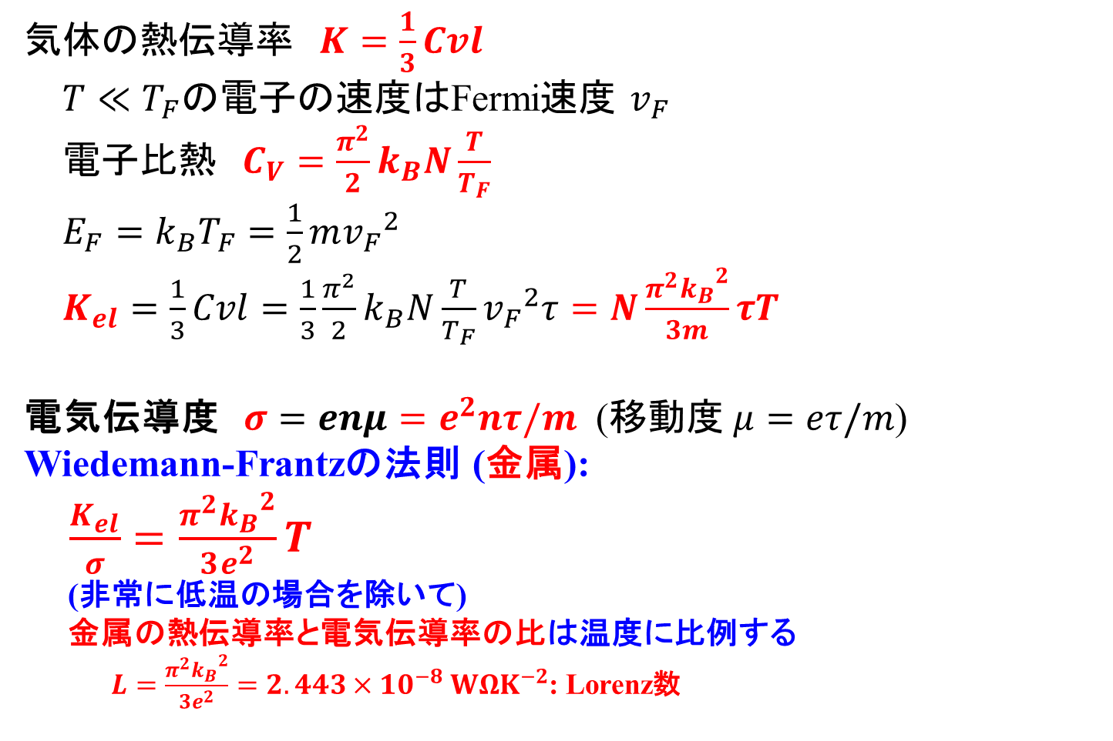
電子熱伝導率とLorentz数 (金属・縮退半導体)
キッテル固体物理学入門 第8版、丸善
気体の熱伝導率 $K=\frac{1}{3}Cvl$
$T≪T_{F}$の電子の速度はFermi速度 $v_{F}$
電子比熱 $C_{V}=\frac{π^{2}}{2}k_{B}N\frac{T}{T_{F}}$
  $E_{F}=k_{B}T_{F}=\frac{1}{2}m{v_{F}}^{2}$
$K_{el}=\frac{1}{3}Cvl=\frac{1}{3}\frac{π^{2}}{2}k_{B}N\frac{T}{T_{F}}{v_{F}}^{2}τ=N\frac{π^{2}{k_{B}}^{2}}{3m}τT$
電気伝導度 $σ=enμ=e^{2}nτ/m$ (移動度 $μ=eτ/m$)
Wiedemann-Frantzの法則 (金属):
$\frac{K_{el}}{σ}=\frac{π^{2}{k_{B}}^{2}}{3e^{2}}T$
(非常に低温の場合を除いて)
金属の熱伝導率と電気伝導率の比は温度に比例する
$L=\frac{π^{2}{k_{B}}^{2}}{3e^{2}}=2.443×{10}^{−8} WΩK^{−2}$: Lorenz数

Slide 10
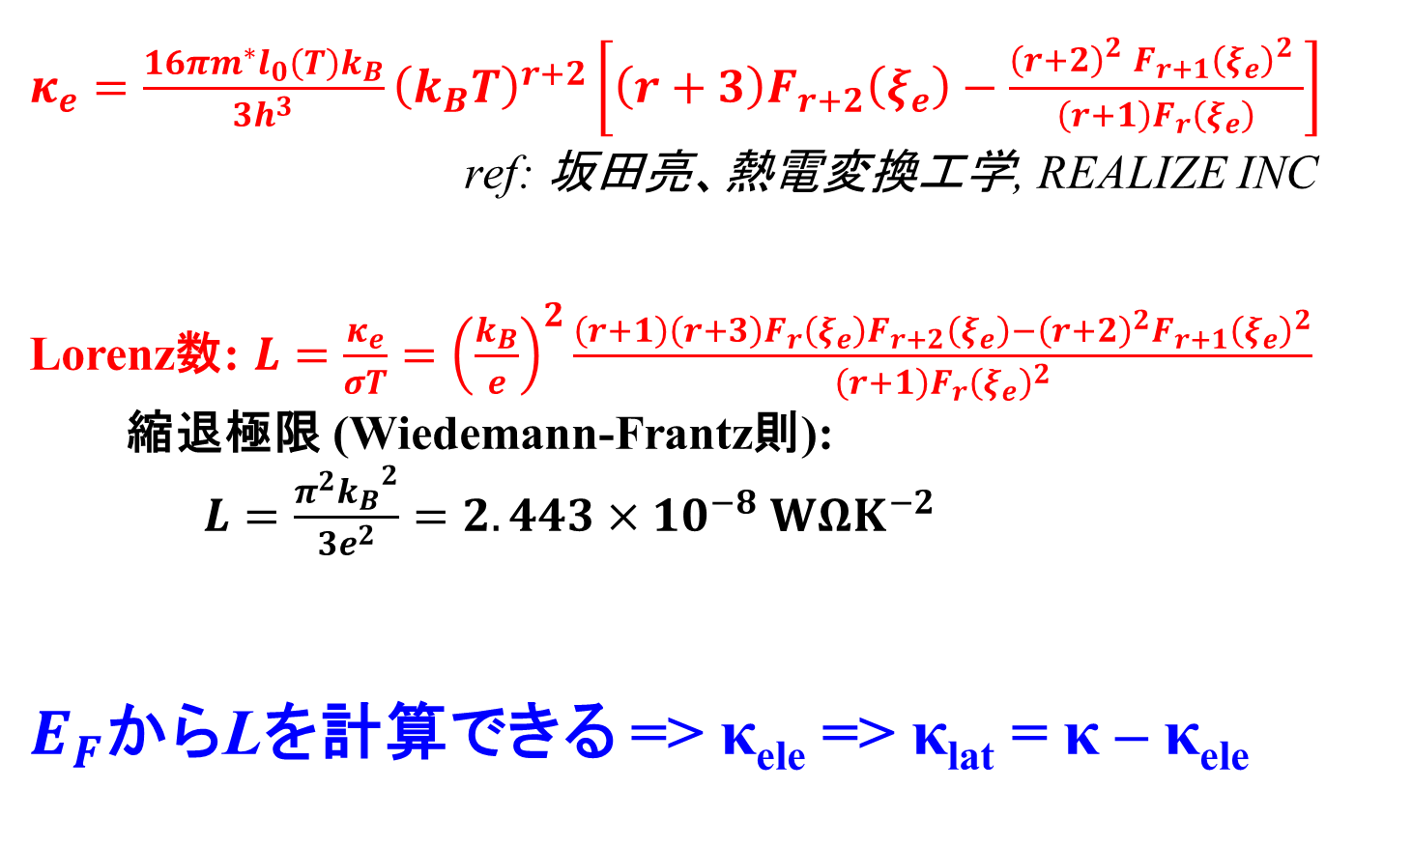
電子熱伝導率とLorentz数 (厳密解)
$κ_{e}=\frac{16πm^{∗}l_{0}\left(T\right)k_{B}}{3h^{3}}{\left(k_{B}T\right)}^{r+2}\left[\left(r+3\right)F_{r+2}\left(ξ_{e}\right)−\frac{{\left(r+2\right)}_{}^{2}{F_{r+1}\left(ξ_{e}\right)}_{}^{2}}{{\left(r+1\right)F}_{r}\left(ξ_{e}\right)}\right]$
ref: 坂田亮、熱電変換工学, REALIZE INC
Lorenz数: $L=\frac{κ_{e}}{σT}={\left(\frac{k_{B}}{e}\right)}^{2}\frac{\left(r+1\right)\left(r+3\right)F_{r}\left(ξ_{e}\right)F_{r+2}\left(ξ_{e}\right)−{\left(r+2\right)}^{2}{F_{r+1}\left(ξ_{e}\right)}^{2}}{\left(r+1\right){F_{r}\left(ξ_{e}\right)}^{2}}$
縮退極限 (Wiedemann-Frantz則):
$L=\frac{π^{2}{k_{B}}^{2}}{3e^{2}}=2.443×{10}^{−8} WΩK^{−2}$
$E_{F}$からLを計算できる => κ_{ele} => κ_{lat} = κ – κ_{ele}

Slide 11
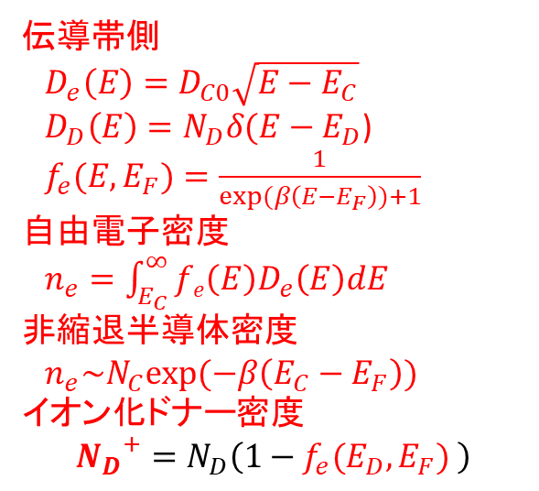
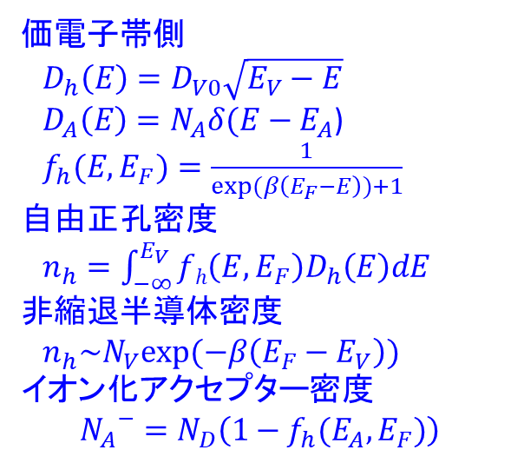
半導体の状態密度、電子、正孔
全状態密度：$D\left(E\right)=D_{e}\left(E\right)+D_{h}\left(E\right)+D_{D}\left(E\right)+D_{A}\left(E\right)$
E_{F}
状態密度
N_{A}
N_{D}
E_{V}
E_{A}
E_{D}
E_{C}
エネルギー
  価電子帯側
  $D_{h}\left(E\right)=D_{V0}\sqrt{E_{V}−E}$
  $D_{A}\left(E\right)=N_{A}δ({E−E}_{A}$)
  $f_{h}(E,E_{F})=\frac{1}{exp(β\left(E_{F}−E\right))+1}$
  自由正孔密度
  $n_{h}=\int_{−∞}^{E_{V}}{fh\left(E,E_{F}\right)D_{h}\left(E\right)dE}$
  非縮退半導体密度
  $n_{h}\sim N_{V}exp(−β\left(E_{F}−E_{V}\right))イオン化アクセプター$密度
  $${N_{A}}^{−}=N_{D}\left(1−f_{h}(E_{A},E_{F})\right)$$
  伝導帯側
  $D_{e}\left(E\right)=D_{C0}\sqrt{E−E_{C}}$
  $D_{D}\left(E\right)=N_{D}δ({E−E}_{D}$)
  $f_{e}(E,E_{F})=\frac{1}{exp(β\left(E−E_{F}\right))+1}$
  自由電子密度
  $n_{e}=\int_{E_{C}}^{∞}{fe\left(E\right)D_{e}\left(E\right)dE}$
  非縮退半導体密度
  $n_{e}\sim N_{C}exp(−β\left(E_{C}−E_{F}\right))イオン化ドナー$密度
  $${N_{D}}^{+}=N_{D}\left(1−f_{e}(E_{D},E_{F}) \right)$$

Slide 12
Fermi準位の求め方: 図解
ΔQ = (n_{e} + N_{A}⁻) – (n_{h} + N_{D}⁺) をE_{F}に対してプロットし、ゼロ点を求める
T = 300.0
E_{g} = 1.12
N_{C} = 1.0e19
N_{V} = 1.0e21
N_{D} = 3.0e17
E_{D} = 1.02
N_{A} = 1.0e13
E_{A} = 0.1
E_{F} = 0.997 eV
ΔQ
E_{F}
Log |ΔQ|
E_{F}

Slide 13
Fermi準位の計算: プログラム
ΔQ(E_{F}) = (n_{e} + N_{A}⁻) – (n_{h} + N_{D}⁺) = 0 を満たす E_{F} を求める。
Newton法は発散しやすい ＝＞ 二分法を使う
数値積分の講義資料: http://conf.msl.titech.ac.jp/Lecture/python/index-numericalanalysis.html
原理: f(x) が単調関数であれば、解 x は f(x₀) < 0 かつ f(x₁) > 0
(あるいは f(x₀) > 0 かつ f(x₁) < 0) を満たす区間 [x₀, x₁] に1つ存在する。
手順: f(x₀) < 0 かつ f(x₁) > 0の場合を考える (f(x₀)･f(x₁) < 0 で判断)。
x₂ = (x₀ + x₁) / 2.0
f(x₂) > 0 (f(x₀)･f(x₂) < 0) であれば、 x₁ をx₂ で置き換える
f(x₂) < 0 (f(x₁)･f(x₂) < 0) であれば、 x₀ をx₂ で置き換える
|x₁ – x₀|, |f(x₁) – f(x₀)| が必要な精度以下になったら、
解を x₂ にして反復終了
1. に戻って反復
x₄
x₅
x₀
x₃
x₂
x₁
x₆

Slide 14
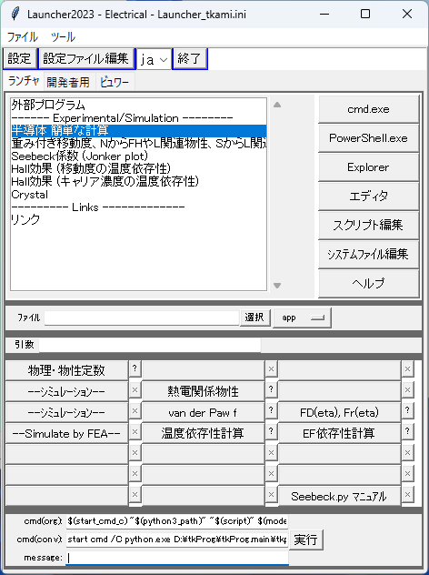
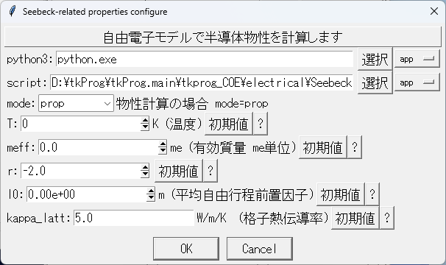
Eelctrical/Launcher.py

Slide 15
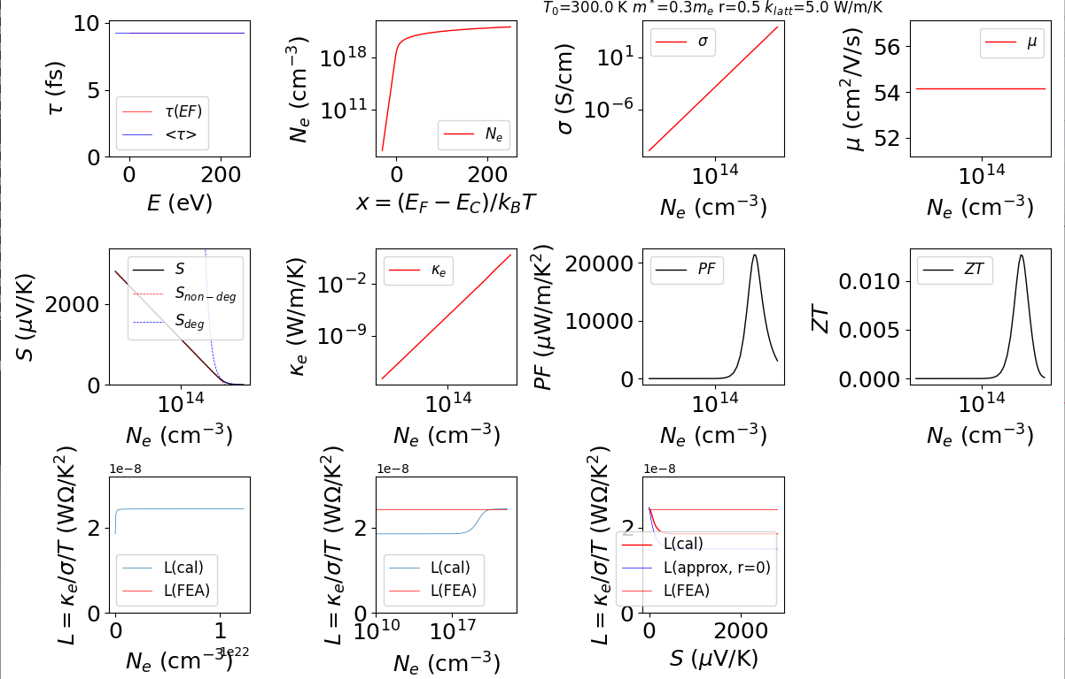
Thermoelectric properties

Slide 16
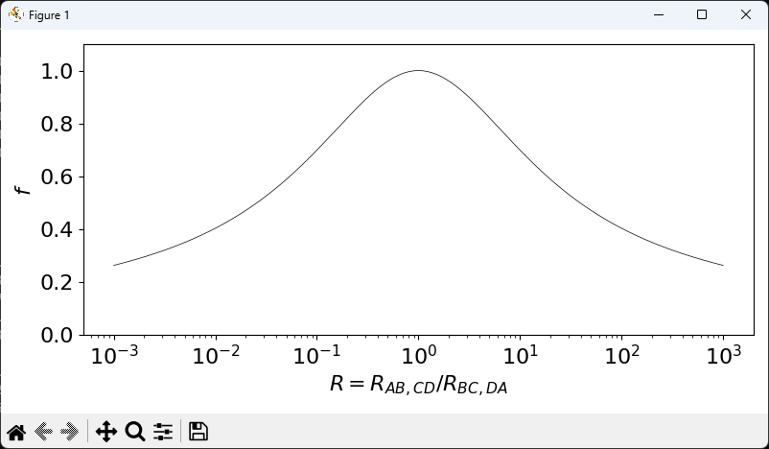
Van der Pauw correction factor

Slide 17
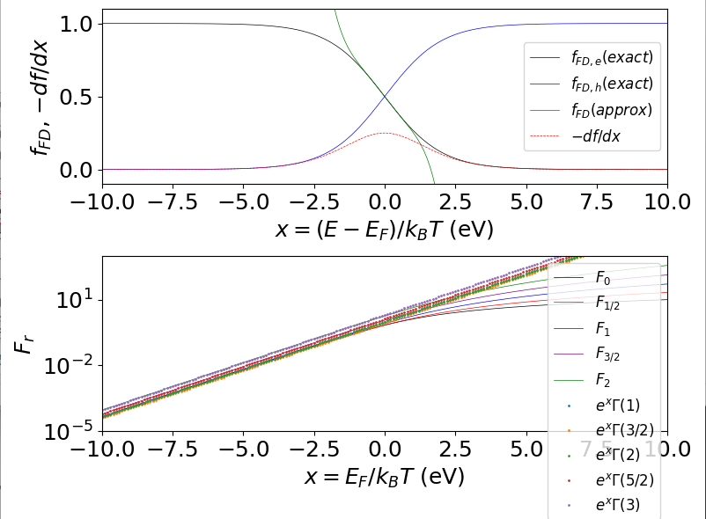
Fermi-Diract distribution /integrals

Slide 18
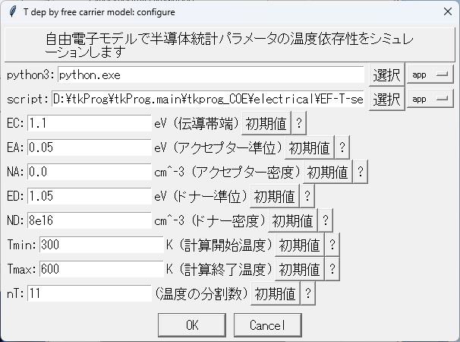
Free-electron model: T dependence

Slide 19
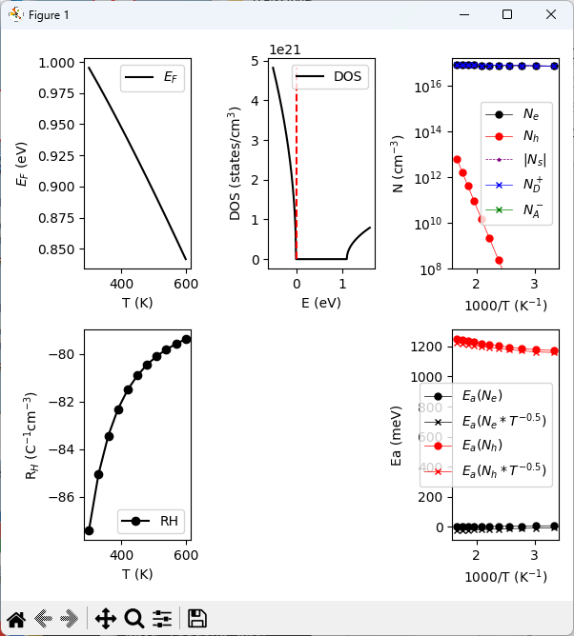
Free-electron model: T dependence

Slide 20
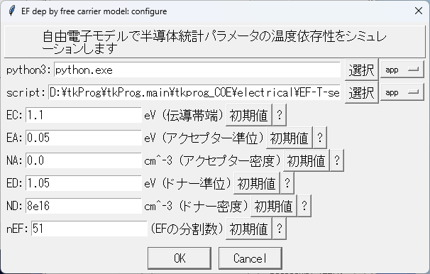
Free-electron model: E_{F} dependence

Slide 21
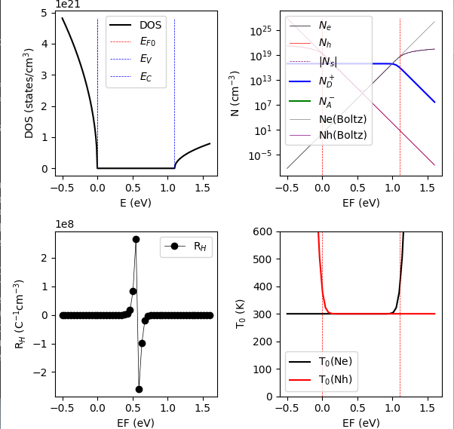
Free-electron model: E_{F} dependence

