Slide 1
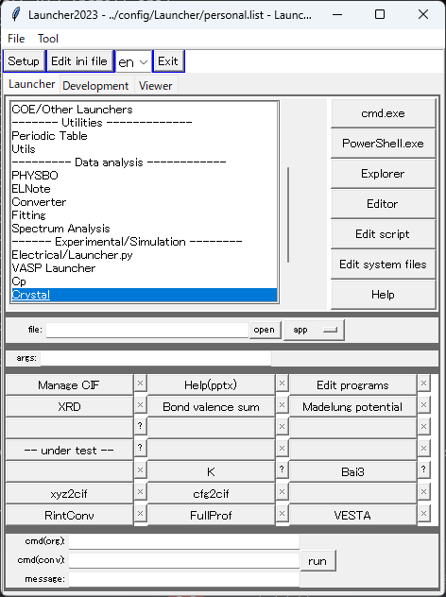
Crystal menu

Slide 2
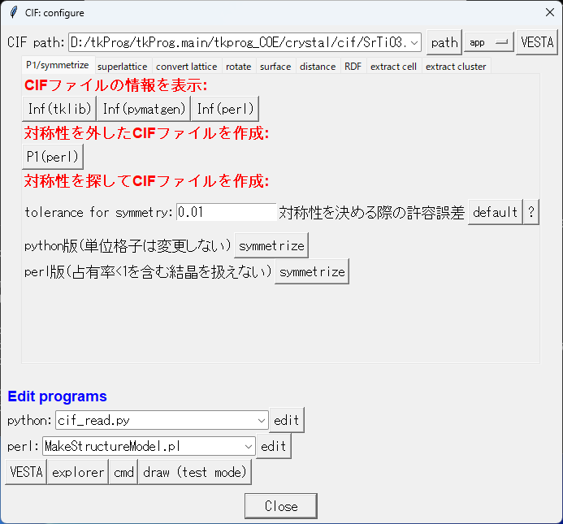
Manage CIF
Choose, e.g., [tkprog_X_path]\crystal\cif\SrTiO3.cif
Show crystal structure information.
These 3 are similar but provide some different info
Break the symmetry and make a P1 symmetry CIF
Used for perl ver
Require python and pymatgen
Require perl and struct.exe (not included in the standard distribution package)
Edit programs

Slide 3
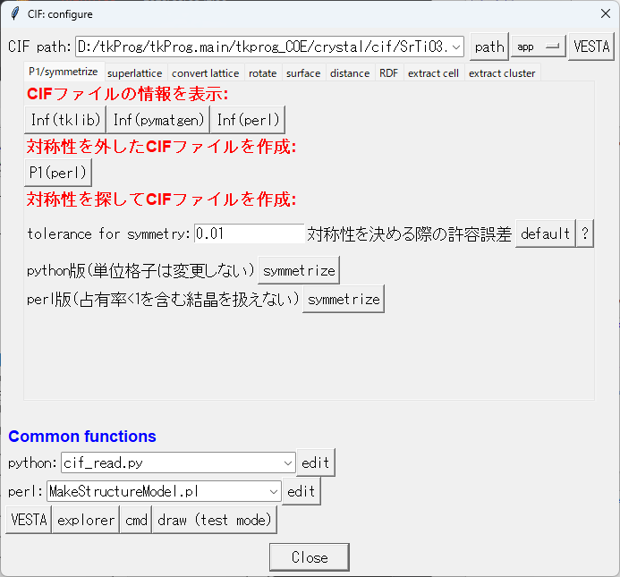
Manage CIF
Choose, e.g., [tkprog_X_path]\crystal\cif\SrTiO3.cif
Other tabs:
superlattice: Make a superlattice CIF
convert lattice: Convert lattice axis.
e.g., from hexagonal to orthogonal
Distance: Calculate interatomic distances and angles
RDF: Calculate radial distribution functions
Other tabs are not tested
Edit programs

Slide 4
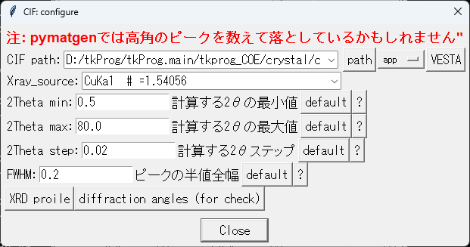
Powder XRD simulation

Slide 5
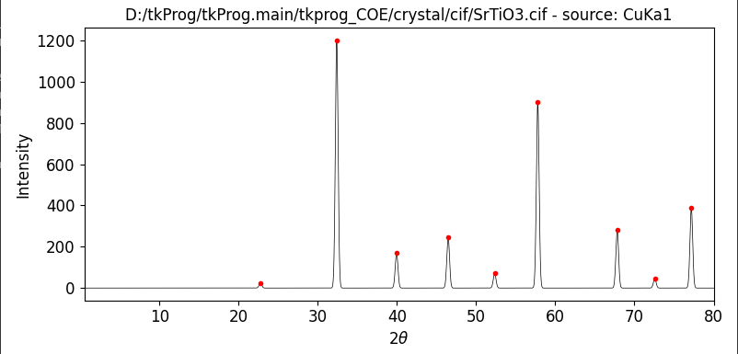
Powder XRD simulation
SrTiO3-pxrd.xlsx

Slide 6
Powder XRD simulation
Show all possible diffractions without considering the distinction rule
Lattice parameters: [3.905, 3.905, 3.905, 90.0, 90.0, 90.0]
hkl range: 3 3 3
Diffraction angle, d, h, k, l:
h k l m dhkl Q2
1 0 0 6 3.905000 22.752946
1 1 0 12 2.761252 32.396338
1 1 1 8 2.254553 39.955517
2 0 0 6 1.952500 46.470786
2 1 0 24 1.746369 52.345000
2 1 1 24 1.594210 57.785763
2 2 0 12 1.380626 67.824262
3 0 0 6 1.301667 72.564632
2 2 1 24 1.301667 72.564632

Slide 7
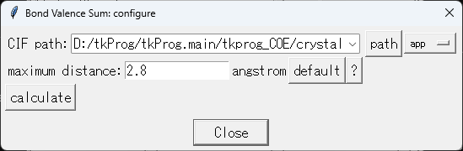
Bond valence sum
DBPath: D:\tkProg\tkProg.main\tkdb\Databases\bvparm2016.cif
CIFPath: D:/tkProg/tkProg.main/tkprog_COE/crystal/cif/SrTiO3.cif
0: Sr2
2: O-1 r0=2.118 B=0.37 ri=2.761 bv=0.176 [a for Sr 2 - O -2]
--cut—
4: O-1 r0=2.118 B=0.37 ri=2.761 bv=0.176 [a for Sr 2 - O -2]
Bond Valence Sum: 2.109
1: Ti4
2: O-1 r0=1.654 B=0.55 ri=1.953 bv=0.578 [bs for Ti 3 - O -2]
2: O-1 r0=1.654 B=0.55 ri=1.953 bv=0.578 [bs for Ti 3 - O -2]
3: O-1 r0=1.654 B=0.55 ri=1.953 bv=0.578 [bs for Ti 3 - O -2]
3: O-1 r0=1.654 B=0.55 ri=1.953 bv=0.578 [bs for Ti 3 - O -2]
4: O-1 r0=1.654 B=0.55 ri=1.953 bv=0.578 [bs for Ti 3 - O -2]
4: O-1 r0=1.654 B=0.55 ri=1.953 bv=0.578 [bs for Ti 3 - O -2]
Bond Valence Sum: 3.470
2: O-1
0: Sr2 r0=2.118 B=0.37 ri=2.761 bv=0.176 [a for Sr 2 - O -2]
--cut—
4: O-1 r0=1.406 B=0.37 ri=2.761 bv=0.026 [e for O -2 - O -2]
Bond Valence Sum: 2.065

Slide 8
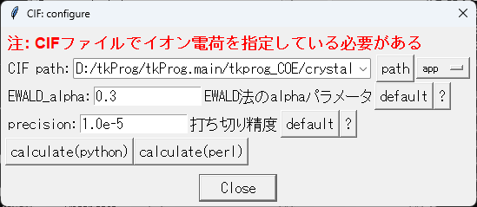
Madelung potential
Both versions should provide the same results
Madelung potential (electrostatic potential):
Sr : Sr1 : q= 2: MP = -3.1827e-18 J (= -1.62078e-18 + 0 - 1.56192e-18)
MP = -19.8648 eV (= -10.1161 + 0 - 9.74872)
Ti : Ti1 : q= 4: MP = -7.31246e-18 J (= -4.18862e-18 + 0 - 3.12384e-18)
MP = -45.6407 eV (= -26.1433 + 0 - 19.4974)
O : O1 : q= -2: MP = 3.81408e-18 J (= 2.25215e-18 + 0 - -1.56192e-18)
MP = 23.8055 eV (= 14.0568 + 0 - -9.74872)
O : O1 : q= -2: MP = 3.81408e-18 J (= 2.25215e-18 + 0 - -1.56192e-18)
MP = 23.8055 eV (= 14.0568 + 0 - -9.74872)
O : O1 : q= -2: MP = 3.81408e-18 J (= 2.25215e-18 + 0 - -1.56192e-18)
MP = 23.8055 eV (= 14.0568 + 0 - -9.74872)
Total Madelung energy in unit cell: -182.563 eV
Madelung constant
NOTE: The a-axis length is taken as the representative atomic distance: a = 3.905
The charge of the 0-th ion is taken as the representative ion charge: q = 2.0
NOTE: This value is in the unit cell chemical formula
The following value must be devided by Z to get the Madeluing constant in the standard definition
Madelung constant in unit cell: 24.754953

Slide 9
Theory

Slide 10
イオン結晶の基礎
★ 原子、イオンは互いに接触して安定な構造を作る
一般に、陰イオンのほうが陽イオンより大きい
陰イオン同士は互いに接して最密充填に
近い構造を取ることが多い
陽イオンは陰イオンがつくるパッキング構造の
隙間に入り、陰イオンと接する
陽イオン同士は接しない
イオン性結晶の最近接イオン間距離は
イオン半径の和でだいたい説明できる

Slide 11
ポーリング則: イオンの安定配列を決める
イオン結晶に共通して見られる特徴
陽イオンの最近接位置には必ず陰イオンが配位している。
M_{m}X_{n}型化合物では、陽イオンM ^{n+}の周りの陰イオンの配位数N_{M}と
陰イオンX ^{m-}の周りの陽イオンの配位数N_{X}はN_{M} : N_{X} = n : mになっている。
ポーリングの法則
陽イオンの配位数は陽イオンと陰イオンの半径比 R_{A}/R_{X} によって決まる。
（半径比則）
配位多面体の陰イオンとそのまわりのすべての陽イオンをつなぐ結合の強度の和が、陰イオンの電荷の総計に等しい。陰イオンの電荷を-me、その周囲の陽イオンの電荷をn_{i}e、配位数をN_{M} _{i}とすれば、次の関係が成立する。
（静電原子価則: 局所的な電荷中性条件）
稜共有構造は不安定で、面共有構造は極めて不安定である。
種々の陽イオンを含む結晶では、原子価が大きく配位数の小さい陽イオンの多面体同士が、面、稜、頂点を共有することはほとんどない。
（陽イオン同士の距離が近くなり、静電ポテンシャル的に不安定になる）
結晶内で化学的に同等な陰イオンは、その周囲の状態をできるだけ同等にする傾向がある。
（異なる成分の数ができるだけ少ない配列をとる＝＞似たイオンは似た構造をとる）

Slide 12
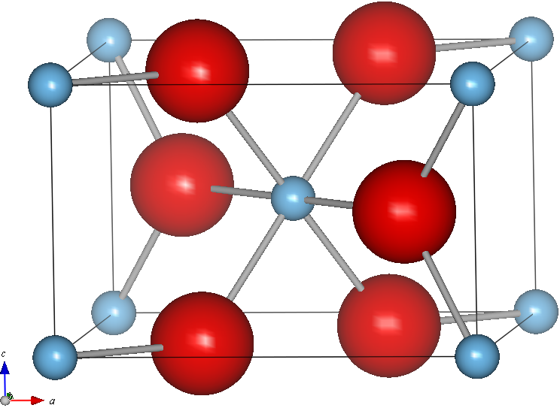
静電原子価則の確認: TiO₂
考え方: イオンがもつ電荷は
配位している結合毎に等分配されて寄与する（結合原子価）
O
Ti
陰イオンの電荷 : -m = -2
陰イオンの配位数: N_{M} = 3
陽イオンの電荷 : n = +4
陽イオンの配位数: N_{X} = 6
右辺 = 4 * 3 / 6 = +2 = m
当然、逆の関係(陽イオンを中心に考える)も成立する
単純化合物の場合、これは結晶全体の電荷中性条件と同じ
陽イオンの全電荷
陰イオンの全電荷

Slide 13
結合原子価和 (Bond valence sum)
ポーリングの第二法則: 結合原子価和
は中心イオンの価数に等しい
拡張
BV: 結合原子価和
B: (結合イオン対で決まる)定数 0.37
r₀: 結合イオン対で決まる定数
r_{i}: 結合長
r₀ (, B)の値は
中井泉, 泉富士夫編集, 粉末X線解析の実際，付録3, 朝倉書店
R.E. Brese, M.O’Keeffe, Acta Crystallogr., Sect. B, 47, 192 (1991)
I.D.Brown: http://homepage.mac.com/fujioizumi/rietan/book/book.html#BVP
LaCuOSeの例:
La: 4×La-O (0.54) + 4×La-Se (0.20) = 2.97
Cu: 4×Cu-Se (0.34) = 1.36
O: 4×O-La (0.54) = 2.16
Se: 4×Se-La (0.20) + 4×Se-Cu (0.34) = 2.18

Slide 14
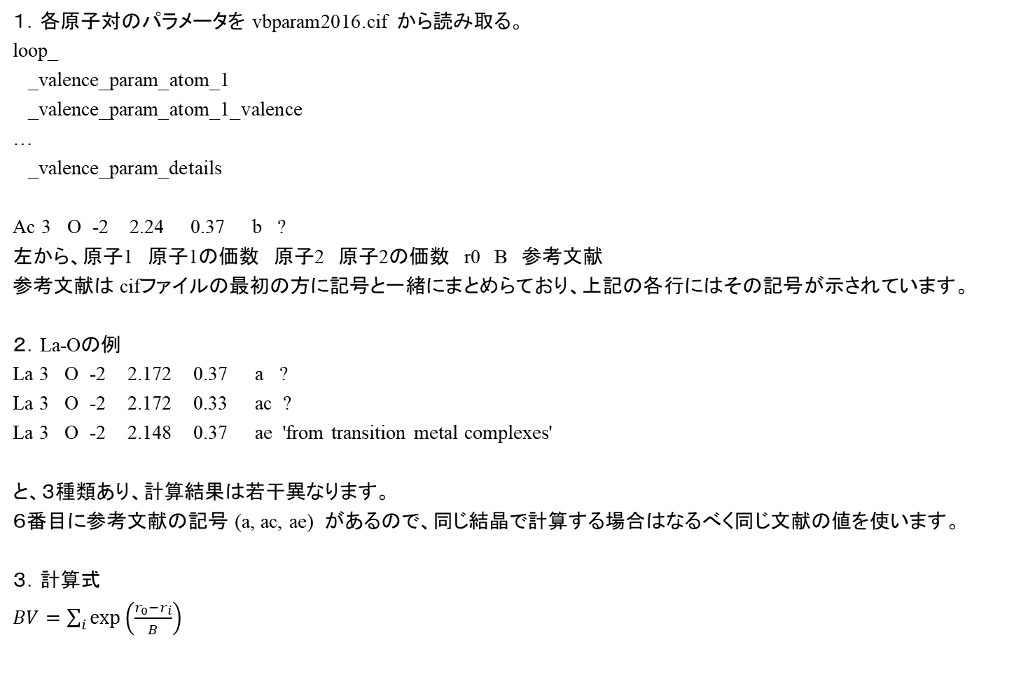
BVSの計算方法
１．各原子対のパラメータを vbparam2016.cif から読み取る。
loop_
_valence_param_atom_1
_valence_param_atom_1_valence
…
_valence_param_details
Ac 3 O -2 2.24 0.37 b ?
左から、原子1 原子1の価数 原子2 原子2の価数 r0 B 参考文献
参考文献は cifファイルの最初の方に記号と一緒にまとめらており、上記の各行にはその記号が示されています。
２．La-Oの例
La 3 O -2 2.172 0.37 a ?
La 3 O -2 2.172 0.33 ac ?
La 3 O -2 2.148 0.37 ae 'from transition metal complexes'
と、３種類あり、計算結果は若干異なります。
６番目に参考文献の記号 (a, ac, ae) があるので、同じ結晶で計算する場合はなるべく同じ文献の値を使います。
３．計算式
$BV=\sum_{i}{\exp\left(\frac{r_{0}−r_{i}}{B}\right)}$

Slide 15
結合原子価和の例
MgO:
Mg : 6×Mg-O (0.33) = 1.96
O : 6×O-Mg (0.33) = 1.96
Fe₃O₄:
Fe(I) : 4×Fe-O (0.85) = 3.40
Fe(II): 6×Fe-O (0.41) = 2.45
O: 1×O-Fe(I) (0.85) + 3×O-Fe(II) (0.41) = 2.08
MgIn₂O₄:
Mg : 6×Mg-O (0.34) = 2.03
In(I) : 4×In(I)-O (0.51) = 2.05
In(II): 6×In(II)-O (0.60) = 3.60
O: 1×O-Mg (0.34) + 3×O-In(I) (0.51) + 3×O-In(II) (0.60) = 3.32
SrFe₂As₂:
Sr: 8×Sr-As (0.23) = 1.96
Fe: 4×Fe-As (0.94) = 3.76 (注: B, r₀はFe⁹⁺ - As³⁻ の値 )
As: 4×As-Sr (0.26) + 4×As-Fe (0.94) = 4.73

Slide 16
Representation of lattice geometry
Unit cell is determined by a set of lattice parameters (a, b, c, α, β, γ)
Atom positions are expressed by ‘fractional coordinate’ (internal coordinate) (x₁, x₂, x₃).
Usual range is 0 <= x₁, x₂, x₃ < 1.0 but can be extended.
Unit cell axes are expressed by base vectors a_{i} (lattice vectors)
R = x₁ a₁ + x₂ a₂ + x₃ a₃ = Σ_{i} (x_{i} a_{i})
Lattice vectors are not always orthogonal

Slide 17
結晶格子の表現： 基本
結晶の単位格子は、格子定数の組（a, b, c, α, β, γ) で定義される。
通常は簡便のため、単位格子内の原子の座標は、「部分座標」あるいは「内部座標」で表現される。これは、単位格子の原点を (0, 0, 0), a軸の端を x = 1.0, b軸の端を y = 1.0, c軸の端を z = 1.0とし、0 から 1 の間の数値で座標を表現するものである。
a, b, c 軸をベクトルで表すのが便利である。これらに対応するベクトルを a, b, c とすると、部分座標 (x, y, z) にある原子の位置ベクトルRは
R = x a + y b + z c = Σ_{i} (x_{i} a_{i}) (1)
とあらわされる (a_{i}: 格子ベクトル)。
格子ベクトルは直交しているとは限らない

Slide 18
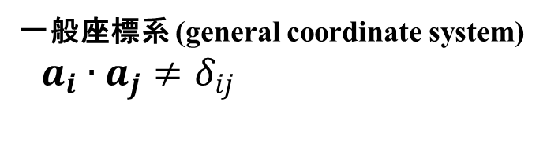
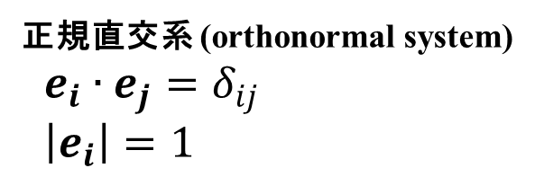

一般座標系 (general coordinate system)
直交座標系 (Orthogonal)
デカルト座標系 (Cartesian)
一般座標/非直交系 (Non-Cartesian)
P
r = x_{c,1}e₁+ x_{c,2}e₂
x_{n,2}
P
r = x_{g,1}a₁+ x_{g,2}a₂
e₂
a₂
e₁
a₁
x_{n,1}
正規直交系 (orthonormal system)
$e_{i}∙e_{j}=δ_{ij}$
$\left|e_{i}\right|=1$
一般座標系 (general coordinate system)
$a_{i}∙a_{j}≠δ_{ij}$
$e_{i}$, $a_{i}$: 基底ベクトル (base vecor)

Slide 19
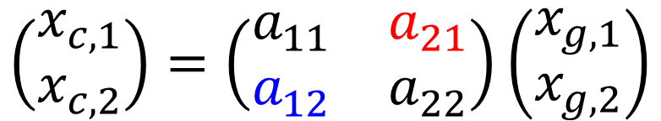
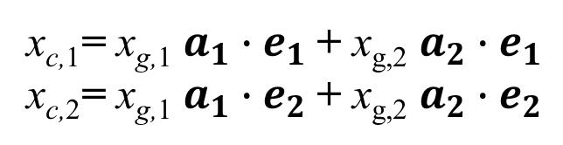
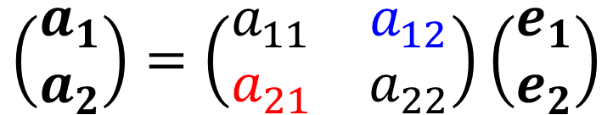
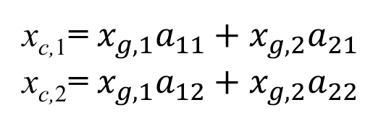
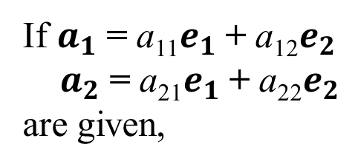
Cartesian – general coord. Conversion
(直交系 － 一般座標系変換)
r = x_{c,1}e₁+ x_{c,2}e₂= x_{g,1}a₁+ x_{g,2}a₂
x_{c,1}= x_{g,1} $a_{1}∙e_{1}$+ x_{g,2} $a_{2}∙e_{1}$
x_{c,2}= x_{g,1} $a_{1}∙e_{2}$+ x_{g,2} $a_{2}∙e_{2}$
If $a_{1}$= a₁₁$e_{1}$+ a₁₂$e_{2}$
$a_{2}$= a₂₁$e_{1}$+ a₂₂$e_{2}$
are given,
$$\left(\begin{matrix}a_{1} \\ a_{2}\end{matrix}\right)=\left(\begin{matrix}a_{11} & a_{12} \\ a_{21} & a_{22}\end{matrix}\right)\left(\begin{matrix}e_{1} \\ e_{2}\end{matrix}\right)$$
x_{c,1}= $x_{g,1}a_{11}+x_{g,2}a_{21}$
x_{c,2}= $x_{g,1}a_{12}+x_{g,2}a_{22}$
$$\left(\begin{matrix}x_{c,1} \\ x_{c,2}\end{matrix}\right)=\left(\begin{matrix}a_{11} & a_{21} \\ a_{12} & a_{22}\end{matrix}\right)\left(\begin{matrix}x_{g,1} \\ x_{g,2}\end{matrix}\right)$$

Slide 20
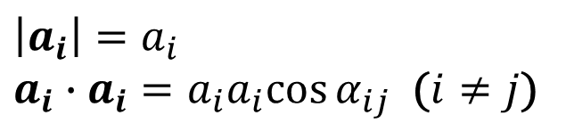
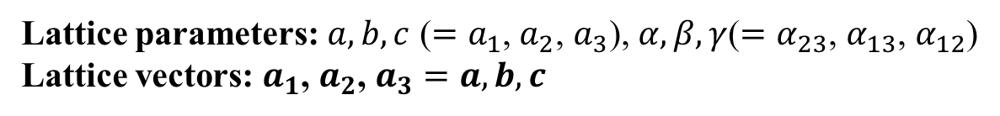
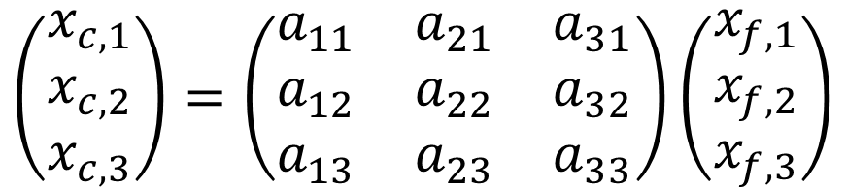
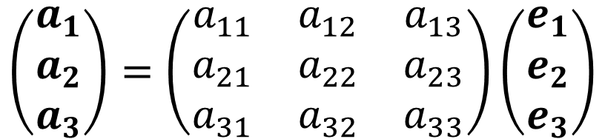
Fractional coordinates in crystal
(結晶の内部座標)
Lattice parameters: $a, b, c$ ($=a_{1}$, $a_{2}$, $a_{3}$), $α,β,γ$($=α_{23}$, $α_{13}$, $α_{12}$)
Lattice vectors: $a_{1}$, $a_{2}$, $a_{3}=a, b, c$
r = x_{f,1}a₁+ x_{f,2}a₂ + x_{f,3}a₃ = x_{c,1}e₁+ x_{c,2}e₂ + x_{c,3}e₃
(x_{f,1}, x_{f,1}, x_{f,3}): Fractional coordinate (部分座標)
Internal coordinate (内部座標)
$$\left|a_{i}\right|=a_{i}$$
$a_{i}∙a_{i}=a_{i}a_{i}cos{α_{ij}}$ ($i≠j$)
$$\left(\begin{matrix}a_{1} \\ a_{2} \\ a_{3}\end{matrix}\right)=\left(\begin{matrix}a_{11} & a_{12} & a_{13} \\ a_{21} & a_{22} & a_{23} \\ a_{31} & a_{32} & a_{33}\end{matrix}\right)\left(\begin{matrix}e_{1} \\ e_{2} \\ e_{3}\end{matrix}\right)$$
Fractional coordinate to Cartesian coordinate
$$\left(\begin{matrix}x_{c,1} \\ x_{c,2} \\ x_{c,3}\end{matrix}\right)=\left(\begin{matrix}a_{11} & a_{21} & a_{31} \\ a_{12} & a_{22} & a_{32} \\ a_{13} & a_{23} & a_{33}\end{matrix}\right)\left(\begin{matrix}x_{f,1} \\ x_{f,2} \\ x_{f,3}\end{matrix}\right)$$

Slide 21
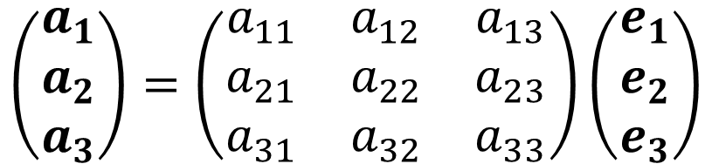
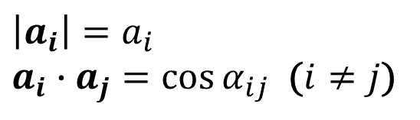
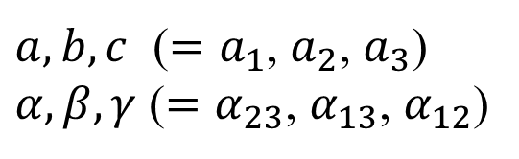
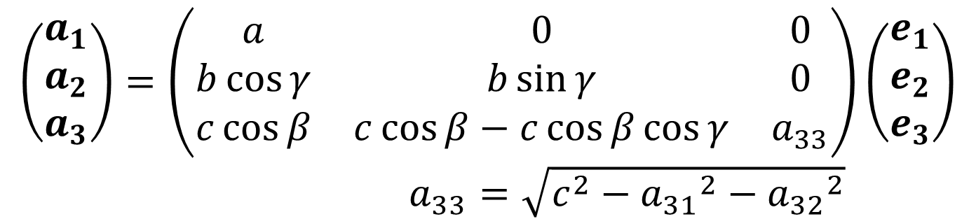
Conversion matrix
$$\left(\begin{matrix}a_{1} \\ a_{2} \\ a_{3}\end{matrix}\right)=\left(\begin{matrix}a_{11} & a_{12} & a_{13} \\ a_{21} & a_{22} & a_{23} \\ a_{31} & a_{32} & a_{33}\end{matrix}\right)\left(\begin{matrix}e_{1} \\ e_{2} \\ e_{3}\end{matrix}\right)$$
$$\left|a_{i}\right|=a_{i}$$
$a_{i}∙a_{j}=\cos{α_{ij}}$ ($i≠j$)
$a, b, c$ ($=a_{1}$, $a_{2}$, $a_{3}$)
$α,β,γ$ ($=α_{23}$, $α_{13}$, $α_{12}$)
tkcrystalbase.cal_lattice_vectors()
$$\left(\begin{matrix}a_{1} \\ a_{2} \\ a_{3}\end{matrix}\right)=\left(\begin{matrix}a & 0 & 0 \\ b\cos{γ} & b\sin{γ} & 0 \\ c\cos{β} & c\cos{β}−c\cos{β}\cos{γ} & a_{33}\end{matrix}\right)\left(\begin{matrix}e_{1} \\ e_{2} \\ e_{3}\end{matrix}\right)$$
$a_{33}=\sqrt{c^{2}−{a_{31}}^{2}−{a_{32}}^{2}}$

Slide 22
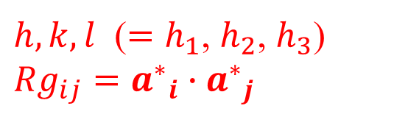
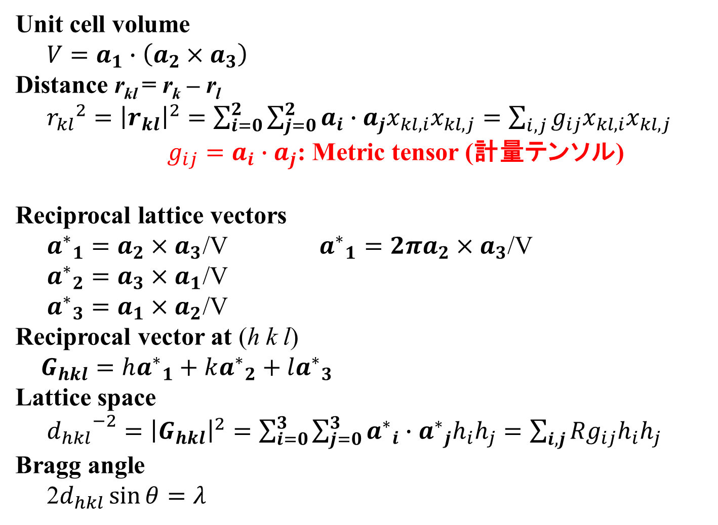
Lattice properties
Unit cell volume
$V=a_{1}∙\left(a_{2}×a_{3}\right)$
Distance r_{kl} = r_{k} – r_{l}
${r_{kl}}^{2}={\left|r_{kl}\right|}^{2}=\sum_{i=0}^{2}{\sum_{j=0}^{2}{a_{i}∙a_{j}x_{kl,i}x_{kl,j}}}=\sum_{i,j}{g_{ij}x_{kl,i}x_{kl,j}}$
$g_{ij}=a_{i}∙a_{j}$: Metric tensor (計量テンソル)
Reciprocal lattice vectors
${a^{∗}}_{1}=a_{2}×a_{3}$/V ${a^{∗}}_{1}=2πa_{2}×a_{3}$/V
${a^{∗}}_{2}=a_{3}×a_{1}$/V
${a^{∗}}_{3}=a_{1}×a_{2}$/V
Reciprocal vector at (h k l)
$G_{hkl}=h{a^{∗}}_{1}+k{a^{∗}}_{2}+l{a^{∗}}_{3}$
Lattice space
${d_{hkl}}^{−2}={\left|G_{hkl}\right|}^{2}=\sum_{i=0}^{3}{\sum_{j=0}^{3}{{a^{∗}}_{i}∙{a^{∗}}_{j}h_{i}h_{j}}}=\sum_{i,j}{{Rg}_{ij}h_{i}h_{j}}$
Bragg angle
2$d_{hkl}\sin{θ}=λ$
tkcrystalbase.cal_volume ()
tkcrystalbase.distance2() / .distance()
tkcrystalbase.cal_metrics()
tkcrystalbase.cal_reciprocal_lattice_vectors()
$h,k,l$ ($=h_{1}$, $h_{2}$, $h_{3}$)
${Rg}_{ij}={a^{∗}}_{i}∙{a^{∗}}_{j}$

Slide 23
Conversion matrixes
crystal_convert_cell.py
def get_conversion_matrix(key):
if key == 'FCCPrim':
return np.array([ [ 0.5, 0.5, 0],
[ 0, 0.5, 0.5],
[ 0.5, 0, 0.5] ])
elif key == 'BCCPrim':
return np.array([ [-0.5, 0.5, 0.5],
[ 0.5,-0.5, 0.5],
[ 0.5, 0.5,-0.5] ])
elif key == 'ACenterPrim':
return np.array([ [ 1.0, 0.0, 0.0],
[ 0.0, 0.5, 0.5],
[ 0.0,-0.5, 0.5] ])
elif key == 'BCenterPrim':
return np.array([ [ 0.5, 0.0, 0.5],
[ 0.0, 1.0, 0.0],
[-0.5, 0.0, 0.5] ])
elif key == 'CCenterPrim':
return np.array([ [ 0.5, 0.5, 0.0],
[-0.5, 0.5, 0.0],
[ 0.0, 0.0, 1.0] ])
elif key == 'RhombHex':
return np.array([ [ 1.0, -1.0, 0.0],
[ 0.0, 1.0, -1.0],
[ 1.0, 1.0, 1.0] ])
elif key == 'HexRhomb':
return np.array([ [ 2.0/3, 1.0/3, 1.0/3],
[-1.0/3, 1.0/3, 1.0/3],
[-1.0/3,-2.0/3, 1.0/3] ])
elif key == 'HexOrtho':
return np.array([ [ 1.0, 0.0, 0.0],
[ 1.0, 2.0, 0.0],
[ 0.0, 0.0, 1.0] ])

Slide 25
Vector analysis: Lattice conversion
Convert base vectors (a_{i}) to (a’_{i}) in real space：
a'_{i} = Σ_{j} (t_{ij} a_{j}) (A' = TA ) T = (t_{ij}): Conversion matrix
Find conversion rules by ‘Invariants (不変量)’ such as scalar and vector
Any point vector R: R = Σ_{i} (x_{i} a_{i}) = Σ_{i} (x'_{i} a'_{i}) = Σ_{i,j} (x'_{i} t_{ij} a_{j})
x_{i} = Σ_{,j} (x'_{j} t_{ji}) ( X = T^{t}X' )
x'_{i} = Σ_{,j} x_{j} (t_{ji})⁻¹ ( X' = T^{t-1}X )
R・G_{hkl} = hx + ky + lz is scalar: R・G_{hkl} = R'・G'_{h'k'l'}
Σ_{i} (h_{i}x_{i}) = Σ_{i} (h'_{i}x'_{i}) = Σ_{i,j} (h_{i} x'_{j} t_{ji})
h'_{j} = Σ_{i} (h_{i} t_{ji}) ( H' = TH )
Any reciprocal space vector G_{hkl}: G_{hkl} = G'_{h'k'l'}
Σ_{i} (h'_{i}a*'_{i}) = Σ_{i} (h_{i}a*_{i}) = Σ_{i,j} (h_{i} t_{ji} a*'_{i})
a*_{i} = Σ_{i,j} (t_{ji} a*'_{j}) ( A* = T^{t}A*' )
a*'_{i} = Σ_{i,j} ((t_{ji})⁻¹ a*_{j}) ( A*' = T^{t-1}A* )

Slide 26
Lattice conversion: Summary
Real space base vectors A’ = TA
a'_{i} = Σ_{j} (t_{ij} a_{ｊ})
a_{i} = Σ_{j} (t⁻¹_{ij} a’_{ｊ})
Real space coordinates X’ = T^{t-1}X
x'_{i} = Σ_{j} (t⁻¹_{ji} x_{j})
x_{i} = Σ_{j} (t_{ji} x‘_{j})
(Reciprocal space base vectors A*’ = T^{t-1}A*
a'*_{i} = Σ_{j} (t⁻¹_{ji} a*_{j})
a*_{i} = Σ_{j} (t_{ji} a’*_{j})
Reciprocal space coordinates H’ = TH
h'_{i} = Σ_{j} (t_{ij} h_{j})
h_{i} = Σ_{j} (t⁻¹_{ij} h’_{j})
(a_{ｊ}) and (h_{j}) have the same conversion rule
実格子基本ベクトルと逆格子座標は同じ変換を受ける
(Covariant vectors: 共変ベクトル)
(x_{ｊ}) and (a*_{j}) have the same conversion rule
実格子座標と逆格子基本ベクトルも同じ変換を受ける
(Contravariant vectors: 反変ベクトル)

Slide 27
Madelung potential
Sum of Coulomb potential in 3D is very slowly converging
Potential is proportional to r⁻¹
Polarization potential due to +/- ions is to r⁻²
Number of ions on the sphere surface at radius r is to r²
=> Contribution of ions from a surface region at r
to Coulomb sum is almost constant, independent of r
Madelung constant

Slide 28
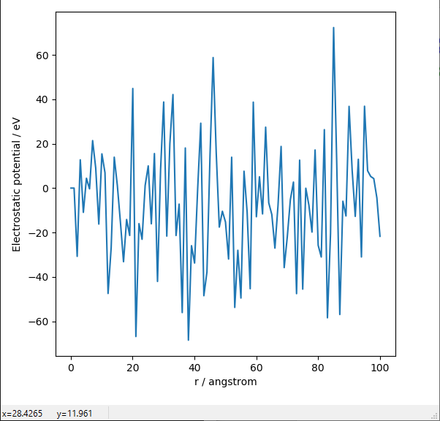
Madelung potential: Simple sum
python crystal_MP_simple.py
Coulomb sum in sphere with the radius r
Exact: -8.9 eV
Rock salt type

Slide 29
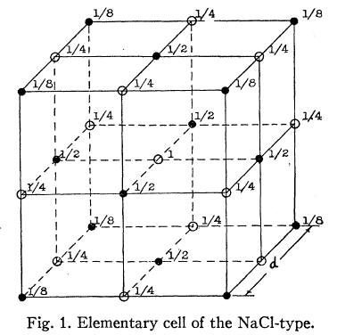
Efficient Coulomb sum: Evjen method
Sum up Coulomb potential in
units with zero net charge
Ion charges: Z_{i}
On boundary plane : 1/2Z_{i}
On boundary edge : 1/4Z_{i}
On boundary corner : 1/8Z_{i}
Madelung constant of Rock salt type structure

Slide 30
Madelung potential: Evjen method
Usage: python crystal_MP_Evjen.py n_{cell}
n_{cell} MP Madelung constant
1 -8.9766 1.7517691
2 -8.95586 1.7477211
3 -8.95521 1.7475955
4 -8.9511 1.7475744
5 -8.95508 1.7475686
6 -8.95507 1.7475665
8 -8.95506 1.7475652
10 -8.95506 1.7475648
Exact (精確値) 1.74756
Rock salt type

Slide 31
3D sum of Coulomb potential: Ewald method
Periodic calculation can be enhanced by FT?
Periodic positions of charge
=> converted to the origin of FT data
But the charges are point charges
=> converted to infinite in FT space
=> Calculate for charges with finite width
(拡がりのある電荷の周期配列として計算する)
+

Slide 32
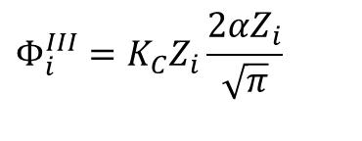
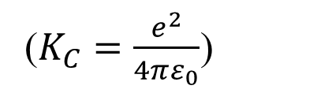

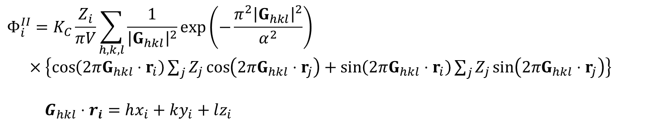
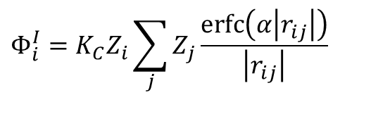
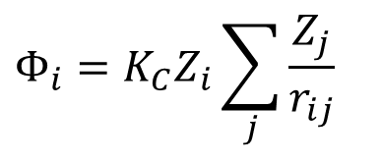
3D sum of Coulomb potential: Ewald method
The finite width charge distributions are converted by FT
=> Take faster calculation parts in the real space and the reciprocal space
拡がった電荷のフーリエ変換を利用し、実空間和と逆空間和の計算の速い部分をとる
$$Φ_{i}=K_{C}Z_{i}\sum_{j}{\frac{Z_{j}}{r_{ij}}}$$
($K_{C}=\frac{e^{2}}{4πε_{0}}$)
$$Φ_{i}^{I}=K_{C}Z_{i}\sum_{j}{Z_{j}\frac{erfc\left(α\left|r_{ij}\right|\right)}{\left|r_{ij}\right|}}$$
$$Φ_{i}^{II}=K_{C}\frac{Z_{i}}{πV}\sum_{h,k,l}{\frac{1}{{\left|G_{hkl}\right|}^{2}}\exp\left(−\frac{π^{2}{\left|G_{hkl}\right|}^{2}}{α^{2}}\right)}$$
$×\left\{\cos\left(2πG_{hkl}⋅r_{i}\right)\sum_{j}{Z_{j}\cos\left(2πG_{hkl}⋅r_{j}\right)}+\sin\left(2πG_{hkl}⋅r_{i}\right)\sum_{j}{Z_{j}\sin\left(2πG_{hkl}⋅r_{j}\right)}\right\}$
$G_{hkl}⋅r_{i}=hx_{i}+ky_{i}+lz_{i}$
$$Φ_{i}^{III}=K_{C}Z_{i}\frac{2αZ_{i}}{\sqrt{π}}$$
$$Φ_{i}=Φ_{i}^{I}+Φ_{i}^{II}−Φ_{i}^{III}$$

Slide 33
Madelung potential: Ewald method
Usage: python crystal_MP_Ewald.py alpha prec
Alpha Precision MP Madelung constant Range Time (s)
0.3 10⁻³ -8.95558 1.7476663 10.1/222 0.063 /222 0.016/0 /0.016
0.3 10⁻⁵ -8.95506 1.7475646 11.9/333 0.105 /222 0.031/0 /0.031
0.3 10⁻⁷ -8.95506 1.7475646 13.6/333 0.147 /333 0.047/0 /0.047
0.2 10⁻³ -8.95506 1.7475646 15.2/333 0.028 /111 0.042/0 /0.042
0.6 10⁻³ -8.95607 1.7477629 5.1/111 0.25 /333 0 /0.016 /0.016
0.8 10⁻³ -8.95584 1.747718 3.8/111 0.45 /444 0 /0.016 /0.016
0.2 10⁻¹⁰ -8.95506 1.7475646 24.3/555 0.093/222 0.16/0 /0.16
0.4 10⁻¹⁰ -8.95506 1.7475646 12.1/333 0.373/444 0.036/0.016/0.052
0.5 10⁻¹⁰ -8.95506 1.7475646 9.7/222 0.58 /555 0.016/0.016/0.031
0.6 10⁻¹⁰ -8.95506 1.7475646 8.1/222 0.84 /666 0.016/0.031/0.047
Exact (精確値) 1.74756
Range: R_{max} [Å]/n_{xmax}n_{ymax}n_{zmax} G_{max} [Å⁻¹]/h_{max}k_{max}l_{max}
Time: Real space sum / Reciprocal space sum / Total [s]
Rock salt type

Slide 34
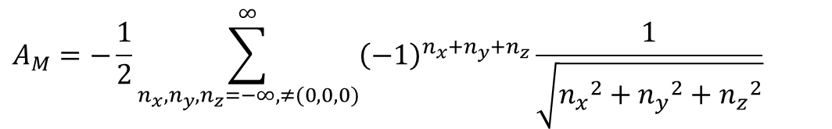
Comparison: Evjen method
$$A_{M}=−\frac{1}{2}\sum_{n_{x},n_{y},n_{z}=−∞,≠(0,0,0)}^{∞}{{\left(−1\right)}^{n_{x}+n_{y}+n_{z}}\frac{1}{\sqrt{{n_{x}}^{2}+{n_{y}}^{2}+{n_{z}}^{2}}}}$$
Rock salt type
Exact value = 1.7476

Slide 35
Convert to P1 symmetry: Perl
Execute Launcher.exe
d:\Programs\Launcher.exe
Choose ‘CIF’ => ‘P1 CIF’
Choose a cif file
Edit arguments:
# For solid-solution (occ < 1.0) cif file. If ChooseRandomly=1, script will try to distribute partially occupied sites to occ=1.0 sites
--ChooseRandomly=0
# Output file
--OutputFile=F:\data-COE\crystal\conversion\MgO-FCC-converted.cif
# Input file
F:\data-COE\crystal\conversion\MgO-FCC.cif
Output: MgO-FCC-converted.cif

Slide 36
Translate coordinates: Perl
Note: Use P1 symmetry CIF for translation
Execute Launcher.exe
d:\Programs\Launcher.exe
Choose ‘CIF’ => ‘Translate’
Choose a cif file
Edit arguments
# Unit of translation vectors. f for internal coordinate, A for angstrom
--unit=f
# Translation vectors of internal coordinates
--deltaX=+0.10
--deltaY=+0.00
--deltaZ=+0.00
# Input file
F:\data-COE\crystal\conversion\MgO-FCC-P1.cif
Output: MgO-FCC-converted.cif
New: Dec 28, 2021

Slide 37
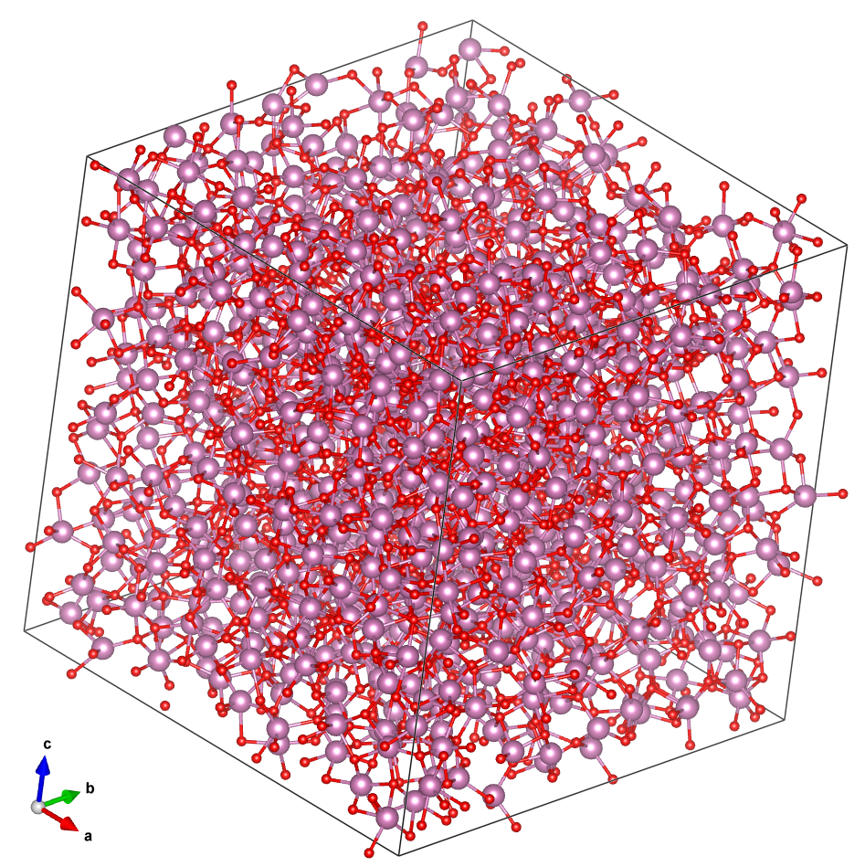
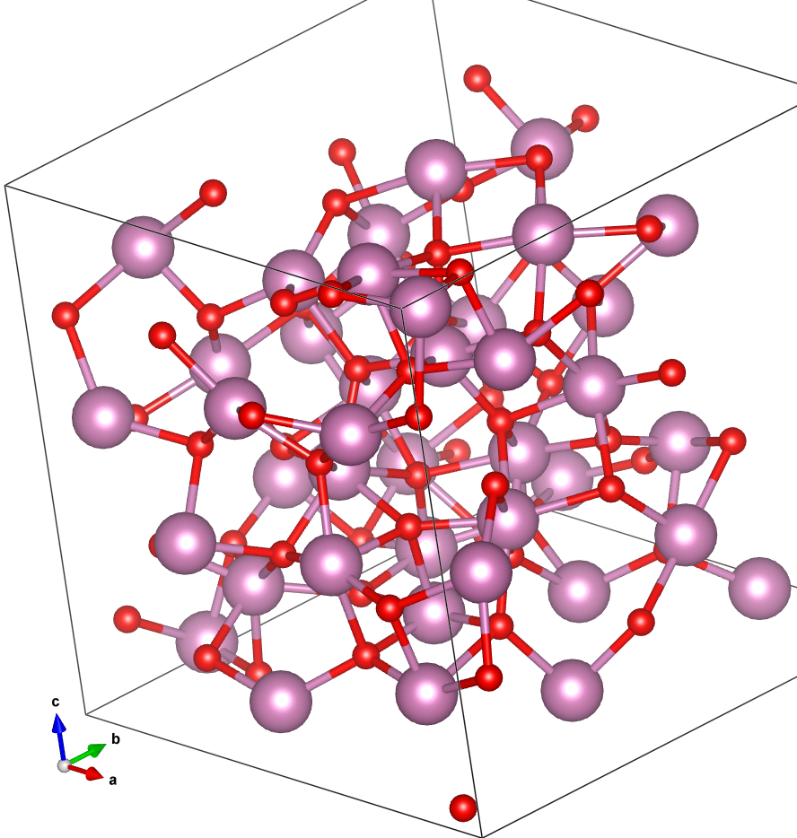
Extract cell from cif: Perl
Execute Launcher.exe
d:\Programs\Launcher.exe
Choose ‘CIF’ => ‘Ext Cell’
Choose a cif file
Edit arguments:
# Do not change
--Action=ExtractCell
# Number of atoms to be extracted
--nOutputAtom=100
# Margin of lattice parameters to fit the extracted cell
# in the new unit cell. [Angstrom]
--LatticeMargin=1.0
# Input file
F:\data-COE\crystal\RDF\a300.cif
# Output file
F:\data-COE\crystal\RDF\a300-Extracted.cif
Output: a300-Extractedcif
a300.cif
a300-Extracted.cif

Slide 38
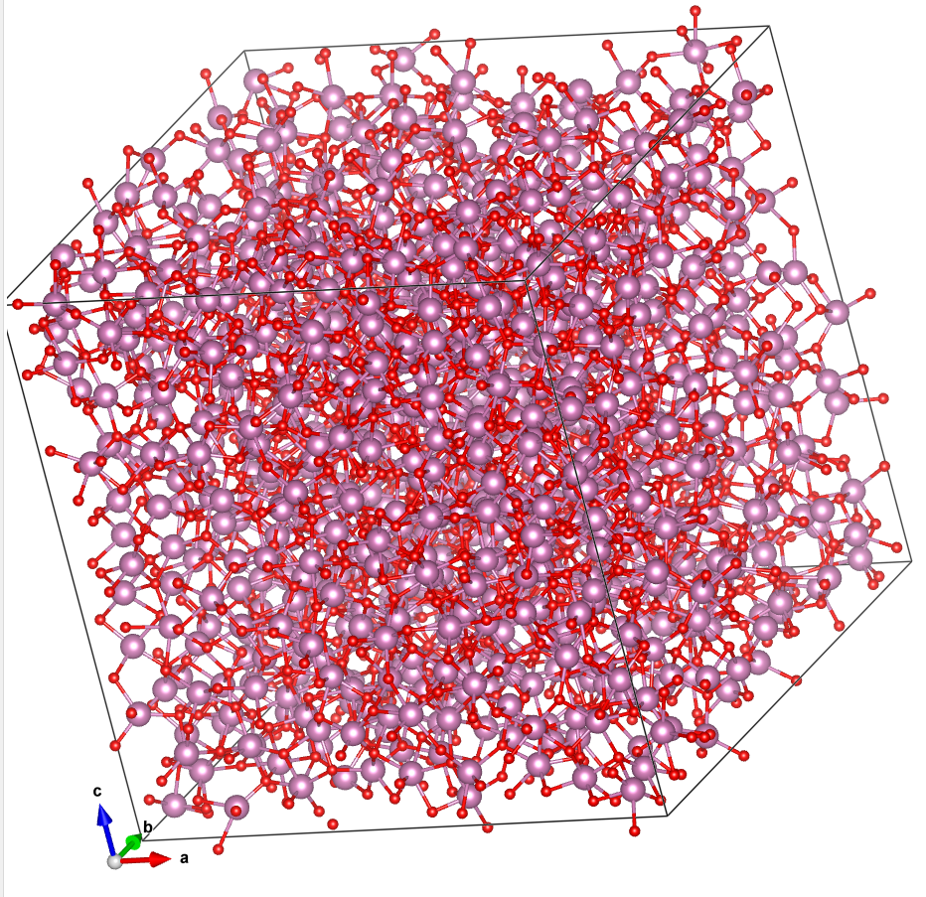
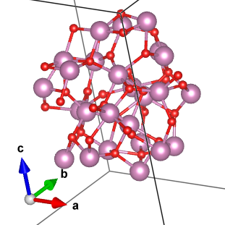
Extract cluster from cif: Perl
Execute Launcher.exe
d:\Programs\Launcher.exe
Choose ‘CIF’ => ‘Ext Cluster’
Choose a cif file
Edit arguments:
# Origin of cluster to be extracted
--Origin=0.5,0.5,0.5
# Maximum distance to extract cluster
--Radius=6.0
# Input CIF file
F:\data-COE\crystal\RDF\a300.cif
# Output file
a300-cluster.cif
Output: a300-cluster.cif
a300.cif
a300-cluster.cif

Slide 39
Make superlattice: Perl
Execute Launcher.exe
d:\Programs\Launcher.exe
Choose ‘CIF’ => ‘MkSuperLattice’
Choose a cif file
Edit arguments:
# Do not change
--Action=shift
# Translation vectors of internal coordinate
--Shift=0,0,0
# For solid-solution (occ < 1.0) cif file. If ChooseRandomly=1, script will try to distribute partially occupied sites to occ=1.0 sites
--ChooseRandomly=0
# Output file
--OutputFile=F:\data-COE\crystal\conversion\MgO-FCC-superlattice.cif
# Input file
# Numbers of supercells along a, b, c axes are specified after ‘:’ WITHOUT SPACE
F:\data-COE\crystal\conversion\MgO-FCC.cif:1,1,2
Output: MgO-FCC-superlattice.cif

Slide 40
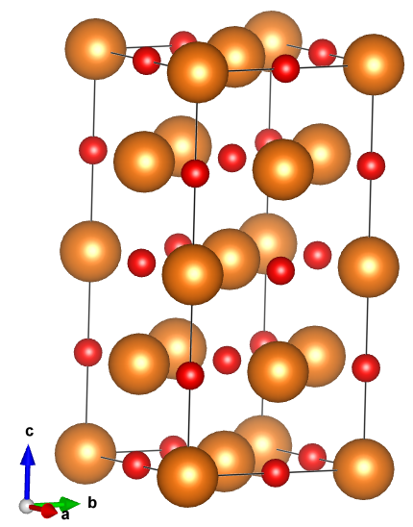
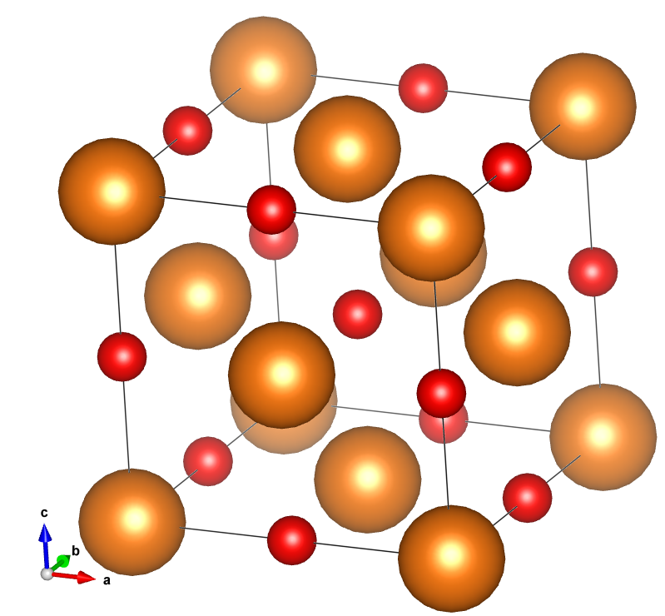
Make superlattice: Perl
Edit arguments:
--Action=shift
--Shift=0,0,0
--ChooseRandomly=0
--OutputFile=F:\data-COE\crystal\conversion\MgO-FCC-superlattice.cif
F:\data-COE\crystal\conversion\MgO-FCC.cif:1,1,2
Output: MgO-FCC-superlattice.cif
MgO-FCC-superlattice.cif
MgO-FCC.cif

Slide 41
Bond distances and angles: Perl
Execute Launcher.exe
d:\Programs\Launcher.exe
Choose ‘CIF’ => ‘Distance’
Choose a cif file
Edit arguments:
# Maximum distance to calculate distances and angles
--MaximumDistance=3.5
# Maximum number of distances and angles to be calculated
--MaximumNumber=1000
# Flag to sort the distances and angles
--DoSort=0
# Input file
F:\data-COE\crystal\conversion\MgO-FCC.cif
Output: MgO-FCC.out.txt

Slide 42
Bond distances and angles: Perl
Edit arguments:
--MaximumDistance=3.5
--MaximumNumber=1000
--DoSort=0
F:\data-COE\crystal\conversion\MgO-FCC.cif
Output: MgO-FCC.out.txt
-- cut –
Site (indep type) 0: Mg (Z=2) (occ=1.): Mg2
Site (indep type) 1: O (Z=-1) (occ=1.): O-1
Type 0: {Mg2} Mg (Z=2) (occ=1.): Mg2[1.0000]
Type 1: {O-1} O (Z=-1) (occ=1.): O-1[1.0000]
-- cut –
Unit cell numbers to be examined: (1, 1, 1)
Inter-atomic distances
0001(0001): Mg1(# 1,@ 1) - Mg1(@ 2)[ 0,-1,-1]: 2.9776 A --- ( 0.0000, 0.0000, 0.0000)-( 0.0000,-0.5000,-0.5000)
0005(0005): Mg1(# 1,@ 1) - O1(@ 8)[ 0, 0,-1]: 2.1054 A --- ( 0.0000, 0.0000, 0.0000)-( 0.0000, 0.0000,-0.5000)
0023(0023): O1(# 2,@ 5) - O1(@ 5)[ 0, 0, 0]: 0.0000 A --- ( 0.5000, 0.5000, 0.5000)-( 0.5000, 0.5000, 0.5000)
-- cut --
Inter-atomic Angles
0001: Mg1(# 1,@ 1) - Mg1(@ 1) - Mg1(@ 2): 60.000 deg --- ( 0.000, 0.000, 0.000)-( 0.000,-0.500,-0.500)-(-0.500, 0.000,-0.500)
0002: Mg1(# 1,@ 1) - Mg1(@ 1) - Mg1(@ 3): 90.000 deg --- ( 0.000, 0.000, 0.000)-( 0.000,-0.500,-0.500)-( 0.000, 0.500,-0.500)
0004: Mg1(# 1,@ 1) - Mg1(@ 1) - O1(@ 5): 45.000 deg --- ( 0.000, 0.000, 0.000)-( 0.000,-0.500,-0.500)-( 0.000, 0.000,-0.500)
0016: Mg1(# 1,@ 1) - Mg1(@ 1) - O1(@ 18): 135.000 deg --- ( 0.000, 0.000, 0.000)-( 0.000,-0.500,-0.500)-( 0.000, 0.500, 0.000)
0604: O1(# 2,@ 5) - O1(@ 19) - O1(@ 10): 120.000 deg --- ( 0.500, 0.500, 0.500)-( 0.500, 1.000, 1.000)-( 1.000, 0.000, 0.500)
0605: O1(# 2,@ 5) - O1(@ 19) - Mg1(@ 11): 45.000 deg --- ( 0.500, 0.500, 0.500)-( 0.500, 1.000, 1.000)-( 0.500, 1.000, 0.500)

Slide 43
Bond Valence Sum: Perl
Execute Launcher.exe
d:\Programs\Launcher.exe
Choose ‘CIF’ => ‘BVSum’
Choose a cif file
Edit arguments:
# Input CIF file
F:\data-COE\crystal\RDF\a300.cif
# Maximum distance to calculate BVS
2.7
Output: a300.bvs.txt
DBPath: d:\Programs\Databases\bvparm2009.cif
CIFPath: F:\data-COE\crystal\RDF\a300.cif
0: In0
1257: O0 r0=1.902 B=0.37 ri=2.157 bv=0.502 [a for In 3 - O -2]
1489: O0 r0=1.902 B=0.37 ri=2.238 bv=0.403 [a for In 3 - O -2]
1586: O0 r0=1.902 B=0.37 ri=2.149 bv=0.513 [a for In 3 - O -2]
1750: O0 r0=1.902 B=0.37 ri=2.248 bv=0.392 [a for In 3 - O -2]
1773: O0 r0=1.902 B=0.37 ri=2.322 bv=0.321 [a for In 3 - O -2]
1916: O0 r0=1.902 B=0.37 ri=2.296 bv=0.345 [a for In 3 - O -2]
Bond Valence Sum: 2.475
1: In0
-- cut –
Bond Valence Sum: 2.596
1313: O0
-- cut –
Bond Valence Sum: 1.456
1314: O0
-- cut –
Bond Valence Sum: 1.384

