Slide 1
Physical parameters perlが必要

Slide 2
Perlのインストール
NAS share/apps/Perl を適当なディレクトリにコピー 例: d:\Perl, c:\Perl などが望ましい => [Perl] と書きます
環境変数 PATH に [Perl]\bin を追加

Slide 3
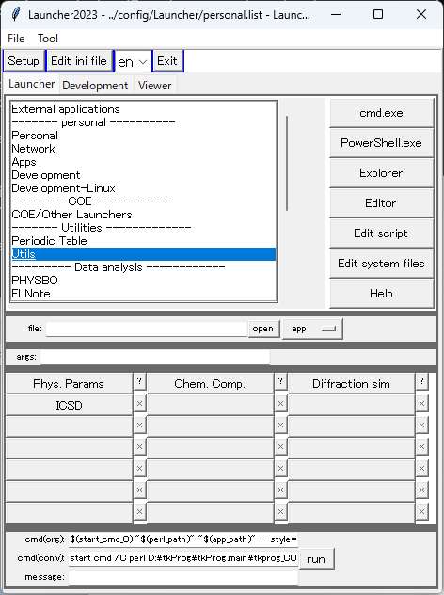
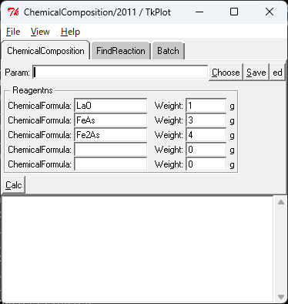
Physical parameters

Slide 4
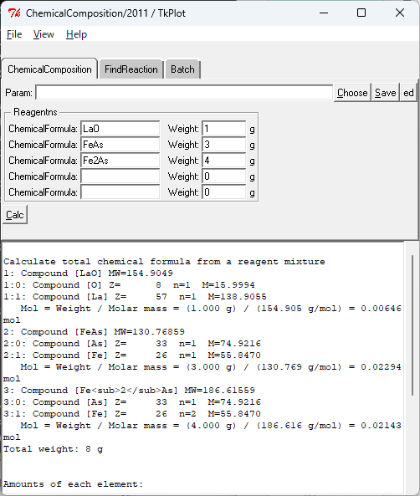
化学組成
LaO 1 g, FeAs 3 g, Fe₂As 4 g
が仮に反応して純粋相を作ったときの
化学組成を求める

Slide 5
化学組成
Calculate total chemical formula from a reagent mixture
1: Compound [LaO] MW=154.9049
1:0: Compound [O] Z= 8 n=1 M=15.9994
1:1: Compound [La] Z= 57 n=1 M=138.9055
Mol = Weight / Molar mass = (1.000 g) / (154.905 g/mol) = 0.00646 mol
--cut--
Total weight: 8 g
Amounts of each element:
Compound [As] 0.04438 mol rel=6743
Amounts of each element:
Compound [Fe] 0.06581 mol rel=10000
Amounts of each element:
Compound [La] 0.00646 mol rel=981
Amounts of each element:
Compound [O] 0.00646 mol rel=981
Amounts of each element:
Normalized compositon: La981Fe10000As6743O981

Slide 6
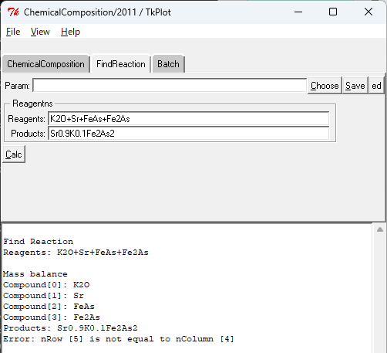
化学反応
K₂O+Sr+FeAs+Fe₂As
を原料にして
Sr_{0.9}K_{0.1}Fe₂As₂
を作るときの化学反応を探す
原料は４種類、元素は５種類
生成物の元素は４種類
＝＞
一意的な解が得られないのでエラーになっている

Slide 7
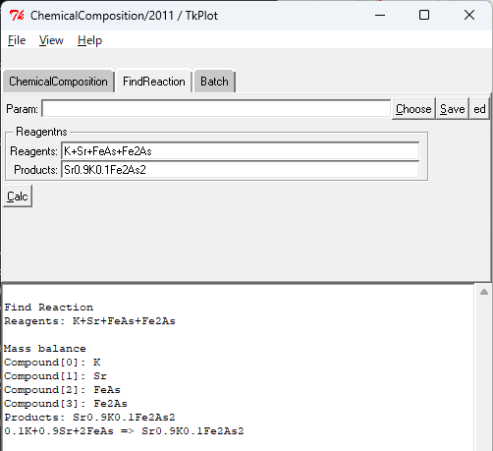
化学反応
K+Sr+FeAs+Fe₂As
を原料にして
Sr_{0.9}K_{0.1}Fe₂As₂
を作るときの化学反応を探す

Slide 8
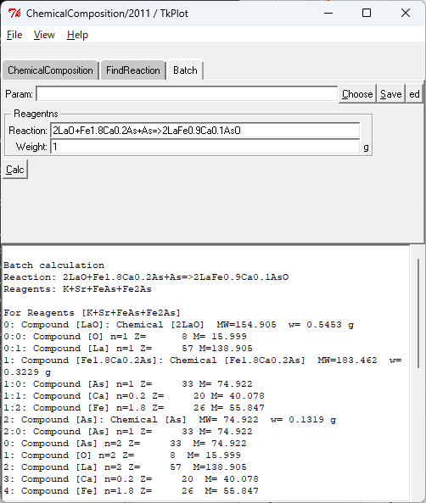
バッチ計算
2LaO + Fe_{1.8}Ca_{0.2}As + As => 2LaFe_{0.9}Ca_{0.1}AsO を 1 g

Slide 9
バッチ計算
Batch calculation
Reaction: 2LaO+Fe1.8Ca0.2As+As=>2LaFe0.9Ca0.1AsO
Reagents: K+Sr+FeAs+Fe2As
For Reagents [K+Sr+FeAs+Fe2As]
0: Compound [LaO]: Chemical [2LaO] MW=154.905 w= 0.5453 g
0:0: Compound [O] n=1 Z= 8 M= 15.999
0:1: Compound [La] n=1 Z= 57 M=138.905
--cut—
For Products [Sr0.9K0.1Fe2As2]
2LaFe<sub>0.9</sub>Ca<sub>0.1</sub>AsO: Compound [LaFe<sub>0.9</sub>Ca<sub>0.1</sub>AsO] n=2 mw=284.097
0: Compound [As] n=1 Z= 33 M= 74.922
--cut—
1: Element [O] n=2 Z= 8 M= 15.999
--cut—
Batch
0: Compound [LaO] n=2 MW=154.905 g/mol w= 0.5453 g
1: Compound [Fe1.8Ca0.2As] n=1 MW=183.462 g/mol w= 0.3229 g
2: Compound [As] n=1 MW= 74.922 g/mol w= 0.1319 g
Total: 1.0000 g

